Slide 1
Entrepreneurship
Business pitch presentation
Mona Alexandra David - 2111962
Title: Business pitch
Module name: Entrepreneurship
Module code: LCBB5001
Lecturer name: Amer Kareem
Submission date: 25/03/2024

Slide 2
Contents
Introduction
Overview of the business idea
Management team plan
Target market and marketing strategies
Competition and differentiation strategies
Funding requirements and allocation
Conclusion

Slide 3
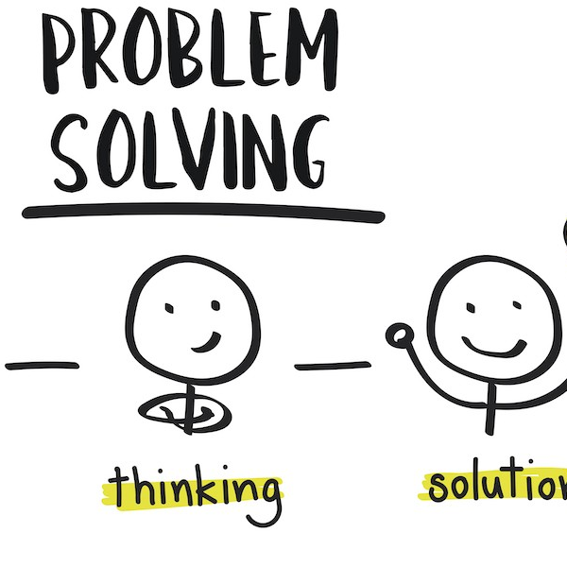
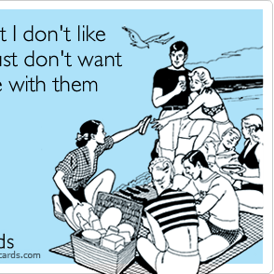


Strengths
I consider unconventional ideas
High drive for success
Weaknesses
Lack of focus but that enables me to include external ideas and change directions`
Threats – Regulatory and legal obstacles
Consumer preference changes
Who Am I
Opportunities
Identify the market gaps and capitalise on them
https://www.linkedin.com/pulse/art-problem-solving-comprehensive-guide-mastering-skill-shobha-sharma-0kezf
https://www.someecards.com/usercards/viewcard/99c01fe50596df7ccb55e1392232ac29af/

Slide 4
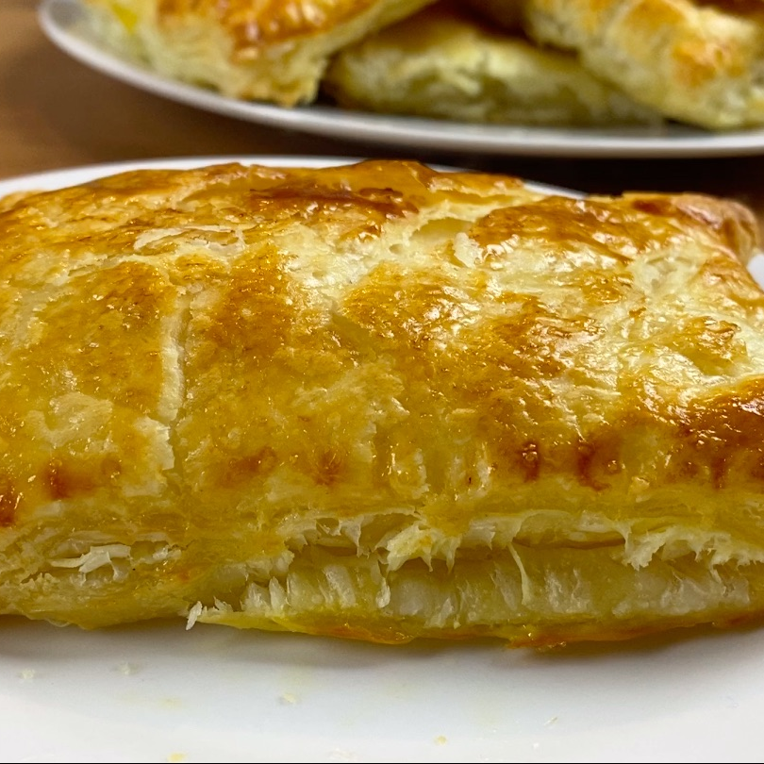
Overview of the business idea
Name of the business: Pastries et al
Mission and vision – to provide the greatest freshly made pastries
Market opportunity – With an absence of specialized pastry vans in the area. My product will fill this market.
Consumer polls – to determine which product will sell and focus on these products
Product - popular savory pastry, including vegan and meat choices
https://theazizkitchen.com/recipe/cheese-onion-pasties/

Slide 5
Management team plan
MD
Marketing Manager
Pastry chef
Salesperson
Driver/buyer

Slide 6

Target market and marketing strategies
Customers- Attendees at car boot sales, festivals, and markets on the weekends; caterers for businesses and events; and door to door salesperson in industrial areas throughout the week
USP- The lack or shortage of specialty trucks for selling pastries at events
Ease of access and lack of direct competition ie: Greggs

Slide 7

Competition and differentiation strategies
Competition
Availability of alternatives
Customers can pick among supermarkets, restaurants, cafés, and food trucks or vans. These options' quality, price, and convenience can affect consumer decision.(Chua et al.)
Switching Costs
Customers have no difficulty choosing to a different meal choice if they are not happy with the quantity, quality, or price of pastries available
Differentiation strategies - Maintaining low costs and using high-quality ingredients can prevent clients from choosing an alternate product.
“In every company, differentiation is never more important than it is in times of trouble, and that’s the time when everyone tends to go to the well and equalize rather than differentiate.”( J. Welch)

Slide 8
Funding requirements and allocation
£30000 is required for the conversion of the existing vehicle and the purchase of start-up materials
£30000
Kitchen Equipment and Initial Inventory 70%
Branding and Marketing 15-20%
Contingency Fund 10 - 15%

Slide 9
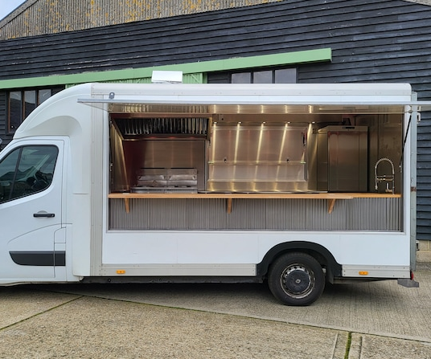
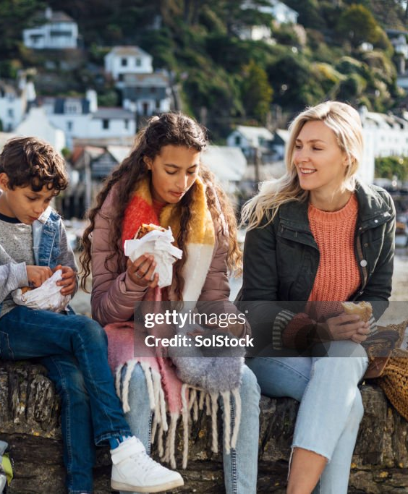
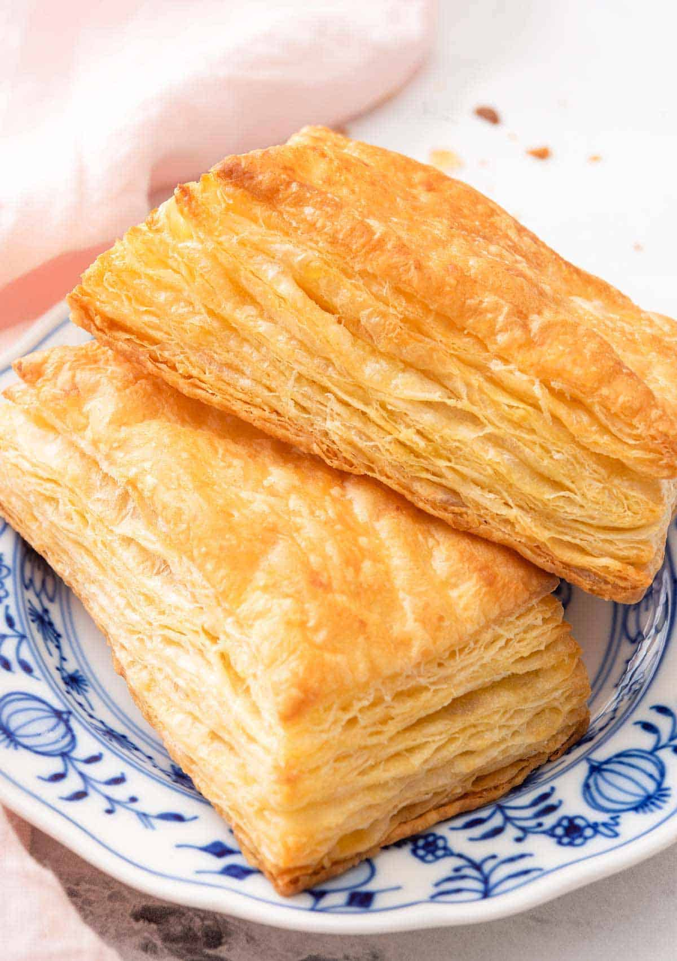
https://www.etsy.com/uk/listing/1484944178
https://www.gettyimages.co.uk/photos/cornish-pasty
Conclusion
https://preppykitchen.com/puff-pastry/

Slide 10
References
1.Sharma, S. (2024) The Art of Problem Solving: A Comprehensive Guide to mastering the skill, LinkedIn. Available at: https://www.linkedin.com/pulse/art-problem-solving-comprehensive-guide-mastering-skill-shobha-sharma-0kezf (Accessed: 23 March 2024). 2. Dowding, T., (GILC), G.I.L.C. and Want to read this article? Register for ultimate access to this article and ALL our premium content ULTIMATE ACCESS PROVIDES YOU WITH Unrestricted access to Commercial Risk (2021) Report highlights global legal, regulatory and socioeconomic issues facing insurers, Commercial Risk. Available at: https://www.commercialriskonline.com/report-highlights-global-legal-regulatory-and-socioeconomic-issues-facing-insurers/ (Accessed: 20 March 2024).
3. OkCredit (2021) How to predict and identify market gaps for your business to succeed?, OkCredit Blogs - Business Ideas, Tips, Government Schemes & more. Available at: https://okcredit.in/blog/methods-to-identify-gaps-in-market/ (Accessed: 23 March 2024).
4. Jack Welch quote: ‘in every company, differentiation is never more important than it is in times of trouble, and that’s the time when every...’ (no date) Quotefancy. Available at: https://quotefancy.com/quote/1463702/Jack-Welch-In-every-company-differentiation-is-never-more-important-than-it-is-in-times (Accessed: 23 March 2024).
5. Chua, Lia, et al. "Customer Restaurant Choice: An Empirical Analysis of Restaurant Types and Eating-Out Occasions." International Journal of Environmental Research and Public Health, vol. 17, no. 17, 2020, https://doi.org/10.3390/ijerph17176276. Accessed 23 Mar. 2024.

