Slide 1

Effective Teamworking
&
Communication
Tahira Begum 1808229
Israil Ali 1810849
Donville Youngsam 1809043
Alina Lungu 1810895
Mohammed Aziz Ul 1809663

Slide 2

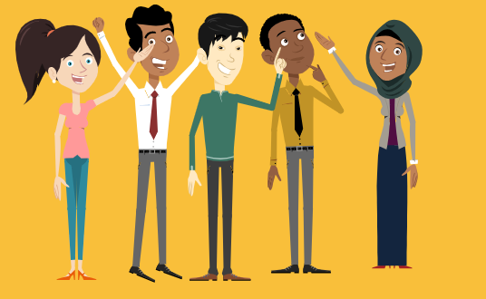
Bright Start Consultants
Bright Start Nursery
A group of people working effectively together in order to achieve a shared goal.
Benefits of Team working
Stages of team development
Team roles
Successful team development
Managing conflict

Slide 3
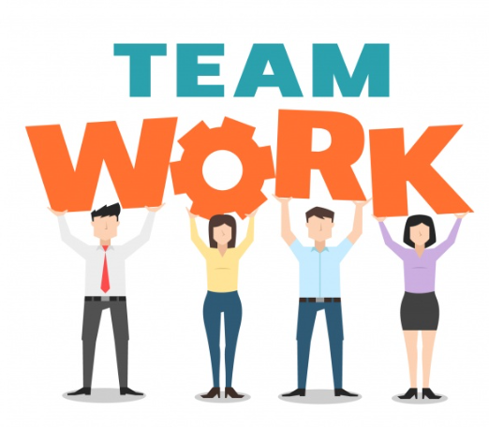
Makes you think more creatively and useful solutions to problems
Creates relationships between team members to communicate openly and have a sense of security.
Creates motivation and self – esteem in the workspace
Benefits of
Creates strong work ethics and team spirit.
Promotes social and leadership skills
The workload is shared between team members enabling them to focus on key objective for faster resolution
Source of learning by sharing ideas and life experience with other members of the team.
Gaining perspective to think and
analyse any situation.

Slide 4
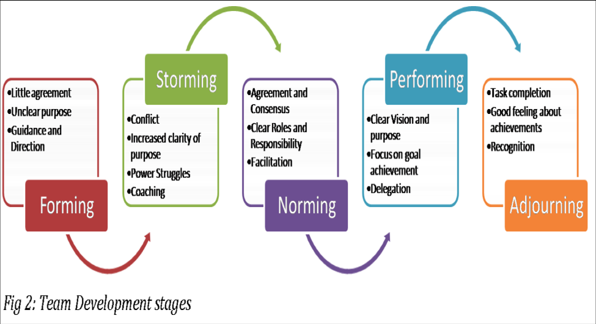

Storming
Preforming
Forming
Norming
Adjourning
Tuckman's Model of group development 1965

Slide 5
Team Roles
Job title | Role
Senior management | Responsible for planning and directing the work and business strategies of a group of individuals – for example managers.
Managers | Staffing, daily operations, set goals, liaising, administration, training and delegating.
Supervisors | Motivating, setting goals, organising, monitoring employees and implementation.
Team workers | Individual skills brought together to work and achieve goals as a team.

Slide 6
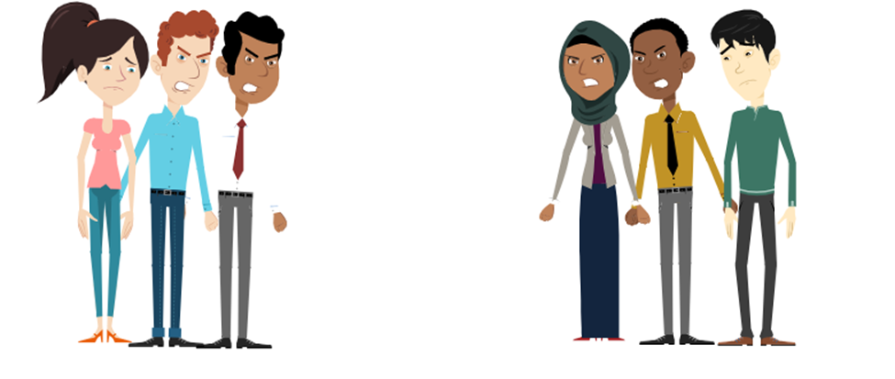
Managing Conflict
Encourage conflicting parties to talk to each other
Set rules for people to follow in your organisation
Prioritise areas of conflict
Ensure you hear the full story from all perspectives
Carry out team building activities to encourage bonding.
Ensure everyone knows what their roles are.
Types of conflict:
Task conflict
Process conflict
Interpersonal conflict
Get parties to reach a compromise
Encourage all involved to remain focused on the task

Slide 7
How can you tell that the Teamwork in your organisation is good?
The task is completed
Team members are each happy with their contribution to a task
Team members are happy to work with each other again.

Slide 8
Thank you for listening to our presentation!

