Slide 1
Tahwar Abdullah
Student ID - 2507971
Module Code – LCHS4010_BIRM
Psychology in Health and Social Care
Lecturer – Prabjot Sahota

Slide 2
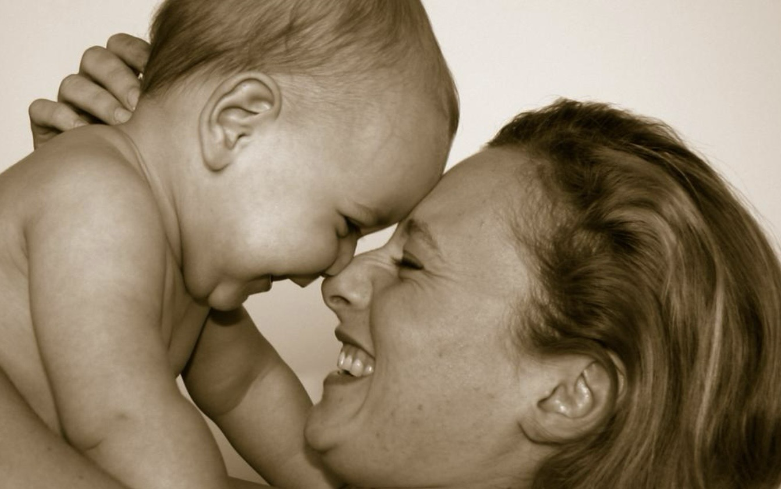
Bowlby’s Attachment Theory
Supporting Shona’s emotional security in the nursery
CASE STUDY -
Shona, age 3
-Separation anxiety
-Limited verbal communication
-Difficultly joining group play
Figure 1: A child exploring with the reassurance of a caregiver.
Page 1

Slide 3
1. What is attachment theory?
According to John Bowlby, young children feel safe enough to explore when they are in close, trustworthy relationships.
SAFE HAVEN
When a child is upset, a trusted adult provides consolation.
SECURE BASE
Curiosity, play and learning are all enhanced by feeling safe.
SEPARATION
There could be distress when a familiar caregiver departs.
Key idea: Children can learn to control their distress and develop the confidence to explore if they receive responsive, consistent care.
Page 2

Slide 4
2. Understanding Shona’s behaviour
Instead of using attachment theory as a diagnosis, use it as one potential lens.
What staff observe
Anxiety upon the departure of her caregiver.
Minimal verbal exchange.
Playing in a group is difficult.
Keep an eye out for trends and triggers over time.
Potential needs pertaining to attachment
Assurance in the midst of change.
A dependable, reliable key person.
Encouraging her to explore at her own speed.
Don’t assume every behaviour is explained by attachment.
Take into account the larger family context as well as language, temperament, recent changes, and sensory needs.
Page 3

Slide 5
3. Practical strategies within the nursery.
Warm, dependable key person Greet Shona in a predictable manner and establish trust by being composed and accommodating.
A gentle farewell A routine that should include a brief, regular handover, acknowledging her emotions, and reassuring that her carer will return.
Use simple gestures and phrases The use of picture cues, and additional processing time for visual and communication support.
Small step social play Begin with a single familiar peer or parallel play, then expand when she’s ready.
Collaborate with family Discuss routines, her comfort and evaluate her progress.
Keep track of what works for her, and when necessary, modify the plan with Shona’s family and the nursery SENCO.
Page 4

Slide 6


4. Critical evaluation, nature, and nurture.
Nature
Shona’s response may be influenced by her temperament, communication style, developmental differences, and sensory sensitivity.
Nurture
Shona’s experience is shaped by relationships, routines, carer consistency, and the nursery setting.
Disadvantages
Cannot diagnose a child or explain every behaviour.
Don’t assume a single attachment style or place blame on families.
Figure 2: A young child exploring toys through play.
Advantages
Emphasises how crucial it is to provide sensitive care.
Directs practical, relationship based assistance.
In conclusion, Shona can benefit from a stable, predictable relationship, but evaluation and assistance should continue to be tailored to each individual.
Figure 3: An adult offering comfort and reassurance to a young child.
Page 5

Slide 7
References
Ainsworth, M.D.S., Blehar, M.C., Waters, E. and Wall, S. (1978) Patterns of Attachment: A Psychological Study of the Strange Situation. Hillsdale, NJ: Erlbaum.
Bowlby, J. (1982) Attachment and Loss. Vol. 1: Attachment. 2nd edn. New York: Basic Books. (Original work published 1969).
Bowlby, J. (1988) A Secure Base: Clinical Applications of Attachment Theory. London: Routledge.
Cassidy, J. and Shaver, P.R. (eds.) (2016) Handbook of Attachment: Theory, Research, and Clinical Applications. 3rd edn. New York: Guilford Press.
Department for Education (2026) Early years foundation stage statutory framework. Available at: https://www.gov.uk/government/publications/early-years-foundation-stage-framework–2 (Accessed: 9 October 2026).
Gaultiere, B. (2014) Mother-child bonding: secure attachment [Photograph]. Wikimedia Commons. Available at: https://commons.wikimedia.org/wiki/File:Mother-child-bonding-secure-attachment.jpg (Accessed: 10 October 2026).
Sroufe, L.A. (2005) ‘Attachment and development: A prospective, longitudinal study from birth to adulthood’, Attachment & Human Development, 7(4), pp. 349–367.
Theck, L.M. (2025) Nurse comforting a young child on a sofa [Photograph]. Unsplash. Available at: https://unsplash.com/photos/nurse-comforting-a-young-child-on-a-sofa-5PMciQ-z8Xs (Accessed: 10 October 2026).
Troy, T. (2019) Toddler playing toy [Photograph]. Unsplash. Available at: https://unsplash.com/photos/toddler-playing-toy-WA2EE7YtzC4 (Accessed: 10 October 2026).
Page 6

