Slide 1
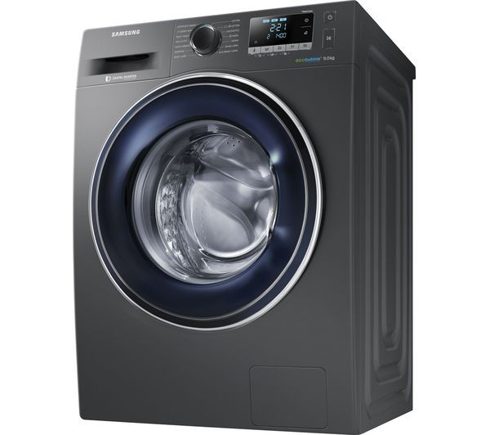
Samsung washing machine
Student name Student ID Topics
Keila Vargas. 1906502. Introduction, Background of the organization
Myriam Tayupanta. 1909629. Challenges before introduction modern technology,
                insights of modern technology
Michael Lara 1906503 Impacts Q&A
Laura Moreno. 1906178 Lessons drawn, Conclusion, references
Name of the lecture : Koushik Modak
Name of the University : University of Wales Saint David
Presentation date : Thursday 19th December 2019

Slide 2
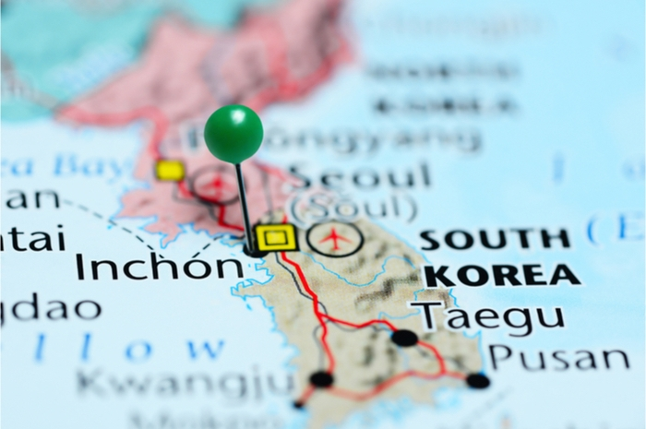
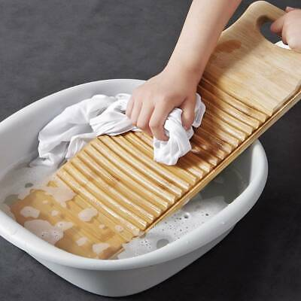
Samsung washing machine
Samsung was founded as a Food exporter to China by Lee Byung-Chull (1938) in Korea, Taegu;
After Korea war samsung go into other business including life insurance and textiles;
In 1969 electronics industry began to export home electronics products Oversea;
Washing machines innovation each year with objective to make our life easy cut washing time and energy usage;
Samsung began number one spot in Korea Market into technology and the wide range.

Slide 3
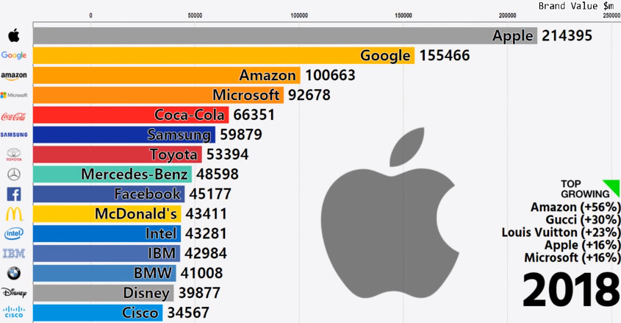
AIM AND OBJECTIVES
AIM : - Achieve annual sales of $400Billion
- Global leader for nine consecutive years
- Samsung made an operation profit of
$13.3Billion on sales of $52.1Billion
OBJETIVES : Putting overall brand Value of
Samsung electronic among the top
five in the world.
MISSION AND VISION
Mission : - Human and technological resources
- Quality consumer electronics and services
Vision : - Innovative technologies products
- Contribute with Societal improvement.

Slide 4
Purpose
Be innovate in each electronic product Without have any direct contact
Create more ecology machines to reduce damage pollution
Provide customer satisfaction.
Current status
Semiconductor market and the strong growth potential in 5G
A wide range of Electronics products
Performance slow revenue was down 4 percent On smartphones
Highly competitive Against apple Ans Google.

Slide 5
CHALLENGES BEFORE INTRODUCING MODERN TECHNOLOGY
NOT WAS VERY EFFICIENT
THEY DIDN’T HAVE WIFI
ONCE YOU STARTED, YOU COULDN’T OPEN THE DOOR
RETAIN THE 1ST POSITION
HAVE TRAINNING PEOPLE

Slide 6
INSIGHTS OF MODERN TECHNOLOGY
DEFINITION
Connect different devices to your network wifi
Using an application to start your washing machine
Having an intelligent options
Wash and spin in 2 drums by separate
Wash and spin in the same drum
Front loading let facility to use high temperatura
Improving washing with ECoBubble technology
(Samsung.com,2019)

Slide 7
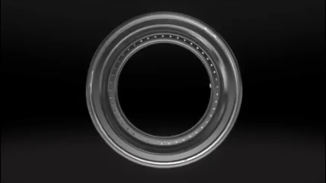
MODELS
2018 QDrive

Slide 8
IMPORTANCE OF MODERN WASHING MACHINE TECHNOLOGY
Give user comfort
To differentiate from the competence
Give customers variety
New innovations are essential otherwise they will be obsolete

Slide 9
IMPACT OF THE MODERN TECHNOLOGY
DISADVANTAGES
ADVANTAGES
Q-rator smart technology
Saving water and energy
Take care your clothe
Reduce laundry time
Program your laundry (app)
Remember yor wash cycle
Homecare wizzard
Lots of models adaptaded to everyone
Less noisy
Add forgotten clothes
Price
Fail network
Don’t have privacy
Updating application

Slide 10
LESSONS DRAWN FROM THE CASE STUDY
Not being afraid of changing the original nature of your business.
Supporting the customers with trained employer.
Investing in a good device for a long using life.
The company success depends upon adaptability to the environment.

Slide 11
CONCLUSION
Being one step in front of the other sellers
Being closer to the customers
Outperforming technological issues
Facing the disadvantages, transforming in groundbreaking devices
Transforming their devices in primordial needs

Slide 12
REFERENCES
Samsung (2019) Homepage [Online]
  Available at : https://new.Samsung.com/cl/lavadoras-una-historia-de-la-innovacion
  ( Accessed: 20th November).
Samsung’s Philosophy and Goals (2019) What we promised
  Available at: https://www.samsung.com/uk/aboutsamsung/vision/philosophy/philosophy-goals/
  (Accessed: 10th November).
Washing machine a history of innovation
  Available at: https://www.Samsung.com?uk/laundry/washer-wf70f5e3w4w/
  (Accessed: 10th November)
What is Q-Rator and how does it work?
  Available at: https://www.samsung.com/sg/support/home-appliances/what-is-q-rator-and-how-does-it-work/
  (Accessed: 10th November).

Slide 13
THANK YOU
FOR YOUR ATTENTION
Any questions?

