Slide 1
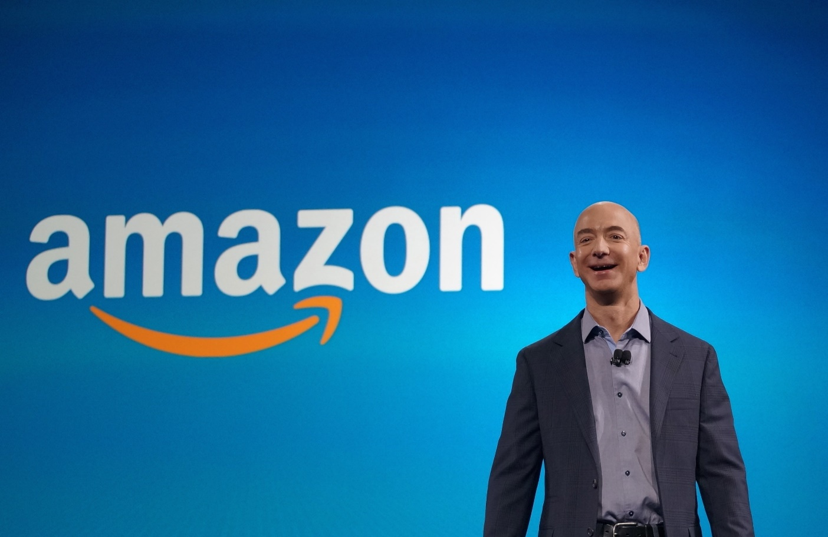
Jeff Bezos

Slide 2
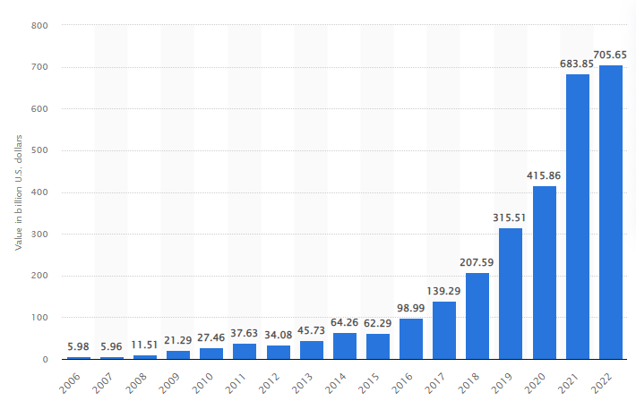
Leadership style of Jeff Bezos
The majority of people agree that Jeff Bezos is a transformational leader Amazon, the biggest online bookstore, was created by him.
Leaders in organizations must take the initiative to ensure that everyone works together to accomplish their shared and separate objectives and it is the main goal of power and leadership theory that jeff Bezos follows.
Notes:
Transformational leadership is a subcategory and most effective leadership style in power and leadership theory. Whenever people work with Bezos, they can be certain that everyone on staff shares the enthusiasm for the company's mission. Jeff Bezos started out in the financial industry in New York as a hedge funder before moving on to found Amazon.com. Initially, Amazon had a hard time turning a profit, but as of 2022, the company's brand worth had hit an all-time high of 705.65 billion U.S. dollars, making it the most valuable brand in history (Statista, 2022). The main reason for the success of Amazon is Jeff Bezos's effective leadership style. This man is a well-known leader that is noted for his ability to plan and produce outcomes using creative means.

Slide 3
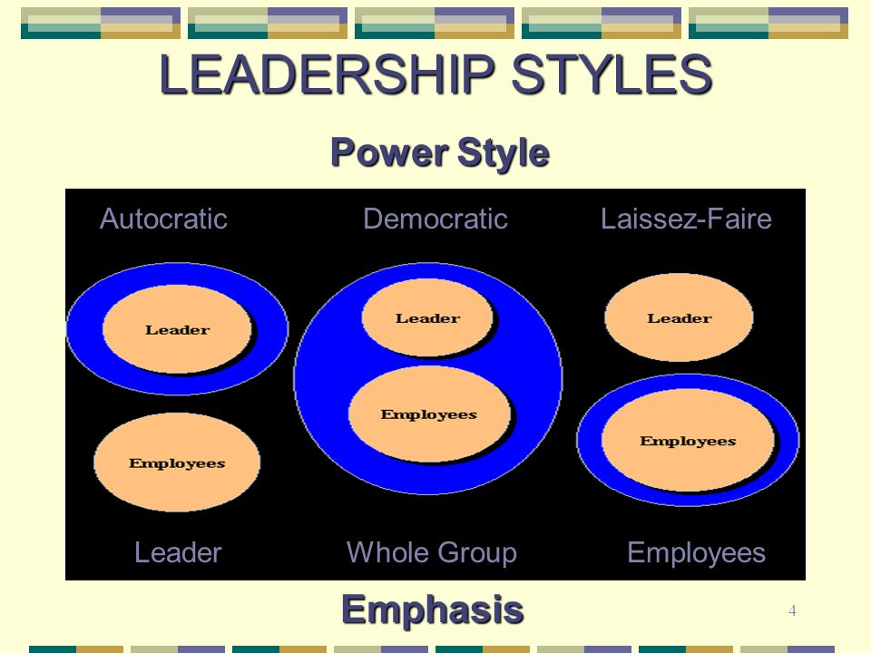
Contd.
By bridging Bezos's long-term goals with the needs and preferences of the public, it will be feasible to better help customers.
In contrast to power, that consists of the ability to force one's will on others, influence is the capacity to profoundly alter the thoughts, feelings, and actions of others.
Jeff Bezos has this two ability that indicates this man follows the power and leadership style.
Notes:
This man follows the power of leadership style means Bezos always promotes innovation. Bezos fully embraces the ever-changing trends in the market. Although Amazon started by selling books, the company has now grown to offer a vast number of other products in addition to practically all of those that are available on the market. The term power of leadership style leadership is used to describe an approach to management in that leaders inspire and urge employees to take risks and come up with new ideas that will help the company thrive in the future. Yet, the company's leadership style is a reflection of Amazon's founder and CEO, Jeff Bezos, that is known for their authoritarian and futuristic outlook. Some members of the leadership team at Amazon have said that Bezos is responsible for maintaining this culture by cultivating a very demanding and ambitious work environment. After then, it is up to Amazon's executives to uphold this culture through their own actions. According to a story by Brad Stone, Jeff Bezos is known to get frustrated with members of Amazon's executive team that do not share a conquer the globe attitude in some way.
Bezos is reportedly responsible for Amazon's executive team reporting that a focus on objective truth has been formed. This indicates that Amazon places less emphasis on its own internal beliefs and more on the facts that are shown to be true in the market. There have also been some concerns about the poisonous and even competitive work climate, that has also come under scrutiny. Some individuals may take offence to that they perceive to be Bezos's forthright manner of communication.

Slide 4
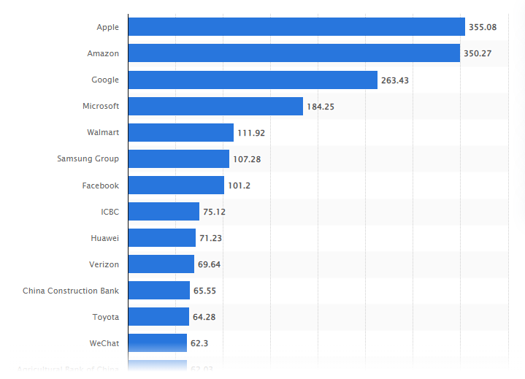
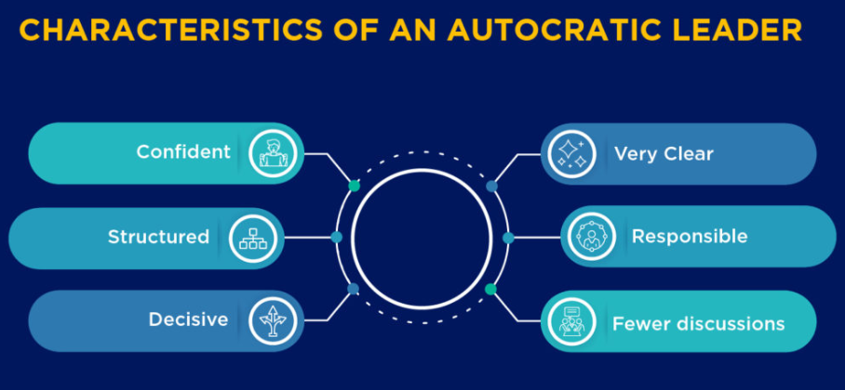
Effectiveness of Jeff Bezos leadership style
Amazon's leadership is characterised as pragmatic, according to outside observers. According to James Clear's book, The Pragmatic Leader, pragmatist leaders set lofty goals and expect nothing less of their subordinates.
Jeff Bezos, founder and former CEO of Amazon, is a remarkable and successful businessman. At the time, Amazon had a brand value of around $254.2 billion USD, making it the second most valuable brand in the world (Statista, 2022).
Notes:
In order to begin, Bezos has achieved success by putting an emphasis on the value that he provides to his consumers. And his fixation on qualities such as quick delivery has given those same consumers an incentive to continue shopping at Amazon. Bezos has instilled a spirit of competition and success in the Amazon workforce. This may irritate certain members of leadership, and it isn't necessarily that has made Amazon the gold standard when it comes to employee happiness. However, if Amazon continues to develop, it's possible that many of the mechanisms they now have in place will be successful.
Jeff Bezos shows signs of having a personality. The growth of our leadership abilities is "in part" influenced by our personalities. Since nobody wants to work for someone who is personality, it is essential that Jeff Bezos be pleasant and has characteristics that are congruent with those of other people. It's possible that some aspects of Jeff Bezos' personality contributed to his drive to start Amazon, even if other people may not have had the same interests. Personality is that differentiates us from other people and has a role in the choices that individuals make for themselves.
In conclusion, Jeff Bezos has shown that he is a successful leader as a result of the fact that he has the four successful traits that make him a great leader. The characteristics consist of a person's general cognitive capacity, crystallised cognitive ability, motivation, and personality. Most people’s prediction is that Jeff Bezos will continue to be an effective leader for a very long time.

Slide 5
Reference
Statista, 2022. Amazon's global brand value from 2006 to 2022. Available at: https://www.statista.com/statistics/326086/amazon-brand-value/ [Accessed on: 5th August, 2022]
Statista, 2022. Most valuable brands worldwide in 2022. Available at: https://www.statista.com/statistics/264875/brand-value-of-the-25-most-valuable-brands/ [Accessed on: 5th August, 2022]

Slide 6

Notes:
The majority of people agree that Jeff Bezos is a transformational leader Amazon, the biggest online bookstore, was created by him.
Leaders in organizations must take the initiative to ensure that everyone works together to accomplish their shared and separate objectives and it is the main goal of power and leadership theory that Jeff Bezos follows.
Whenever people work with Bezos, they can be certain that everyone on staff shares the enthusiasm for the company's mission. Jeff Bezos started out in the financial industry in New York as a hedge funder before moving on to found Amazon.com. Initially, Amazon had a hard time turning a profit, but as of 2022, the company's brand worth had hit an all-time high of 705.65 billion U.S. dollars, making it the most valuable brand in history (Statista, 2022). The main reason for the success of Amazon is Jeff Bezos's effective leadership style. This man is a well-known leader that is noted for his ability to plan and produce outcomes using creative means.
By bridging Bezos's long-term goals with the needs and preferences of the public, it will be feasible to better help customers.
In contrast to power, that consists of the ability to force one's will on others, influence is the capacity to profoundly alter the thoughts, feelings, and actions of others.
Jeff Bezos has these two abilities that indicates this man follow the power of leadership theory.
This man follows the power and leadership style and that means that Bezos always promotes innovation and that he fully embraces the ever-changing trends in the market. Although Amazon started by selling books, the company has now grown to offer a vast number of other products in addition to practically all of those that are available on the market. Leaders inspire and urge employees to take risks and come up with new ideas that will help the company thrive in the future. Yet, the company's leadership style is a reflection of Amazon's founder and CEO, Jeff Bezos, that is known for the authoritarian and futuristic outlook. Some members of the leadership team at Amazon have said that Bezos is responsible for maintaining this culture by cultivating a very demanding and ambitious work environment. After then, it is up to Amazon's executives to uphold this culture through their own actions. According to a story by Brad Stone, Jeff Bezos is known to get frustrated with members of Amazon's executive team that do not share a conquer the globe attitude in some way.
Bezos is reportedly responsible for Amazon's executive team reporting that a focus on objective truth has been formed. This indicates that Amazon places less emphasis on its own internal beliefs and more on the facts that are shown to be true in the market. There have also been some concerns about the poisonous and even competitive work climate, that has also come under scrutiny. Some individuals may take offence to that they perceive to be Bezos's forthright manner of communication.
Amazon's leadership is characterised as pragmatic, according to outside observers. According to James Clear's book, The Pragmatic Leader, pragmatist leaders set lofty goals and expect nothing less of their subordinates.
Jeff Bezos, founder and former CEO of Amazon, is a remarkable and successful businessman. At the time, Amazon had a brand value of around $254.2 billion USD, making it the second most valuable brand in the world (Statista, 2022).
In order to begin, Bezos has achieved success by putting an emphasis on the value that he provides to his consumers and his fixation on qualities such as quick delivery has given those same consumers an incentive to continue shopping at Amazon. Bezos has instilled a spirit of competition and success in the Amazon workforce. This may irritate certain members of leadership, and it isn't necessarily that has made Amazon the gold standard when it comes to employee happiness. However, if Amazon continues to develop, it's possible that many of the mechanisms they now have in place will be successful.
Jeff Bezos shows signs of having a personality. The growth of our leadership abilities is "in part" influenced by our personalities. Since nobody wants to work for someone who has a difficult personality, it is essential that Jeff Bezos be pleasant and has characteristics that are congruent with those of other people. It's possible that some aspects of Jeff Bezos' personality contributed to his drive to start Amazon, even if other people may not have had the same interests. Personality is that differentiates us from other people and has a role in the choices that individuals make for themselves.
In conclusion, Jeff Bezos has shown that he is a successful leader as a result of the fact that he has the four successful traits that make him a great leader. The characteristics consist of a person's general cognitive capacity, crystallised cognitive ability, motivation, and personality. Most people’s prediction is that Jeff Bezos will continue to be an effective leader for a very long time.
Reference list
Statista, 2022. Amazon's global brand value from 2006 to 2022. Available at: https://www.statista.com/statistics/326086/amazon-brand-value/ [Accessed on: 5th August, 2022]
Statista, 2022. Most valuable brands worldwide in 2022. Available at: https://www.statista.com/statistics/264875/brand-value-of-the-25-most-valuable-brands/ [Accessed on: 5th August, 2022]

