Slide 1
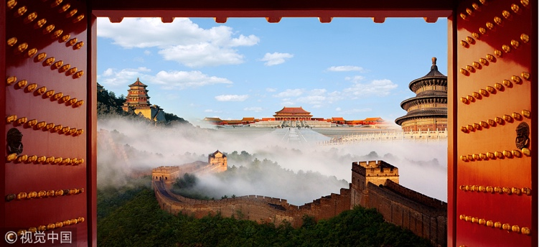




生存汉语
Survival Chinese
Lesson 1 Panorama of China

Slide 2
一.(General Introduction）
Language study：.BASIC KNOWLEDGE OF CHINESE PINYIN
HOW TO SAY HI AND THANKS ,SORRY
二.（Shopping)
Language study: Numbers & HOW to ASK PRICE AND MAKE A BARGAIN.
三.（Eating cultrue&food）
Language study: Words of BASIC MEAT AND FOOD
HOW TO EXPRESS WHAT TO WANT TO HAVE
四.（Transportation）
Language study: WORDS OF DIFFERENT KINDS OF TRANSPORTATIONS
eXPRESSIONS OF WHERE YOU WANNA GO TO
五（Entertainment;travel:）
Language study: words about colors and review of chinese pinyin
六.（Etiquette and taboos）礼仪禁忌
Language study: How to ask time ,date ,and location.
七.（Chinese characters）拼音与汉字
Language study: make a chinese name and experience chinese caligraphy
八.Review of the lesson and preperation for the tour.(self-introduction in Chinese)

Slide 3
warm up ：self-introduction
If with gifts：put three gifts in a bag, and pass the bag with music on,
when you stop the music,people who is holding the bag can pick a gift and ask you a question,
If without gift: put three numbers in the bag ,
and let the person who get the bag guess what is the question of the number,
mostly it is about your age, how long have you been there or how many family menbers in your family.
or use your own METHOD.

Slide 4
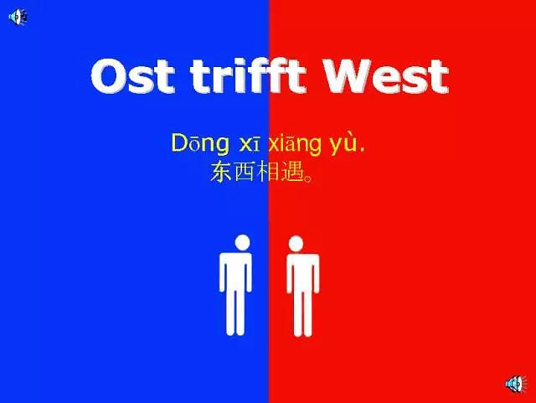

Slide 5
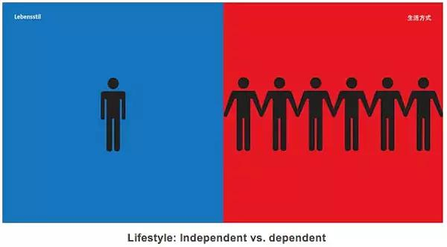

Slide 6
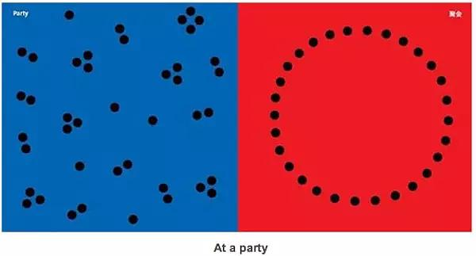

Slide 7
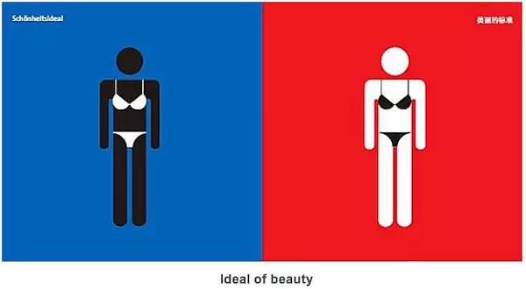

Slide 8
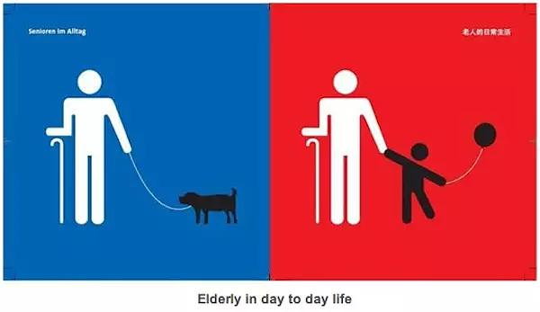

Slide 9
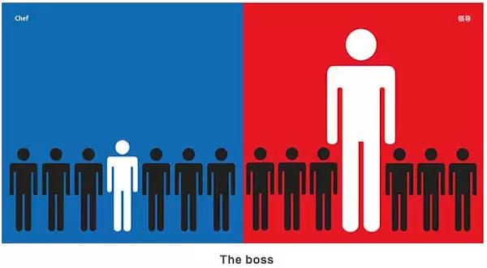

Slide 10
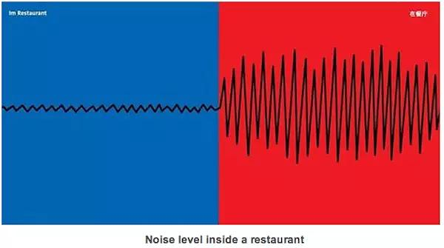

Slide 11
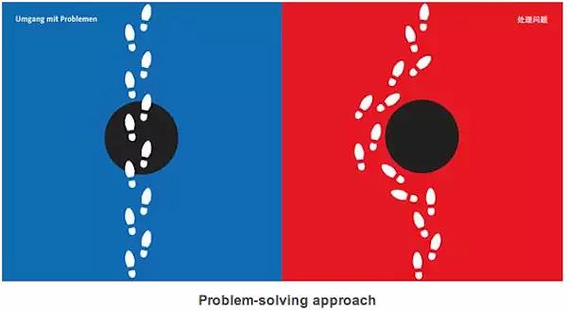

Slide 12
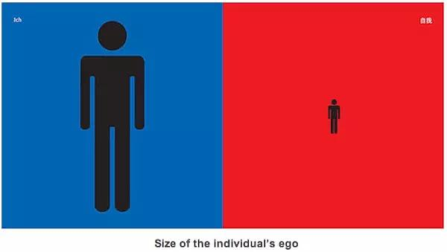

Slide 13
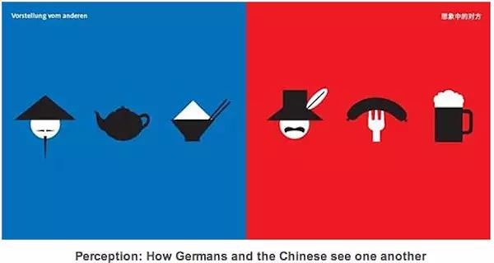

Slide 14
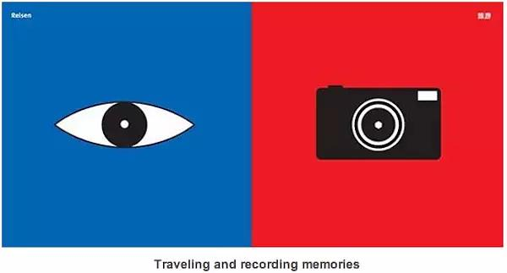

Slide 15
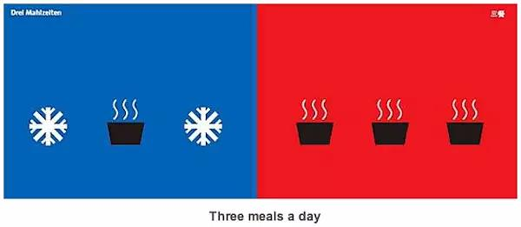

Slide 16
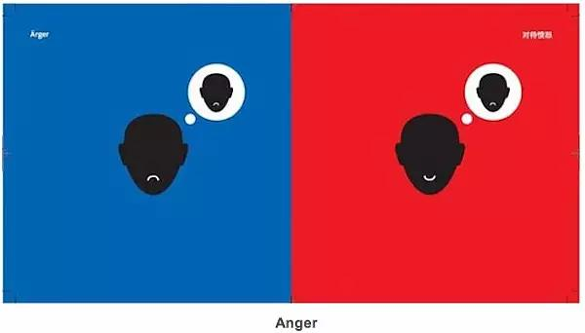

Slide 17
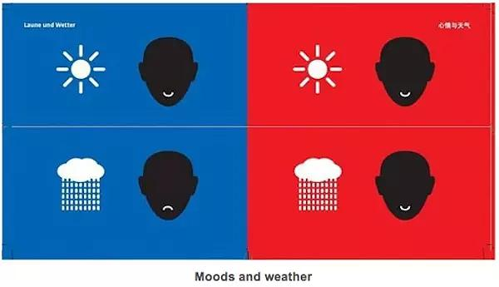

Slide 18

Sunday on the street.

Slide 19

Emotions

Slide 20

Shower Time

Slide 21

Sunshine

Slide 22
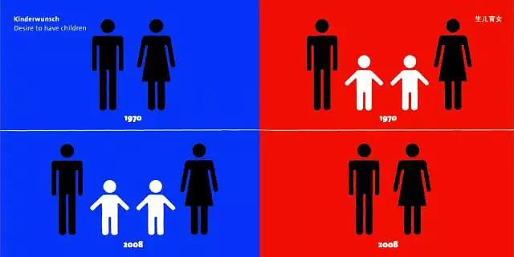
Desire to have children

Slide 23

Entertainment

Slide 24
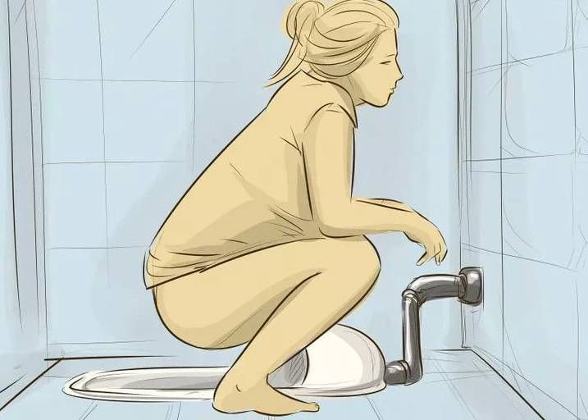
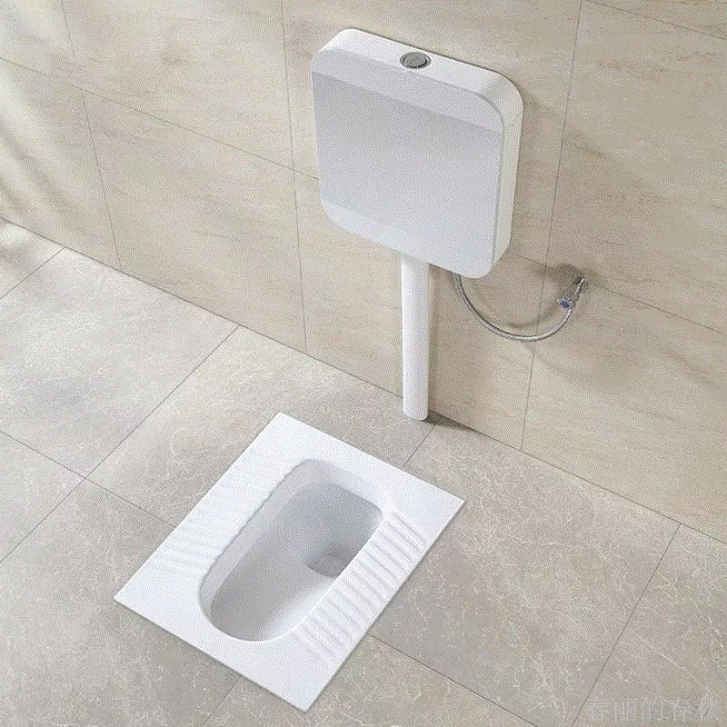

Closestool
Squatting pan？

Slide 25
Video about China in foreigners's perspectives

Slide 26
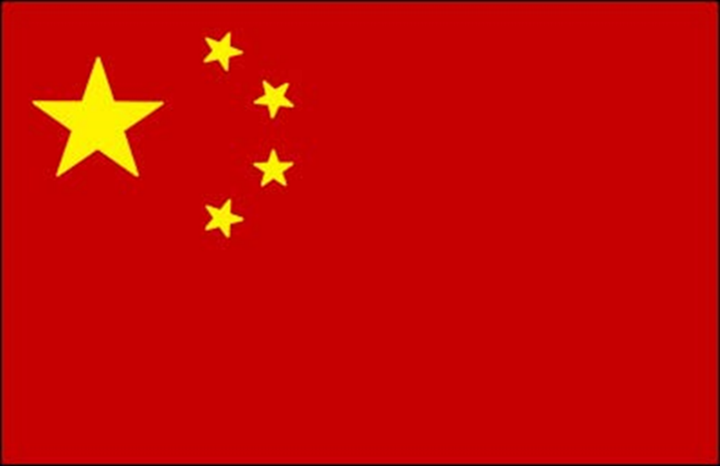
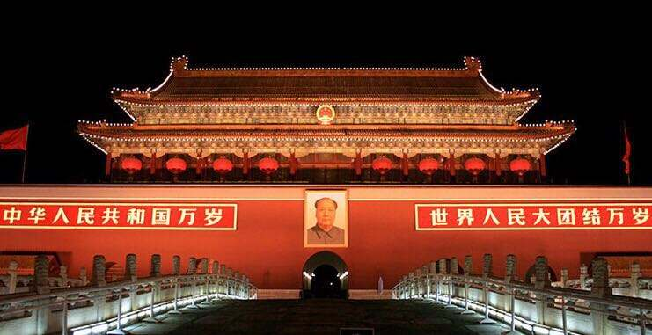
Basic information
The People’s Republic of China is commonly called China.
National flag: the Five-Starred Red Flag
Capital: Beijing
Language: Mandarin(In common use) + more than 100 dialects
Currency: Ren Min Bi (RMB)

Slide 27
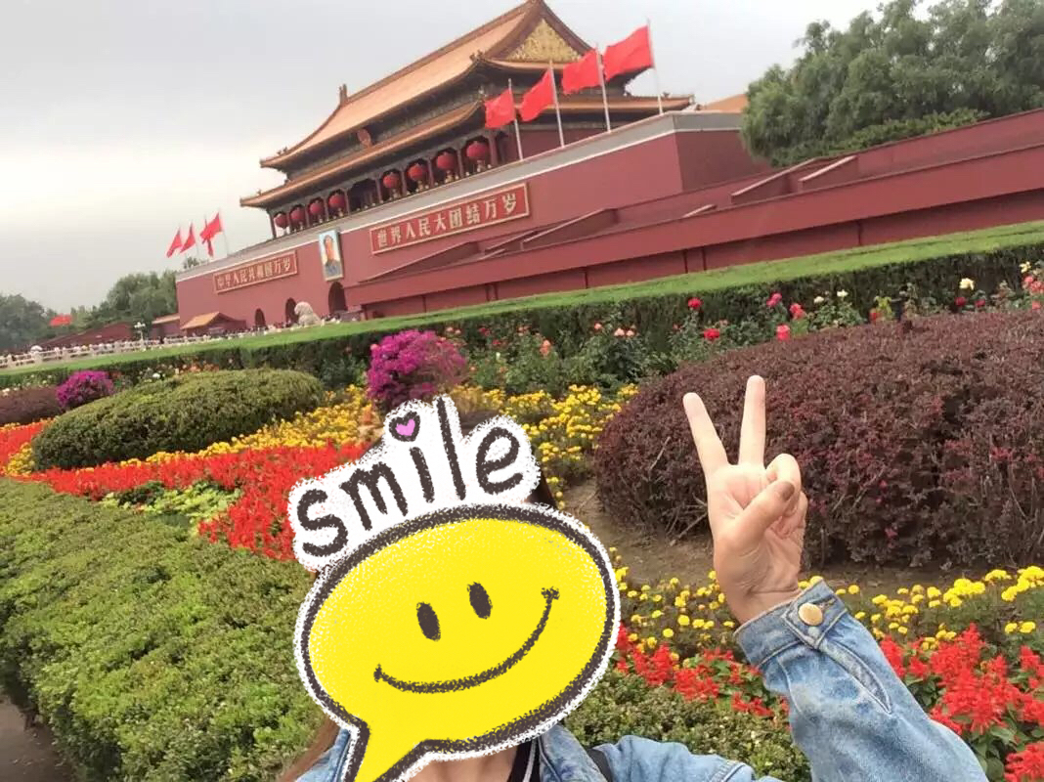
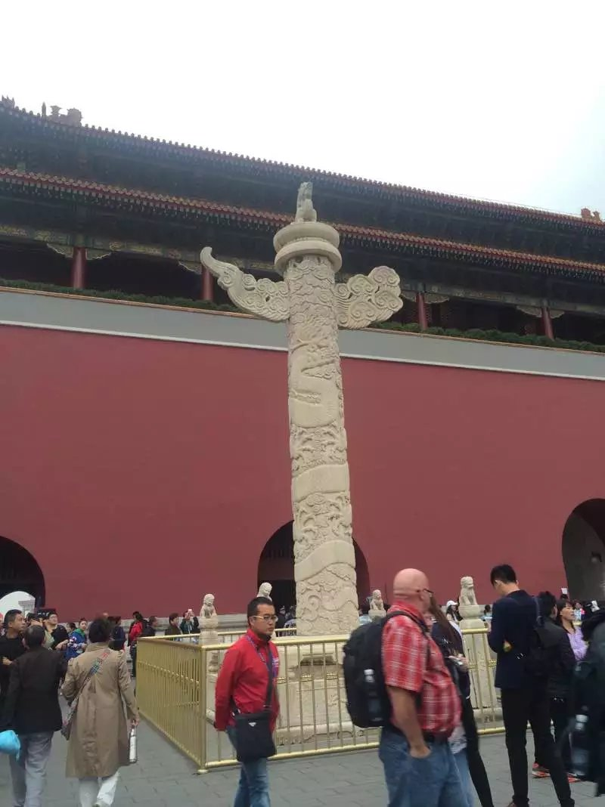
NATIONAL DAY: 1, OCT.

Slide 28
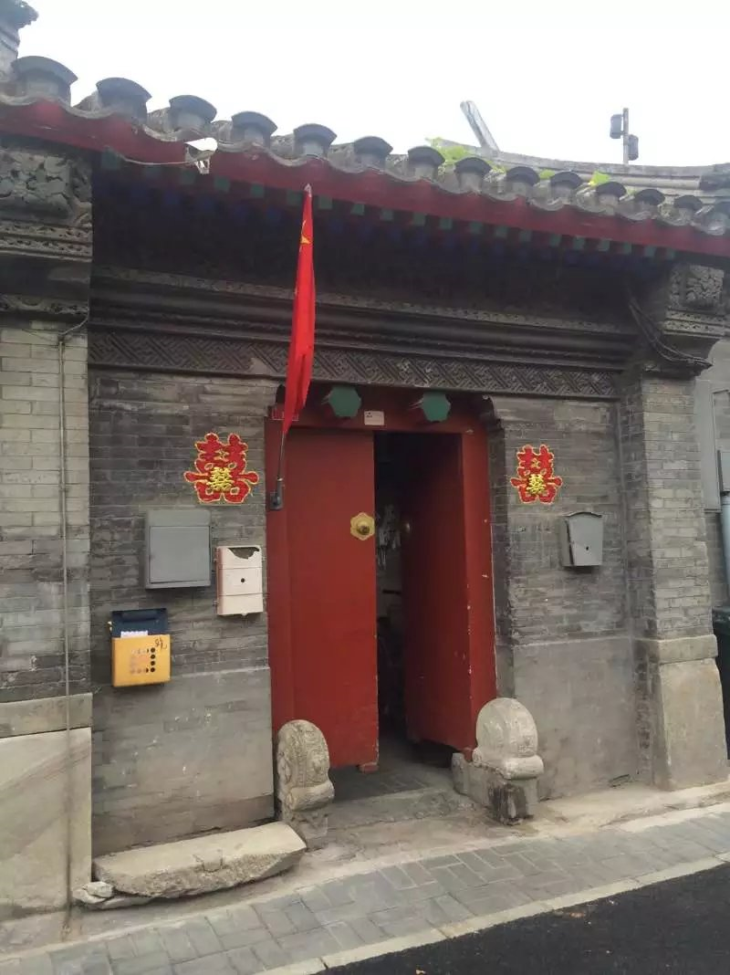
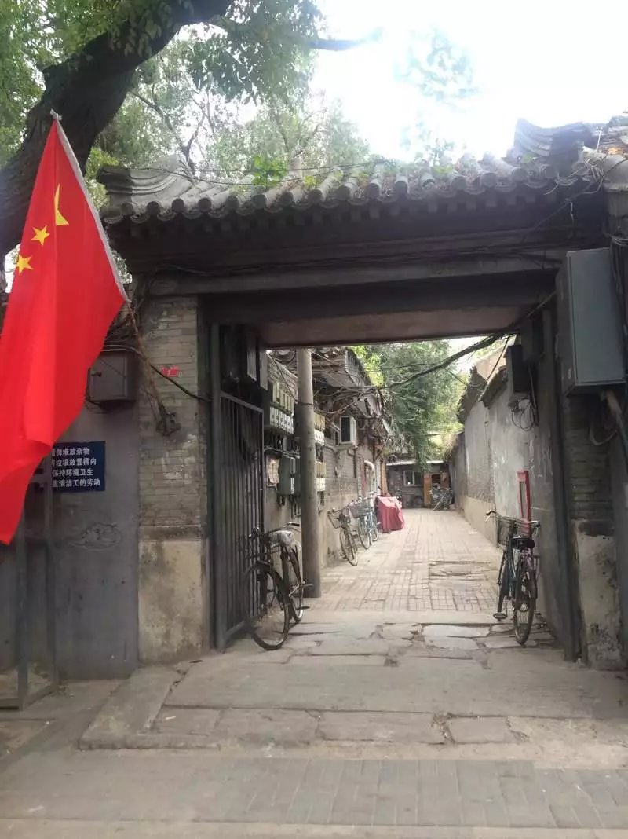
Beijin Hutong
(Alley)
on National Day

Slide 29
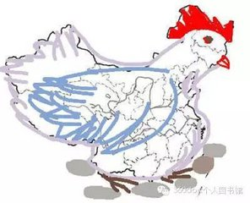
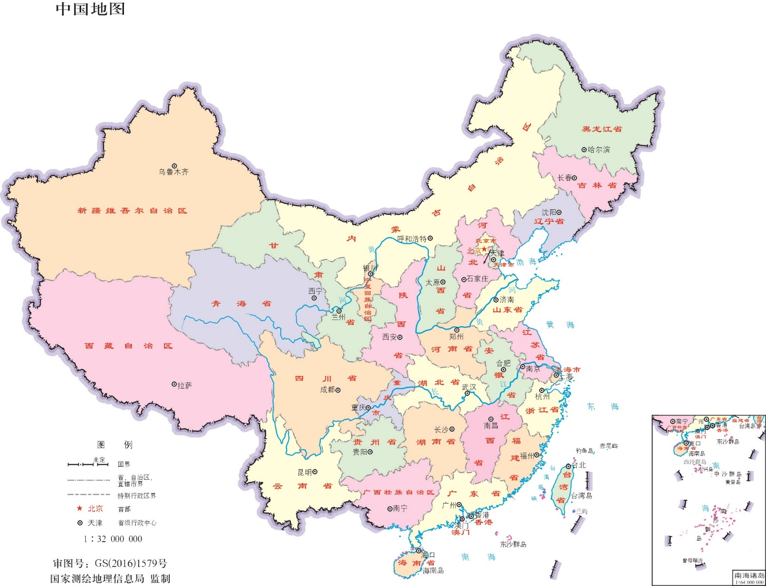
Location
In Eastern Asia, by the west of the Pacific Ocean.
Capital City: Beijing

Slide 30
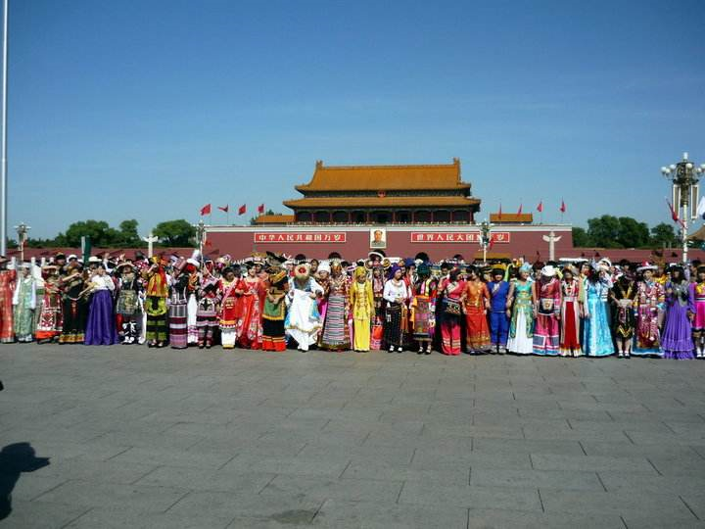
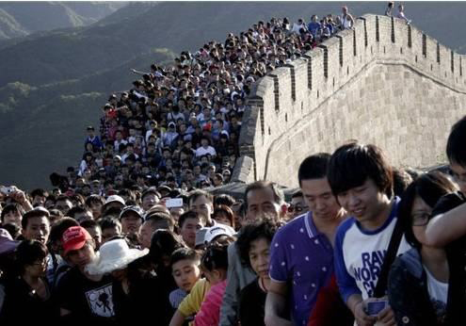
Population
1.4 billions
56 ethnic groups, most of people are Han.
Territory area: 9.6 millions square km
Notes:
插入您所在国家/地区的地图。

Slide 31
Climate
Useful Tips
In Beijing
Spring : Around 8℃
Summer: Around 30℃
Autumn: Around 5℃
Winter: Around -5℃
Windy
Dry
T varies widely from day to night
Chinese climates differ from region to region because of the country's extensive and complex topography.
Gernaerally Speaking:
It is hot all over the country in Summer. (25℃-40℃)
In the north, Spring and Autum is short , cold in winter（-0℃）.
In the Middle, seasons are distinctive，it's around 0℃ in winter.
In the South, most of the time will be warm or hot.

Slide 32
Beijing
A great integration of modern and ancient elements.
VIDEO 5 MINUTES

Slide 33



Happy Chinese
演讲老师：优品
演讲时间：2017.10

Slide 34
拼音（pinyin）
Initials
Tones
nǐ hǎo
你 好
Finals

Slide 35
Initials and Finals of Chinese Pinyin

Slide 36
韵母（finals）
声母（initials）
finals(24)
a o e i u ü
ai ei ui ao ou iu
ie üe er an en in
un ün ang eng ing ong
initials(23)
b p m f d t n l
g k h j q x
zh ch sh r z c s
y w

Slide 37
整体认读音节（ whole-syllable ）
（whole-syllable means these letters together only makes one syllable sound）
whole-syllables(16)
zhi chi shi ri
zi ci si
yi wu yu
ye yue yuan
yin yun ying

Slide 38
拼音太极
https://www.youtube.com/watch?v=qKep0hxW_hE
https://youtu.be/O_T-QR0Fxlw
声母韵母歌
https://www.youtube.com/watch?v=H6jX4oZrlwo
pronunciation
声调
https://www.youtube.com/watch?v=--2tfkFeM9E
https://www.youtube.com/watch?v=zYAFn5DQ3vw

Slide 39
What is tones（声调）？ different tone can suggest totally different characters in Chinese.
声调的作用（function）
tāng 汤——soup
táng 糖——sugar
tǎng 躺——lie down
tànɡ 烫——hot

Slide 40




laa
ā
what？
á
no！à
Uh huh？
ǎ

Slide 41
Finger catching game
Make a circle and when heard second tone，catch the finger.

Slide 42
n^ hǎo
你 好!
（hello）

Slide 43
ù
Neutral
Tone
nǐ hǎo ma
--你 好 吗？
How are you doing recently？
wǒ h6n h2o
—我 很 好。
I am fine.

Slide 44
zài jiàn
再 见 ！
（bye）

Slide 45
xi7 xie
－谢 谢！
(Thank you！)
bú y-ng xi7
－不 用 谢！
（No thanks）

Slide 46
duì bù qǐ
－对 不 起
（sorry）
－méi guān xi
没 关 系
（Never mind）

Slide 47
Initials：h
hāo háo hǎo hào
ao
hǎo
好
h
h4n h5n h6n h7n
en
h6n
很

Slide 48
Initials：m
mā má mǎ mà
ma
吗
ɑ
m
m4i m5i m6i m7i
ei
méi
没

Slide 49
Final： i
nǐ nī ní nǐ nì
你
n
i
q
qǐ qī qí qǐ qì
起
xi
系
x
xī xí xǐ xì

Slide 50
1.根据英文说中文
2.拍苍蝇

Slide 51
How are you？
I am fine.
Thank you！
（No thanks）
（hello！）
sorry
（bye）
Never mind

Slide 52
情景剧台本或自我发挥

Slide 53
1. n^ hǎo
A: 你 好!
（hello！）
nǐ hǎo ma
B: 你 好 吗
How are you doing recently？
A: wǒ h6n h2o
我 很 好.
I am fine.
(fA is too excited to drop his/her book to the ground, and B quickly pick it up and give it back to A)
A: xi7 xie
－谢 谢！
(Thank you！)
B：bú y-ng xi7
－不 用 谢！
（No thanks）
AB ：
zài jiàn
再 见 ！
（bye）
2. n^ hǎo
A: 你 好!
（hello！）
nǐ hǎo ma
B: 你 好 吗
How are you doing recently？
A: wǒ h6n h2o
我 很 好.
I am fine.
AB: zài jiàn
再 见 ！
（bye）
(After you said good bye and you are leaving and A happens to bump against B）
A： duì bù qǐ
－对 不 起
（sorry）
B－méi guān xi
没 关 系
（Never mind）
zài jiàn
再 见 ！
（bye）

