Slide 1

Unit 1 Assessment 1 presentation​
Angy Carolan - 2509406​
Amrita Kaur- 2505384​
Gurdith Barkar- 2506015​
Katya Pinheiro- 2413723​
Rachel Hathaway - 2509405​
Lecturer Anita-Tahsin Ahmed
​
LCHS4007 ​
7/10/25
DIGITAL SKILLS AND RESEARCH METHODS

Slide 2
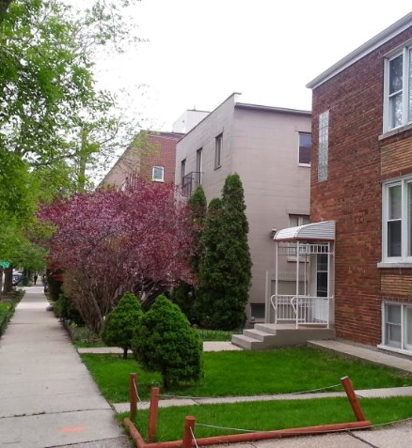
Introduction for sunrise residential care home
In this assignment we will be looking at the advantages and the disadvantages of using Microsoft word and outlook, along with the impact of digital skills and digital safety.
We will then link that back to how and why word and outlook may or not be beneficial to use in the sunrise residential care home for service users who suffer with dementia mobility skills and long-term health conditions.

Slide 3
What are the benefits and limitations of word?
Benefits
Limitations
Microsoft word is easily accessible to anyone with different ages and variety of skills , One fact about word that I think links to service users in the residential care home is that word offers a grammar and spelling check to make sure that documents are free of errors and professional.
Word helps with future planning , residents inside the care home can make a list of daily tasks they would like to carry out during that specific day, which can then be accessed by staff members inside the care home. If for example, residents with dementia were to forget of an activity that they had planned for the day showing them the plan on Microsoft word will prevent the confusion or emotional service users once reminded.
Enhanced communication which means there will be a more updated and better way of communicating with other staff members residents, family and friends. Ensuring that important confidential information is shared on a need to know basis and understood whilst making a secure and safe environment for those we work for and with.
As healthcare professionals we stride to provide the best duty of care we are able to give . Microsoft is a tool on which we can use work securely on multiple devices. The use of word can help staff at the care home to quickly make reports, update care plans send emails which is less time consuming.
Using words means that staff can spend less time doing formal documentation rather then, being digital and not having to do repetitive work and can use extra time with resident who require support. Staff who will use Microsoft word can stay updated in the loop rather than having to constantly check paperwork . Task reminders are also available on Microsoft such as smart scheduling, for medication checks , care reviews, automatic reminders and training.
Microsoft word is a risk as important documents can be easily deleted/compromised making it a failure of poor security for the elderlies living at the care home that rely on being protected.
having access to computer/devices is very limited as it's expensive to own a device, as well as pay a subscription to use desktop app such as word being one of the main applications.
those that don’t have access to the latest model will suffer loss on private information not being saveable, along with data loss.
There are now systems which are up to date and running on a faster software so you can rely on better utilities for example, google documents which has better functionalities.
Software like word can be a confusing platform to use as some would find it to be over complicated as they’ve had too many features to even understand unnecessary option.
The nhs has a duty of care under (data protection act) to ensure valid data is secured confidential and sensitive data including microsoft word. Micrsosoft word

Slide 4

Benefits of microsoft word
Microsoft word is easily accessible to anyone with different ages and variety of skills , One fact about word that I think links to service users in the residential care home is that word offers a grammar and spelling check to make sure that documents are free of errors and professional.
Word helps with future planning , residents inside the care home can make a list of daily tasks they would like to carry out during that specific day, which can then be accessed by staff members inside the care home. If for example, residents with dementia were to forget of an activity that they had planned for the day showing them the plan on Microsoft word will prevent the confusion or emotional service users once reminded.
Enhanced communication which means there will be a more updated and better way of communicating with other staff members residents, family and friends. Ensuring that important confidential information is shared on a need to know basis and understood whilst making a secure and safe environment for those we work for and with.
As healthcare professionals we stride to provide the best duty of care we are able to give .Microsoft is a tool on which we can use work securely on multiple devices. The use of word can help staff at the care home to quickly make reports, update care plans send emails which is less time consuming.
Using words means that staff can spend less time doing formal documentation rather then, being digital and not having to do repetitive work and can use extra time with resident whore quire support. Staff who will use Microsoft word can stay updated in the loop rather than having to constantly check paperwork . Task reminders are also available on Microsoft such as smart scheduling, for medication checks , care reviews, automatic reminders and training.
(Bing, n.d.)

Slide 5
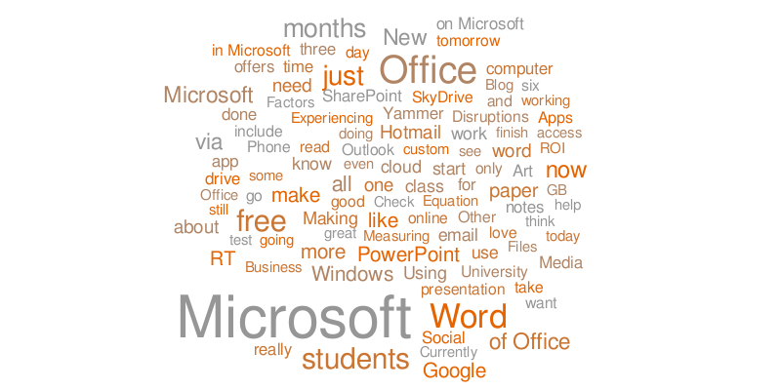
Limitations of microsoft word
Microsoft word is a risk as important documents can be easily deleted/compromised making it a failure of poor security for the elderlies living at the care home that rely on being protected.
having access to computer/devices is very limited as it's expensive to own a device, as well as pay a subscription to use desktop app such as word being one of the main applications.
those that don’t have access to the latest model will suffer loss on private information not being saveable, along with data loss.
There are now systems which are up to date and running on a faster software so you can rely on better utilities for example, google documents which has better functionalities.
Software like word can be a confusing platform to use as some would find it to be overcomplicated as they’ve had too many features to even understand unnecessary option.
The NHS has a duty of care under (data protection act) to ensure valid data is secured confidential and sensitive data including Microsoft word.
(Bing, n.d.)

Slide 6
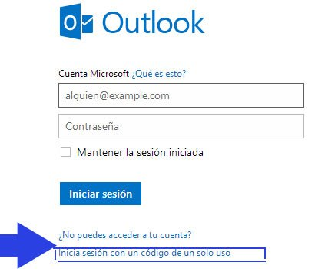
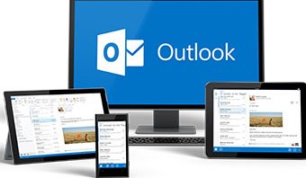
(Bing, n.d.)
Advantages of using Outlook at Sunrise Residential care home
Outlook is a great tool for scheduling meetings. Sunrise is a facility with 35 residents and a team of nurses, care workers and administrators. This outlook tool is crucial for modern enhancement to reliably manage the many accounts and appointments of their service users and staff rotas, visitor logs, doctor's appointments, and medications.
​
Outlook is necessary to productively typing emails, and managing your calendar schedule, all accessed in the same place.
​
Unlike written notes a digital calendar has reminders, alarms and the ability to be shared with colleges and peers creating a sharable online calendar app.​
Online calendars are powerful collaboration tools and make it easier to coordinate activities with others, for both your work and personal life.
This collaborative aspect enhances communication and ensures that everyone involved is on the same page, fostering a more efficient and synchronized approach to shared responsibilities. (Microsoft, 2025)
(Bing, n.d.)

Slide 7

Disadvantages Of Outlook in Sunrise Care Home
Slow performance can cause a delay in care for patients.
Susceptible to crashes and connection issues which can be detrimental to the health of patients for things such as medications.
Many people are IT illiterate or unfamiliar with Outlooks complexities & will require in depth training for staff.
Security vulnerabilities & risk of confidentiality breaches.
Subscription Costs may be unaffordable for staff.

Slide 8
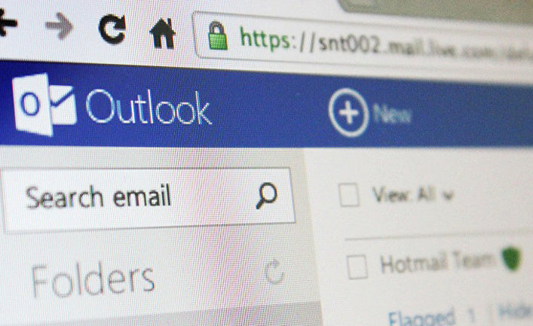
Disadvantages continued...
Components of technostress
• Techno-invasion (employees can be reached anytime).
• Techno-overload (technology forces users to work faster and longer).
• Techno-complexity (users feel inadequate regarding their competences).
• Techno-uncertainty (ongoing changes lead to uncertainty and constant learning).
• Techno-insecurity (feeling threatened about losing one's job because of automation).
• Techno-unreliability (unreliability of technology used).
(Golz, 2021)
Emails, along with other computer-based technologies, contribute to ‘technostress’ (Golz, 2021). This has been defined as ‘a modern disease of adaptation caused by an inability to cope with the new computer technologies in a healthy manner’ (Brod, 1984, cited in Golz, 2021)

Slide 9
The importance of digital literacy in the care home
Informed decision making – This will help improve services and make the right decision based on each individuals plan.
Enhanced patient care and safety- digital tools , such as mobile applications, online feedback and (EHR) which stands for electronic health records which will be used by all staff members for better patient outcome (Cummings and Davis, 2018).
Workforce development- doing digital training instead of doing manual handwritten which is more secure and safe then having a written copy , as it prevents staff retention and removes workload of staff and management.
Time management – Allows staff to take pride and prioritise service users
Use accurate examples with supporting points with relevant academic sources.(EXPLAIN)

Slide 10
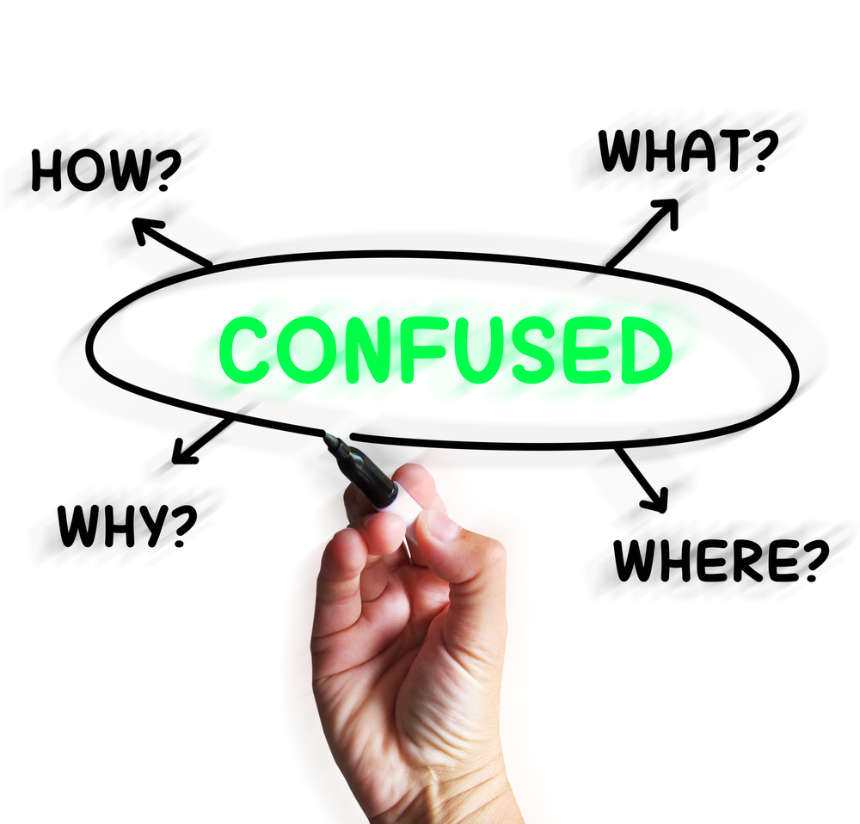
Impact of limited digital skills
Limited digital skills among staff at Sunrise nursing home could significantly impact various aspects of their operations. Impact on Care Delivery Electronic records: If staff struggle with digital systems (like electronic care plans, medications charts, or incident reporting tools), mistakes may occur, leading to delays or errors in care.
Monitoring technology: Many homes use digital tools for falls monitoring, tracking vital signs, or medication dispensing. Limited skills may reduce the accuracy of data entry or staff confidence in using these tools, which could compromise resident safety. Efficiency: Staff may spend longer navigating systems, leaving less time for direct resident care. Communication Internal communication: Digital platforms (emails, staff portals, apps) are often used to update staff about residents' needs, rote changes, or policy updates.
If staff lack confidence, they might miss important messages. External communication: Contact with families, GPs, or external services often happens via digital channels. Poor skills could cause delays in updating families or coordinating with health professionals.
(Bing, n.d.)

Slide 11

Teamwork Uneven skills across staff: Some staff may be digitally confident while others are not, creating inequality and tension within the team. This can make task delegation harder and frustrate colleagues who need to “cover” for others. Training gaps: Limited digital literacy makes it harder to complete mandatory online training, potentially reducing compliance with standards and creating a skills divide.
Collaboration tools: If staff cannot use shared digital platforms effectively, teamwork and handover quality may suffer, leading to miscommunication and fragmented care. This makes us understand that limited digital literacy can slow down processes, increase risks, and weaken collaboration, which directly impacts the quality of resident care and staff morale. But to improve these important points, it would involve comprehensive digital literacy training, ongoing support, and potentially a gradual rollout of new technologies to ensure all staff can adapt effectively.

Slide 12
The checklist for digital safety practices in Sunrise Care Home
secure logins, email safety, safe document storage and maintaining patient confidentiality.
Protects patient information keeping it confidential
Digital safety has been put in place to prevent hacking or breach of data
Legal and ethical duty resedential care home must follow policies and procedures in order to keep data protected and private.

Slide 13

conclusion
In conclusion, to this assignment our opinion is that the use of Microsoft word, outlook, digital literacy and digital skills are a beneficial tool for service providers to use inside the residential care home. Furthermore, digital technologies is more advanced than previously. Using advanced technology can help boost staff confidence whilst teaching healthcare workers new skills making them more knowledgeable

Slide 14
Reference list
To be put in alphabetical order when all refs are added
Gurdith
Nhs website 2022 The Health Informatics Service. [online] Available at: https://www.this.nhs.uk/insights/article/microsoft-office-365-benefits.uk. (n.d.)
Scott, J. (2022). "18 Advantages And Disadvantages Of Microsoft Word." [online] PresentationSkills.me. Available at: https://www.presentationskills.me/advantages-and-disadvantages-of-microsoft-word/.
Angy & Rachel-
Microsoft. (2025) 'Sharable Online Calendar App' Connect, organise and get things done efficiently with a free person email account and online calendar, p. Available at; http://www.microsoft.com/en-us/microsoft-365/outlook/calender-ap#benefits-of-using-an-online-calender.
Golz, C, Peter KA, Zwakhalen SMG, et al (2021) Technostress among health professionals - a multilevel model and group comparisons between settings and professions. Informatics for Health and Social Care, 46: 136–47. Available at: https://www.cambridge.org/core/journals/bjpsych-advances/article/email-in-healthcare-pros-cons-and-efficient-use/57CF2D21E20BE6D7B30519BBC0FEBCCD
-Amrita
NHS, (2024). 'SUCCESS Computer Consulting' The Health Informatics Service. Available at: https://www.this.nhs.uk/insights/article/microsoft-office-365-benefits.(Accessed 29 Sep 25).
(2025). Care Home Software and Integrations: 11 Benefits to Consider. [online] Available at: https://www.theaccessgroup.com/en-gb/health-social-care/sectors/care-homes/care-home-software-and-integrations-11-benefits-to-consider/ [Accessed 1 oct 2025].
Katya Pinheiro
"Digital kills Framework for Health and Social care" (My Learning Cloud, 2025): Overview, framework details, and training solutions for digital skills in adult social care.

Slide 15
Reference list p.2

