Slide 1
Student name: Ayesha Masood
Student ID number: 2220784
Module: Health, Wellbeing and Sustainable Development
Module code: BMHP6030
Lecturer: Parese Ahmed
Assignment Title: Component 1: Presentation

Slide 2
Introduction
Explores links between health, wellbeing & SDG 3 (Good Health & Wellbeing).
Reviews how UK policy (e.g. NHS Long Term Plan) aligns with UN global goals.
Introduces key concepts: health, wellbeing, sustainable development.
Reflects on inequalities in access & outcomes.
Highlights need for inclusive, joined-up approaches.

Slide 3
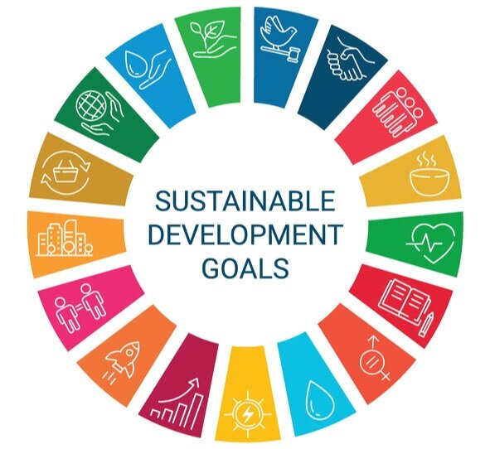
Key Concepts: Health, Wellbeing & Sustainability
Health: Physical, mental & social wellbeing (WHO, 1948).
Wellbeing: Dynamic – shaped by housing, resilience, social ties (Dodge et al., 2012).
Sustainable Development: Meeting present needs without harming future generations (WCED, 1987).
SDG 3: Prevention, equity, sustainability in health systems.
ThePhoto by PhotoAuthor is licensed under CCYYSA.

Slide 4
Theoretical Perspectives
Biopsychosocial Model → body, mind & society shape health (Engel, 1977).
Ecological Model → environment & systems influence wellbeing (Bronfenbrenner, 1979).

Slide 5
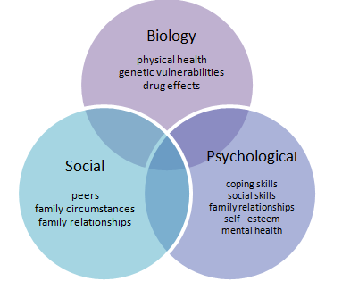
Biopsychosocial Model
Considers biological, psychological & social factors (Engel, 1977).
Supports holistic, person-centred care (Petroff et al., 2023).
Used in multidisciplinary practice.

Slide 6
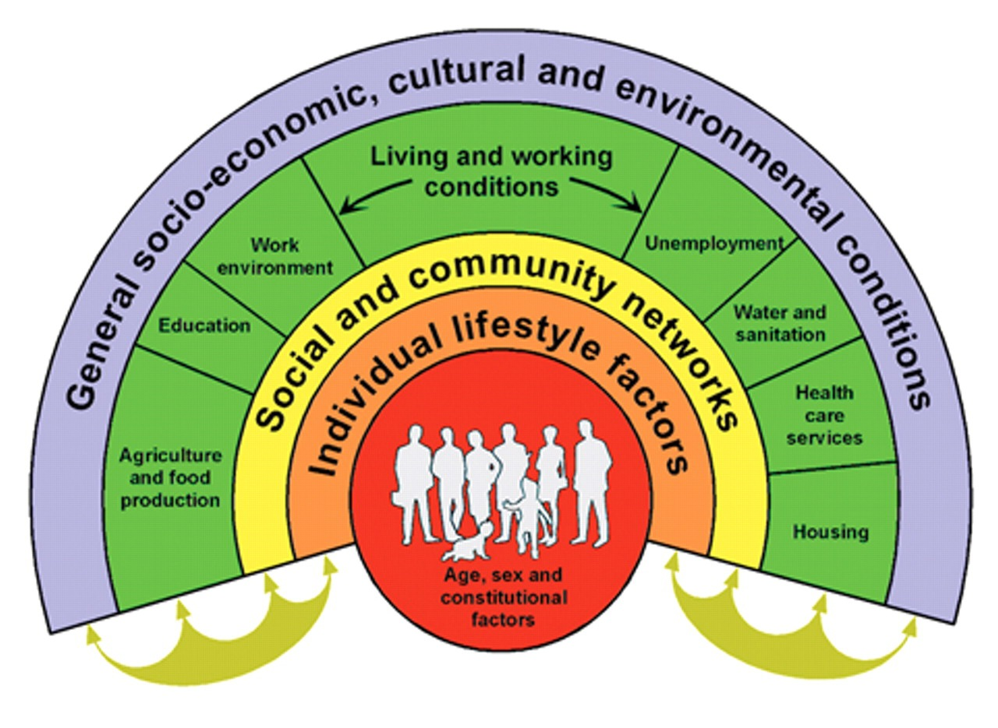
Ecological Model
Health shaped by community & environment (Bronfenbrenner, 1979).
Policies target housing, pollution & green space (Kennedy et al., 2021).
Example: smoking bans, urban planning.
ThePhoto by PhotoAuthor is licensed under CCYYSA.

Slide 7
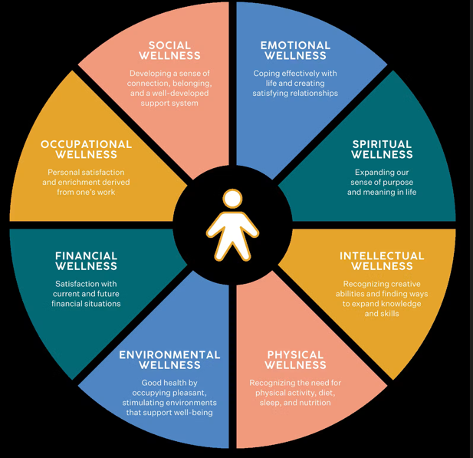
Well-being Models
Wellbeing models show different ways of understanding quality of life.
Dimensions of wellbeing: physical, mental, emotional, social, economic, environmental (Dodge et al., 2012; ONS, 2023).
Subjective wellbeing: how people feel about life → happiness, life satisfaction.
Objective wellbeing: living conditions → income, housing, healthcare access.
Used by policymakers to design services that support both feelings and living standards.

Slide 8
Sustainable Development Goals (SDGs)
United Nations created 17 SDGs in 2015 for a fairer, healthier, greener world (UN, 2015).
Goal 3: Good Health and Wellbeing → ensure healthy lives for all ages.
Linked goals also shape health:
  Goal 1: No Poverty → poverty reduction improves health.
  Goal 2: Zero Hunger → food security prevents malnutrition.
  Goal 4: Quality Education → education improves health choices.
  Goal 13: Climate Action → tackling climate change protects global health.
Health is connected to progress in all other goals.

Slide 9

Integration into UK Health & Social Care
SDG 3: Ensure healthy lives & promote wellbeing for all.
NHS Long Term Plan (2019): prevention, sustainability, digital access.
SDGs link health to poverty, education & climate change.
Examples: Diabetes Prevention Programme, NHS sustainability goals.

Slide 10

Slide 9 – Policy & Governance
NHS Long Term Plan → prevention & digital health (NHS England, 2019).
Health and Care Act → integrated care systems (DHSC, 2022).
Care Act → wellbeing principle (DHSC, 2014).
WHO “Health in All Policies” → cross-sector approach (WHO, 2014).

Slide 11
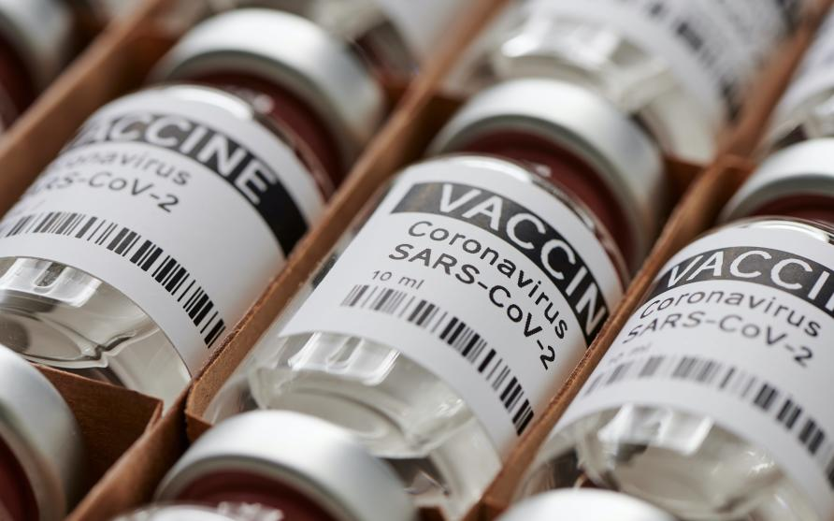
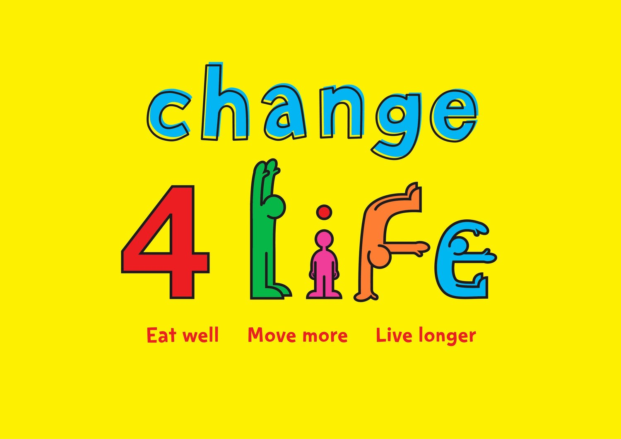
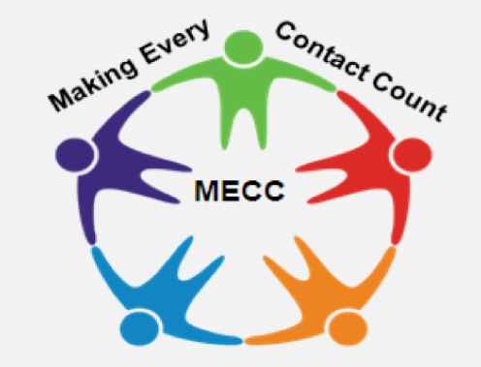
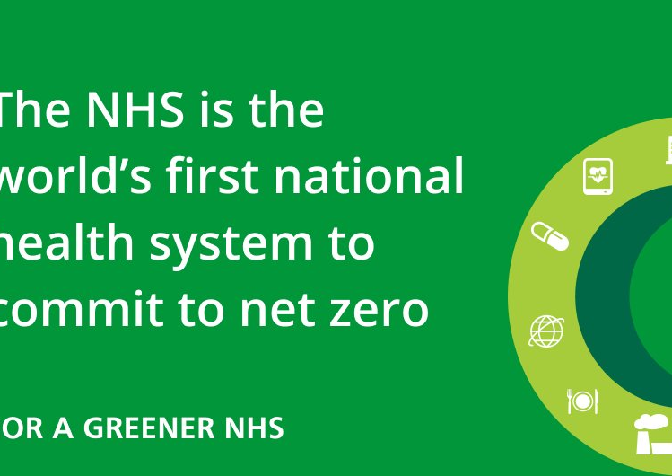
Slide 10 – Case Studies & Campaigns
MECC → behaviour change in everyday care (Innovative Health, 2019).
Change4Life → family lifestyle campaign (Public Health England, 2018).
Greener NHS → sustainability plan (NHS, 2024).
COVID-19 vaccines → equity focus (Open Gov, 2023).

Slide 12
Case Study: COVID-19 (Evaluation)
Global crisis → tested health, wellbeing, and sustainability systems.
Strengths:
  Fast development & delivery of vaccines (Open Government Partnership, 2023).
  Community outreach clinics improved access in deprived areas.
  Use of digital tools for appointments & information sharing.
Weaknesses:
  Inequalities – higher death rates in Black and South Asian groups (Public Health England, 2020).
  Digital exclusion limited access for some communities.
  Mental health worsened due to lockdowns and isolation (ONS, 2021).
Learning: importance of prevention, fairness, communication, and addressing social determinants

Slide 13

Inequalities & Barriers
COVID-19: higher mortality in ethnic minorities (Public Health England, 2020).
Deprivation → shorter life expectancy (Marmot, 2010; Marmot, 2020).
Digital exclusion limits access (NICE, 2025).
Barriers: housing, transport, income.

Slide 14
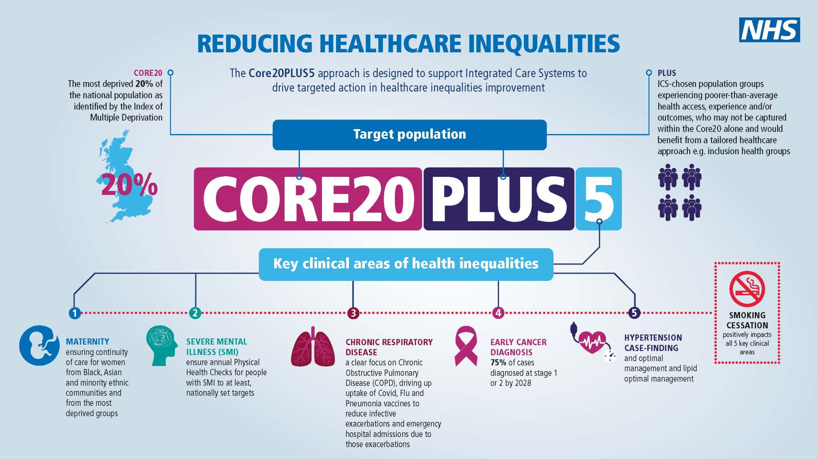
Policies to Reduce Inequalities
Core20PLUS5 → NHS framework for inequality reduction (NHS England, 2021).
Digital inclusion → free data & training (NICE, 2025).
Solutions: cultural sensitivity, hybrid services, social support (Eden, 2022).

Slide 15
Recommendations
Strengthen prevention → expand early health promotion & lifestyle programmes (Public Health England, 2018).
Promote holistic care → apply models like the Biopsychosocial approach across services (Engel, 1977).
Address inequalities → expand Core20PLUS5 and tackle digital exclusion (NHS England, 2021; NICE, 2025).
Embed sustainability → grow the Greener NHS plan and link to SDGs (NHS, 2024; UN, 2015).
Improve communication → use Health Belief Model strategies to boost public trust (Rosenstock, 1974).
Learn from COVID-19 → keep community outreach but reduce inequalities and support mental health (Public Health England, 2020).
Joined-up working → health, social care, education, and housing must continue integrating (DHSC, 2022).

Slide 16
Slide 13 – Conclusion
Health, wellbeing & sustainability are interconnected.
Theories (BPS, ecological, HBM) guide integrated care.
Policies embed prevention & equity (NHS England, 2019; WHO, 2014).
Gaps remain → inequalities, digital exclusion, funding pressures (Marmot, 2020).
Future: inclusive, sustainable, joined-up care.

Slide 17
References
Bronfenbrenner, U. (1979) The ecology of human development: Experiments by nature and design. Cambridge, MA: Harvard University Press.
Department of Health and Social Care (DHSC) (2014) Care Act 2014. London: The Stationery Office.
Department of Health and Social Care (DHSC) (2022) Health and Care Act 2022. London: The Stationery Office.
Dodge, R., Daly, A.P., Huyton, J. and Sanders, L.D. (2012) ‘The challenge of defining wellbeing’, International Journal of Wellbeing, 2(3), pp. 222–235.
Engel, G.L. (1977) ‘The need for a new medical model: A challenge for biomedicine’, Science, 196(4286), pp. 129–136.
Green, E.C., Murphy, E. and Gryboski, K. (2020) The health belief model. Washington, DC: Population Reference Bureau.
Innovative Health (2019) Making Every Contact Count. London: Innovative Health.
Kennedy, R., Kearney, J. and Fletcher, J. (2021) ‘Applying ecological models to health promotion’, Journal of Public Health, 43(2), pp. 219–226.
Marmot, M. (2010) Fair society, healthy lives: The Marmot Review. London: The Marmot Review.
Marmot, M. (2020) Health equity in England: The Marmot Review 10 years on. London: Institute of Health Equity.
NHS England (2019) The NHS Long Term Plan. London: NHS England.
NHS England (2021) Core20PLUS5 approach to reducing healthcare inequalities. London: NHS England.

Slide 18
NHS (2024) Greener NHS report. London: NHS.
NICE (2025) Digital inclusion and health inequalities. London: NICE.
Open Government Partnership (2023) COVID-19 vaccine equity initiatives. London: OGP.
Public Health England (2018) Change4Life campaign. London: PHE.
Public Health England (2020) Disparities in the risk and outcomes of COVID-19. London: PHE.
Rosenstock, I.M. (1974) ‘The Health Belief Model and preventive health behaviour’, Health Education Monographs, 2(4), pp. 328–335.
WCED (World Commission on Environment and Development) (1987) Our Common Future. Oxford: Oxford University Press.
World Health Organization (WHO) (1948) Constitution of the World Health Organization. Geneva: WHO.
World Health Organization (WHO) (2014) Health in All Policies: Framework for country action. Geneva: WHO.
United Nations (2015) Sustainable Development Goals. New York: United Nations.

