Slide 1

LCLM4002
Assessment
Lesson 2

Slide 2
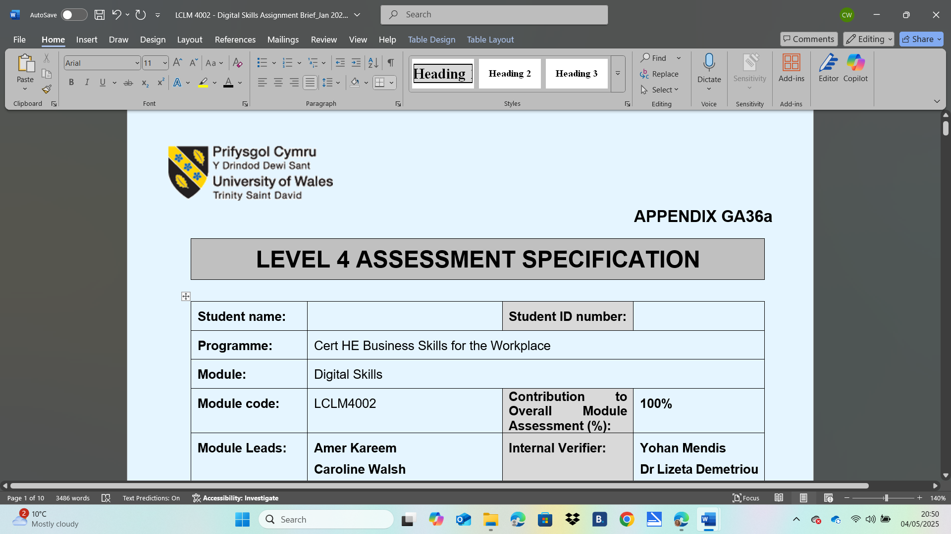
Assessment Specification – LCLM4002
Where to find it?

Slide 3
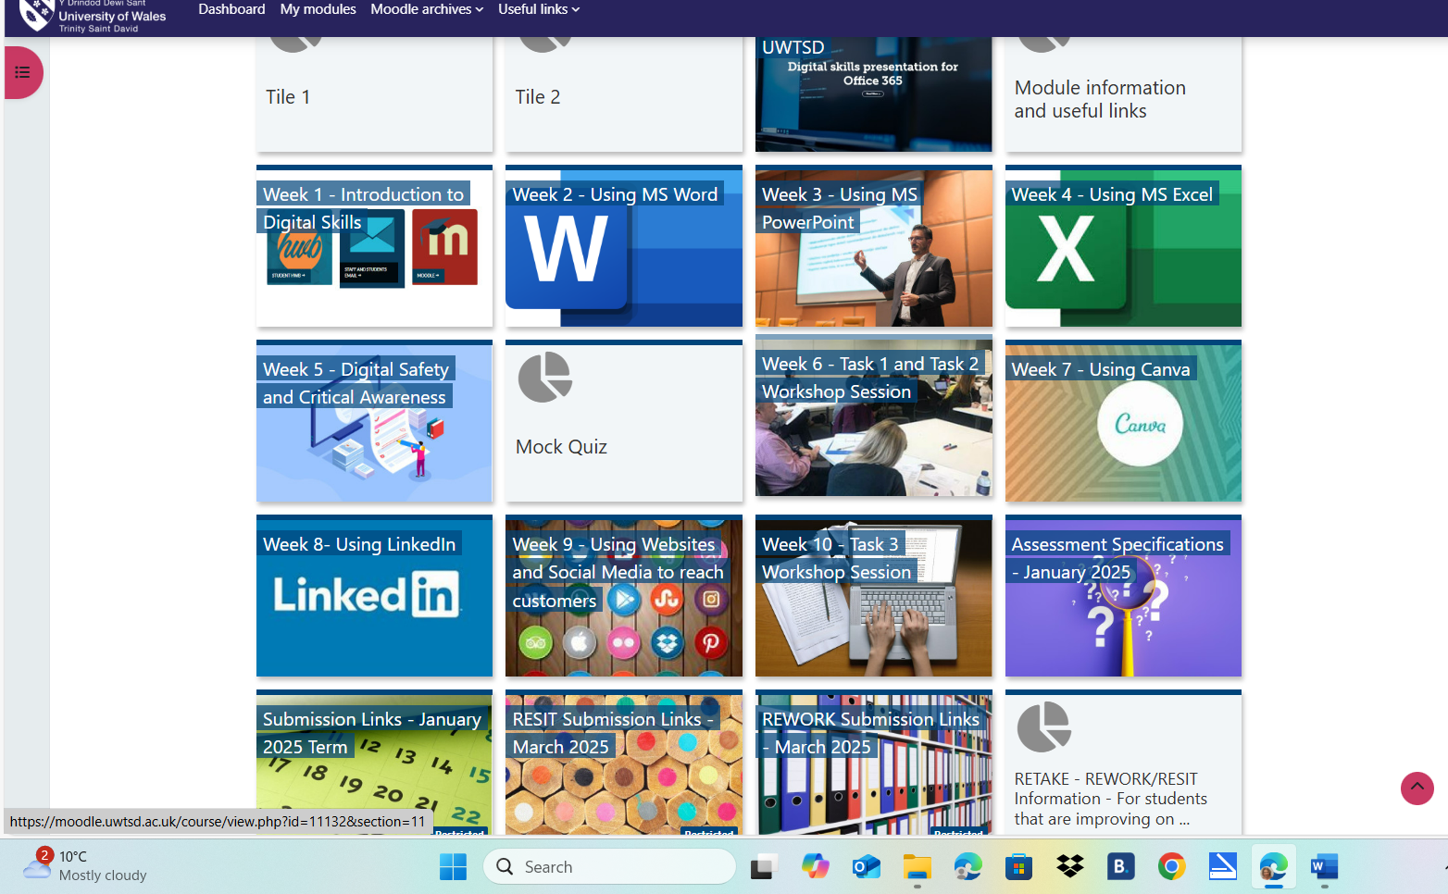
The assessment brief can be found in the purple tile on the Digital Skills homepage.

Slide 4
How do you pass the Module?
Teachers use criteria to assess your work.
What is criteria?
a standard by which you judge, decide about, or deal with something:
e.g. The Health Service should not be judged by financial criteria alone.
CRITERION | English meaning - Cambridge Dictionary
Criteria = plural noun
Criterion = singular noun

Slide 5
Task 1
Spend 30 minutes reading the assignment brief.
Read the three separate tasks (p2-3)
Annotate/highlight important information e.g marks for each task
Write down the submission dates.

Slide 6
Guidance for students in the completion of tasks
Assessment Criteria – 5 generic criteria (p4-6)
This is the criteria you will find in all your modules. This is important for:
Students – what to include in each task
Teachers – how we mark it and give you a grade
Engagement with Literature Skills
Knowledge and Understanding Skills
Cognitive and Intellectual Skills
Practical Skills
Transferable Skills for Life and Professional Practice

Slide 7
Generic Assessment Criteria
The marking criteria is broken down into % grades (p8-10):
Excellent (70-84%) Pass mark = 40%
Very good (60-69%)
Good (50-59%)
Satisfactory (40-49%)
Fail (30-39%)
Homework
Read and compare the wording for each grade for each criterion. Underline the differences in adjectives e.g.excellent/sound/good limited evaluation... (criterion 3)

Slide 8
Specific guidance for each task
Task 2
Read the Guidance specific to this assessment for each task (red writing, p5-6).
In groups, choose one of the assessment criterions. In the table below, identify the key words and phrases that are important.
Crit. 1 | Crit. 2 | Crit. 3 | Crit. 4 | Crit. 5

Slide 9
Class Feedback
In groups, explain your criterion to the class. Relate the skill (criterion) to the three tasks (some may relate to just two tasks).

Slide 10
Use of AI
Task 3
What is AI? Read the Use of Generative AI in Assessment (p2).
Class discussion:
Using ChatGPT to research the topic for your assessment.
Using Copilot to write your assessment.
Using translation tools to write your assessment.
What would be the advantages and disadvantages of using AI?
In what ways can you use it in this assessment?
Academic Misconduct
You will learn more about misuse of AI in your Academic Skills lesson.

