Slide 1
Week 8
Aim:
To understand Key legislation affecting the operation of a hotel:
Liability
Health and safety
Food hygiene
Risk management
Licensing
Hotel Proprietors Act 1956.

Slide 2
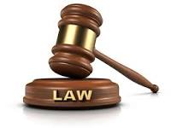
Legislation
Legislation (or statutory law) is law which has been promulgated (or "passed") by a legislature or other governing body or the process of making it. ... Legislation can have many purposes: to regulate, to authorize, to outlaw, to provide (funds), to sanction, to grant, to declare or to restrict.
Please follow the link
https://www.legislation.gov.uk/understanding-legislation

Slide 3
What is hospitality legislation?
Hospitality law is a legal and social practice related to the treatment of a person's guests or those who patronize a place of business. Related to the concept of legal liability, hospitality laws are intended to protect both hosts and guests against injury, whether accidental or intentional.

Slide 4
Why is it important to understand the legislation that affect you in the hospitality industry?
Food safety laws play a major role in the hospitality industry, and knowledge about how to clean and store food can keep your customers safe and help your business avoid lawsuits and fines. ... Clearly, this is a list you want to be on, so be sure you know the hotel laws on fire safety

Slide 5
What are legal issues in hospitality industry?
Common labour and legal issues can include discrimination, unfair pay practices, workplace safety, and retaliation.

Slide 6
Activity 30 Min
A Case Study in Labour Law
Please follow the link and read the case study, come back with your understanding of how Labour law is effecting hospitality industry.
https://study.com/academy/lesson/hospitality-industry-labor-legal-issues.html

Slide 7
Liability
Liability is a fancy word for debt, or something that you owe. Once you know your total liabilities, you can subtract them from your total assets, or the value of the things you own — such as your home or car — to determine your net worth.

Slide 8
Liability and Hospitality
The Law Hotel proprietors are strictly liable to make good the loss of a guest's property unless they can prove that the loss was caused as a result of the negligence of the guest. This duty is set out in s. ... Liability is restricted to those guests who have purchased sleeping accommodation only
Please follow this links:
http://www.legislation.gov.uk/ukpga/Eliz2/4-5/62
https://api.parliament.uk/historic-hansard/lords/1956/jun/19/hotel-proprietors-liabilities-and-rights

Slide 9
Hospitality Health and safety legislation
https://www.bbc.co.uk/bitesize/guides/zbrdvk7/revision/1
https://www.hse.gov.uk/pubns/cais25.pdf

Slide 10
Hospitality Food and Hygiene laws
https://www.bighospitality.co.uk/Article/2010/05/05/Food-hygiene-the-law

Slide 11
Risk Management
The most common hazards in the hospitality industry are:
lifting and pushing - eg. handling heavy or awkward shaped objects.
slips, trips, falls - eg. slipping on a wet floor or tripping on uneven surfaces.
hot surfaces and substances - eg. ...
cutting equipment - eg. ...
occupational violence

Slide 12
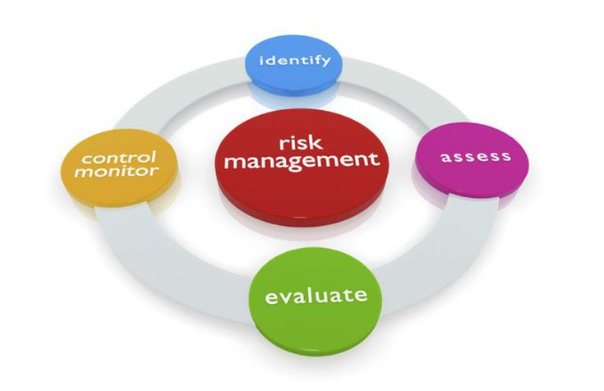

Slide 13
Hotel Licensing
https://www.locusassignments.com/solution/hospitality-management-law-licensed-premises-assignment

Slide 14
Hotel Proprietors Act 1956.
The Hotel Proprietors' Act 1956 defines a hotel as 'an establishment held out by the proprietor as offering food, drink and, if so required, sleeping accommodation, without special contract, to any traveller presenting himself who appears able and willing to pay a reasonable sum for the services and facilities ...
http://www.legislation.gov.uk/ukpga/Eliz2/4-5/62

Slide 15
Q&A

