Slide 1
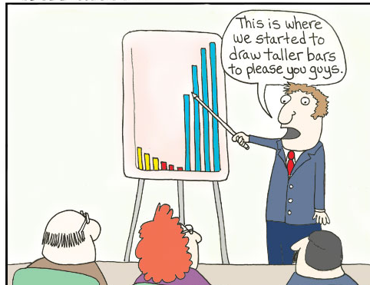
Presentation
You need to choose a partner (or a max of 3 in a group) to work with for the presentation by the end of this session – so we know who is working with who
Time for the presentation is 7.5 mins PP & up to 5 mins for questions at the end ( e.g. 2 people 20 mins)
We will give time in sessions (this may not always be the same amount, to work together on your presentation). Half of week 6 will be assignment support
You can choose where to work in the time we offer you in lectures for the presentation – I will be in here
You need to be organised and focussed – you will have other assignments from other modules due around the same time

Slide 2
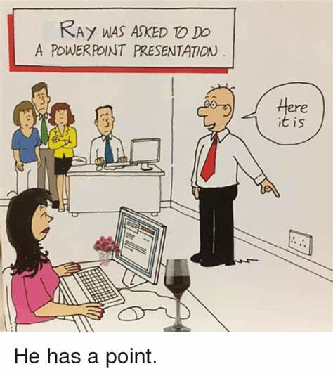
Presentation
This presentation offers a template/ guidance on how you may wish to structure your presentation. And/Or, suggestions on how you may wish to communicate your findings, including areas you may wish to consider.
Your presentation will focus on one case study to explore – lets explore them all now first – See if you have a preference
Keep the same style for the slides throughout and if you think 15 slides 15 minutes? As a rough guide but you can do less – would more be too many?!

Slide 3
Presentation Case Study – add your family letter here
Children, Young People and Families
Examplar template/ guidance
Add your name and student number here
Module: BMHP5004_BIRM
Lecturer:
Add the submission date here
Notes:
Welcome to groups c's presentation, myself Fozeea, Husna, Annmarie and Norbit will be presenting today.

Slide 4
Presentation Contents
Here you may add a contents page, this will also help you focus your presentation.
Introduction – what will you be introducing?
Risk factors – what does this mean?
Mother
Child (age)
Child (age)
Father
The ones underlined are dependant upon your family case, this is just an example
Current relevant policy
Importance of a multiagency/ partnership approach
Conclusion
Notes:
In this case study we have highlighted the risk factors, we have analysis and critiqued, policies and professional interventions, we have discussed and evulgated the current policy, case management, initiatives used by the multi- disciplinary agencies.

Slide 5
Introduction
Introduce your presentation and case study
What are the aims and objectives of this presentation?
Offer key items that you will discuss…

Slide 6

RISK FACTORS
Safeguarding?
Certain abuse?
Psychological, emotional, physical, development concern?
Criminal activity/ concern?
Addiction?
Relationship breakdown?
Wellbeing concerns?
What are the risk factors related to your family case? The rest of the presentation will then break this down.
Notes:
Risk factors which have contributed to the vulnerability of the family members are as follows

Slide 7
Example-Risk factors- you may wish to communicate your findings in a table
Adults | Children
Parenting problems | Welfare, neglect, and or protection issues
Mental health issues including depression and anxiety | Offending behavior
 | Development Delay and or special educational needs
 | Anti-social behaviour

Slide 8
Analysis of mother- example/ guidance
Break down the risk factors related to the mother
Why might this be the situation?
Who may this impact and how?
What intervention/ agencies might be considered and why?
How does policy support this?
Tip- Consider the mother, then also consider the impact upon the whole family
Notes:
Mothers depression and anxiety why this would be seen as a risk factor? Affects child's development. How a child sees the world and the parent. Express less. Less eye contact. Even to activities. Academically. Course behavior problems and isolations problems for both mother and child due to mom finding it hard not to go out.

Slide 9
Analysis of the child – example/ guidance
Break down the risk factors related to the child
Why might this be the situation?
Who may this impact and how?
What intervention/ agencies might be considered and why?
How does policy support this?
Tip- remember the childs age, maybe there needs to be youth offending teams ect …again, consider the impact this person may have upon the whole family ..

Slide 10
Antisocial Behaviour example- consider using diagrams to communicate your findings
Involvement in crime, Vandalism, anti-social behaviour
Housing conditions
& Unemployment
Underage drinking & drugs
School absenteeism/ Drop out
Parental neglect
Due to Mental
Health Issues
(Fergusson, Bowden, & Horwood, 2009; Kim–Cohen et al. 2003)
states that children who engage in antisocial behaviour are at risk due to adverse developmental outcomes, including school drop-out, criminal behaviour, psychopathology, and substance dependence.
Notes:
Case Study C
The risk factors in this case are:
Parental neglect due to the mother’s ongoing mental heath issues. Impacts on the children who live at home with her, lack of attention and engagement.
Antisocial Behaviour: Harmful or hostile behaviour deviating from the social, societal norms. Low family income, poor parental supervision. (Farrington,2005)
Phychopathology:
The study of mental disorders/ unusual maladaptive behaviours.
Depressive disorder, bipolar disorder, schizophrenia, paranoid personality, and social anxiety disorder.
Housing conditions
One of the main risk factors that impacts
They are living in a house that does not promote good mental health & well being. Their surroundings are bleak, and a reason for the son not to stay at home. Venturing out leads to dangerous & risky behaviour, Involvement in adult things. i.e alcohol and drugs.
Unemployment
Impacts the family economically
The family is unable to afford the basics of life. Plunging them into poverty.

Slide 11
Analysis of child (age)- example- consider connecting your findings?
poor behaviour
Psychopathology
Neglect, unable to take her child to nursery each day, lack of engagement and nurturing
Negative parenting
Poor living conditions
Income poverty
Social deprevation
Underdevelopement of social skills, education behaviour displayed by her brother
Unhealthy Sibling influence influences
Negative family relations
Abusive behaviour : verbal, non-verbal, physical, emotional, sexual.
Low self esteem
Notes:
Child vulnerability is caused by many different factors, such as income poverty, (Wikle, 2018)

Slide 12

Examples - You may wish to Consider these policies within your case study- Current Policy
CAF
Common Assessment Framework now Early Help Assessment (EHA)
Identifies unmet needs, strengths and protective factors
UNCRC
UN Convention on the Rights of the Child/UNICEF
EQUALITY ACT 2010
Reducing socio-economic inequalities (UK Government, 2010)
Reducing discrimination/equal opportunities
CHILDREN ACT
provide for local authority services for children in need (UK Government, 2021)
SOCIAL MODELS
MASLOW- hierarchy of needs

Slide 13
example- Importance of multiagency approach:
Intervention and prevention
Key actions implemented | Rationale
Providing extra-curricular activities (ECA) for children (be clear who are they for in each section) | Disadvantaged and vulnerable children may benefit more from participation in ECAs than more advantaged and less vulnerable children (Citation, 2022).
The mothers held belief that repairing the house would steer child away from outside harmful activities | ……………………………
Parenting and personal development classes | …………………………..
Encouraging mother to take child to nursery | ……………………………………
Anger management for the son and utilizing youth play services. | Early interventions to inhibit the risk of the young child resorting to criminal activities would be beneficial to child and mother as this is main concern for her. The established liaison with youth offending teams, antisocial behavior therapists are suggested to encourage youths to focus on behaviour, improve school attendance and work towards critical skills needed to build healthy future (Citation, 2022)
Employment and training for …. | …………
This is another way you may wish to communicate your findings, here explains the key actions implemented and a rationale as to why these have been implemented.
The rationale should be supported by evidence – reference throughout, for example see table-
You may discuss here the importance of a multiagency/ partnership approach including-
What is it?
How its achieved?
Why it is necessary ?
Are there any connotations of the potential interventions you put in place?

Slide 14

conclusion
Provide a summary of your case study including all key points made- remember- theory, policy and practice

Slide 15
References
Arora, S.K., Shah, D., Chaturvedi, S., Gupta, P., 2015. Defining and measuring vulnerability in young people. Indian journal of community medicine: official publication.
Barker, M., Dombrowski, S.U., Colbourn, T., Fall, C.H., Kriznik, N.M., Lawrence, W.T., Norris, S.A., Ngaiza, G., Patel, D., Skordis-Worrall, J. and Sniehotta, F.F., 2018. Intervention strategies to improve nutrition and health behaviours before conception. The Lancet, 391(10132), pp.1853-1864.
Farrington, D., 2005. The Importance of Child and Adolescent Psychopathy. Journal of Abnormal Child Psychology, 33(4), pp.489-497.
Fergusson, D.M., Boden, J.M., & Horwood, L.J. (2009). Situational and generalised conduct problems and later life outcomes: Evidence from a New Zealand birth cohort. Journal of Child Psychology and Psychiatry, 50, 1084– 1092.Wiley Online Library PubMed Web of Science®
GOV.U.2021.Support parents of children in the youth justice system: section 9 case management guidance.[online]Available at: Support parents of children in the youth justice system: section 9 case management guidance - GOV.UK (www.gov.uk) [Accessed 3rd July]
Hallet, C., and Birchall, E., 1992. Coordination and Child Protection.
Hedy, c., Unell, I., Jane, A., 2011. Children’s Needs – Parenting Capacity. [ebook] London: TSO. Available at: <https://assets.publishing.service.gov.uk/government/uploads/system/uploads/attachment_data/file/182095/DFE-00108-2011-Childrens_Needs_Parenting_Capacity.pdf> [Accessed 3 July 2021].
Mahoney, J., 2005. Organized Activities As Contexts of Development.
Lancashire County Council (2021) Common Assessment Framework (CAF), Available at: https://www.lancashire.gov.uk/practitioners/supporting-children-and-families/common-assessment-framework/ (Accessed: 11 July 2021).Mallett, C.A., 2017. The school-to-prison pipeline: Disproportionate impact on vulnerable children and adolescents. Education and urban society, 49(6), pp.563-592.
NHS Birmingham and Solihull Mental Health (2021) Youth First Community Child and Adolescent Forensic Service West Midlands, Available at: https://www.bsmhft.nhs.uk (Accessed: 11 July 2021).
UK Government (2021) Children Act 1989, Available at: https://www.legislation.gov.uk/ukpga/1989/41/contents (Accessed: 11 July 2021).
UK Government (2010) Equality Act 2010, Available at: https://www.legislation.gov.uk/ukpga/2010/15/contents (Accessed: 11 July 2021).
Wikle, J. (20188), “Adolescent Exposure to Community and Family in Neighbourhoods with High Intergenerational Mobility”, https://www.popcenter.umd.edu/research/sponsored-events/tu2018/papers/wikle (accessed on 15th July 2021).
Yale Medicine.2021.Parental depression: how it affects a Child.[online] Available at :Parental Depression: How it Affects a Child > Fact Sheets > Yale Medicine [Accessed 1 July 2021

