Slide 1

Revision the definitive guide

Slide 2

Pathway of the blood
Superior Vena Cava
Right Atrium
Tricuspid Valve
Right Ventricle
Pulmonary Semilunar Valve
Lungs
Pulmonary Vein
Bicuspid Valve
Left Ventricle
Aortic Semilunar Valve
Aorta
To the bodies organs & cells

Slide 3
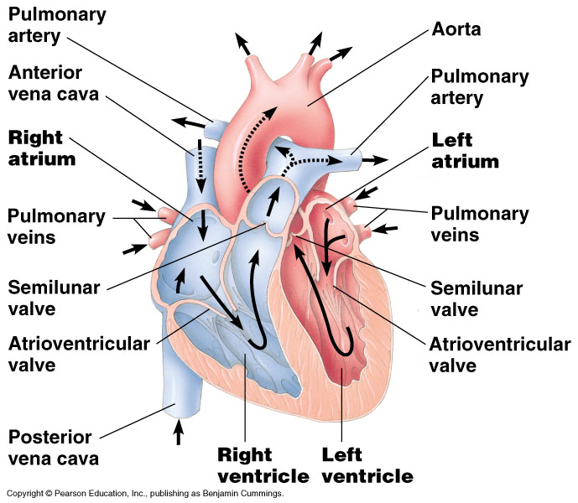

Slide 4

The Cardiovascular System Blood Vessels
Arteries→arterioles move away from the heart
Elastic Fibers
Circular Smooth Muscle
Capillaries – where gas exchange takes place.
One cell thick
Serves the Respiratory System
Veins→Venules moves towards the heart
Skeletal Muscles contract to force blood back from legs
One way values
When they break - varicose veins form

Slide 5
Layers of blood vessels
Tunica intima
Tunica media
Tunica externa.

Slide 6

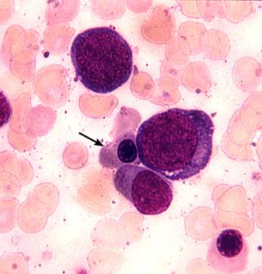
Blood Components
Plasma
Liquid portion of the blood. Contains clotting factors, hormones, antibodies, dissolved gases, nutrients and waste

Slide 7


Erythrocytes - Red Blood Cells
  Carry hemoglobin and oxygen. Do not have a nucleus and live only about 120 days.
  Can not repair themselves

Slide 8
Modifiable and non modifiable causes of heart disease
Modifiable
Weight
Diet
Exercise
Drinking
Smoking
Type 2 diabetes
Non Modifiable
Type one diabetes
Age
Sex
Hereditary factors
Type one diabetes

Slide 9
Definition of blood pressure
Blood pressure definition is - pressure that is exerted by the blood upon the walls of the blood vessels and especially arteries
Blood pressure varies with the muscular efficiency of the heart, the blood volume and viscosity, the age and health of the individual, and the state of the vascular wall.

Slide 10
Formula for BP
BP= CO X TPR
CO is determined by SV x HR
Stroke volume is the amount of blood ejected from the left ventricle of the heart during contraction. It usually measures between 60 and 130 mL/beat in healthy individuals.

Slide 11
What determines cardiac output?
Cardiac output: The amount of blood the heart pumps through the circulatory system in a minute.
Depends on circulating volume, heart muscle and HR.

Slide 12
Long Term consequences of high blood pressure
Stroke
Heart Disease
Kidney disease
Eye Disease
Heart failure

Slide 13
Factors that increase blood pressure
Loss or increase in circulating volume
Stress
Obesity
Smoking
Alcohol
Heat or cold
Vessel disease

Slide 14
Chemo Receptors
Chemoreceptors, located in the aorta and the carotid artery, monitor the CO2 levels, O2 levels and pH levels in the blood. When the receptor picks up the stimulant it transfers it to the sensory neurone to the medulla oblongata (also known as medulla) which also has chemoreceptors
Bodies preferred Ph 7.35-7.45

Slide 15
High levels of O2 and pH with low levels of CO2
The impulse will go through the sensory neurone to the medulla and through the parasympathetic neurone releasing acetylcholine from the sinoatrial node (an inhibitory neurotransmitter) which makes the heart rate slower. This is so the levels of O2 and pH can lower and CO2 levels can be raised.

Slide 16
Baroreceptors
Blood pressure is constantly monitored by your body and adjusted constantly to meet the needs of your body. This monitoring is performed by baroreceptors.
Baroreceptors are special receptors that detect changes in your blood pressure. Baroreceptors are found within the walls of your blood vessels. The aorta and the carotid sinus contain important baroreceptors which constantly monitor blood pressure fluctuations.

Slide 17
Arterial Blood Pressure
Arterial blood pressure is normally regulated within a narrow range, with a mean arterial pressure typically ranging from 85 to 100 mmHg in adults. It is important to tightly control this pressure to ensure adequate blood flow to organs throughout the body. This is accomplished by negative feedback systems incorporating pressure sensors (i.e., baroreceptors) that sense the arterial pressure.

Slide 18
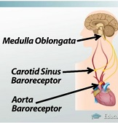
Baroreceptors transmit their data to the central nervous system, and more specifically, to the cardio regulatory centre of the medulla oblongata
.

Slide 19
Blood Pressure Regulation
If blood pressure within the aorta or the carotid sinus increases, the walls of these arteries stretch and stimulate increased activity within the baroreceptor. This information is then sent via nerves to the cardio regulatory centre within the medulla, which responds by initiating mechanisms that decrease the blood pressure to a normal level.

Slide 20
High Blood Pressure
If there is high blood pressure the route it follows is through the parasympathetic neurone which releases acetylcholine from the sinoatrial node slowing the heart rate down to lower the blood pressure.

Slide 21
Responses To High Blood Pressure
First see a decrease of sympathetic input and an increase in parasympathetic input to the heart.
The sympathetic nervous system increases heart rate and stimulate the heart muscle to pump with more force.

Slide 22
The parasympathetic nervous system
The parasympathetic nervous system can decrease the heart rate. Therefore, by shutting off the sympathetic stimulation and boosting the parasympathetic stimulation, we decrease the heart rate and stroke volume, which decreases the cardiac output and decreases blood pressure.
Second, if the baroreceptors are detecting that blood pressure is too high, the cardio regulatory centre of the medulla will also decrease sympathetic input to the blood vessels. This causes vasodilation, which decreases total peripheral resistance and decreases blood pressure.

Slide 23
Responses to Low Blood Pressure
When the baroreceptors of the aorta or carotid sinus detect a drop in blood pressure. A decrease in blood pressure causes a decrease in action potentials sent to the cardio regulatory centre of the medulla.
If there is low blood pressure the route it follows is through the sympathetic neurone which releases noradrenalin from the sinoatrial node making the heart rate faster to raise the blood pressure.
Therefore, to raise blood pressure, the body will first cause an increase in sympathetic nerve activity to the SA node, causing it to fire more frequently, which increases the heart rate.

Slide 24
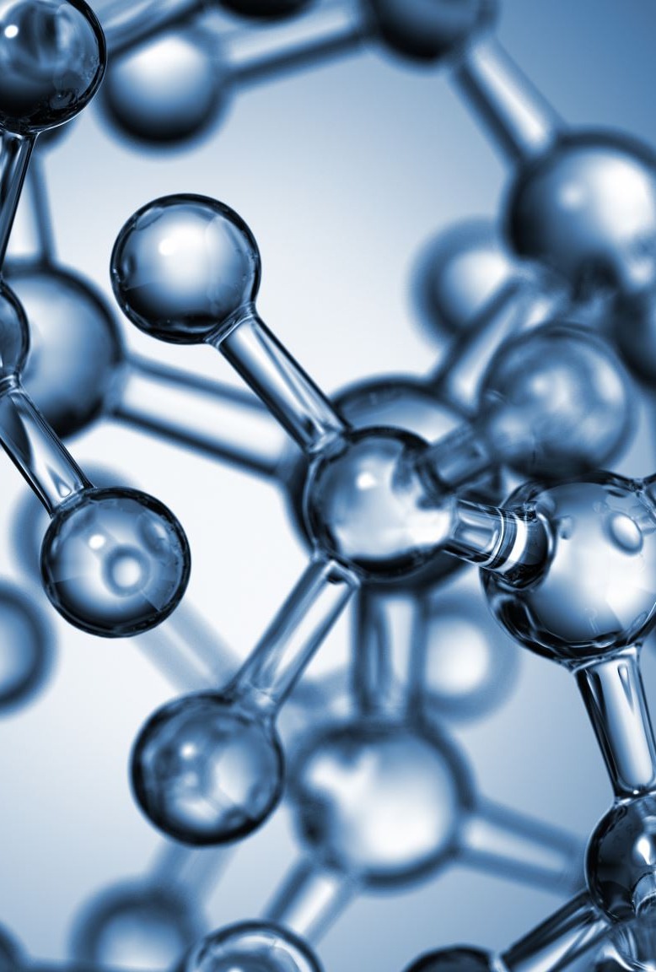
The heart muscle is also stimulated to pump with more force, and this increases the stroke volume. When heart rate and stroke volume increase, we see an increase in cardiac output.
An increase in cardiac output causes an increased blood pressure, restoring blood pressure back to a normal level. Second, this causes an increased sympathetic input to the blood vessels, which stimulate the smooth muscle to contract, causing vasoconstriction, which increases total peripheral resistance and increases blood pressure.

Slide 25
Ultrafiltration and production of urine
ULTRAFILTRATION – Filtration on a molecular scale between the glomerulus and Bowman’s capsule (cleaning of the blood).
SELECTIVE REABSORBTION – some substances are filtered out of the blood and then selectively reabsorbed.
OSMOREGULATION - The regulation of the concentration of water molecules in the blood.

Slide 26
Ultrafiltration
Dirty blood enters the kidney via the renal artery.
The artery splits up into a ball of capillaries called the glomerulus.
The Blood is under high pressure (coming from the pumping heart and also because the blood vessel leading away from the glomerulus has a smaller diameter)
The high pressure forces all small molecules out of the holes in the capillary walls leaving only large molecules like proteins in the blood.

Slide 27
The small molecules enter the Bowman’s capsule (now called glomerular filtrate) and travel into the proximal convoluted tubule where glucose is reabsorbed back into the blood by active transport.
The filtrate travels down through the loop of Henlé where water is reabsorbed by osmosis.
The filtrate then enters the distal convoluted tubule where minerals, amino acids and other useful substances are reabsorbed back into the blood

Slide 28
Continued
The remaining fluid containing urea, excess salts and excess water passes into the collecting duct.
The distal convoluted tubules from several other nephrons join up to form the collecting duct.
The collecting ducts from the other nephrons join to form the ureter, which leads to the bladder.
The fluid (urine) is stored in the bladder ready for excretion.
The urine travels down the urethra to the outside.

Slide 29
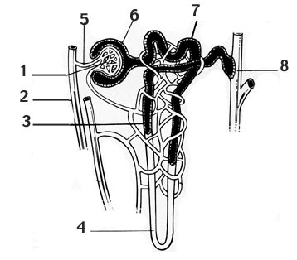
Nephron

Slide 30
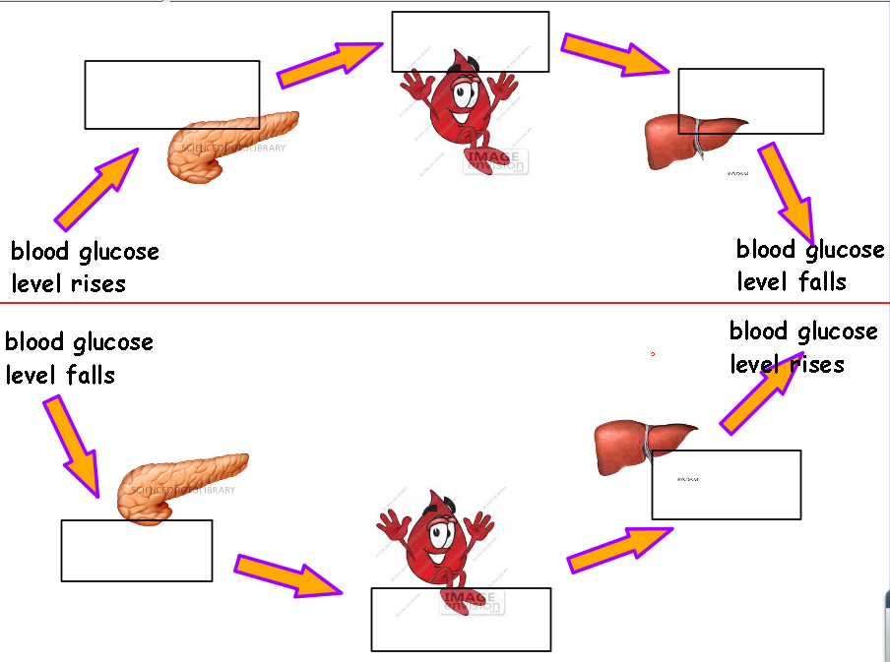
Glucose Regulation

Slide 31
Thermoregulation
Thermoregulation is a process that allows your body to maintain its core internal temperature. All thermoregulation mechanisms are designed to return your body to homeostasis. This is a state of equilibrium.

Slide 32
Thermoregulation
When your internal temperature changes, sensors in your central nervous system (CNS) send messages to your hypothalamus. In response, it sends signals to various organs and systems in your body. They respond with a variety of mechanisms.

Slide 33
When you are too hot
Sweating: Your sweat glands release sweat, which cools your skin as it evaporates. This helps lower your internal temperature.
Vasodilatation: The blood vessels under your skin get wider. This increases blood flow to your skin where it is cooler — away from your warm inner body. This lets your body release heat through heat radiation.

Slide 34
When you are too cold
Vasoconstriction: The blood vessels under your skin become narrower. This decreases blood flow to your skin, retaining heat near the warm inner body.
Thermogenesis:Your body’s muscles, organs, and brain produce heat in a variety of ways. For example, muscles can produce heat by shivering.
Hormonal thermogenesis: Your thyroid gland releases hormones to increase your metabolism. This increases the energy your body creates and the amount of heat it produces.

Slide 35
Cellular respiration
O2 + Glucose > CO2 + H20 + ATP
This process is a combined set of metabolic reactions that occur in every cell, that converts biochemical energy derived from food, into the energy currency of the body, which are ATP (Adenosine Triphosphate) molecules. It also involves the release of waste products.
The nutrients derived from foods like glucose, are the raw materials of cellular respiration. Carbohydrates or sugars are processed at a cellular level to create energy, that is stored in the form of ATP molecules. When these molecules get converted to ADP (Adenosine Diphosphate), energy is released. All the bodily functions are made possible due to ATP molecule conversion.

Slide 36
Gas Exchange
In simple terms, gas exchange is a process that’s essential to life. Gas Exchange Gas exchange is the ‘exchange’ of oxygen and carbon dioxide in the lungs. The Alveoli, are located on the bronchioles and are surrounded by capillaries, tiny blood vessels. At the same time, carbon dioxide in the blood diffuses into the Alveoli and is exhaled out through a process called simple diffusion .Diffusion refers to the net movement of molecules from higher to lower concentration.

Slide 37
Video clip
https://binged.it/37rovgC

