Slide 1
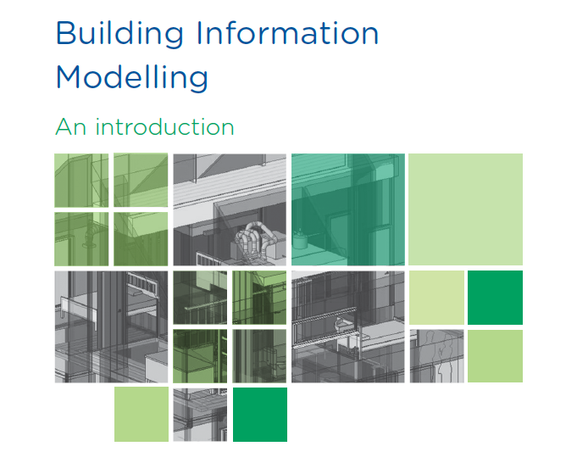
Jeffrey Roberts

Slide 2
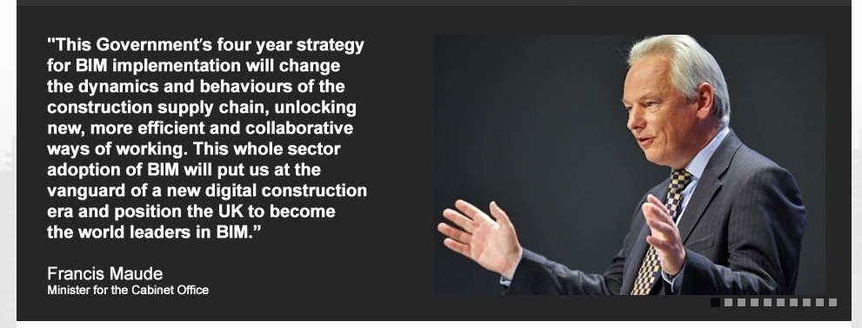
How did BIM start?
www.bimtaskgroup.org
2010
  The Government sets up a BIM Task Group to look at increasing efficiency on government led construction projects
2011
  The Government published its BIM strategy and mandates that Government projects over £5m must have the BIM protocol embedded
  Estimates of up to a 30% saving in costs

Slide 3

How did BIM start?
2016
The Government states that all projects must be BIM compliant by April 2016

Slide 4

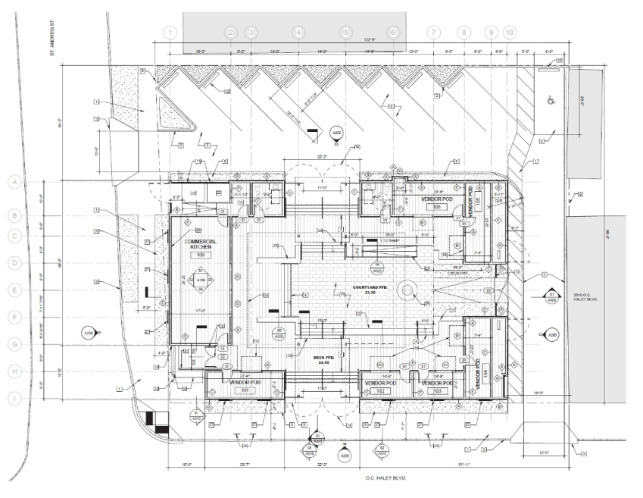
So what is BIM?
Building Information Modelling
It’s best thought of as a process to manage project information, and has a number of key elements:
The embedding of data within the electronic documents– i.e. the design model
Streamlining of knowledge transfer for all personnel working on a project

Slide 5
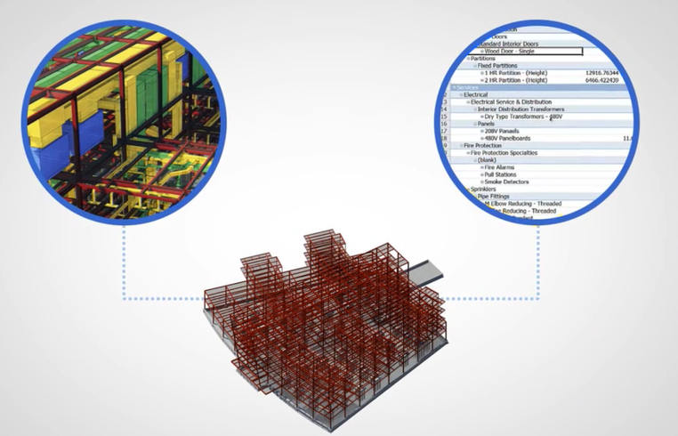
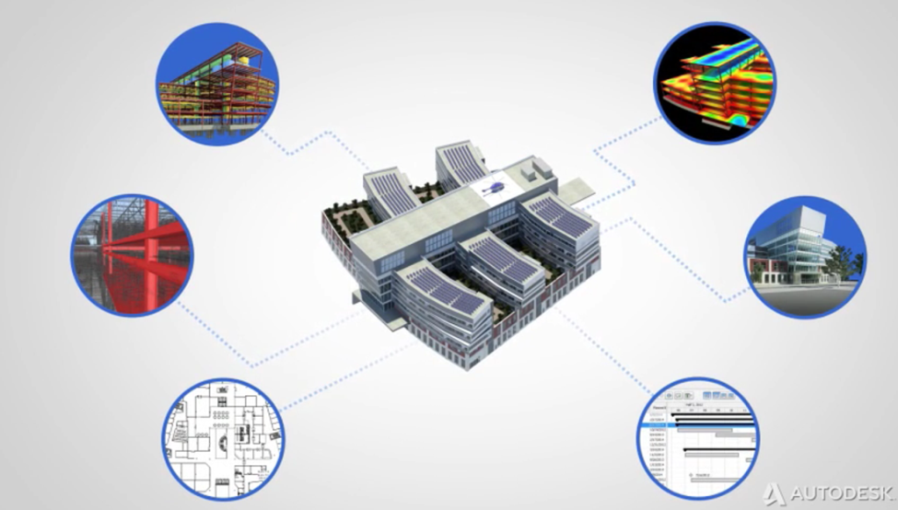
So what is BIM?
Improved visualization via 3D models
Improved productivity due to easy retrieval of information
Increased coordination of construction documents – i.e. data held in the models
Embedding and linking of vital information such as vendors for specific materials, location of details and quantities required for estimation and tendering
Increased speed of delivery
Reduced costs

Slide 6
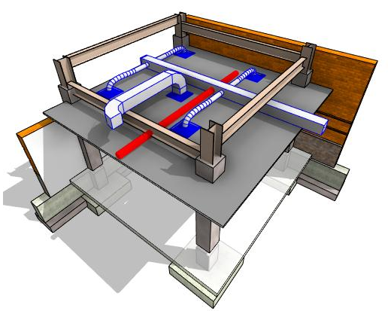

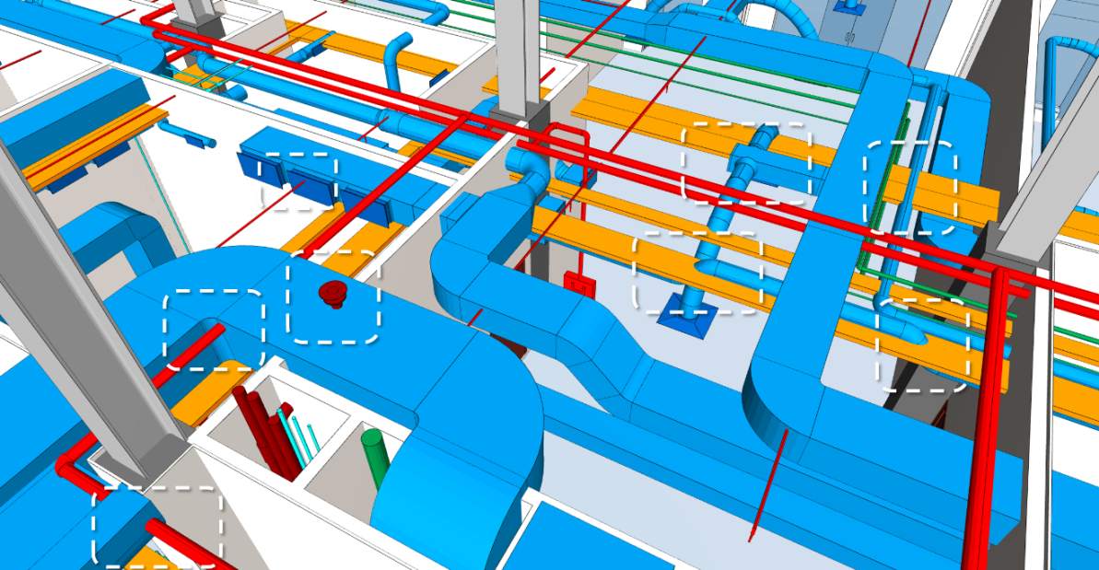
Clash Detection

