Slide 1
Assignment on Menu Design of Hotel Trinity
Submitted By: Syed Mohammad Nurer Nabi Bhuyan
Student Number- 2109792
Food & Beverage Operation (BMIH 4002)
Ffion Cumberpatch

Slide 2

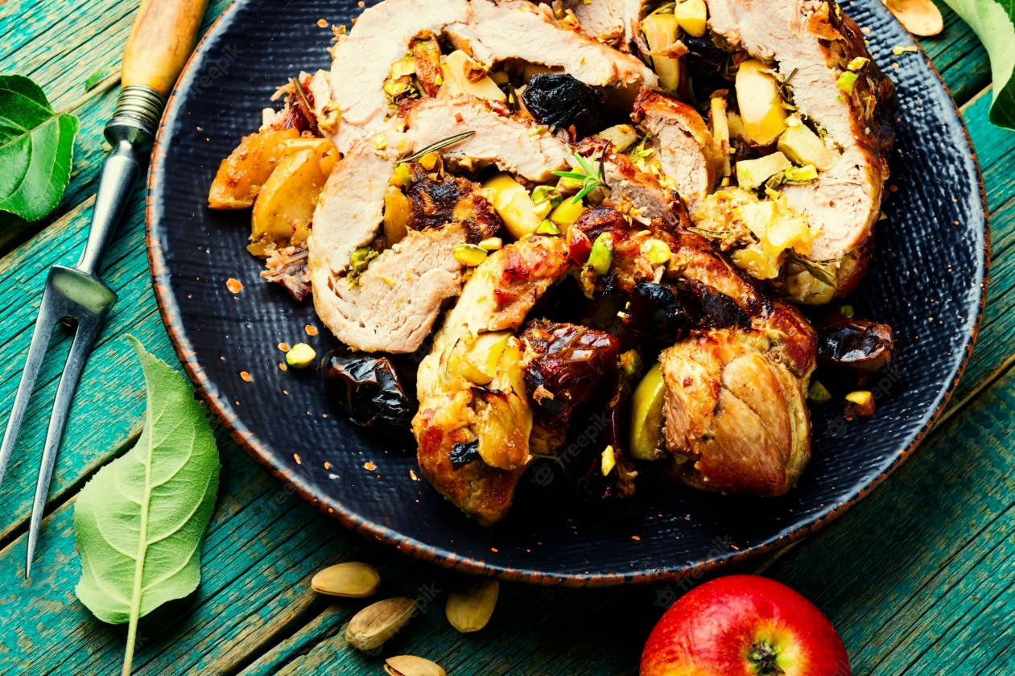
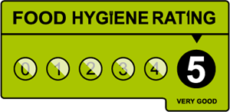

Trinity Hotel
Takeaway menu
Orders are delivered through the following mediums
5%
Special Discount on Family Dine
Call for Home Delivery: +44 01766 3342 986
Opening Hours
8:00 a.m – 11:00 p.m
173/A, Swansea, South Wales
Trinityhotelwales.com

Slide 3

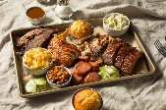
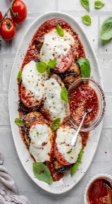
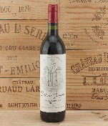
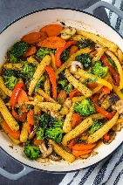
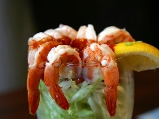

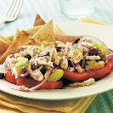




Pork Platter
Chicken Ceaser
Lean Pork
(Served with French fries or rice of fettuccine with coleslaw salad and mustard sauce. Contains 85% fat)
Roasted Pork Knuckle
(Served with mashed potato and grilled chaomin with coleslaw salad and BBQ Sauace.)
Stirfry pork with Mustard Cream
(Filled of pork saute with garlic and vegatble with oyster and mashroom sauce served with rice and bread)
Seaglass Pinot Nior (100 ml Bottle)
(High quality grape and le rime pinot grigio with twisted strawberry flavour. Imported from Italy. Contains 55% alcohol and much sugar. Suits best with porks.)
Chateu Greysac (120 ml Bottle)
(Suited best with pork and beef items. Imported from Spain)
€70
€45
€85
€90
€130
Coq Au Vin Chicken
(Crumb fried supreme of chicken with paprika tartar sauce. Contains Fat and minimal nutrition.)
Chicken Cordonbleu
(Mushroom, onion, spicy bonless chicken served with bread and rice.)
Grilled Chicken Parmesan
(Grill chicken bockwurst served with mashed potato, parmesan cheese and white mashroom sauce. May Allergic to cheese haters)
Michelob lite (120 ml Bottle)
(Domestic alcoholic drink with light alcohol. Made from grape fruits and lime drip. Perfectly suited with chicken and birds meats item.)
Stella Artols (150 ml Bottle)
(Almosyt like canyon road pinot grigio. Mid level alcoholic drink. Contains high sugar and 30% alcochol)
€65
€70
€65
€95
€90
Veg Vegabond
Kids Kudos
Stir Fry Vegetable
(Stir fry vegetables served with rice. Vegetable items may vary from time to time due to seasonal practices. All the vegetables contain a high level of nutrition and vitamins)
Vegetable Tempura
(Thick sliced mixed vegetable deep fried in tempura batter served with soya green chilli sauce. Contains 2% sugar and 78% minerals and vitamins.)
Vegetable Platter
(Batter-fried mushroom and saute vegetable served with mashed potato and rice or bread. Contains rich vitamins)
Sterling Cabernet (100 ml Bottle)
(Grape for this wine sourced from San Lucas Valley. It is pure Cabernet Sauvignon and suits best with vegetable dining. Contains 45% alcohol and sugar)
Copper Ridge White Zinfadel (120 ml Bottle)
(It is a mix of raspberry, and watermelon with a drip of fresh cherry aroma. Suits best with mushroom-type vegetables and contains mid-level alcohol of around 18%)
€95
€60
€65
€85
€120
Crab Toast
(Crispy bread triangles topped with crab mixer and parmesan cheese. May be allergic to kids who avoid milk and cheese. Served 3 pieces per plate)
Cheese Toast
(Crispy bread triangles topped with cheese and green chilis 6 pieces per serving. Contains low-fat items)
Prawn Cocktail
(Boiled medium prawns on a bed of lettuce with a lime wedge and cocktail sauce. A very popular item among kids.)
Sea America
(Diced seafood shrimp, fish, cuttlefish served with parsley, tomatoes on a bed of lettuce cocktail sauce. Contains 75% nutrition of sea dishes)
Mediterran Tuna Salad
(Fresh Tuna fillet with potato, green beans, tomatoes, anchovies, olive and boiled eggs tossed in balsamic vinaigrette)
€55
€60
€45
€45
€30
Dessert Dishes
Beverages and Juices
Chocolate Martini
(White Godiva with chocolate drizzle. Contains 82% fat and sugar.)
Berries Cookies
(Chambord, Frangelico and cream fuzz as the topping. Contains vitamins and high sugar)
Wales Angel Cake
(Baileys, Frangelico, coffee, whipped cream. Contains 2% rose water and liquor)
Tia Maaria
(Vanilla spread cream with lime toppings and carvings. Iced tea is served as complimentary food)
Coconut Creamtini
(Malibu, Chocolate Godiva with Frangelico cream. Allergic to those who do not like coconut. Contains diabetic sugar)
Coke
(Pepsi, Coca-Cola, Mojo. Served in a glass of 250 ml)
Lemonade Soda
(Fresh lemon juice with an ice cube and glittering syrup. 120 ml glass)
Columbian Coffee
(100% original Colombian coffee. Served in both hot and cold coffee. The price is the same for both )
Ginger Ale
(Special flavoured iced drink available only at weekend. Reviewed as the best item in our menu set.)
Pineapple Pilla
(Thick juice and feel like cream eating. Contains diabetic sugar)
€25
€20
€35
€25
€40
€45
€30
€35
€25
€30
Both Cash on Delivery and online payments like Paym, Google Pay etc are available.
Notes:
Some foods are allergic and strong scented. Customers are requested to read the menu details before proceeding any order.

Slide 4
References
Buja, L.M., 2022. The History, Science, Art Of Wine and The Case For Health Benefits: Perspectives of an Oenophile Cardiovascular Pathologist. Cardiovascular Pathology, p.107446.
Harding, G., 2022. The Food and Drink of the Nineteenth-Century British Picnic.
Moe, S. 2022, In the Weeds with Literate Activity in the Restaurant Industry.
Nguyen, T.H.Y., 2022. Brunch Menu Planning for Mekong Restaurant.
Reynolds, D., 2022. Wine-menu design: an investigation using brain-computer interface technology. Journal of Foodservice Business Research, pp.1-14.
Shen, D., 2022. Naturalistic Covert Progression Behind Complicated Plot: Chopin's" A Pair of Silk Stockings". Journal of Narrative Theory, 52(1), pp.1-24.
Staub, C. and Siegrist, M., 2022. Rethinking the wine list: restaurant customers’ preference for listing wines according to wine style. International Journal of Wine Business Research.
Taylor, C.S., 2022. VII. Learning to taste: Praising the Transcendent Rilke’s Sonnets to Orpheus Heidegger Hölderlin Heraclitus.
Vink, N., 2022. GERARD BASSET. Tasting Victory: The Life and Wines of the World's Favourite Sommelier. London, Unbound, 2020, 256 pp., ISBN 978-1-78352-861-5 (ebook), $17.99. Journal of Wine Economics, 17(1), pp.83-86.

