Slide 1
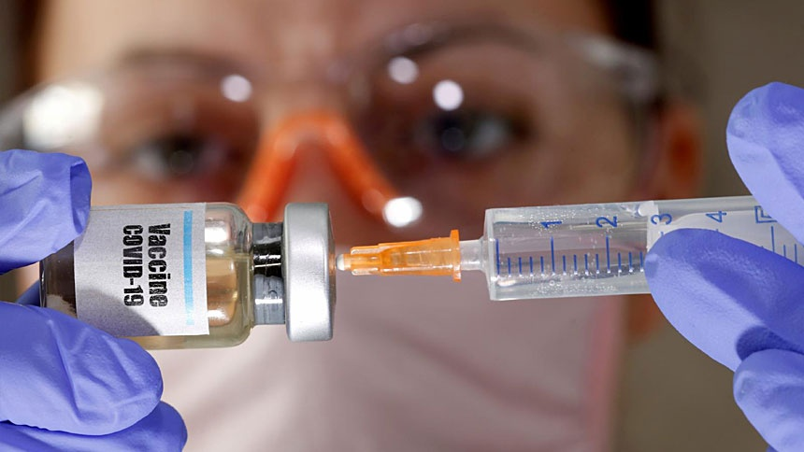
Covid -19 Vaccine

Slide 2
What Is It?

Slide 3
Who It Effects

Slide 4
What Factors Might Affect The Campaign ?

Slide 5
How Is The Campaign Promoted Digitally

Slide 6
How Effective Is The Campaign

Slide 7
Recommendations

Slide 8
References
Works Cited
Europe, E. (2019, October 23). How to Use TikTok to Promote your Business. Retrieved 11 18, 2021, from https://www.entrepreneur.com/article/340216
GOV.UK. (2021, 8 5). COVID-19 vaccination programme or children and young people; guidance for schools (version 2). Retrieved 11 18, 2021, from https://www.gov.uk/government/publications/covid-19-vaccination-resources-for-schools/covid-19-vaccination-programme-for-children-and-young-people-guidance-for-schools
GOV.UK. (2021, 7 9). COVID-19 vaccines highly effective in most people in clinical risk groups. Retrieved 11 18, 2021, from https://www.gov.uk/government/news/covid-19-vaccines-highly-effective-in-most-people-in-clinical-risk-groups
Guardian, T. (2011, 11 3). How anti- vaxxers and ivermectin advocates have co-opted US local news. Retrieved 11 20, 2021, from https://www.theguardian.com/media/2021/nov/03/how-anti-vaxxers-and-ivermectin-advocates-have-co-opted-local-news
Health Organization, W. (2021, 7 14). COVID-19 advice for the public - getting vaccinated. Retrieved 11 18, 2021, from https://www.who.int/emergencies/diseases/novel-coronavirus-2019/covid-19-vaccines/advice
INDEPENDENT. (2021, 11 25). Everything young people, parents, guardians and carers need to know about the Covid vaccine. Retrieved 11 18, 2021, from https://www.independent.co.uk/news/covid-vaccine-young-people-b1925936.html
NHS. (2021, November 11). Coronavirus (COVID-19) vaccines. Retrieved from https://www.nhs.uk/conditions/coronavirus-covid-19/coronavirus-vaccination/coronavirus-vaccine/
NHS. (2011, 11 11). NHS . Retrieved 11 18, 2021, from NHS Covid Pass: https://www.nhs.uk/conditions/coronavirus-covid-19/covid-pass/
Statistics, O. f. (2021, 5 7). COVID-19 vaccine refusal, UK: February to March. Retrieved 11 18, 2021, from https://www.ons.gov.uk/peoplepopulationandcommunity/healthandsocialcare/healthandwellbeing/bulletins/covid19vaccinerefusaluk/februarytomarch2021

