Slide 1
Reflective Presentation
Digital Skills for Personal Development and Business Growth
Student: Daniela Ruiz
Module: BMSW4008
Date: 2026

Slide 2
Introduction
This presentation reflects on what I learned during the Digital Skills for Personal Development and Business Growth module.
The module helped me understand the importance of digital skills for education, work and personal development.

Slide 3

Module Overview
Key topics covered:
- Digital literacy
- Office365 tools
- Microsoft Excel
- Online collaboration
- Digital productivity

Slide 4
Digital Skills Assessment (Task 1)
I completed a Digital Skills Assessment to evaluate my digital abilities.
My strengths included communication, collaboration and productivity tools.

Slide 5
LinkedIn Learning (Task 2)
I completed LinkedIn Learning courses related to Office365.
These courses helped improve my knowledge of digital productivity tools and professional digital skills.

Slide 6
Excel Skills (Task 3)
In Task 3 I explored the importance of Microsoft Excel.
Excel helps organise data, perform calculations, analyse information and create charts.

Slide 7
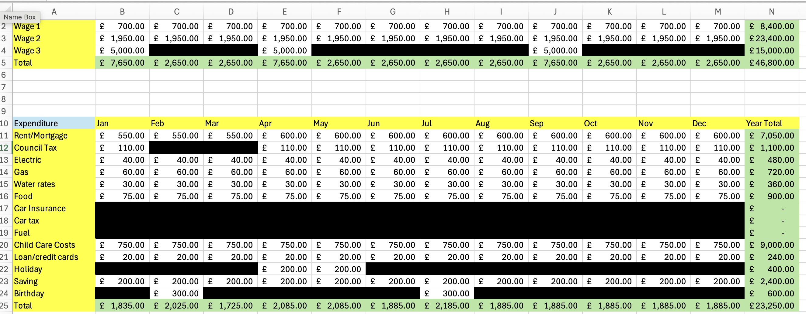
Monthly Household Expenses

Slide 8
Skills Developed
Skills developed during this module:
- Digital literacy
- Excel and Office skills
- Financial awareness
- Research and critical thinking

Slide 9
Future Application
The skills learned in this module will help me:
- Manage my personal finances
- Work efficiently with digital tools
- Improve my employability

Slide 10
Conclusion
This module improved my confidence using digital tools and helped me develop important skills for both academic and professional environments.

Slide 11
References
Bawden (2008) Digital Literacies
Gilster (1997) Digital Literacy
Jisc (2023) Building Digital Capability
Microsoft (2024) Excel Documentation

