Slide 1
Business Name, Concept & Story
Business Name: SmokeyCats Café

Slide 2
Concept: SmokeyCats Café is a modern and cozy café that combines three experiences in one — a relaxing coffee shop, an interactive cat lounge, and a comfortable Shisha area. The café aims to provide a welcoming space for people to unwind, socialize, and connect with animals.

Slide 3

The idea for SmokeyCats Café came from noticing how many students and young adults look for calm, comfortable spaces where they can relax, study, or escape stress. Most cafés in Cardiff close early or are too busy, and shisha lounges usually only open at night — meaning there is no single place that offers both a peaceful day-time environment and a social evening vibe.

Slide 4
Chosen Target Industry (Pros & Cons)
Industry: Hospitality – Coffee shop, pet café, and Shisha lounge sector
Pros:
• Growing demand for unique café experiences
• Social media appeal – people love taking photos with cats and sharing their experiences
• Attracts a wide range of customers (students, young adults, cat lovers, couples, etc.)
• Repeat business potential through loyal customers and regular Shisha users
Cons:
• High start-up and maintenance costs (especially pet care and Shisha equipment)
• Health and safety regulations related to animals and smoking
areas • Need for strong hygiene management • Competition from regular cafés and Shisha bars

Slide 5

Objectives:
Successfully launch SmokeyCats Café in Cathays within the first 12 months.
This is achievable because Cathays has strong student footfall, affordable rental spaces, and a clear target market.
• Reach 60–80 customers per day by Month 6 of operation.
This target is realistic for a student café located in a high-traffic area like Salisbury Road or Woodville Road.
• Achieve at least 75% customer satisfaction during the first 6 months.
This can be measured using feedback cards, Google reviews, and simple QR-code surveys.
• Grow the SmokeyCats Café social media accounts (Instagram + TikTok) to a combined 4,000–5,000 followers within the first year.
This is realistic when using viral-style content, student influencers, and aesthetic café posts.
• Register at least 150 loyalty-card users within the first 3 months through digital and in-store sign-ups.
Students respond well to loyalty rewards, especially free drinks and discounts.

Slide 6

3. Mission Statement, Aim & Objectives
The mission of SmokeyCats Café is to create a welcoming and calming space where students and young adults can relax, study, and socialise. By combining high-quality coffee, a cosy cat-themed environment, and a chilled evening shisha lounge, the café aims to offer comfort, community, and a memorable experience from morning until late night.

Slide 7

Aims:
To provide a relaxing environment that helps customers unwind, reduce stress, and feel comfortable staying for long periods.
• To offer high-quality drinks, snacks, and shisha at affordable prices that match student budgets.
• To maintain excellent hygiene standards and ensure responsible, professional care across all areas of the café.
• To build a friendly, community-focused space that encourages students and young adults to return regularly.

Slide 8
SMART Objectives
• Open SmokeyCats Café in Cathays within the first 12 months, securing a suitable unit on Salisbury Road or Woodville Road.
• Reach 60–80 customers per day by Month 6, supported by launch promotions, loyalty rewards, and student-focused pricing.
• Achieve a minimum of 75% customer satisfaction within the first 6 months, measured through Google reviews, QR surveys, and in-store feedback.
• Grow SmokeyCats Café’s social media presence to 4,000–5,000 combined followers (TikTok & Instagram) in the first year, using aesthetic content, short-form videos, and campus influencer partnerships.
• Register at least 150 loyalty-card users within the first 3 months, using digital sign-ups, free-drink promotions, and campus marketing campaigns.

Slide 9
4. Physical Location & Why
Why This Location Was Chosen:
Cathays is one of the busiest and most student-dominated areas in Cardiff, making it the ideal place for SmokeyCats Café. The district sits next to Cardiff University and is surrounded by student accommodation, libraries, bus routes, and popular walking paths. This guarantees consistent daily footfall from students who already visit cafés regularly — which was strongly supported by the primary data collected in the market-research survey.
Streets such as Salisbury Road and Woodville Road already host independent cafés, fast-food outlets, and shisha spots, showing clear demand for affordable, social environments. SmokeyCats Café fits naturally into this environment by offering something unique: a daytime study space with a cosy cat-themed atmosphere and a relaxed evening shisha lounge.
Cathays also aligns perfectly with the target audience seen in the questionnaire results — mainly students aged 18–25 who visit cafés 1–2 times per week, value affordability, and enjoy social spaces. The high concentration of this demographic makes Cathays the most strategic and realistic location for launching the business.
Location Chosen: Cathays, Cardiff

Slide 10
5. Human Resource Strategy
Manager/Owner
Oversees day-to-day operations, staff performance, customer service, stock control, and financial management. Supports health and safety compliance across the café, shisha lounge, and cat-themed areas.
Pay: £25,000–£28,000 per year.
Baristas (2–3)
Prepare drinks and light snacks, manage the till, maintain cleanliness in the café area, and deliver friendly customer service.
Pay: £11.50–£12.00 per hour.
Shisha Attendants (2)
Responsible for preparing shisha, maintaining hygiene standards, checking equipment safety, and ensuring customers are using shisha responsibly.
Pay: £12.00–£13.00 per hour + tips.
Cat Care Assistants (2)
Monitor the cats’ health, behaviour, hygiene, and comfort; clean cat areas; handle feeding routines; and ensure customers interact with the cats safely. They also complete daily welfare logs and report any injuries or unusual behaviour.
Pay: £11.00 per hour + small monthly welfare bonus.
Cleaner (1)
Maintains hygiene and cleanliness in the café, lounge, toilets, and cat area. Supports deep-clean tasks and follows strict cross-contamination rules.
Pay: National Living Wage + reliability bonus.
All new staff will complete a structured 2-day induction, covering:
Health and safety training
Food hygiene and cross-contamination procedures
Customer service standards
Cash handling and till training
Shisha safety procedures (for relevant staff)
Emergency procedures and incident reporting
Cat care assistants receive additional specialist training covering:
Understanding cat behaviour and stress signals
Safe handling techniques
Cleaning and disinfecting cat areas
What to do if a cat or customer becomes injured
How to complete daily welfare checks
When to escalate concerns to a vet

Slide 11

Entrepreneurial Strengths
1. Practical leadership and teamwork experience
You have real experience managing teams during busy shifts, handling pressure, and solving problems quickly. This translates well into running a small business where clear leadership is essential.
2. Strong customer-service skills
Your hospitality background means you understand how to speak to customers, deal with complaints, and create a positive environment. This is a valuable skill for any café or shisha lounge.
3. Good understanding of young adult behaviour
Working in Cardiff and being surrounded by students gives you insight into what young people enjoy, what trends they follow, and what attracts them to certain cafés or social spaces.
4. High motivation and creativity
You show creativity in developing new ideas (such as the cat-themed concept) and you are motivated to build something different from typical cafés in Cardiff.

Slide 12

Entrepreneurial Weaknesses
1. Limited experience running a full business independently
Although you have strong management experience, running an entire business — finances, legal responsibilities, licensing, marketing, and long-term planning — is something new, and will require learning.
2. Need to improve financial and budgeting skills
Cash flow forecasting, tax management, and cost control are key areas that many first-time entrepreneurs struggle with. You may need extra support, training, or advice in this area.
3. Dependence on external funding
As a start-up, the business will rely on savings, loans, or investors to launch. This means budgeting must be tighter, and the business must prove it can generate income quickly.
4. Limited experience with animal-welfare regulations
Because the café includes cats, there are added responsibilities: welfare logging, vet checks, safety procedures, and hygiene requirements. This is new territory and will require training and guidance.

Slide 13

Marketing Activities
To successfully launch and grow SmokeyCats Café, a combination of digital marketing, in-store promotions, community engagement, and student partnerships will be used. These activities directly target the main audience identified in the market-research questionnaire: students and young adults who frequently visit cafés, value affordability, and are highly active on social media.

Slide 14
Examples:
TikTok video: “A day in the life of a stressed uni student… ending at GMGN Lab Café” showing coffee, cat lounge, and shisha.
Instagram Reel: Slow-motion pour of our signature “Morning Boost Latte” with a cat sitting on the counter in the background.
Photo Carousel: Featuring the best spots inside the café for studying, socialising, and relaxing with shisha.
X/Twitter Posts: Daily motivational quotes paired with morning coffee photos — “Good Morning, Good Night energy.”

Slide 15
Grand Opening Event & Weekly Promotions
We will attract attention through themed events and regular deals designed for students.
Examples:Grand Opening: Free mini pastries + 20% off all coffee for the first 50 customers.
Weekly Events:
Monday: “Good Morning Mondays” – £2 filter coffee before 12pm.
Wednesday: “Cat Lounge Happy Hour” – buy 1, get 1 half-price entry.
Friday Night: “Shisha Social Night” with a DJ and student discount.

Slide 16

Loyalty & Retention Activities
Cat-Naming Reward System Regular customers who collect a set number of loyalty points are entered into a monthly draw to name one of the café’s cats. Their chosen name is displayed on the cat’s profile wall and on social media, increasing engagement and repeat visits.
Cat Lounge Membership Pass
A monthly membership that gives regulars:
Discounted entry to the cat lounge
One free drink per week
Early access to events
Priority on naming competitions
Students are likely to buy this because they enjoy subscription-style deals.
“Buy 5 Drinks, Get a Surprise Cat Treat”
After five purchases, customers receive a small reward such as:
A free pastry
A cat-themed keyring
A discounted cat-lounge entry
This creates excitement because the reward is not the same every time.

Slide 17
Local University Marketing
Targeting students directly where they are.
Examples:Posters and QR codes in student accommodations and gym notice boards.
Partner with the Student Union to give out free drink vouchers during Freshers Week.
Set up a pop-up booth during university events offering samples of iced lattes.

Slide 18
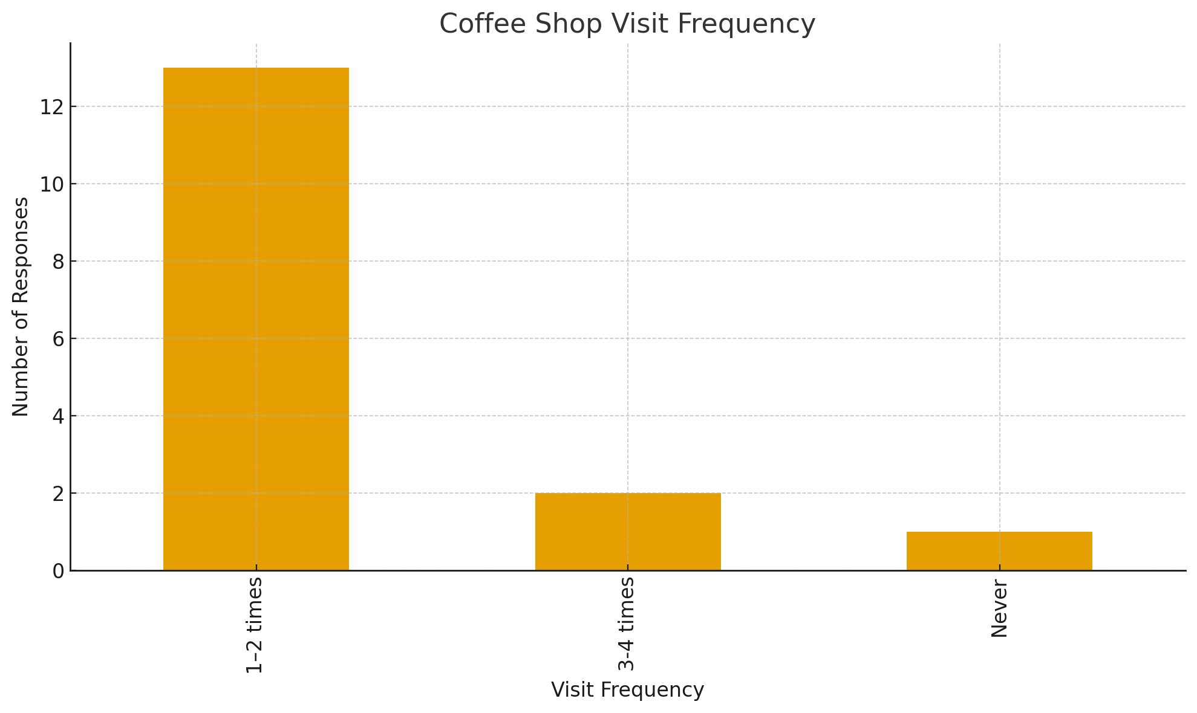
Market Research My question results
The data shows that most people visit coffee shops 1–2 times per week, making it the highest bar on the graph. This suggests that coffee shops are already a regular weekly habit for many students and young adults. This is important for GMGN Café because it means:
There is consistent, predictable customer traffic
People are likely to return weekly, helping build a loyal customer base
Marketing does not need to convince people to go to coffee shops, only to switch to yours

Slide 19
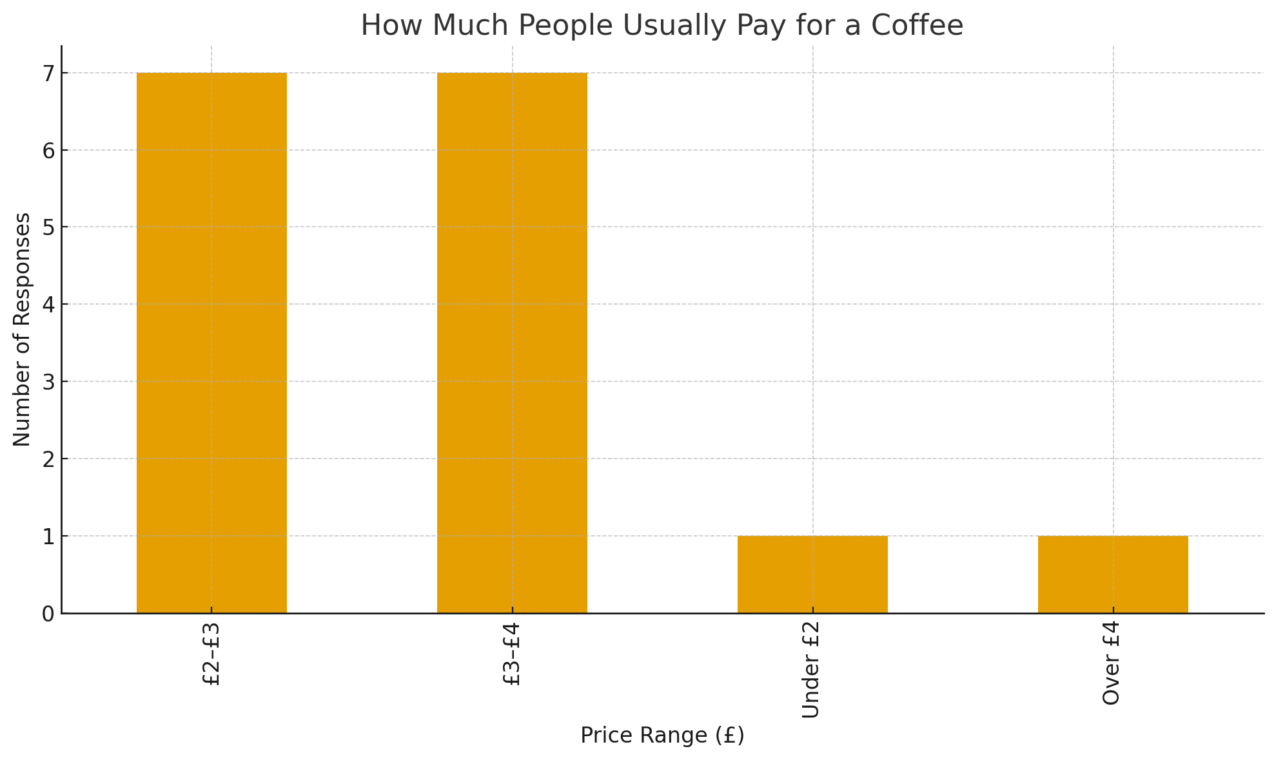
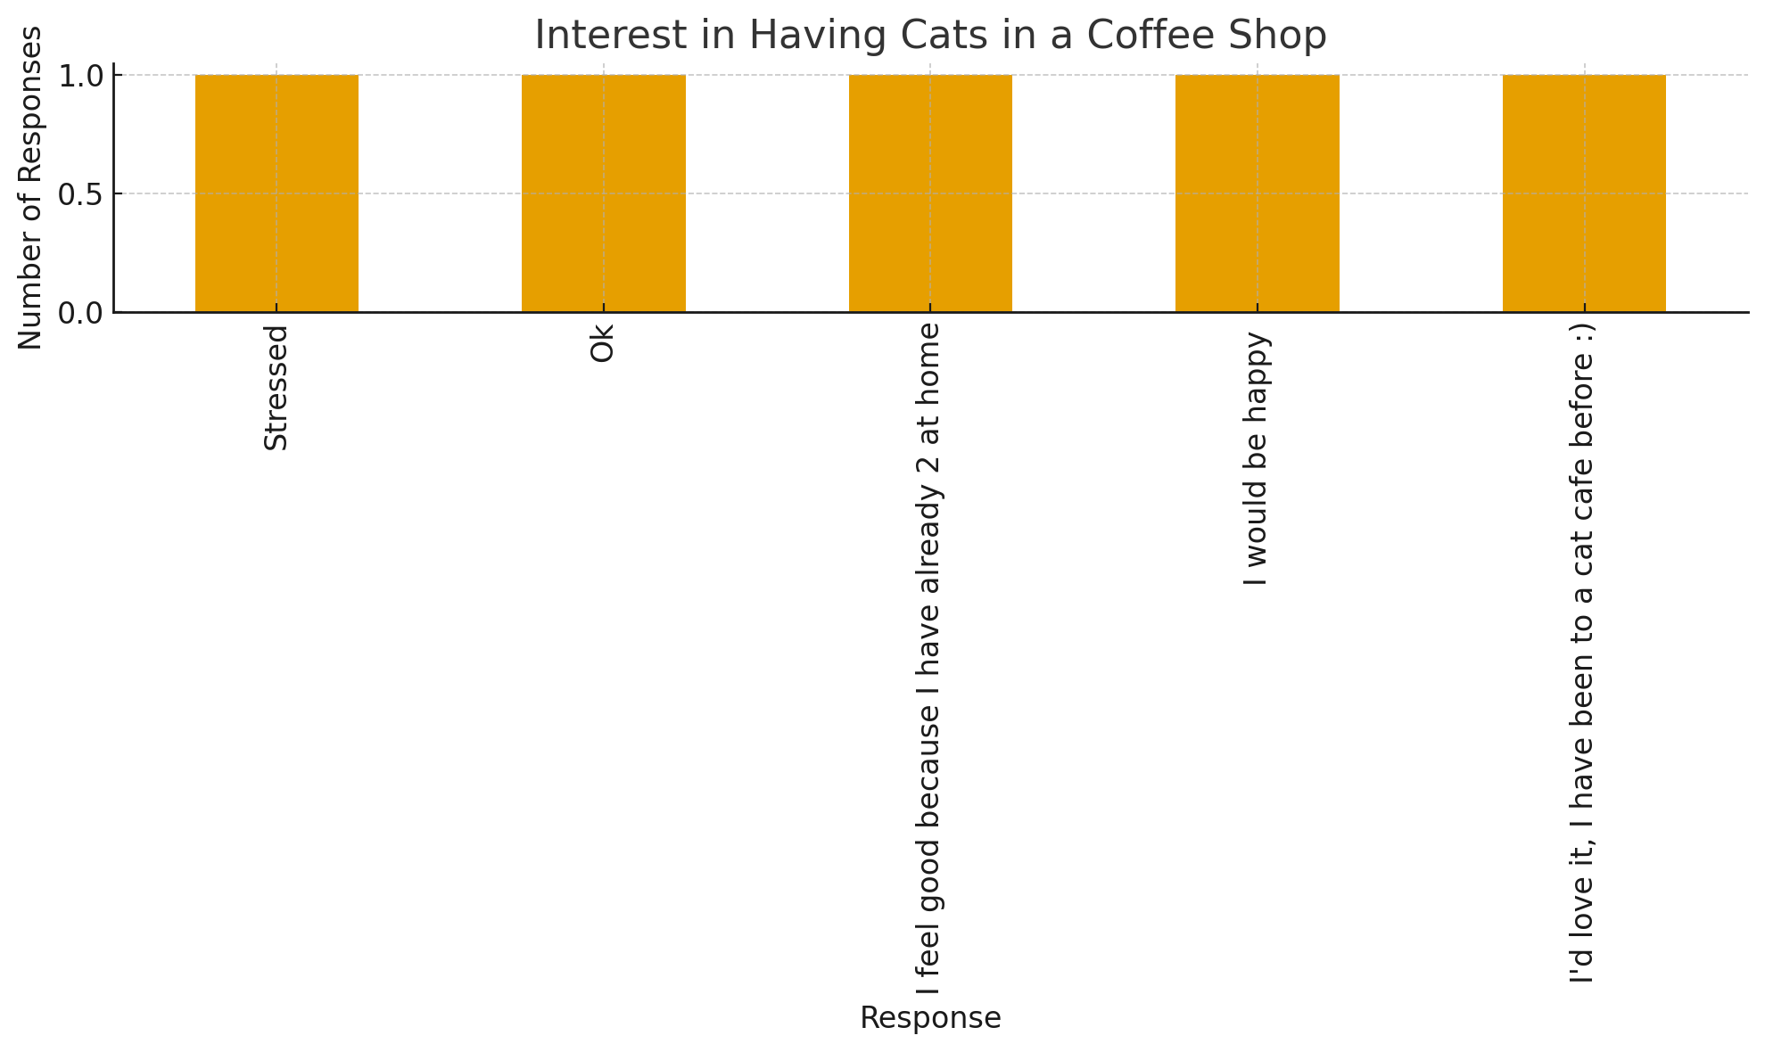
The data shows that the most common price ranges for coffee are £2–£3 and £3–£4, both receiving the highest number of responses. This tells us several important things:
These prices match the standard UK coffee shop market, especially for chains like Caffè Nero, Starbucks, Pret, and local cafés.
Students and young adults — your main target group — typically have limited budgets, so they prefer affordable mid-range prices.
A price above £4 is less popular because many students feel it is too expensive for everyday use.
The graph shows that every response is positive toward having cats inside a coffee shop. Even though people expressed it in different ways 'id love it I would be happy”, “Ok, all responses show no negativity. Why the numbers look like this:
Cat cafés are already popular worldwide, especially among young adults.
Cats create a relaxing, comforting environment, which reduces stress — a key benefit for students.
People see cats as friendly, cute, and good for mental health, making the idea attractive.
Many respondents have seen cat cafés on TikTok/Instagram, so the concept feels fun and modern.

Slide 20
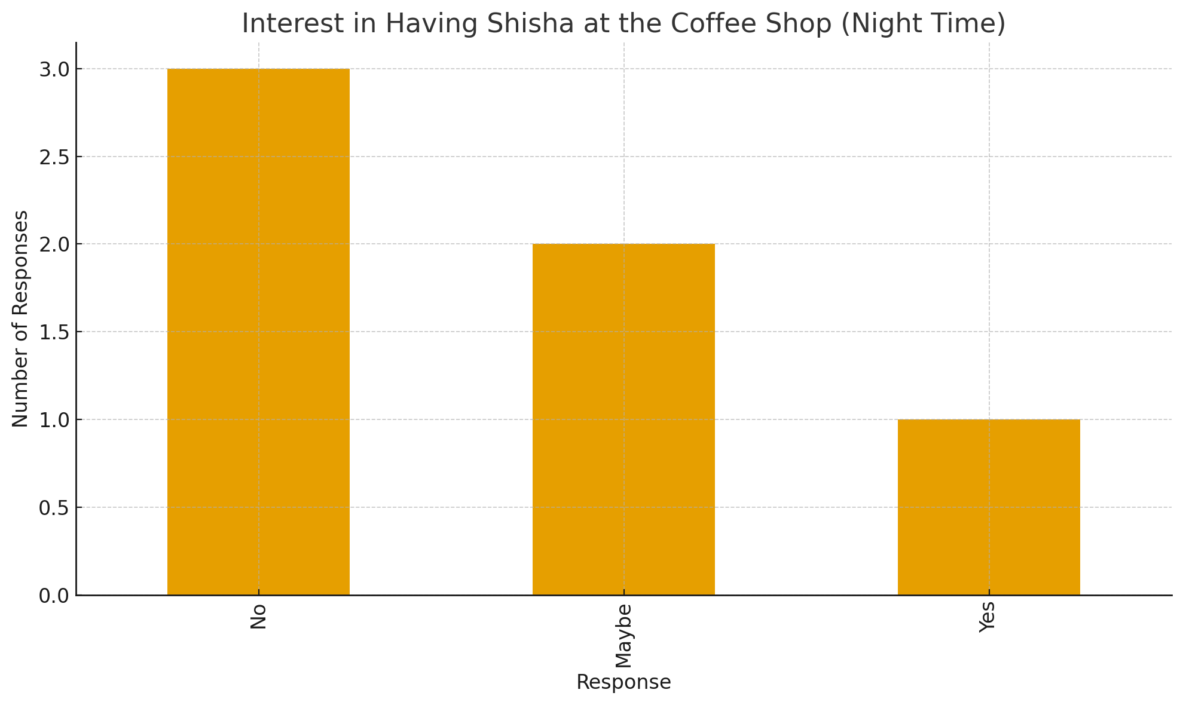
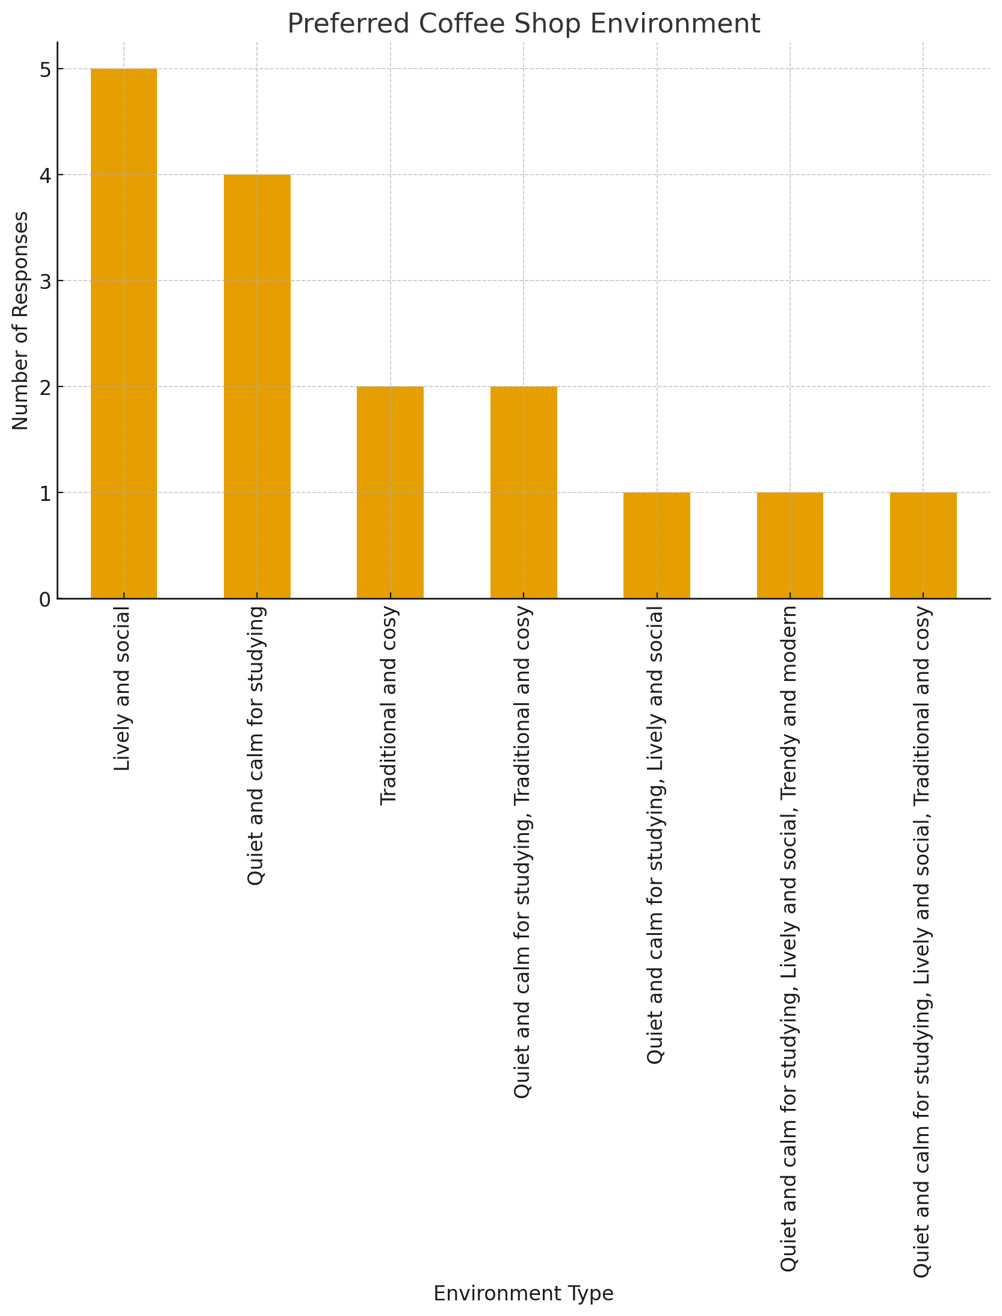
The data shows mixed feedback:
“No” has the highest responses meaning not everyone wants shisha
“Maybe” is also strong showing uncertainty or curiosity
“Yes” has fewer responses but still shows a clear group who definitely want shisha
The graph shows that people prefer two main types of environments in a coffee shop: This means many customers want:
A place to study
A calm vibe
A comfortable, low-noise environment
Space to use a laptop, read, or unwind

Slide 21
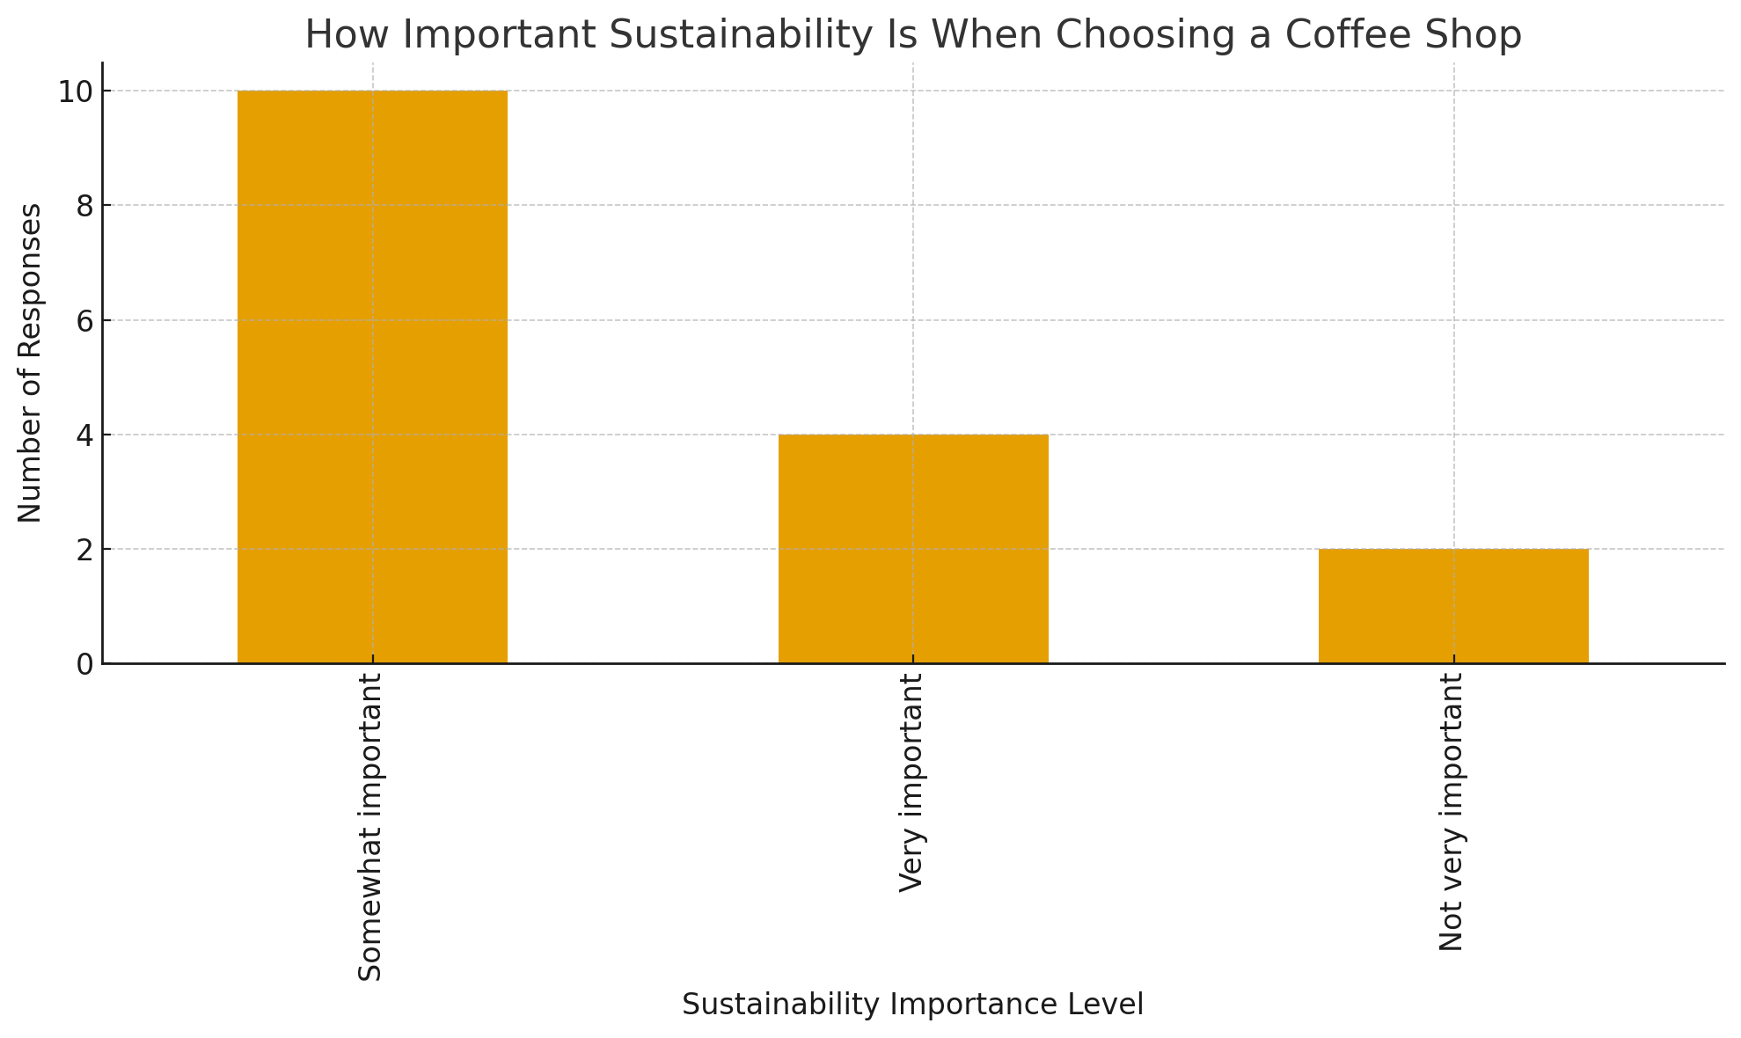
The graph shows that most people selected Somewhat important with a smaller but still strong number choosing Very important. Only a few respondents said sustainability was Not very important. Why the numbers look like this:
Young consumers (especially students) are becoming more aware of the environment.
Many people prefer cafés that use reusable cups, recycled materials, and local suppliers.
Customers feel better buying from places that are eco-friendly, even if it’s not their main priority.
Social media has increased awareness around sustainability, making it a normal expectation.

Slide 22

SWOT Analysis
Strengths
SmokeyCats Café has a strong and unique concept that instantly separates it from ordinary coffee shops. By blending a daytime café, a relaxing cat lounge, and an evening shisha area, it offers customers three different experiences under one roof. This creates multiple income streams and attracts a wide range of customers. The student population in Cathays also provides a consistent and reliable customer base, as students regularly look for affordable, comfortable places to study and socialise. Additionally, the café has strong social-media potential due to the cat theme, which helps generate organic marketing.
Weaknesses
The business also has some challenges. The cost of caring for the cats, maintaining hygiene, and managing separate zones (cats vs shisha) increases operational complexity. As a first-time business owner, there is limited experience in running a start-up from scratch, especially when it comes to finances and licensing. Shisha also requires strict compliance with local council regulations. These weaknesses don’t stop the business but need careful management.
Opportunities
There is a growing trend in the UK for themed cafés, animal cafés, and “experience-based” hospitality. SmokeyCats Café fits perfectly into that trend. The Cathays area has thousands of students who are always searching for new social spots. This opens opportunities for events, loyalty programmes, memberships, cat-themed merchandise, and future expansion into city centre locations or a second branch.
Threats
Competitors such as existing cafés and lounges in Cathays could affect customer numbers. Rising costs (stock, rent, utilities) also threaten profitability. Another risk is public concern about animal hygiene if not managed properly. Finally, shisha regulations could change at any time, so the business must stay compliant to avoid fines or closures.

Slide 23

PESTLE ANALYSIS
Political
The café must comply with food-safety laws, shisha licensing regulations, and animal-welfare standards. These political considerations influence how the business is set up and monitored by the council.
Economic
Students often work with tight budgets, meaning prices must be affordable. At the same time, economic conditions such as inflation and rising utility bills could increase operating costs. However, during economic uncertainty, cafés that offer affordable social spaces usually perform well.
Social
There is a strong cultural and social interest in mental-wellbeing spaces, cosy cafés, and pet-themed environments. Students and young adults love Instagrammable spots and stress-relief experiences, which benefits SmokeyCats Café. Cat cafés are trending globally, making this concept socially attractive.
Technological
Social media platforms like TikTok and Instagram play a major role in modern café marketing. SmokeyCats Café can benefit from online booking systems for the cat lounge, QR menus, and digital loyalty cards to strengthen customer convenience.
Legal
The business must follow the Animal Welfare Act, hygiene standards, shisha safety rules, GDPR (for customer data), and staff training laws. Failing to meet legal standards could cause fines, so legal compliance is essential.
Environmental
Customers now expect sustainable practices such as recyclable cups, eco-friendly packaging, and reducing waste. SmokeyCats Café can strengthen its brand by using ethical suppliers and promoting environmental responsibility.

Slide 24

FINANCIAL OVERVIEW
To launch SmokeyCats Café, initial start-up funding is required for renovations, equipment, cat adoption, shisha licences, and marketing. The estimated start-up cost is £23,000, which includes furniture, decoration, cat care setup, coffee machines, shisha equipment, and the first stock order.
Monthly running costs are estimated at around £8,300, which covers rent, electricity, heating, staff wages, cat food and vet care, shisha supplies, coffee ingredients, insurance, and ongoing marketing.
Projected income is divided across three areas:
Café sales from drinks and snacks — approx. £5,500 per month
Cat lounge entry fees — approx. £2,000 per month
Evening shisha sessions — approx. £2,500 per month
This gives a total projected monthly revenue of around £10,000, resulting in an estimated monthly profit of £1,700 after all expenses. Based on this projection, the business is expected to break even between Month 6 and Month 8, depending on marketing performance and customer growth.

Slide 25

ELEVATOR PITCH
SmokeyCats Café is designed to offer something Cardiff currently does not have: a multi-experience venue where customers can relax with high-quality drinks, interact with friendly cats, study in a quiet space, and enjoy an evening shisha lounge. My market research with students shows strong demand for comfortable and unique social environments, with many people saying they would visit weekly.
The business has three stable revenue streams — café sales, cat-lounge entry fees, and shisha evenings — giving it a stronger financial foundation than a standard café. Its theme is highly attractive on social media, which helps reduce advertising costs and grow brand awareness quickly.
With an investment of £50,000, SmokeyCats Café will secure the location in Cathays, complete renovations, purchase essential equipment, and set up the cat-care area and shisha lounge safely. I have real leadership and customer-service experience and understand exactly what students want from a café. SmokeyCats Café is more than a café — it’s a community hub with long-term potential to expand across Cardiff.

Slide 26

HARVARD REFERENCES
Armstrong, G. & Kotler, P. (2023). Marketing: An Introduction. Pearson.
Barrow, C., Barrow, P. & Brown, R. (2021). The Business Plan Workbook. Kogan Page.
Barringer, B. & Ireland, R. (2022). Entrepreneurship: Launching New Ventures. Pearson.
Finch, B. (2022). How to Write a Business Plan. London: Kogan Page.
Hooley, G., Nicoulaud, B. & Rudd, J. (2020). Marketing Strategy and Competitive Positioning. Pearson.
Johnson, G., Scholes, K. & Whittington, R. (2020). Exploring Strategy. Pearson.
Williams, S. (2022). The Financial Times Guide to Business Start-Up. Pearson.
ACAS (2024). Hiring Staff: Guidance for Employers. Available at: https://www.acas.org.uk
Business Wales (2024). Start-Up Advice and Support. Available at: https://businesswales.gov.wales
RSPCA (2024). Guidelines for Cat Welfare. Available at: https://www.rspca.org.uk

Slide 27
AI statement
I acknowledge the university’s AI guidance for assessments.
For this presentation, I confirm that I have not used any Generative AI tools to create, edit, structure, proofread, or develop any part of this assessment.
All content and design are entirely my own work.

