Slide 1
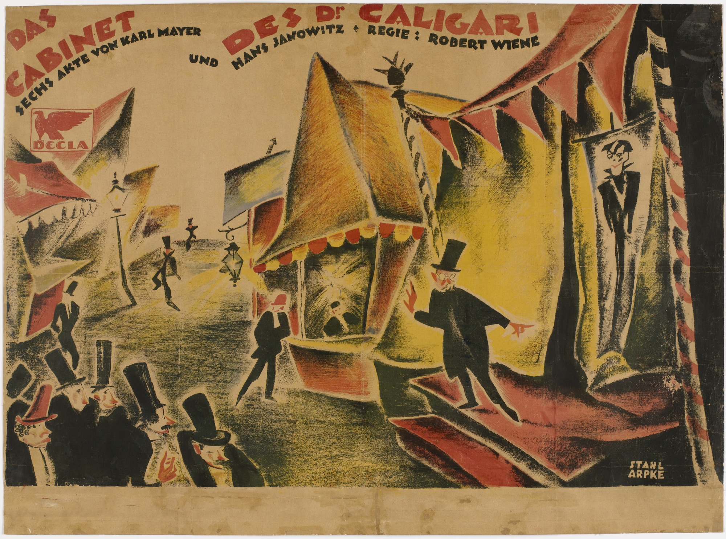
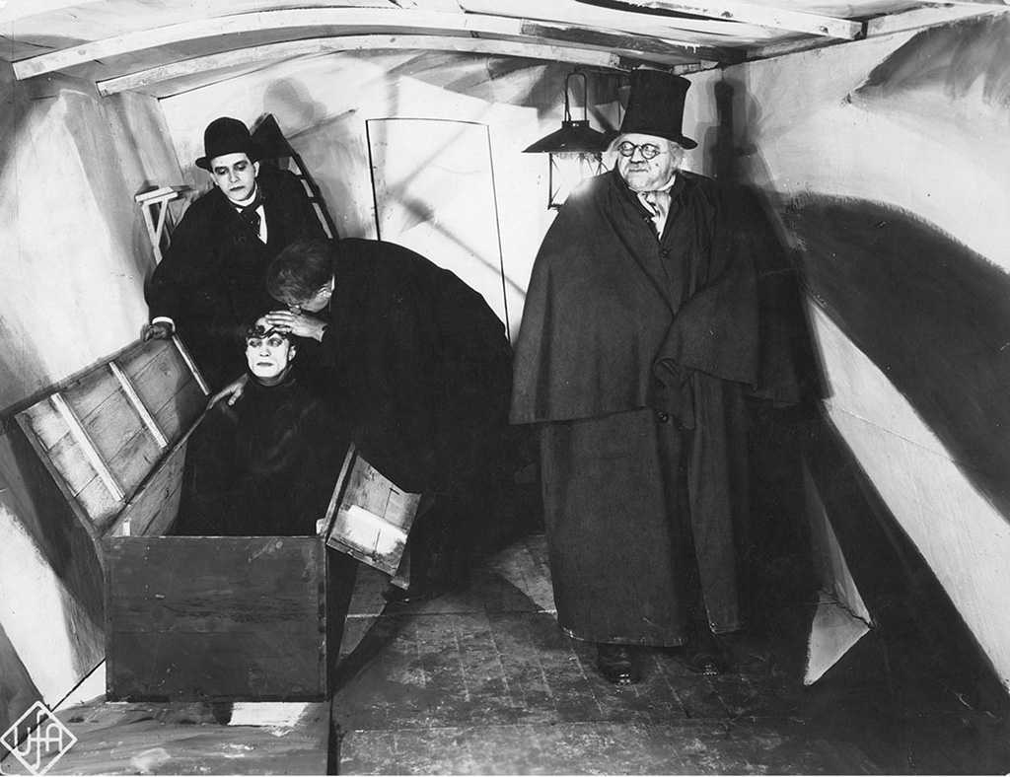
The Cabinet of Dr Caligari (Wiene, 1920)
Art Direction: Hermann Warm
https://www.artofthetitle.com/title/the-cabinet-of-dr-caligari/

Slide 2
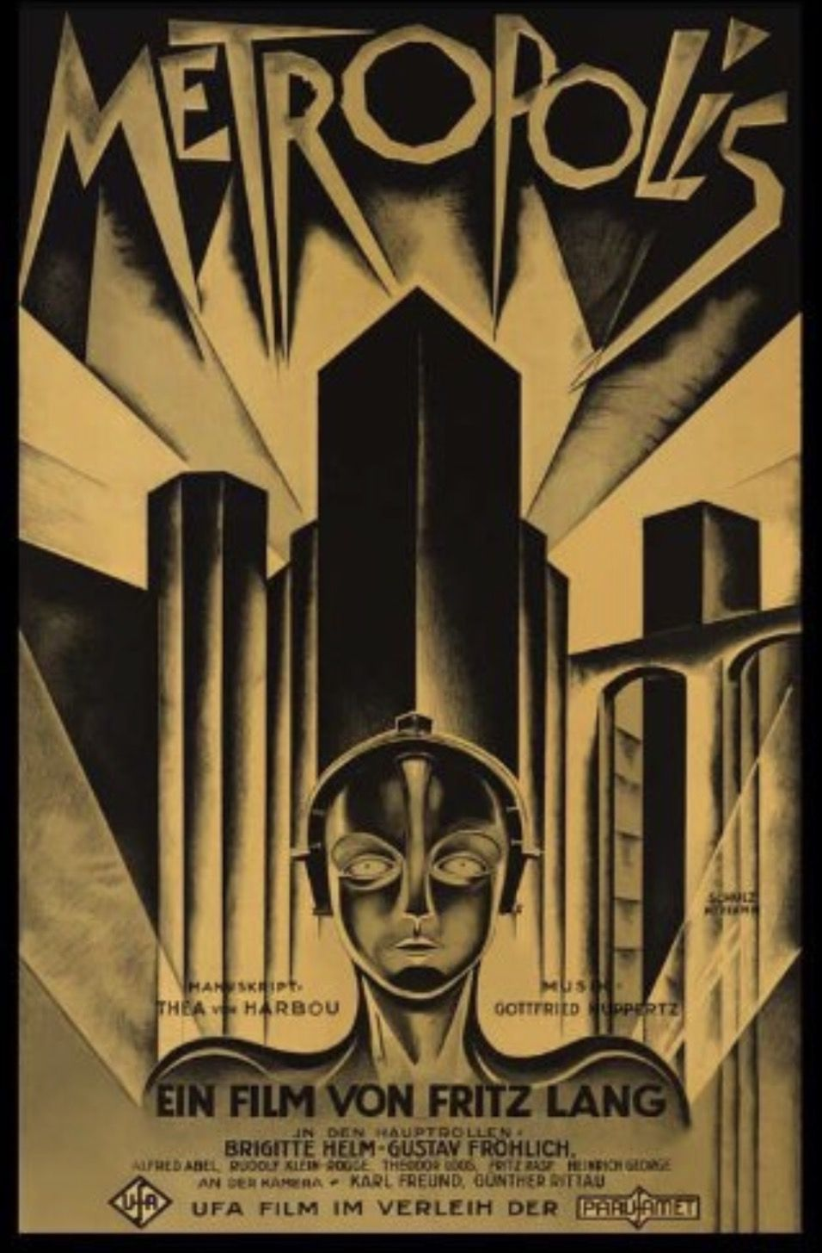
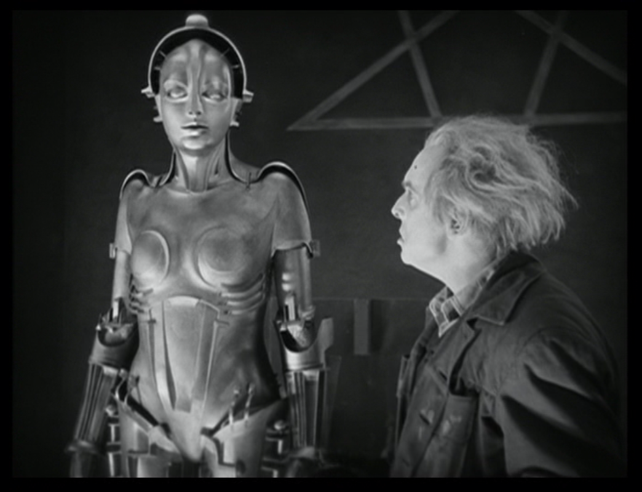
Metropolis (Lang, 1927)
https://www.artofthetitle.com/title/metropolis/

Slide 3
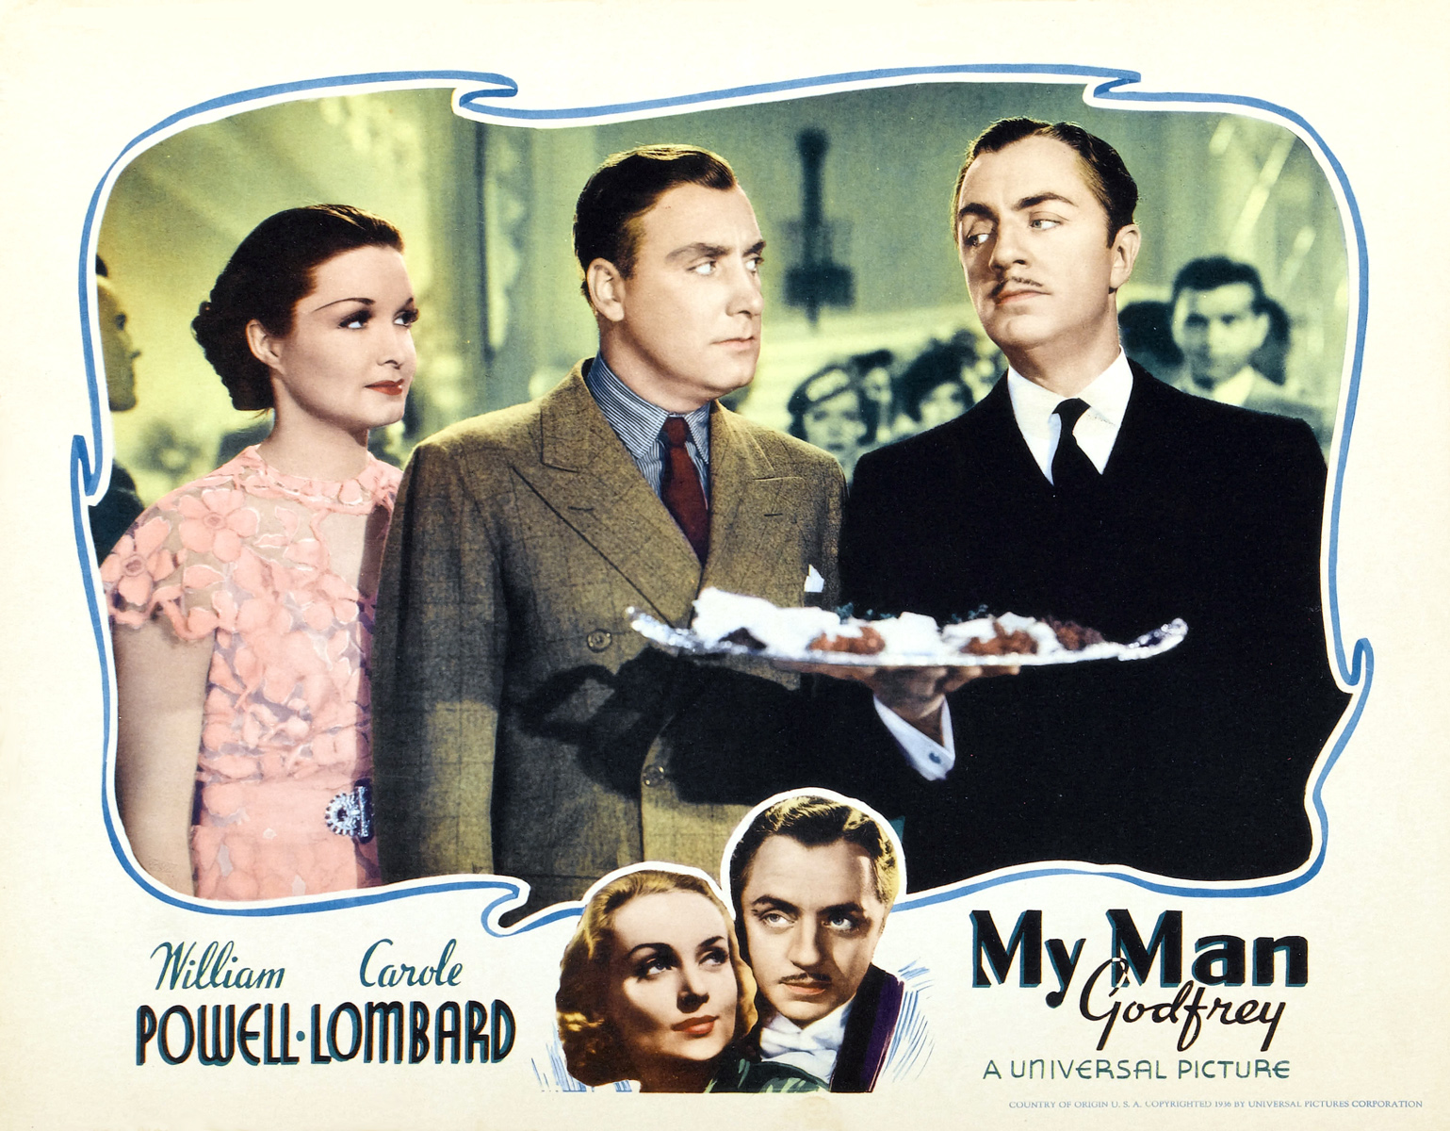
My Man Godfrey (La Cava, 1936)
Production Designer: Charles D. Hall
https://www.artofthetitle.com/title/my-man-godfrey/

Slide 4
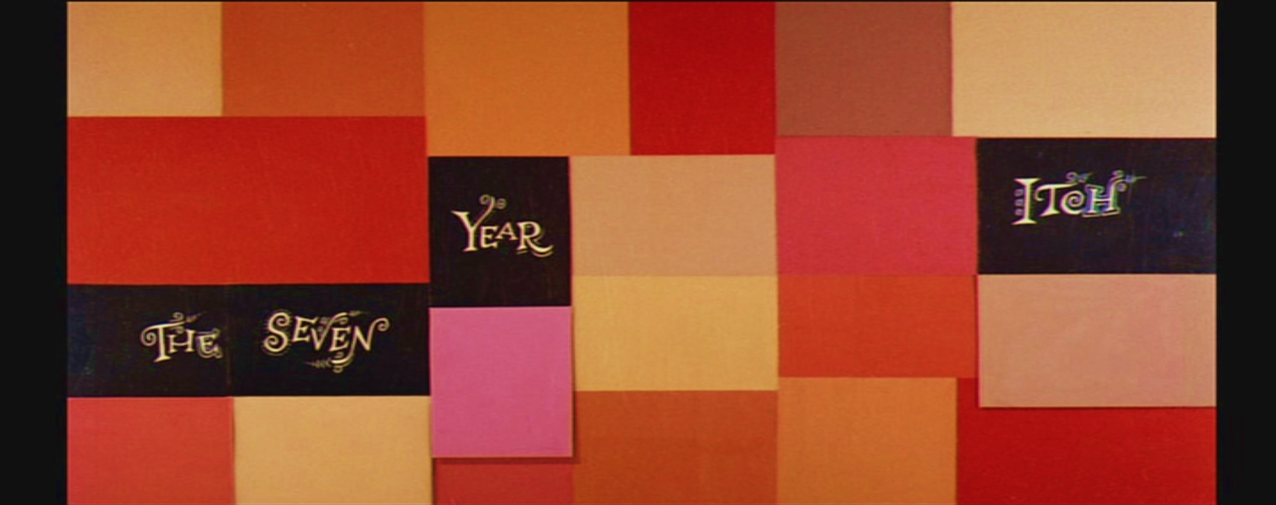
DOUBLE INDEMNITY (1944)
The Seven Year Itch (Wilder, 1955)
https://www.artofthetitle.com/title/the-seven-year-itch/

Slide 5

DOUBLE INDEMNITY (1944)
https://www.artofthetitle.com/title/vertigo/

Slide 6
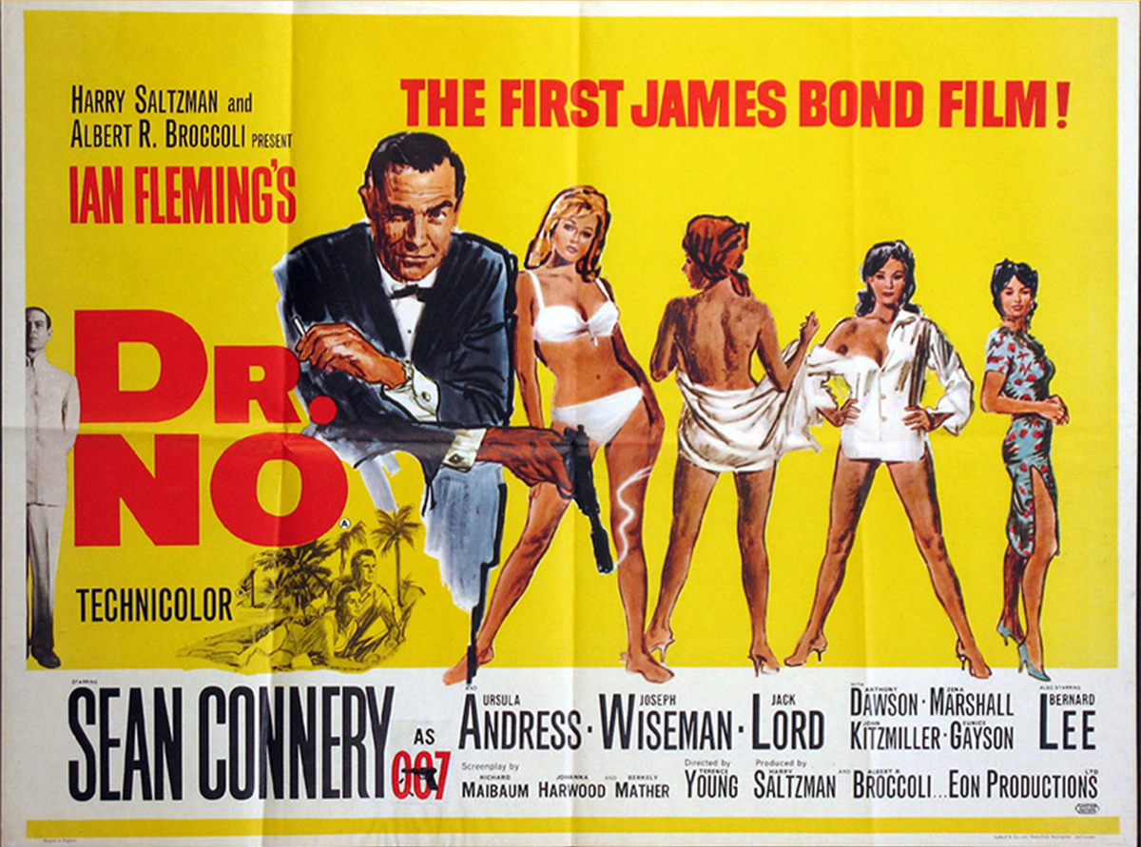
DOUBLE INDEMNITY (1944)
Dr No (Young, 1962)
Design: Maurice Binder; Animation: Trevor Bond
https://www.artofthetitle.com/title/dr-no/

Slide 7
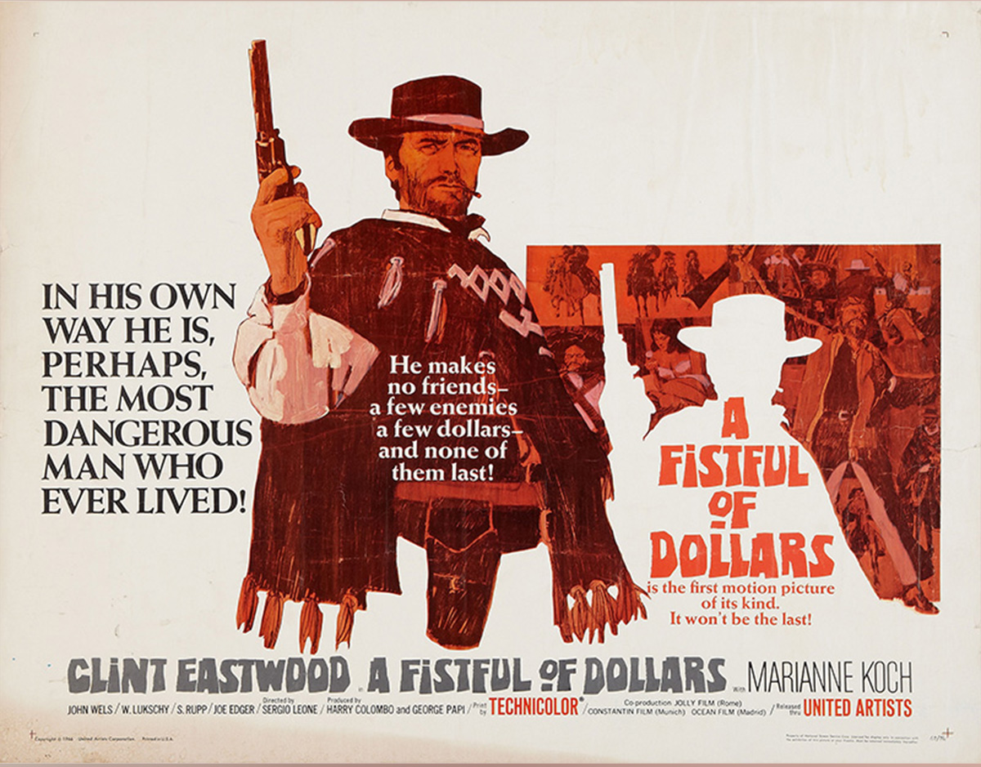
A Fistful of Dollars (Leone, 1964)
DOUBLE INDEMNITY (1944)
Designer: Ignio Lardani
https://www.artofthetitle.com/feature/a-fistful-of-titles-the-westerns-of-iginio/

Slide 8
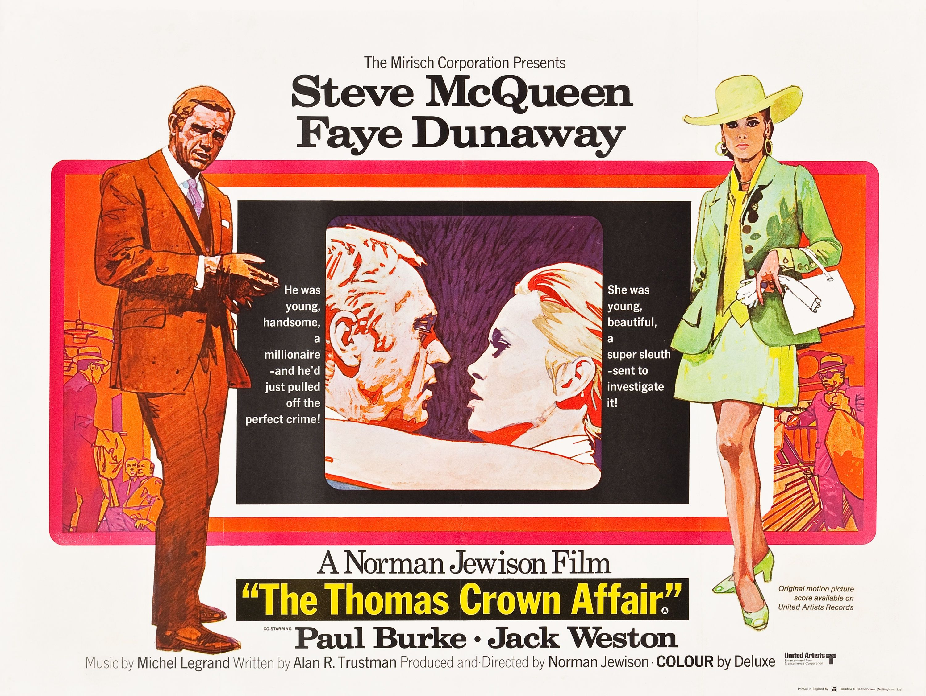
DOUBLE INDEMNITY (1944)
The Thomas Crown Affair (Jewison, 1968)
Design: Pablo Ferro
https://www.artofthetitle.com/title/the-thomas-crown-affair/

Slide 9
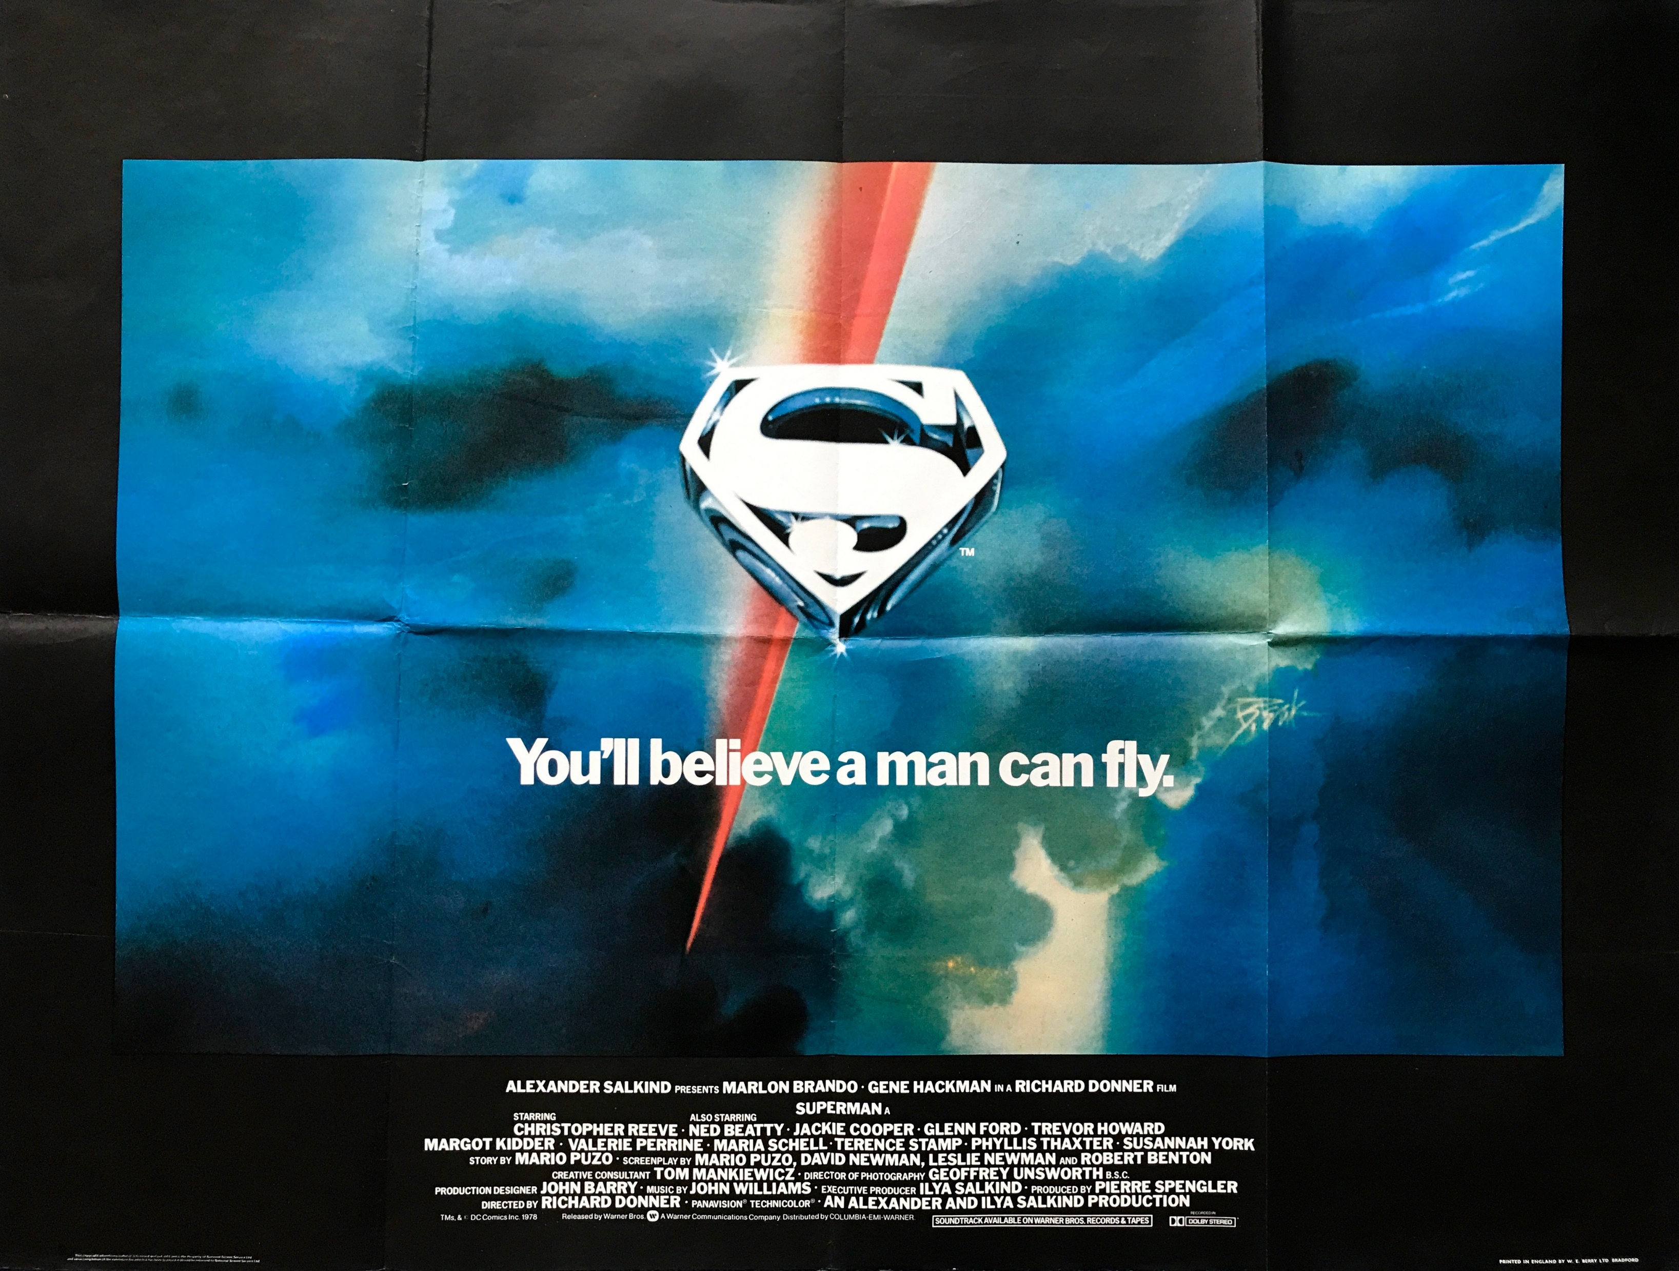
DOUBLE INDEMNITY (1944)
Superman (Donner, 1978)
Design: R Greenberg Associates
https://www.artofthetitle.com/title/superman/

Slide 10
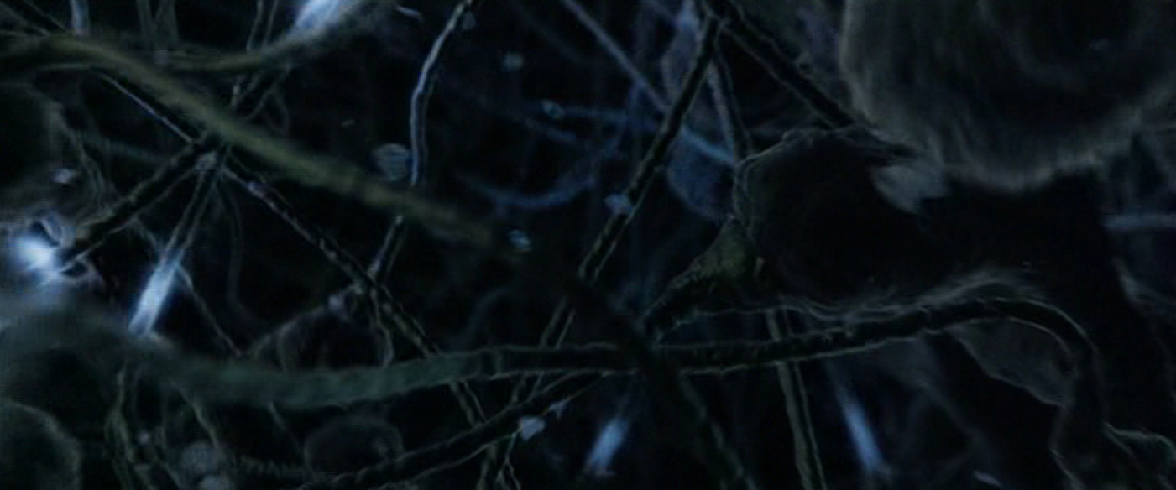
DOUBLE INDEMNITY (1944)
Fight Club (Fincher, 1999)
Design: Digital Domain; Kevin Tod Haug
https://www.artofthetitle.com/title/fight-club/

Slide 11
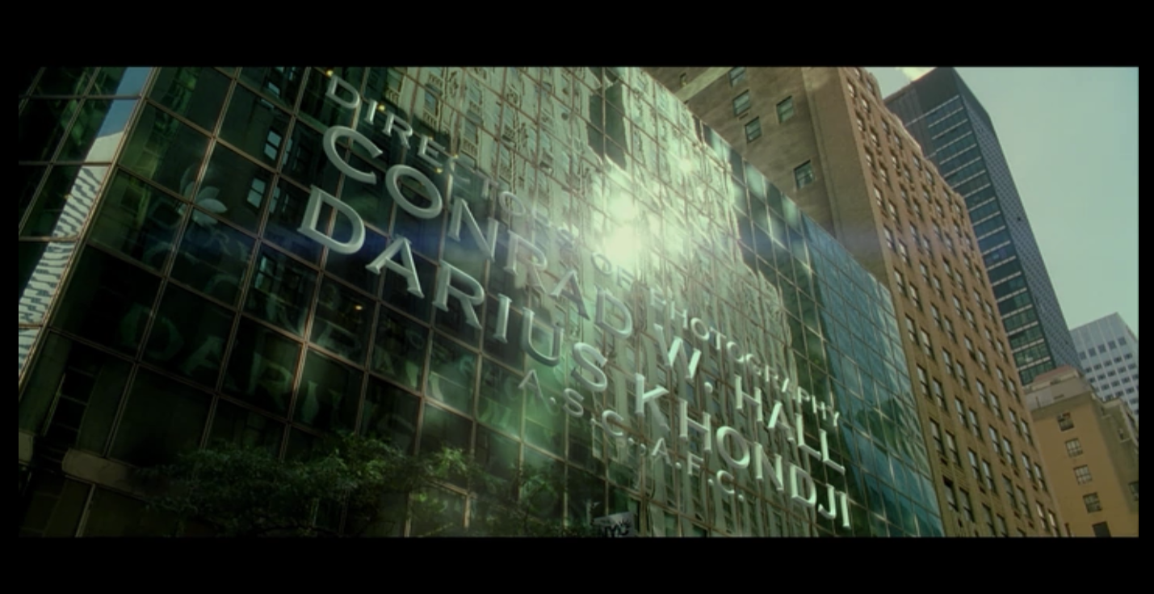
DOUBLE INDEMNITY (1944)
Panic Room (Fincher, 2002)
Design: The Picture Mill; William Lebeda
https://www.artofthetitle.com/title/panic-room/

Slide 12

True Detective (Season 3)
Design: Antibody
https://www.artofthetitle.com/title/true-detective-season-3/

