Slide 1
Challenges of an Ageing Population - Age UK report

Slide 2
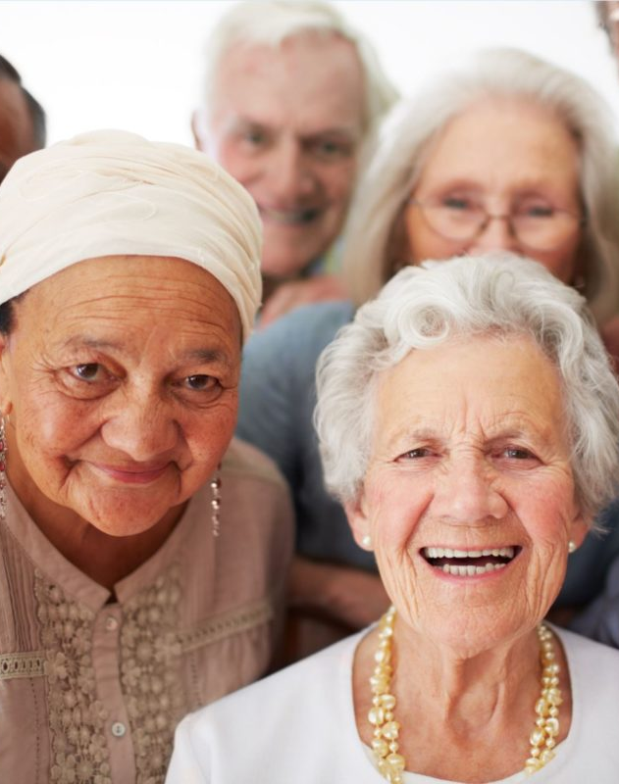
The growing number of older people in the UK presents major opportunities for our society – but rarely since the Second World War has there been such a tough time to pursue the aim of a better later life (Age UK 2023).
This Photo by Unknown Author is licensed under CC BY

Slide 3

While the current fragility of the world economy makes this an exceedingly difficult time to find the funding necessary to make life better for current pensioners and tomorrow’s generation of older people, the changes needed are about more than just money.
Equally lacking, is a positive approach to ageing backed by a coherent and joined up vision of a society in which older people are able to fully participate, avoiding life limiting disability and isolation.

Slide 4
A quarter of older households live in non-decent housing – impacting not only on the size of their heating bills but also on their health
There is a growing “health gap” for older people in parts of Britain. The number of years someone can expect to live without a disability after the age of 65 now varies by more than 12 years between local authorities with the highest and lowest levels of disability free life expectancy.
More than 300,000 carers were forced out of the workplace last year because they were not able to work flexibly.

Slide 5
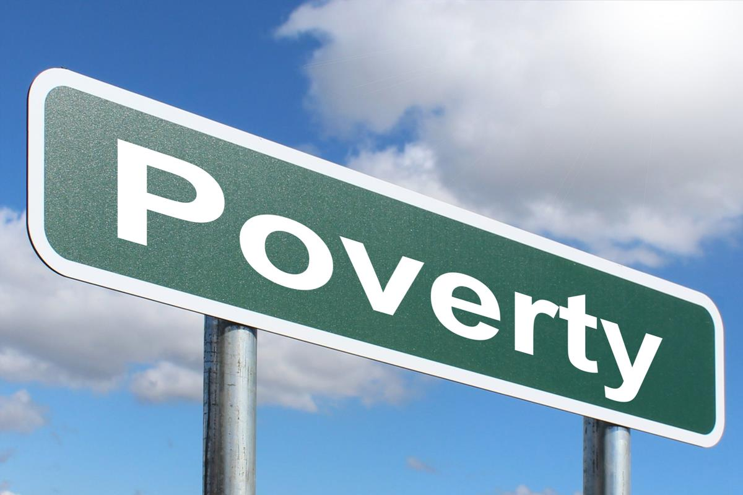
Poverty Line
Whilst some improvements were made during the past two decades, poverty amongst older people is now rising and around 1 in 5 older people (18%) in Wales are living in relative income poverty.
The number of people aged 75 and over is projected to increase by 29.3% to 378,100 between 2018 and 2028 • By 2030, it is projected that there will be over 1,008,000 older people in Wales – 33% of the total population.9
This Photo by Unknown Author is licensed under CC BY-SA

Slide 6

Despite the challenges facing the UK to become a society that enables its ageing population to live as fulfilling lives as possible, there has been significant progress made over the last year which should not be overlooked. The Government’s plans for a single tier pension and its announcement that it would introduce a cap on social care costs are good news (Age UK 2020)

Slide 7
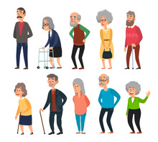
Ageing and Health
All countries face major challenges to ensure that their health and social systems are ready to make the most of this demographic shift.
In 2050, 80% of older people will be living in low- and middle-income countries.
The pace of population ageing is much faster than in the past.
In 2020, the number of people aged 60 years and older outnumbered children younger than 5 years.
Between 2015 and 2050, the proportion of the world's population over 60 years will nearly double from 12% to 22%.

Slide 8

Health Issues of the Older Population
An estimated 4 million older adults in the UK (36% of people aged 65-74, and 47% of those aged 75+) have a limiting long-standing illness; equating to 40% of all people aged 65+.
In the UK, 1 in 3 adults aged over 65 with an alcohol problem developed this problem in later life. Frequently reported reasons among older adults for starting to drink more include retirement, bereavement, loss of purpose, lack of socialising opportunities and changes in financial circumstances
In 2019, there were more than 850,000 people with dementia in the UK. This represents 1 in every 14 of the population aged 65 years and over.7
Regarding health conditions, 92 per cent of people living with dementia have at least one other health condition and 45 per cent have four or more other health conditions.

Slide 9

The number of people aged 65 + in employment has risen to 967,000 from 885,000 in the last year.
Annual spending for older households up from £109 billion to £121 billion
Nearly 4.9 million people aged 65 and over in England take part in volunteering or civic engagement - more than half of that age group.
Older people contribute up to £50 billion in unpaid family care for grandchildren, spouses and older family members.

Slide 10
Projection
The number of people aged 65 years and over in England and Wales is projected to increase by 65 per cent in the next 25 years to more than 16.4 million in 2033, as more of us live for longer
The number of over 85s in the UK is set to double in the next 20 years and nearly treble in the next 30.
Britain’s older population is more diverse than ever before. The number of black and minority ethnic people aged 70+ is projected to rise from 170,000 in 2006 to 1.9 million in 2051 – an 11-fold increase.

Slide 11
Perceptions of youth and old age across Europe
The European Social Survey analysed perceptions of youth and old age across Europe. It found that perceptions of old age vary considerably between countries. In the UK, old age is perceived to begin at 59 – the second youngest of the countries surveyed. Youth is perceived to end at 35 – again earlier than most countries, and far younger than in Cyprus or Greece where 52 is regarded as young.

Slide 12
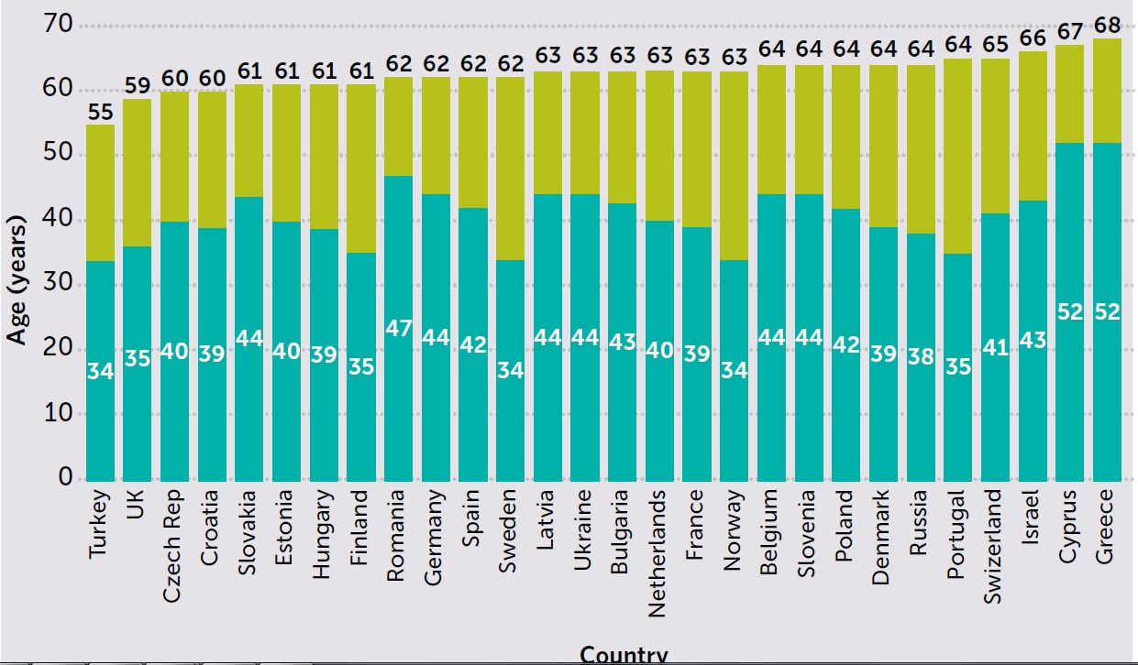

Slide 13
This is because, despite increases to SPA, the number of pensioners is increasing faster than the number of working age people – a growth of 37% (to 16.8 million) from 2012 to 2041, compared to 13% (to 44.6 million).

Slide 14
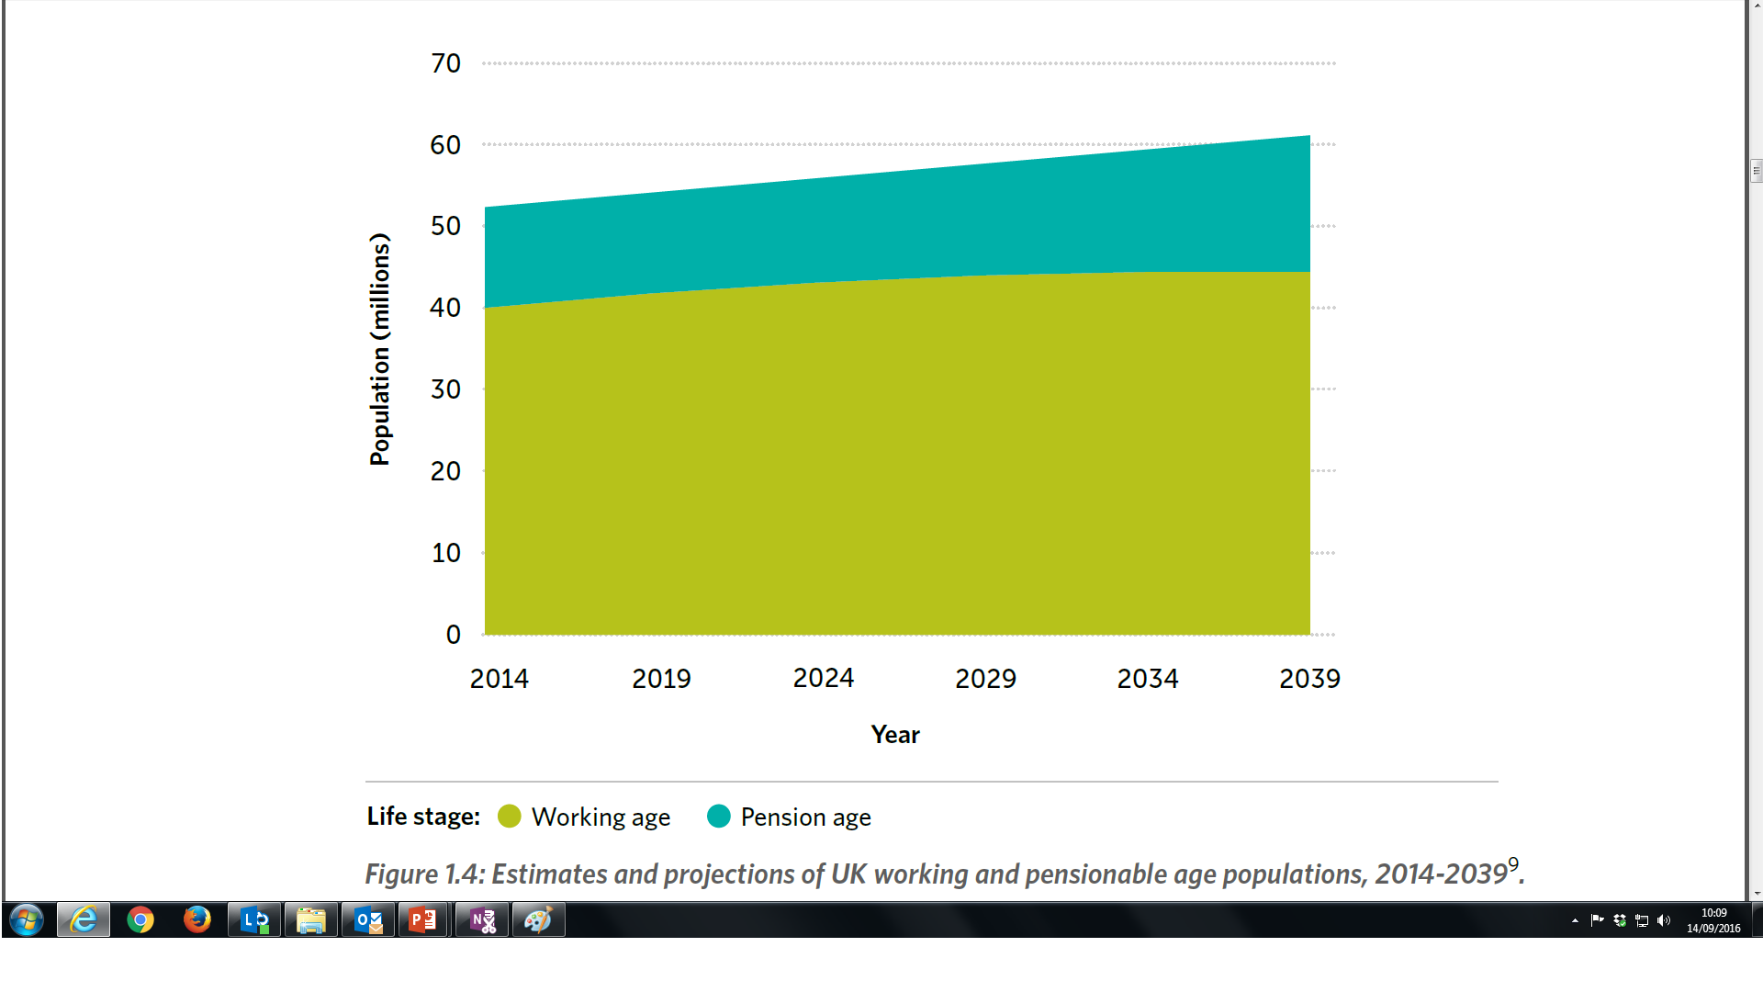

Slide 15

Raising Retirement Age
The retirement age will have to rise to 71 for middle-aged workers across the UK, according to research into the impact of growing life expectancy and falling birthrates on the state pension.
The UK pension age of 66 is set to rise to 67 between May 2026 and March 2028. From 2044, it is expected to rise to 68.
But the research suggests that this is not enough, and that anyone born after April 1970 may have to work until they are 71 before claiming their pension.
This age limit may need to be set even higher, say experts, thanks to the high rate of workers exiting the workforce before they reach state pension age, predominantly due to preventable ill health.
This Photo by Unknown Author is licensed under CC BY-ND

Slide 16
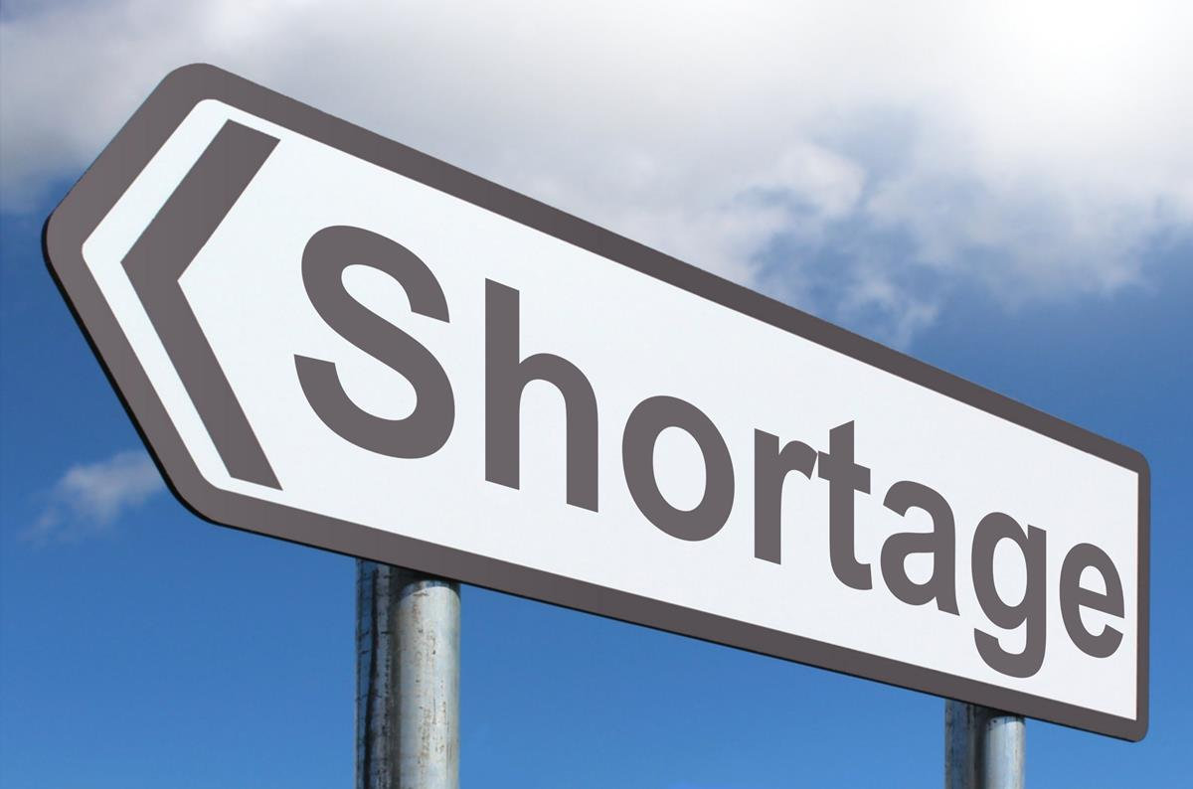
A Smaller Working Population
By age 70, only 50% of adults in England and Wales are now disability-free and able to work. A smaller working population and a large economically inactive population reduces the tax base to pay for pensions – and creates huge labour shortages, which creates its own problems.
According to the Office for Budget Responsibility, pensioner benefits will cost the UK government £136bn in 2023-24, of which £124bn will be spent on state pensions.
This Photo by Unknown Author is licensed under CC BY-SA

Slide 17
References
Age UK (2023) Challenges of an Ageing Population - Age UK report. [online] available at: http://www.ageuk.org.uk/latest-press/archive/vision-and-imagination-critical-to-meet-challenges-of-ageing-population/ (accessed 14-9-16)
Government Office Science (2016) Future of an Ageing Population [online] available at: https://www.gov.uk/government/uploads/system/uploads/attachment_data/file/535187/gs-16-10-future-of-an-ageing-population.pdf

