Slide 1
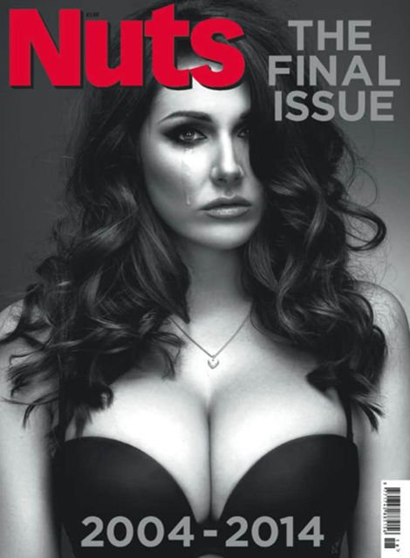
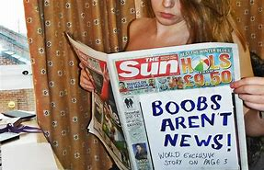
Polly Gale ECED7003
1601786
(Image 1)
(Image 2)

Slide 2
This presentation aims to present a critique of the current discourses associated with the concepts of hyper-masculinity and the emasculation of the male in society

Slide 3
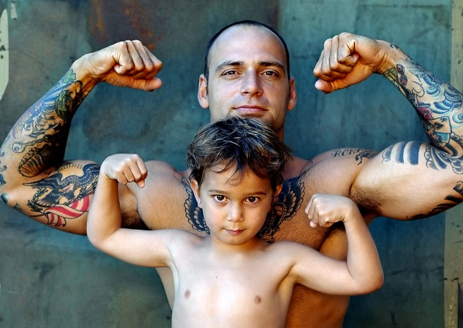
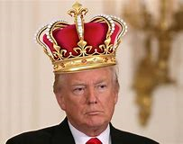
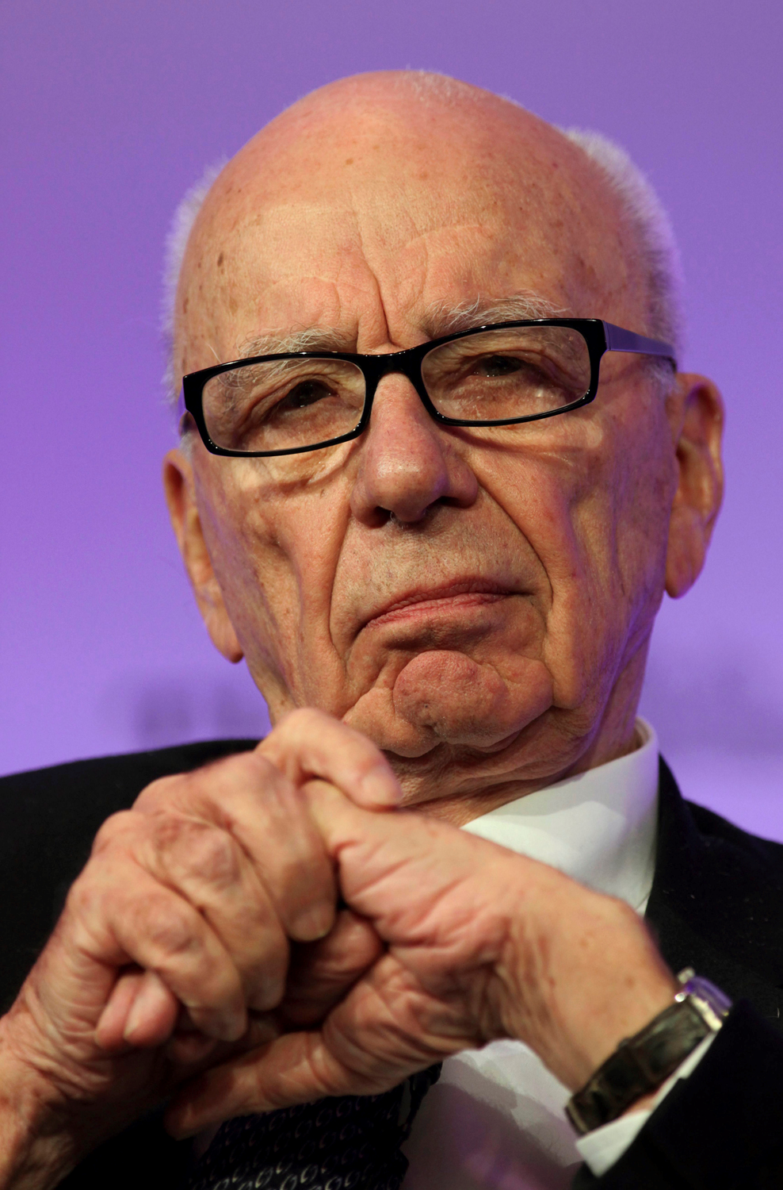
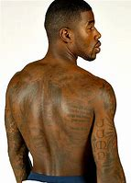
INTRODUCTION
(Image 3)
(Image 6)
Gender as a social institution
Hyper-masculinity
Hegemony Theory
Emasculation of men in society
Hyper-masculinity and the media
Conclusion
(Image 4)
(Image 5)

Slide 4
Gender as a social institution
‘Institutions entail distinct social practices that recur (Giddens 1984), recycle (Connell 1987), or are repeated (over time) by group members.’
Martin (2004, p. 8)
Patterns of social activity
Gender role/sex role socialisation
Distinctive practices differentiate institutions from each other
Advantage/disadvantage
Institutions and individuals equally constitute each other; they are not divided by macro and micro experiences
Power/control
Conflict

Slide 5
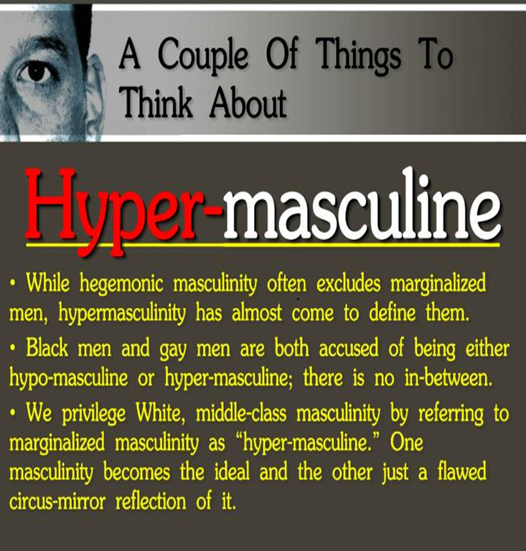
Hypermasculinity
Gender-based ideology and what it means to be a
man in society
Script Theory
Calloused attitudes towards women
Violence as manly
Danger as exciting
Toughness as emotional self-control
(Image 7)
Zaitchik & Mosher (1993)

Slide 6
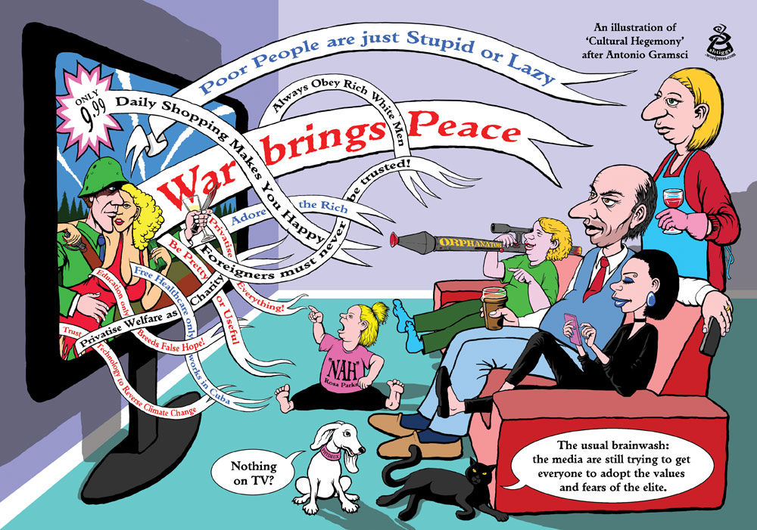
Hegemony theory
Hegemony and the relationship between:
Gender systems
Social development
Power and coercion
Forces of oppression
Forces of change
(Image 8)
Demetriou (2014)

Slide 7
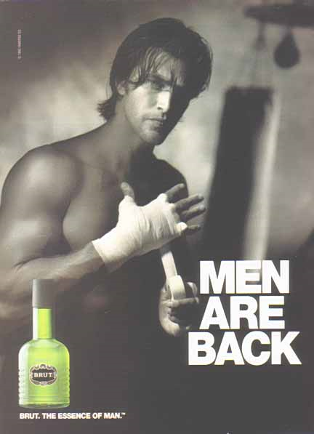
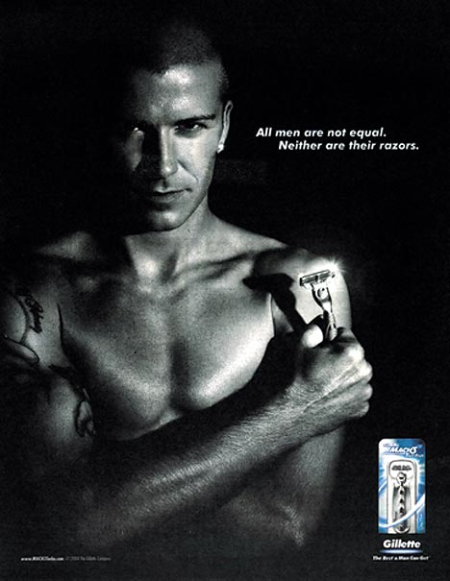

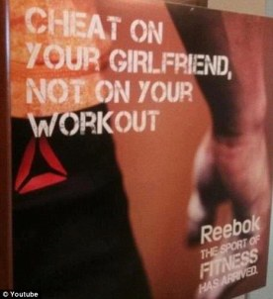
Hyper-masculinity and the media
(Image 9)
Mass media/Communication Theory
Representations matter
The sexualisation of culture (García-Favaro, and Gill, 2016)
(Image 10) (Image 11)
‘We live in terms of the stories we tell—stories about what things exist, stories about how things work, and stories about what to do—and television tells them all through news, drama, and advertising to almost everybody most of the time’ (Gerbner et al., 1978, p.178).
(Image 12)

Slide 8
Emasculation of men in society
The liberation of women and the emasculation of men
Masculinity crisis
Masculinity is shaped by society
Double standards
British feminist campaign - Lose the Lads’ Mags
‘The war on the normal bloke’
‘Feminist Tyranny’
‘Male sexuality under threat’
García-Favaro and Gill (2015)

Slide 9
Conclusion
Patriarchal gender systems and social development
Privilege and advantage
Subordination and disadvantage
The sexualisation of culture
Power
Dominion
Inequality
Reproduction of gender hierarchies

Slide 10
References
Acker, J. (1990) ‘Hierarchies, Jobs, Bodies: A Theory of Gendered Organizations.’ Gender and Society, 4, pp. 139–58.
Acker, J. (1992) ‘Gendered Institutions: From Sex Roles to Gendered Institutions.’ Contemporary Sociology, 21, pp. 565–69.
Agnew, R. (1992) ‘Foundation for a General Strain Theory of Crime and Delinquency’, Criminology, 30(1), pp. 47-87.
Alexander, E. (2014) Image 1. ‘Nuts final issue: Lucy Pinder cries on the front cover as the lads' mag’, Independent [online]. Available at: https://www.independent.co.uk/news/people/nuts-final-issue-lucy-pinder-cries-on-the-front-cover-as-the-lads-mag-9310248.html (Accessed 22 January 2020).
Demetriou, D. Z. (2014) ‘Connell's concept of hegemonic masculinity: A critique’, Theory and Society, 30(3), pp. 337-361 [jstor]. Available at: http://www.jstor.org/stable/657965 (Accessed: 22 December 2019).
Donaldson, M. (1993) ‘What Is Hegemonic Masculinity?’, Theory and Society, 22(5), pp.643-657. Available at: https://ro.uow.edu.au/cgi/viewcontent.cgi?article=1149&context=artspapers (Accessed: 22 December 2019).
Connell, R. (1987) Gender and Power: Society, the Person, and Sexual Politics. Stanford University Press.
Connell, R. W. (2005) Masculinities (2nd ed.). Berkeley, California: University of California Press.
Connell, R. W., and Messerschmidt, J. W. (2005) ‘Hegemonic Masculinity: Rethinking the Concept’, Gender and Society, 19(6), pp. 829-859 [Google Scholar]. Available at: https://pdfs.semanticscholar.org/6aa5/3e0a9005f6826c21edeb7da5afbaa75af1d6.pdf (Accessed: 15 January 2020).
Emily (2015) Image 9. Men are Back. Available at: https://mrstereotype.wordpress.com/2014/08/30/stereotypes-in-advertising/ (Accessed: 15 January 2020).

Slide 11
Faludi, S. (1992) Backlash: The Undeclared War Against Women. London: Random House.
Faludi, A. (2011) Stiffed: Betrayal of the Modern Man. London: Random House.
García-Favaro, L. and Gill, R. (2015). ‘Emasculation nation has arrived’: Sexism rearticulated in online responses to Lose the Lads’ Mags campaign’, Feminist Media Studies. Available at: https://openaccess.city.ac.uk/id/eprint/14459/3/ (Accessed: 10 January 2020).
Gerbner, G., Gross, L., Jackson-Beeck, M., Jeffries-Fox, S., and Signorelli, N. (1978). ‘Cultural indicators: Violence proﬁle no.9’, Journal of Communication, 28, pp. 176–206.
Giddens, A. (1984) The Constitution of Society: Outline of the Theory of Structuration. University of California Press.
Gorman S, Monk-Turner E, Fish J. (2010). ‘Free adult internet website: How prevalent are degrading acts?’ Gender Issues, 27, pp. 131–145. Available at: http://xyonline.net/sites/xyonline.net/files/Gorman%2C%20Free%20Adult%20Internet%20Web%20Sites%20-%20How%20prevalent%20are%20degrading%20acts.pdf Accessed: 03 January 2019).
Mann, R. (2011) Image 5. Power without responsibility: Rupert Murdoch's Australian. Available at: https://www.abc.net.au/religion/power-without-responsibility-rupert-murdochs-australian/10101178 (Accessed: 14 January 2020).
Martin, C. (2013) Image 3. Another Reason Why We Should Ditch Toxic Masculinity. Available at: https://urge.org/toxic-masculinity-the-toxic-sludge-weve-got-to-get-rid-of/ (Accessed: 14 January 2020).

Slide 12
Gramsci, A. (1971) Selectíons from the Prison Notebooks. Hoare, Q., and Nowell Smith, G. (Eds.) London: Lawrence & Wishart.
Greene, K., Rubin, D. L., Hale, J. L., Walters, L. H. (1996) ‘The Utility of Understanding Adolescent Egocentrism in Designing Health Promotion Messages’, Journal Health Communication,
8(2), pp. 131-152. Available at: http://eclipse.rutgers.edu/wp-content/uploads/sites/51/2014/pdf/HCx-ego-96.pdf (Accessed: 06 January 2019).
Greene, k., Krcmar, L., Walters, H. L., Rubin, D. L., and Hale, J. L, (2000) ‘Targeting adolescent risk-taking behaviors: the contributions of egocentrism and sensation-seeking’, Journal of Adolescence, 22(4), pp. 439-461 [Google Scholar]. Available at: https://scholar.google.co.uk/scholar?cluster=16199177145053795925&hl=en&as_sdt=0,5 (Accessed: 06 January 2019).
GILL, R. (2007) Gender and the Media. Cambridge: Polity Press.
Jhally, S. (2006). Advertising, cultural criticism, and pedagogy. The Spectacle of Accumulation: Essays in Culture, Media, and Politics. Peter Lang: New York.
Kareithi, P. J. (2014) ‘Hegemonic masculinity in media’, in Media and gender: a scholarly agenda for the Global Alliance on Media and Gender. Paris: United Nations Educational, Scientific and Cultural Organization. Available at: https://scholar.google.com/scholar?hl=en&as_sdt=0%2C5&q=Hyper-masculinity+in+the+media&btnG= (Accessed: 22 December 2019).
Mosher, D.L., and Tomkins, S.S. (1988). ‘Scripting the macho man: Hypermasculine socializations and enculturation.’ The Journal of Sex Research, 25(I), pp. 60-84.

Slide 13
Murnen, S. K., Wright, R. and Kaluzny, G (2002) ‘If “Boys Will Be Boys,” Then Girls Will Be Victims? A Meta-Analytic Review of the Research That Relates Masculine Ideology to Sexual Aggression’, Sex Roles, 46(11/12), pp. 359-375 [Google Scholar]. Available at: https://scholar.google.com/scholar?hl=en&as_sdt=0%2C5&q=hyper+masculinity+and+callous+attitudes+towards+women&btnG= (Accessed: 18 December 2019).
O'shaugnessy, M., and Stader, J. (2005) Media and Society: An Intoduction (3rd. Ed). Oxford University Press.
Peden, M., Scurfield, R., Sleet, D., Mohan, D., Hyder, A. D., Jarawan, E., and Mathers, C. (2004) World report on road trafﬁc injury prevention. Available at: https://apps.who.int/iris/bitstream/handle/10665/42871/9241562609.pdf;jsessionid=3BD0FAFA23B96701E1ADB2AE2D5B90A2?sequence=1 (Accessed 04 January 2019).
Pyke, K.D. (1996) ‘Class-based masculinities. The interdependence of gender, class, and interpersonal power,’ Gender and Society, 10, 527-549.
Soria, J. (2018) Cultural Hegemony, image 8. Available at: https://twitter.com/EquisSJ/status/1057378730664964097 (Accessed: 06 January 2019).
Smith, K., Moriarty, S., Barbatsis, G., and Kenney, K. (2019) ‘Perception Theory from: Handbook of Visual Communication, Theory, Methods, and Media: Routledge. Available at: https://pdfs.semanticscholar.org/d8f8/ae443d95f015714342ff09a12f9c18998a7a.pdf?_ga=2.249941966.952372269.1579463666-1055319019.1579463666 (Accessed: 19 January 2020).
The Arts (2014) Image 4. Back Tattoos Men. Available at: http://th34rt.blogspot.com/2013/02/back-tattoos-men.html (Accessed: 14 January 2020).

Slide 14
The Daily Mail (no date) Image 11. All men are not equal. Neither are their razors. Available at: https://img.dailymail.co.uk/i/pix/2008/01_03/gillette_468x605.jpg (Accessed: 15 January 2020).
Vokey, M. L. (2008) ‘An Analysis of Hyper-Masculinity in Magazine Advertisements.’ Masters theses. University of Manitoba. Available at: https://scholar.google.co.uk/scholar?hl=en&as_sdt=0%2C5&q=Hyper-masculinity+in+the+media&btnG= (Accessed: 06 January 2020).
Waxman, S. (2017) Image 6. Donald Trump Thinks He Should Be King, Not President. Available at: https://www.thewrap.com/donald-trump-thinks-king-not-president/ (Accessed: 14 January 2020).
Wood, j. (2013) Image 10. Aggressive Adverstising May Make for Aggressive Men. Available at: https://psychcentral.com/news/2013/03/03/aggressive-advertising-may-make-for-aggressive-men/52140.html (Accessed: 15 January 2020).
Sean, m. (no date) Image 7. Revisiting Hypermasculinity: Shorthand for Marginalized Masculinities? Available at: https://www.slideserve.com/mathilda/revisiting-hypermasculinity-shorthand-for-marginalized-masculinities (Accessed: 15 January 2020).
Smoking Gun (2015) Image 2. Epic PR fail or triumph: No more Page 3. Available at: https://smokinggunpr.co.uk/2015/01/28/epic-pr-fail-triumph-page-3/ (Accessed: 22 January 2020).
Quaintelf (2012) Image 12. The role of women in offensive advertising. Available at: https://quaintelf.wordpress.com/2012/07/29/the-role-of-women-in-offensive-advertising/ (Accessed: 15 January 2020).
Zaitchik, M. C., and Mosher, D. L. (1993). ‘Criminal justice implications of the macho personality constellation’, Criminal Justice and Behavior, 20, pp. 227–239.

