Slide 1
DS3 Digital Portofolio+Audio Reflection

Slide 2
In Week 9 We have learned about Excel training and development overview we have learned
how to Enter and organize data, perform calculations create charts and graphs,
analyze data
format worksheets
Here is a visual preview
We have done in class
Training Area | Number of Requests
Health and safety | 22
Customer communication | 18
Digital Systems | 15
Data protection | 9
Time management | 7

Slide 3
Microsoft Word
Microsoft Word I Learned to:
Create Essays
Reports
Letters
Notes
Editing texts
Change Font size & Text color
Adding headers footers
Check Spellings
Adding Page Numbers
Adding Pictures
Captions
Tables

Slide 4
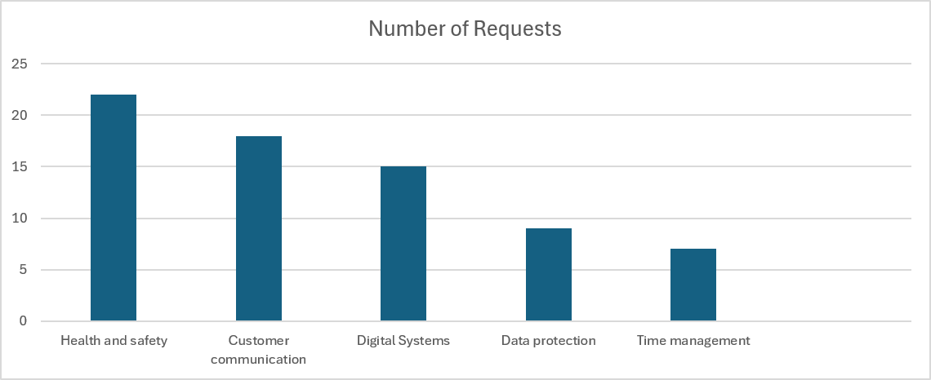
Staff Training and Development Overview
Overview
The organisation has carried out a review of its current approach to staff training and development following recent changes to working practices. The review focused on how new staff are supported during their first months in the organisation and how existing staff access ongoing training opportunities. Feedback collected internally suggests that while training resources exist, they are not always easy to locate or clearly structured.
The review also examined how training responsibilities are shared across teams. In some areas, managers take an active role in supporting development, while in others responsibility is less clear. This inconsistency can lead to uneven experiences for staff and may affect confidence, performance, and retention.
Internal Data collected over the last 3 months highlights the most
Common areas where staff requested additional training or support.
These request relates to both technical skills and workplace processes
And suggest a need for clearer communication and better learning
Using:
Headings
Paragraph
Tables
Captions
numbering

Slide 5

Week 7- A business design example in PowerPoint - I learned how to:
Create Presentation. Design Slides add Images add Effects Animation SmartArt
FREE
Brake check with every
Instant oil change
Starting at 24.99
PowerPoint is used to make slides add effects
Animations transitions and make slideshows
It also allows users to record video audio
Drawings & create presentations

Slide 6
Reflection
At the beginning of the module, I found using some of these programs challenging, I was not very confident with Excel formulas or creating presentations, and I always needed help
Overall, I Feel Confident with digital skills now, as I have learned about word Excell PowerPoint one drive I also learned about one drive and I know I can keep improving on New Digital Skills by Attending and practicing there is always
Room for more learning especially from such professionals as my tutor's
At UWTSD University

