Slide 1


University of Wales
Trinity Saint David
LCBB5004
Managing People – Dr Mushfiqur Rahman
The flexible forms of working and the HR Manager role
Teodora Georgieva
Student ID: 2111818

Slide 2

Aims and Objectives
Introduction
Organizational background at Marks and Spencer (M&S)
The role of HR, diversity, and inclusion at M&S
Flexible form of working at M&S
Economic efficiency
Increased productivity
Personal freedom and satisfaction
Attractiveness
Continuity of work and processes
Sustainability

Slide 3

Aims and Objectives
Aims:
The aim of this presentation is to present and evaluate the introduction of flexible working conditions in the work process and development of the Marks and Spencer company.
To examine the methods of diversity and inclusion successfully applied by the HR manager to further increase the level of satisfaction and success.
Objectives:
Evaluating the role of HR with the methods of diversity and inclusion at M&S
To explore what is flexible working
To assess the effect of that factors on company productivity, efficiency, attractiveness and sustainability

Slide 4

Introduction
Post COVID challenges
The need of a work-life balance
New HR strategy/approach
Flexibility as a solution

Slide 5
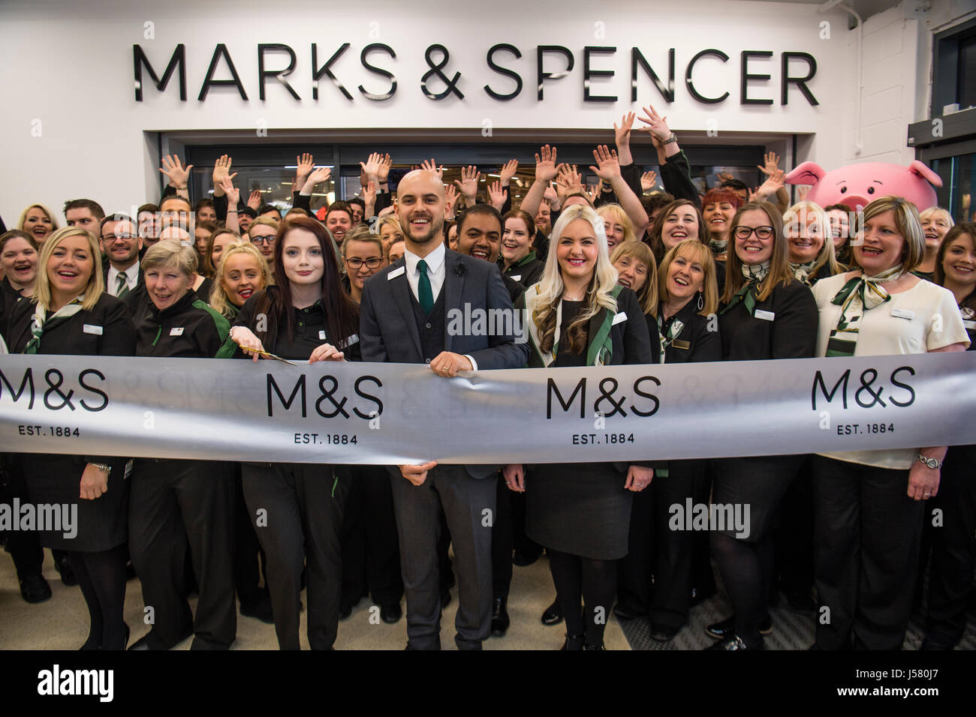
Organizational background at Marks and Spencer (M&S)
Beginning in 1884 as Penny Bazaar in Leeds to British institution with over 65,000 employees and over 700 stores (Marks and Spencer, n.d.)
One of the most preferred multi-channel retailers offering food, home goods, clothing and services such as insurance and credits at good prices and exceptional quality (M&S, n.d.)
People - the main value of our business
Pursuit of social responsibility, healthy working environment and equality (M&S, n.d.)

Slide 6

The role of HR, diversity, and inclusion at M&S
Innovation – a recipe for survival and success in today’s dynamic society (Lazonick and Prencipe, 2005).
The role of HR
Diversity: changes in workforce expectations influenced by demographic and organizational differences, ethnicity race, and gender (Hays-Thomas, 2017).
Inclusion at work:
  inclusion in the processes and organizational climate of the company
  a sense of belonging to the collective and satisfaction (Shore et al., 2011, p.1265).

Slide 7

Flexible form of working at M&S
Working outside the standard constraints of workplace, time and quantity, allowing the employee to approach the case in a non-standard and free manner (Kattenbach, Demerouti,&Nachreiner, 2010).
Responding to change in circumstances and expectations
Advantages for both parties:
  economic efficiency
  high productivity
  personal freedom and satisfaction
  attractiveness,
  continuity of processes
  sustainability

Slide 8

Economic efficiency
The reduction of a large number of current costs, and a reduced need for office space and staff premises
Large concentration of long-term and well-trained professionals
Reduced staff turnover and the training budget
Reflected in the way of work - the speed of taking important decisions increases by 45% (Oseland & Webber, 2012).

Slide 9

Increased productivity
More presence
No delays due to transport, weather or personal reasons
A workspace of our personal preferences
The ability and willingness to work overtime increased

Slide 10
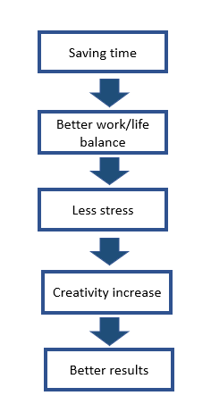

Personal freedom and satisfaction

Slide 11

Attractiveness and continuity of work and processes
Better flexibility at work is highly appreciated
Employees strive to retain their positions
People who take care of sick or elderly parents or small children fit into the social environment (Makatoa, 2016)
Hourly work increases the employment rate - giving students, those with different cultural or faith customs and people with a disability a chance to participate in the labour market

Slide 12

Sustainability
Last but not least:
Companies that promote environmental protection and carbon footprint reduction should be encouraged and valued highly for their moral standing
M&S and plan A program from 2007

Slide 13

References
Hays-Thomas, R., 2017. Managing Workplace Diversity. First ed. New York: Routledge.
Kattenbach, R., Demerouti, E., &Nachreiner, F. (2010). Flexible working times: Effects on employees' exhaustion, work-non-work conflict and job performance. Career Development International, Vol.15 No.3, pp. 279–295
Lazonick, W. and Prencipe, A. (2005), “Dynamic capabilities and sustained innovation: strategic control and financial commitment at Rolls-Royce Plc”, Industrial and Corporate Change,Vol. 14 No. 3, pp. 501-542.
M&S, n.d. About Us. (Online)
Available at: https://corporate.marksandspencer.com/about-us
(Accessed 19 11 2022).
M&S, n.d. Our People. (Online)
Available at: https://corporate.marksandspencer.com/sustainability/our-people
(Accessed 19 11 2022).
Makatoa, S. R., 2016. Flexible working should be the norm for everyone ; Susan Redden Makatoa ; TEDxMacquarieUniversity. (Online)
Available at: https://www.youtube.com/watch?v=EWSyCpqxbCg
(Accessed 11 11 2022).
Marks and Spencer, n.d. Marks in Time. (Online)
Available at: https://marksintime.marksandspencer.com/ms-history/timeline
(Accessed 19 11 2022).
Oseland, N. & Webber, C., 2012. Flexible Working Benefits, s.l.: Workplace Unlimited.
Shore, L. M., Randel, A. E., Chung, B. G., Dean, M. A., Ehrhart, K. H., & Singh, G. (2011). Inclusion and diversity in work groups: A review and model for future research. Journal of Management, Vol.37, pp. 1262–1289.

Slide 14


