Slide 1
Gender
ECED7005
Session 6
Sharon H Cole MA

Slide 2
Gender
“Gender refers to the characteristics of women, men, girls and boys that are socially constructed. ... Gender interacts with but is different from sex, which refers to the different biological and physiological characteristics of females, males and intersex persons, such as chromosomes, hormones and reproductive organs.”
(WHO, 2021)

Slide 3
Gender
Psychological, social and cultural differences between men and women
Linked to ‘socially constructed notions of masculinity and femininity’
Not necessarily a direct product of biological sex, but has been generally linked to this throughout our culture
        Giddens and Sutten, 2017
Notes:
Whatever our bodies sex is, is also our gender.

Slide 4
How we socially define men and women.
Gender norms are social norms defining acceptable and appropriate actions for women and men in a given group or society.
They are embedded in formal and informal institutions
Nested in the mind and
Produced and reproduced through social interactions
They are the expectations for masculinity and feminimity

Slide 5
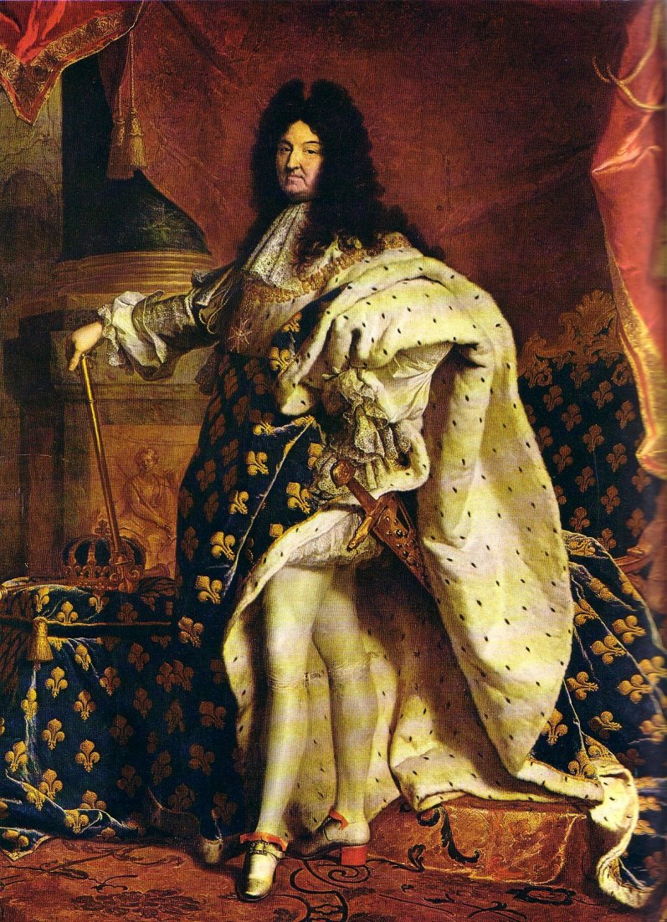
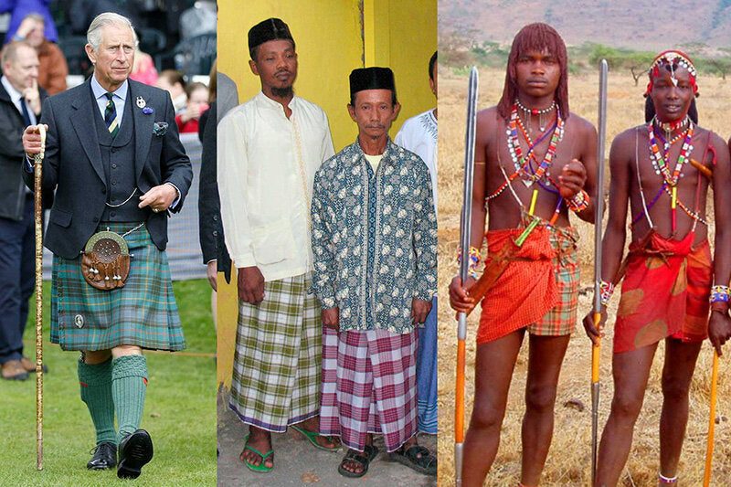
Historically
What it is to be a man or a woman depends largely on the historical period in which you live, together with class, age, ethnicity, race and nationality.

Slide 6


Slide 7
‘Games. Boys often prefer rough-and-tumble games, with lots of pretend-play fighting, while girls are less involved in these activities. Boys usually prefer outdoor play while girls generally like more sedate activities.
Aggression. Physical aggression (for instance, hitting, kicking) is more commonly seen between boys when they disagree than between girls. When girls bicker they are more likely to use words rather than physical aggression.
Clothes. Although boys and girls often wear the same type of clothes (sweatshirt, jogging pants, trainers) the chances are that amongst the children you care for, more girls than boys wear clothes that are coloured pink or pale yellow. Boys tend to wear darker colours.’ (Childcare.ie, xxxx)
Notes:
What year do you think this was written?

Slide 8
Types of Gender Stereotypes
Personality traits
Domestic behaviours
Occupations
Physical appearance.

Slide 9
Gender Socialisation
The learning of gender roles via social agencies;
    Family
    State
    Mass Media
Notes:
Distinguishes biological sex from social-cultural gender. An infant is born with the first but develops the second.

Slide 10
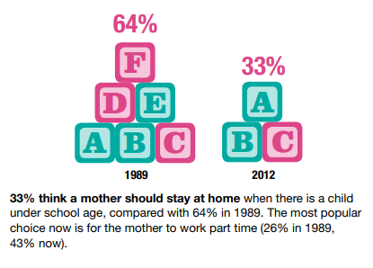
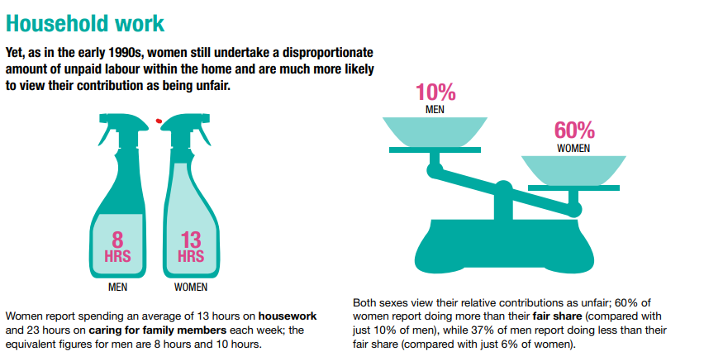
Family Gender Norms
Notes:
Support for a traditional division of gender roles has declined over time, though substantial support remains for women having the primary caring role when children are young.

Slide 11
State Gender Norms
The limiting effects of gender socialisation and stereotypes start early and may create gender inequities in education, employment, income and empowerment. Many children can see the restrictive impact of stereotypes, yet they are hard to resist when they want to fit in with their peers. While children should hear they can do anything or that gendered language is wrong, they also need these messages reflected in their learning, experience and environment. (King, 2023)
11% of Registered Nurses in the UK identify as male. 89% identify as female. (Nurses.co.uk, 2023)
As of 2024, 62.5 percent of police constables in England and Wales were males, compared with 35.4 percent who were female. (Clarke, 2024)
Notes:
How else are gender roles learnt through the state?

Slide 12
Mass Media and Gender Socialisation
Media significantly shapes perceptions of gender
Children are exposed to various media sources from a young age, influencing their views on gender
Traditional gender stereotypes are often perpetuated in media with women depicted as homemakers and men as active figures
Female characters in children’s programming are often underrepresented and shown in stereotypical roles

Slide 13

Gender Stereotypes
Notes:
2018

Slide 14
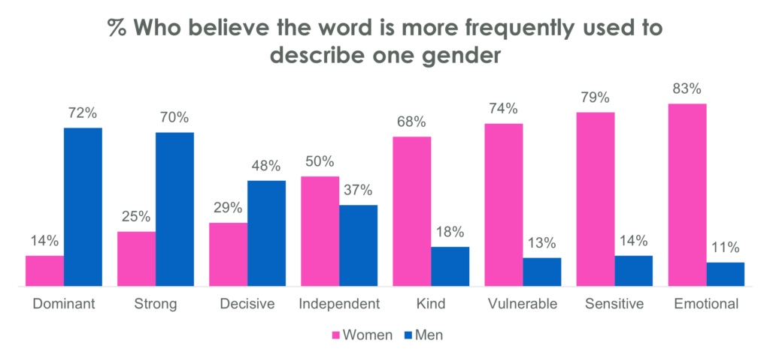
Gender Stereotypes UK

Slide 15
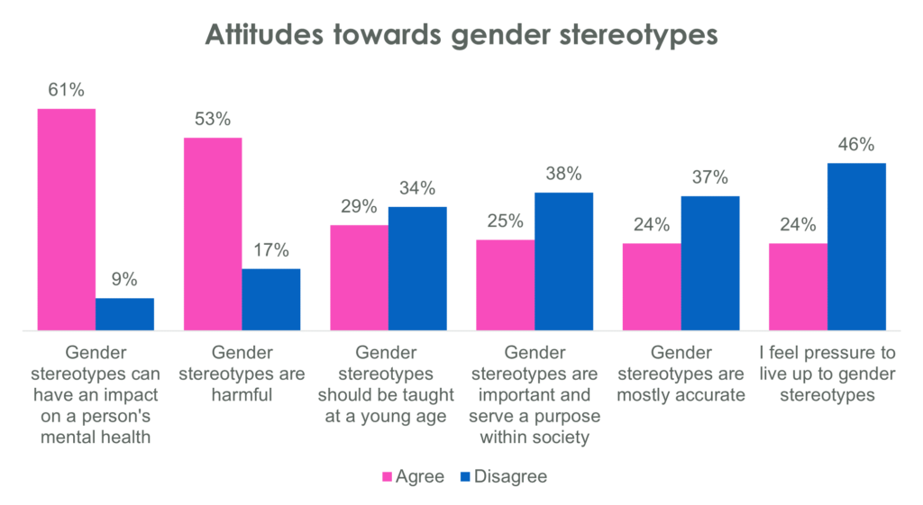

Slide 16
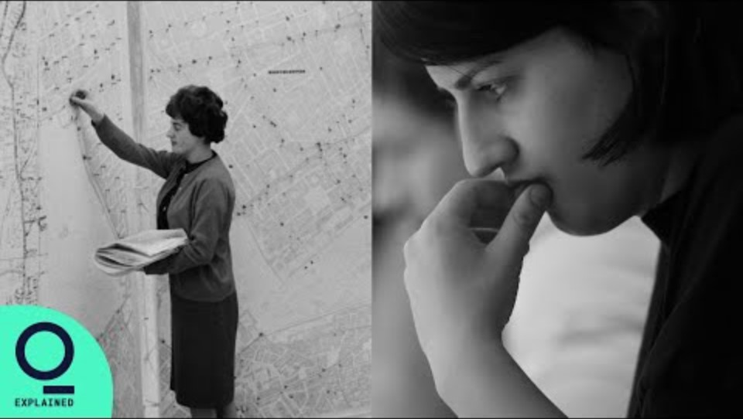
Gender Pay Gap

Slide 17
Flexible Working and Gender Equality?
When women work flexibly, it significantly increases their housework burden regardless of whether their husbands also use flexible working.
Gender norms in the UK are fairly traditional, encouraging women to derive their identity more from their family role than from work, so when they use flexible working, they tend to do more household labour, blurring the border between family and work.
Overall, instead of providing an opportunity for a more egalitarian division of housework, flexible working exacerbates the situation, increasing women’s already heavy domestic burden, and maintains or reinforces women’s disadvantaged position. Entrenched traditional gender norms mean that couples structure their work and family time in gendered ways.
(Wang & Cheng, 2024)

Slide 18
Gender pay gap or discrimination against working mothers?
Research suggests that the ‘motherhood penalty’ is now the most significant factor of the Gender Pay Gap.
In 2021 the Organisation for Economic Co-operation and Development (OECD) found that ‘the motherhood penalty accounted for 60% of the gender pay gap across 25 European countries’ ( PWC, UK 2023)
Social norms, gender stereotyping and discrimination making up the remaining 40%

Slide 19
Nature or Nurture?
Nature – biology creates inherent and deep-seated behavioural differences between men and women
Nurture – All behavioural gendered characteristics are constructed by the culture a person inhabits
A combination of the two – most gendered characteristics are culturally constructed, although some behavioural differences are hard to deny
What does setting up this depate in such a binary way tell us about our own period, context and culture?

Slide 20
Binary
What does setting up this debate in such a binary way tell us about our own period, context and culture?
The assumption that there are two, fundamentally different genders ‘correlating in a straightforward way to two oppositely sexed bodies’ (Cheadle, 2020)
Cheadle asserts that this too is impacted by culture

Slide 21
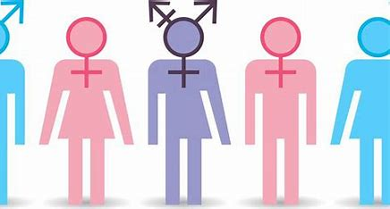
Gender Identities

Slide 22
How many Gender Identities are there?
How many identities are there? All 21 genders now officially recognised by the NHS and what they really mean | Express.co.uk
Sex, sexuality and gender do not mean the same thing.
What is your understanding of the terms sex, sexuality and gender?
Group feedback…

Slide 23


How many gender identities are there?
Female to male transgender (FTM)
Male to female transgender (MTF)
‘Bi-gendered’
‘Non-gendered’
Notes:
Although within our law within the UK only male and female are recognised.
bigender as a single person connecting with two distinct gender identities. The term became popularized in the 1980s within queer and trans communities as a way to describe people who aligned with multiple genders.
Non Gendered - Agender individuals, also known as genderless, gender-free, non-gendered, or ungendered, [32][33] have no gender at all. [34][35][13] This group represents a spectrum of identities that diverge from conventional gender norms.

Slide 24
Terminology – Sex, Sexuality & Gender
“Sex“ refers to the biological status of male or female. It includes physical attributes such as chromosomes, reproductive organs and genitalia.
“Sexuality” refers to a persons emotional and physical reaction to other sexes and genders.
“Gender” refers to how people feel about themselves and their emotional and personal identity.

Slide 25
Gender
“Gender is hierarchical and produces inequalities that intersect with other social and economic inequalities.
Gender-based discrimination intersects with other factors of discrimination, such as ethnicity, socioeconomic status, disability, age, geographic location, gender identity and sexual orientation, among others. This is referred to as intersectionality. ”
(WHO, 2021)

Slide 26
Gender and Labels
These represent one set of labels for people in the ‘gender variant’ community
It is important to remember that there are many ‘gender identities’
One person’s experience of being ‘male’ will be different from anther person’s
Some labels are chosen by ‘gender variant’ people for themselves and some are imposed upon them by society

Slide 27
Gender Identity – Increasing Complexity
In the late 20th century the acronym LGBT was used
What do the initials LGBT stand for?
Today, however, activists and campaigners use LGBTQIA+
What do the initials QIA stand for?

Slide 28
Gender Identity – Increasing Complexity
Queer
Intersexual
Asexual
What do you understand these terms to mean?
Why do you think they are used by people in the gender variant community?

Slide 29
Terminology – Gender
Gender identity
One's innermost concept of self as male or female or both or neither—how individuals perceive themselves and what they call themselves.

Slide 30
Gender Identity – Increasing complexity
It is difficult to find accurate figures on the number of people who are transgender and gender variant
“There are huge inconsistencies in population estimates of both transsexual people and the less clearly defined trans community”.
Estimates of people who have undergone gender realignment vary from 2,400 to 6,500
Estimates of people who are gender variant vary from 65,000 to 300,000

Slide 31
Gender variance / Gender non-conforming
Gender variance refers to the extent to which a person’s gender identity or expression of gender differs from the cultural norms of society expected of people of a particular biological sex

Slide 32
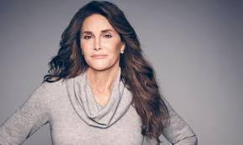

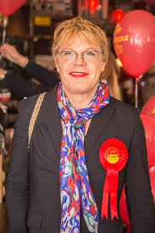
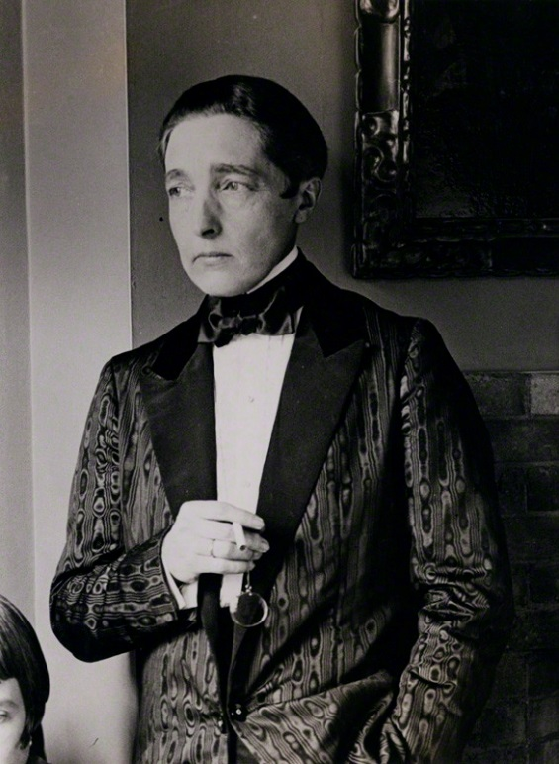
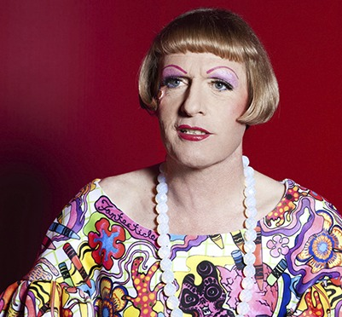

Slide 33
Terminology – Gender
Gender expression
Where as gender identity is ‘internal’ gender expression relates to the way in which an individual presents their gender to those around them.
Individuals express their gender in a variety of ways including:
Their behaviour,
Their style of dress,
Their hairstyle,
Their voice or body characteristics

Slide 34
Terminology – Gender
‘Passing’
This phrase is used by gender variant people to describe the situation where society accepts them in their chosen gender identity.
For example, a FTM transgender person being accepted by (most) people as a man.

Slide 35
Terminology – Gender
Transphobia
“The irrational fear of those who are perceived to break or blur stereotypical gender roles, often expressed as stereotyping, discrimination, harassment and violence. Frequently directed at those who defy stereotypical gender norms or those who are perceived to exhibit non heterosexual characteristics regardless of their actual gender identify or sexual orientation”.
Darrell (2015)

Slide 36
Terminology – Gender
Gender dysphoria
“Based on the Greek (dys‐phoria: hard to bear), this is the medical term for the condition in which a person who has been assigned one gender at birth on the basis of their physical sex self‐identifies as belonging to another gender. People who experience gender dysphoria are in no way mentally ill, but they often suffer great stress from hiding their identity”.
Jackson (2017)

Slide 37
Terminology – Gender
Gender dysphoria
There are four possible outcomes for people who present with the dilemma of gender dysphoria:
an unresolved outcome,
acceptance of one's given gender,
engaging in a cross-gender role on a part-time basis, and
making a full-time transition to the other gender role.
Carroll (1999)

Slide 38
Terminology – Gender
Gender dysphoria
In each individual case the causes and treatment for gender dysphoria are different
Treatments can include
Counselling,
Psychotherapy
Hormone therapy
Gender re-alignment surgery

Slide 39
Terminology – Gender
Gender dysphoria
For some people counselling and psychotherapy can help them come to terms with their feelings of confusion and dysphoria
For others hormone therapy (testosterone for FTM and oestrogen for MTF) is sufficient
In the UK a person has to spend a year living in their preferred gender role before they can have surgery. This is known as ‘social gender role transition’

Slide 40
Terminology – Gender
Transition
This describes the process of changing gender identity
The process of transition can include the following:
Changing one’s name
Living as the chosen gender identity
Taking hormone therapy
Surgery
Changing legal documents (e.g. Driver’s licence, Birth Certificate etc.)
Application for a Gender Recognition Certificate

Slide 41
Gender Recognition Certificate
Established by the Gender Recognition Act 2004
Applications are made to the Gender Recognition Panel
Applicants need to meet certain requirements in order to be granted a GRC
The Government set up a consultation on this in 2018 but to date the results have not been released.

Slide 42
Gender Recognition Certificate
Read the HM Courts and Tribunals Service General Guidance on Gender Recognition
https://researchbriefings.files.parliament.uk/documents/CBP-9079/CBP-9079.pdf
Or, search for Courts and Tribunals Service T455
Discuss the document in groups and identify:
The stages in the process of applying for a GRC
Any issues that you can identify with the process
https://www.gov.uk/apply-gender-recognition-certificate

Slide 43
2020 Government Consultation
Nearly two thirds (64.1 per cent) called for the requirement for a diagnosis of gender dysphoria to be removed.
Four in five (80.3 per cent) supported the removal of the requirement for a medical report detailing all treatment.
Nearly four in five (78.6 per cent) called for the removal of the requirement for individuals to provide evidence of having lived in their ‘acquired gender’ for a period of time.
Five in six (84.9 per cent) called for the removal of the requirement that a married trans person must obtain consent from their spouse before successfully getting legal gender recognition

Slide 44


Slide 45
A New Legal Battle in Scotland
https://www.bbc.co.uk/news/articles/cy8p41z972vo
Take some time to read through this and then discuss in class any social implications.

Slide 46
Issues that Transgender People Face
Discrimination against transgender people is included in the Equality Act
The Equality and Human Rights Commission have a wealth of information on this issue at
https://www.equalityhumanrights.com/en/advice-and-guidance/gender-reassignment-discrimination
You should watch the video on this webpage

Slide 47
Impact on Individuals: Sport
As well as watching the video from the previous slide you should also read, watch and listen to the following;
UK Athletics bans transgender women from competing in female category - BBC Sport
https://www.bbc.co.uk/sport/46453958
https://www.bbc.co.uk/sport/athletics/47467522
https://www.bbc.co.uk/news/av/uk-scotland-47448863/transgender-debate-playing-for-a-women-s-team-didn-t-seem-possible
https://www.bbc.co.uk/programmes/w172w4pxcth6mmt
Discuss the issues raised by these stories

Slide 48
Non-Binary
an umbrella term for people who don't identify as exclusively male or female. It can also refer to identities that fall outside the male/female gender binary, such as agender, bigender, genderqueer, or gender fluid.
It is difficult to estimate the number of individuals in the UK who do not identify within binary genders as most research has not gathered responses from this group
Individuals within this group use can use pronouns; they/them/theirs
This is not new and there are many non-binary genders recognized by cultures around the world including; Hijra, the Bugis, Muxes, Sekrata, two spirit, Bakla

Slide 49
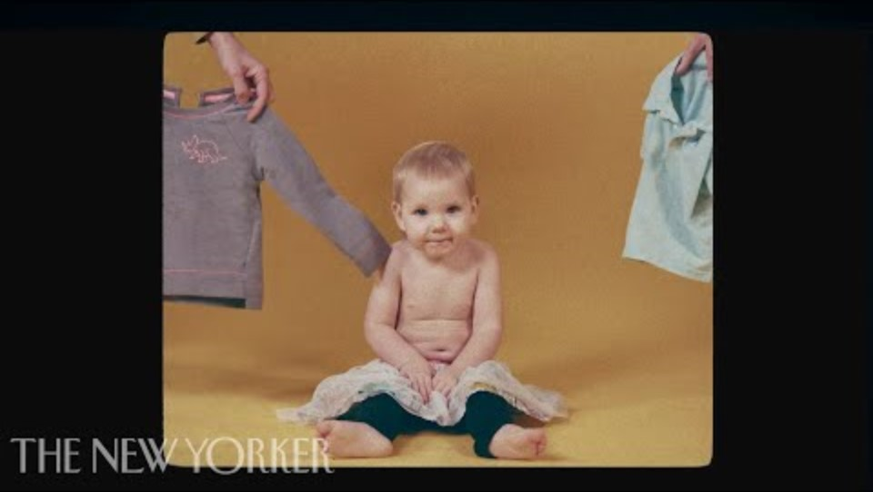
Avoiding Gender Socialisation

Slide 50
Reference List
Carroll, R.A. (1999) ‘Outcomes of Treatment for Gender Dysphoria’ Journal Of Sex Education And Therapy Vol. 24 , Iss. 3
Darrell, J. (2015) Gender Diversity Awareness The Beaumont Trust Available at http://www.beaumont-trust.org.uk/ [Accessed 05/03/2017]
Gittins, D (1993) The Family in Question: Changing Households and Familiar Ideologies, Basingstoke: Macmillan.
Goldthorpe, JH (1987) Social Mobility and Class Structure in Modern Britain, Oxford: Clarendon Press.
HM Courts and Tribunals Service (2016) Gender Recognition Act 2004: The General Guide for All Users London: HMCTS Available at https://assets.publishing.service.gov.uk/government/uploads/system/uploads/attachment_data/file/786910/t455-eng.pd f [Accessed 18/03/2020]
Jackson, Justice P. (2017) JUDGMENT: J v B (Ultra‐Orthodox Judaism: Transgender) Available at https://www.judiciary.gov.uk/judgments/j-v-b-and-the-children-ultra-orthodox-judaism-transgender/ [Accessed 18/03/2020]
McKie, L & Callan, S (2012) Understanding Families: A Global Introduction, London: Sage.

Slide 51
Reference List
Muncie, J. et al (Eds) (1997) Understanding the Family London: Sage
Murdock, GP (1949) Social Structure, New York: Macmillan.
Newman, D.M. & Grauerholz, L. (2002) Sociology of Families Thousand Oaks: Pine Forge Press
NHS (2016) Gender Dysphoria: Treatment Available at http://www.nhs.uk/Conditions/Gender-dysphoria/Pages/Treatment.aspx [Accessed 18/03/2020]
Office of National Statistics (2009) Trans Data Position Paper London: ONS
Parke, R.D. (2013) Future Families: Diverse Forms, Rich Possibilities, Chichester, Sussex: Wiley Blackwell.
Ribbens McCarthy, J & Edwards, R (2011) Key concepts in Family Studies, London: Sage.
Steel, L, Kidd, W & Brown, A (2012) The Family, Basingstoke, Hampshire: Palgrave Macmillan.
University of California (No Date) LGBTQIA Resource Centre Glossary Available at http://lgbtqia.ucdavis.edu/educated/glossary.html [Accessed 18/03/2020]
UK Government (2004) Gender Recognition Act Available at http://www.legislation.gov.uk/ukpga/2004/7/contents [Accessed 18/03/2020]
Wiseman, M. & Davidson, S. (2011) ‘Problems with binary gender discourse: Using context to promote flexibility and connection in gender identity’ in Clinical Child Psychology and Psychiatry Volume 17(4) pp.528–537

Slide 52
Reference List
APA, https://www.apa.org/pi/lgbt/resources/sexuality-definitions.pdf
WHO, (2021) Gender and Health Available at: https://www.who.int/health-topics/gender#tab=tab_1 (Accessed: 20 January 2021).

