Slide 1

UWTSD
Oral Presentations - Tips and Techniques
Notes:
Suggestion 1 for PPT template – clear and simple – can we use CU logo? And lock PPT.

Slide 2
Oral Presentations - Lesson aims
You will be able to recognise features of good and bad presentations
You will be more familiar with the structure of an academic presentation
You will understand what is required for the homework task

Slide 3
Oral Presentations
Make brief notes on the questions below:
Have you ever given a presentation to a group of people before?
What language did you use?
What did you talk about?
Did you have any problems?
Did you enjoy giving the presentation?

Slide 4
Oral presentations
What makes a good presentation?
When delivering a presentation your listeners will be judge you on certain criteria ie. the things you need to do well in order to impress your audience.
eg. having a clear logical structure
Think of 3 other things that you will need to do to perform a successful presentation:
1
2
3

Slide 5
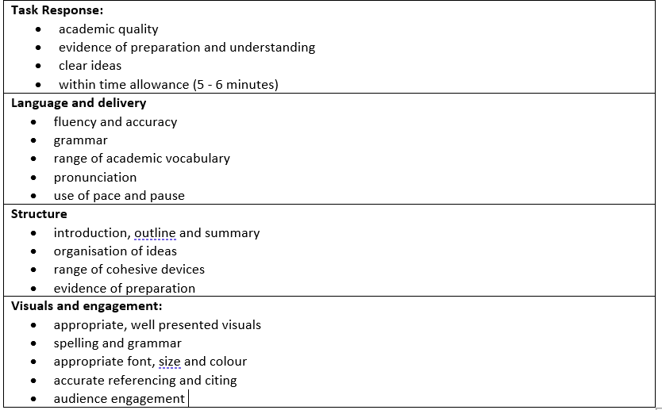
Presentations
These are the things you are usually judged on by your audience

Slide 6
Presentations - some clever ideas
https://www.youtube.com/watch?v=k8GvTgWtR7o

Slide 7
Presentations - questions
Choose the best answer to the following 12 questions.
1. Engaging your audience should take:
a) 30 seconds - 1minute b) 5minutes
2. A good presenter is:
a) cautious b) spontaneous
3. Should you make eye contact with your audience?
a) yes b) no

Slide 8
Presentations - questions
4. It is impossible to overcome nerves.
true b) false
5. You should use:
subject specific vocabulary (jargon) b) simplified vocabulary
6. Always have a script
right b) wrong
7. Visual aids need to be
a) detailed b) simple

Slide 9
Presentations - questions
8. It isn’t a problem to go over time if you have more information to give to the audience.
a) true b) false
9. Your material should be:
a) suitable for your audience b) suitable for the subject matter
10. Pausing is:
a) positive b) negative
11. You should explain the structure of your presentation at the beginning
a) true b) false

Slide 10
Presentations - answers
1. Engaging your audience should take a) 30seconds - 1minute or perhaps even less for short presentations – It is better to quickly capture your audience’s attention and focus them on what you are going to talk about.
2. A good presenter is a) cautious
Always stick to what you have planned to say so you do not go off topic.
3. Should you make eye contact with your audience? a) yes
Eye contact will make the audience more engaged and interested in your presentation. It will also add a personal touch .
4. It is impossible to overcome nerves. b) false,
The more you practice your presentation in front of a mirror for example, the less nervous you may feel on the day.

Slide 11
Presentations - answers
5. You should use b) simplified vocabulary – You want your audience to understand your message, as they may have no previous knowledge of the subject.
6. Always have a script b) wrong, use cue cards - Reading your presentation may show that you do not understand your topic. Using cue cards can make you look more relaxed, in control and comfortable with what you are talking about.
7. Visual aids need to be b) simple – You do not want to confuse your audience with complicated graphs and statistics. It is better to have a simple image and then explain what it represents or shows.

Slide 12
Presentations - answers
8. It is not a problem to go over the time if you have more information to give to the audience. b) false - It is only fair that every student has the same amount of time. Sticking to the time limit shows you can manage your time, and that you have not spoken for too long or slowly on one particular section of your presentation.
9. Your material should be a) suitable for your audience – Your audience may not know anything about your topic, so it is important that they can understand what you are talking about.
10. Pausing is a) positive - This shows that you are not nervous and that you are in control.

Slide 13
Presentations - answers
11. You should explain the structure of your presentation at the beginning
a) true – This will tell the audience exactly what you are going to talk about and in what order, so they know what to expect.
12. Putting your hands in your pockets will have a positive effect on the audience
b) false (body language will not be assessed online but important to know) Body language can add more impact to your points and strengthen your message and ideas. It also shows you are interested and passionate about your subject.

Slide 14
Structure
Listed below are the 7 sections of a typical academic presentation:
1) Welcome / engage the audience
2) Introduce yourself
3) Introduce subject; give background and reasons why this subject is important
4) Outline main points – the main body
5) Conclusion; summary, implications and final thought
6) References – if relevant
7) Audience questions

Slide 15
Oral Presentations - Task
Plan and design an oral presentation to be delivered in next week’s lesson…
Use visuals, eg, ppt slides if you think it will enhance your presentation.
Your presentation should be no longer than 5 minutes long...
You shouldn’t need anymore than 5 slides…
Topic – choose and explain an aspect of Chinese art, culture or tradition to your audience (assume your audience knows nothing about the topic ie. me!)
https://www.phuse.eu/blog/8-tips-to-improve-virtual-presentations-new-

Slide 16


