Slide 1
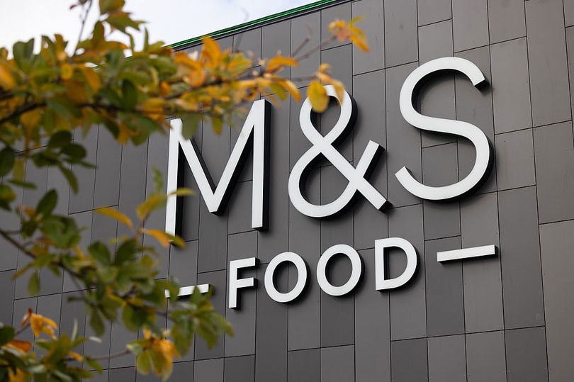
CRITICAL EVALUATIONOF THE IMPACT OF CMR ON
PRESENTED BY: DIMITRICHKA GEORGIEVA
STUDENT NUMBER (2116247)
DATE :11/12/2025
MODULE: BUILDING A SUSTAINABLE MARKETING RELATIONSHIP
LECTURE :GWYNETH JONES

Slide 2
INTRODUCTION & OVERVIEW
M&S POSITIONING: PREMIUM CONVINENCE, FOCUSED ON QUALITY AND TRUSTED VALUE.
CRM TOOLS: SPARKS LOYALTY PROGRAMME (CENTRAL DATA EXCHANGE).
PREFORMANCE CONTECT: FOOD DEVISION SHOWS STRONG 8.7% SALES GROWTH.
FOCUS : EVALUATION OF HOW DIGITAL & SPCIAL MEDIA ARE USED TO BUILD AND SUSTAIN CUSTOMER RELATIONSHIPS.

Slide 3

DEFINING DIGITAL & SOCIAL CHANNELS
TRANSACTIONAL DATA-DRIVEN ( SPARKS APP, WEBSITS,EMAILS.
EMOTIONAL & COMMUNICATIVE (INSTAGRAM TIK TOK).

Slide 4

SUSTAINING RELATIONSHIPS
SUCCESS RETENTION : DIGITAL CHANNELS ENABLE PROACTIVE CHURN PREDICTION (M&S FOOD ANALYSIS,2015).
TARGETED OFFERS INTERVENE TO SUSTAIN RELATIONSHIP ( BUTTLE,2009).
CRITICAL RISK TRUST : HEAVY DATA COLLACTION CREATES RISK OF FEELING " TOO NOSEY".
LOSS OF TRUST LEADS TO RELATIONSHIP FAILURE (MOLLER,2009).

Slide 5
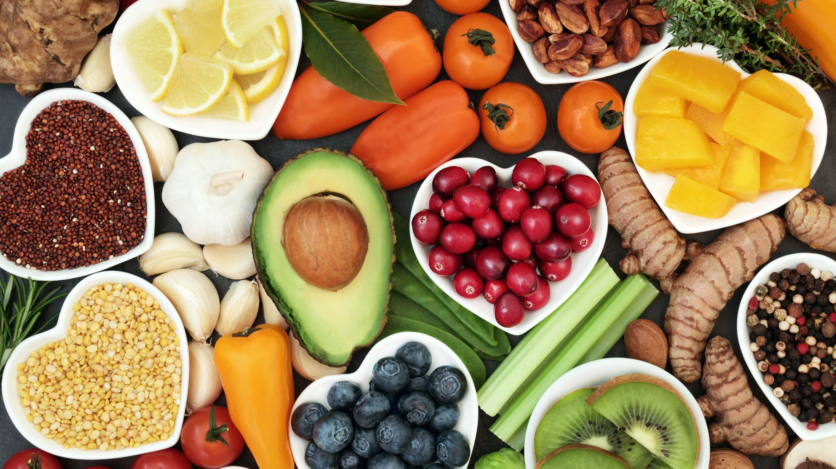
ENHANCING EXPERIENCE & ENGAGMENT
POSITIVE IMPACT : PERSONALIZED REWARDS LET TO 15.7% INCREASE IN CUSTOMER SATISFACTION ( M&S FOOD ANALYSIS,2025).
ALIGNS WITH THE 4Cs MODEL( LOUTERBORN,1990)
IMPROVEMENT PRICE PRECEPTION: M&S IS VULNERABLE TO THE " TOO EXPENSIVE " TAG.
RECOMMENDATION: TO USE DIGITAL CHANNELS TO COMMUNICATE " HIDDEN VALUE" (SOURSING ?QUALITY) TO JUSTIFY PREMIUM PRICE ( PORTER,1985).

Slide 6
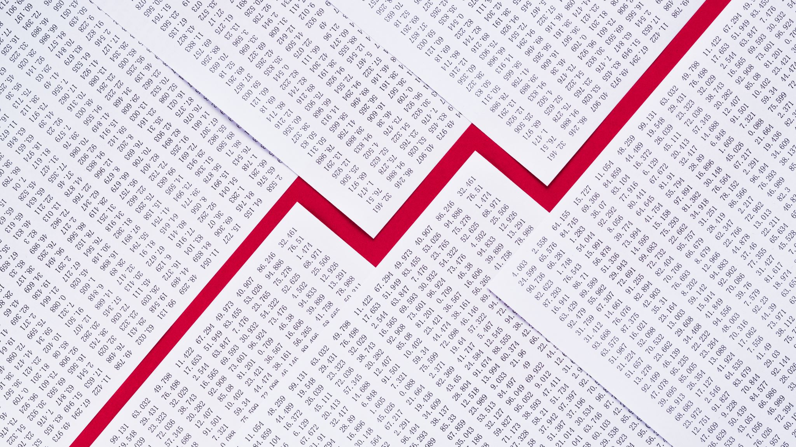
SUPPORTING ORGANISATION PERFORMANCE
FINANCIAL SUCCESS: STRATEGY SUPPORTS CURRENT 8.7% SALES GROWTH. MAXIMIZES CUSTOMER LIFTIME VALUE.(CLV) ( KOTLER & KELLER,2016).
CRITICAL RISK DEPENDENCY: SYSTEM RELIES ON PAST PURCHASE DATA.
VULNERABLE TO EXTERNAL ECONOMIC DOWNTURN ( M&S FOOD ANALYSIS2026),MAKING PAST DATA IRRELEVANT.

Slide 7

REFERENCE LIST
Johnson (2023): M&S Archive Food Timeline.
Link: https://archive.marksandspencer.com/timeline/food/
Kotler, P., & Keller, K. L. (2020): Principles of Marketing, Global Edition, 18th Edition. Pearson Education.
Concept: Cited for Customer Lifetime Value (CLV) and long-term customer relationship
Marks & Spencer Corporate (2025): 2025 Annual Report & Financial Statements (Full Year Results for 52 Weeks Ended 29 March 2025). Marks & Spencer Group.
Link: https://corporate.marksandspencer.com/sites/m-arksandspencer/files/09-2025/SIGNED%20Financial%20Statements%20-%20Marks%20and%20Spencer%20plc%20FY25.pdf
Marks & Spencer Corporate (2025): Plan A - Our Planet: Sustainability Report Update. Marks & Spencer Group.
Link: https://corporate.marksandspencer.com/sustainability/sustainability-ms
Morgan, A., & Smith, J. (2022): Digital Transformation in the Customer Experience.
Link: https://www.researchgate.net/publication/386519617_Digital_Transformation_in_th
Payne, A., & Frow, P. (2017): Strategic Customer Management: Integrating Relationship Marketing and CRM. Cambridge University Press.
Concept: Cited for the reliance on collecting and analyzing data for long-term customer relationships.
Link: https://www.cambridge.org/core/books/strategic-customer-management/7C4D36EC74B57D8A8B43DB31229B9F0
Porter (1985): Differentiation Strategy.
Concept: Achieving competitive advantage through unique, superior value to justify a premium price.
Retail Gazette (2024): M&S profits soar as it sees 'strongest value perception' in a decade (November 2024 Article).Link: https://www.retailgazette.co.uk/blog/2024/11/m-s-profit-up/
The MBS Group (2020): M&S Renews Its Iconic Sparks Loyalty Scheme in Digital Push (July 2020).
Link: https://www.thembsgroup.co.uk/external/ms-renews-its-iconic-sparks-loyalty
YouGov (2020): Relaunched M&S Loyalty Scheme Sparks Customer Satisfaction Boost (July 2020).
Link: https://yougov.co.uk/en-gb/articles/31110-relaunched-ms-loyalty-scheme

