Slide 1
Training
Claire Edwards 1812182

Slide 2
Definition of Training
‘Training and development is critical for any professional. It helps you improve your performance and helps your organization meet its business goals. Building new skills makes an individual more efficient at a job or capable of handling different responsibilities and challenges.’ (Knowledgehut.com. 2020).

Slide 3
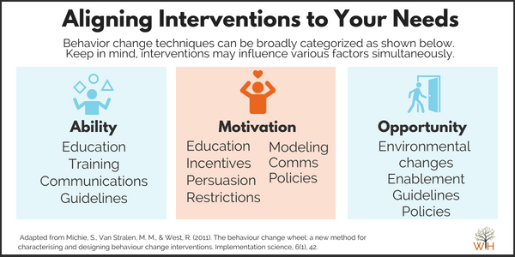
AMO Theory
‘Drawing on the AMO theory, we predict that the effectiveness of performance management implementation will be a function of three factors. First, line managers should have the Ability to enact the activities that are involved in performance management. Secondly, they should be Motivated to perform these activities. Thirdly, line managers should have sufficient Opportunity to fulfill these activities on top of the demands from other organizational.’ (Thomas Van Waeyenberg, 2020).
‘The AMO theory suggests that there are three independent work system components that shape employee characteristics and contribute to the success of the organization. According to the theory, organizational interests are best served by a system that attends to the employees ability, motivation, and opportunity’ (Study.com. 2020).
‘Training typically focuses on providing employees with specific skills or helping them correct deficiencies in their performance.’ (Iosrjournals.org. (2020).

Slide 4
Positive’s and Negative's to training
‘Training becomes mandatory under each and every step of expansion and diversification. Only training can improve the quality and reduce the wastages to the minimum. Training and development is also very essential to adapt according to changing environment.’ (Your Article Library. 2014).
(Bizfluent. 2020). Says that ‘One of the biggest potential disadvantages of training employees is the cost of the process. If you handle the training internally, it costs money because you have to pay one of your employees for training instead of doing productive work. If you use an outside trainer, you have to pay him for his time. You could send your employees to a seminar or training conference in another location, which also can represent a substantial cost for the company.’
The purpose of HR development is to provide the 'coaching' needed to strengthen and grow the knowledge, skills, and abilities that an employee already has. The goal of development and training is to make employees even better at what they do. (study.com. 2020)
Positives to training.
important activity of HRD
improves efficiency
Develops self confidence and existing life skills
Identifies skill gaps
Negative’s to training.
Unhappy, Unsatisfied Employees
Unsafe Work Environments
Reduced Productivity

Slide 5
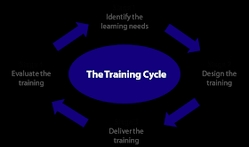
The training cycle

Slide 6

Asda Training
‘We have recently introduced a program called ‘You Can Be’. This has been designed to enable colleagues to take charge of their own development journey and supports them in shaping a truly personalised schedule of learning that meets their own development needs.’(Asda.com. 2020)

Slide 7
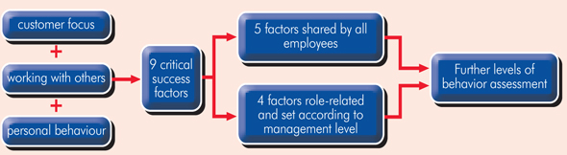
Tesco training
(Business Case Studies. 2019). Says that ‘The Tesco Leadership Framework focuses on three key themes to guide appropriate behaviour in employees. These link to nine critical success factors, which break down further into various levels of assessment. This framework helps to identify those employees with the potential to be the 'best leaders of the future.’

Slide 8
Asda.com. (2020). Asda.com - Online Food Shopping, George, & more. [online] Available at: https://www.asda.com/creating-change-for-better/better-lives/great-place-to-work [Accessed 29 Oct. 2020].
Bizfluent. (2020). What Are the Disadvantages in Training Employees?. [online] Available at: https://bizfluent.com/info-8026443-disadvantages-training-employees.html [Accessed 3 Nov. 2020].
Knowledgehut.com. (2020). How Training Development can change your career?. [online] Available at: https://www.knowledgehut.com/blog/career/why-training-development-is-important-in-your-life [Accessed 24 Oct. 2020].
Line managers’ AMO to manage employees’ performance: the route to effective and satisfying performance management. (2020). The International Journal of Human Resource Management, [online] p. Available at: https://www.tandfonline.com/doi/full/10.1080/09585192.2018.1445656?scroll=top&needAccess=true [Accessed 29 Oct. 2020].
Iosrjournals.org. (2020). [online] Available at: http://www.iosrjournals.org/iosr-jbm/papers/Vol16-issue3/Version-3/D016332735.pdf [Accessed 26 Oct. 2020].
Study.com. (2020). [online] Available at: https://study.com/academy/lesson/human-resource-development-definition-importance.html [Accessed 29 Oct. 2020].
Study.com. (2020). [online] Available at: https://study.com/academy/lesson/amo-theory-ability-motivation-opportunities.html#:~:text=The%20AMO%20theory%20suggests%20that,%2C%20and%20opportunity%20(AMO). [Accessed 26 Oct. 2020].
Business Case Studies. (2019). 4 how training and development supports business growth - Business Case Studies. [online] Available at: https://businesscasestudies.co.uk/how-training-and-development-supports-business-growth/ [Accessed 4 Nov. 2020].

