Slide 1

Typography & Illustration

Slide 2
For this weeks task you can select an article based on one of the following current affairs news stories-
Voting for 16 & 17 year olds in Wales
The death of Prince Phillip
NASA flies helicopter on Mars
Pubs reopening
M&S v Aldi Caterpillar cake

Slide 3
Today’s brief is to do with combining the image and the typography and not seeing them as separate elements. You can combine just some keys words, the title or all the article, what we are looking for is a cohesive overall image.
Firstly find an appropriate article
Create a range of rough visuals, approx 10
Final artwork which combines the image and the text

Slide 4
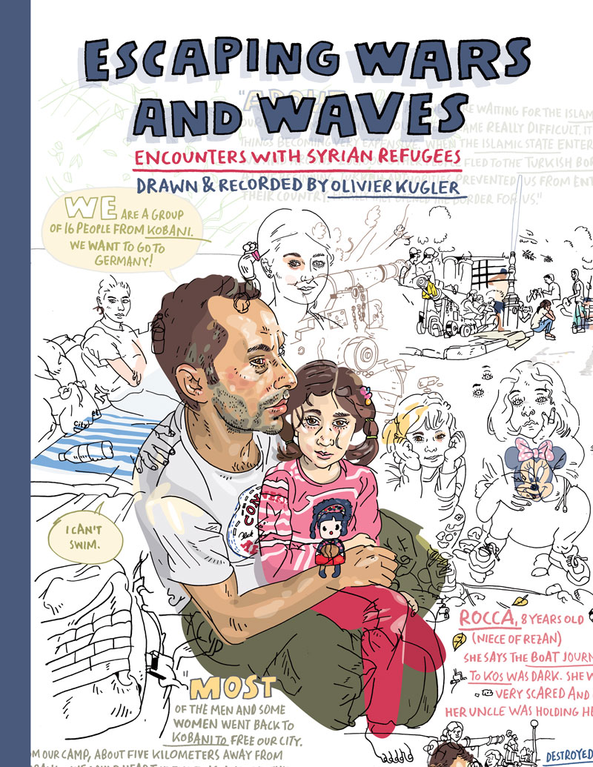
Olivier Kugler

Slide 5
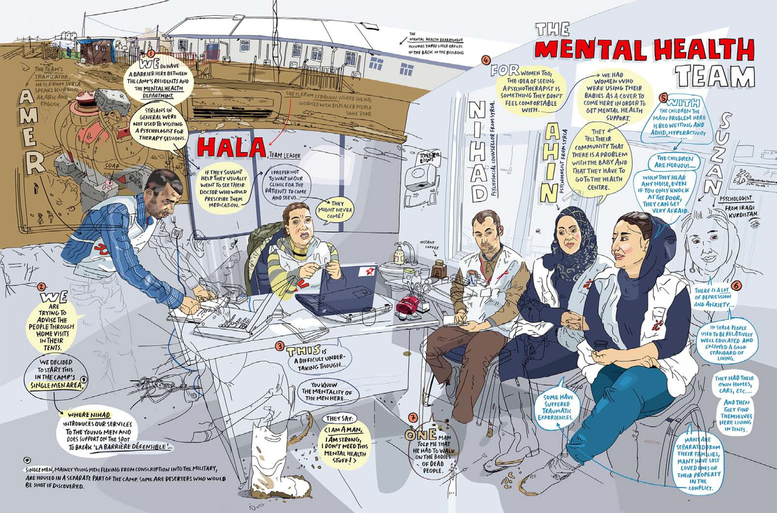

Slide 6
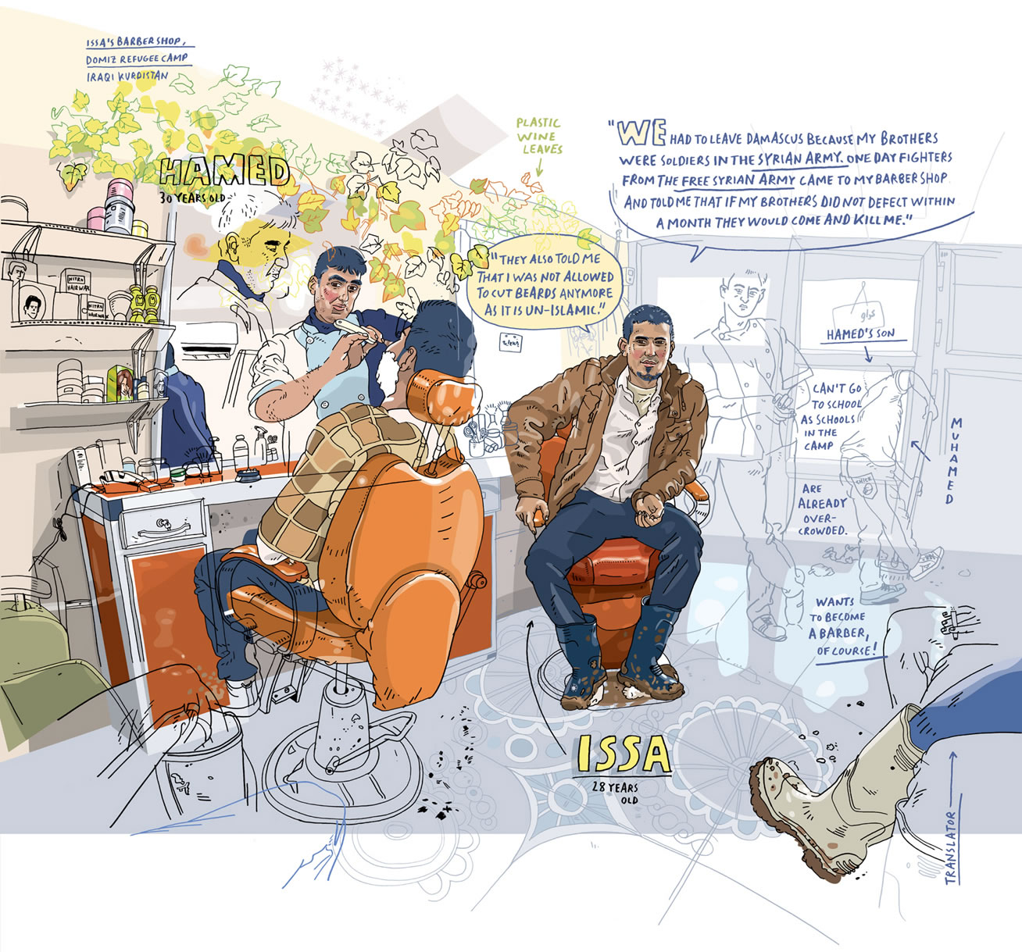

Slide 7
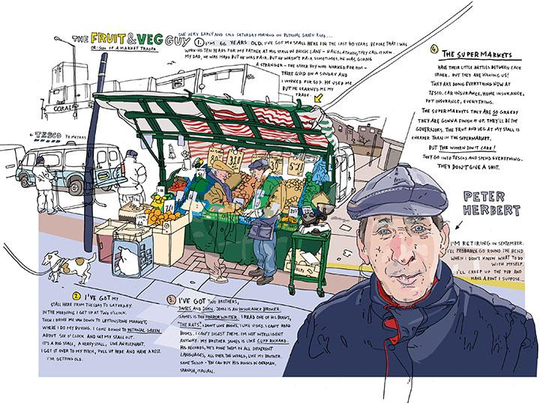

Slide 8
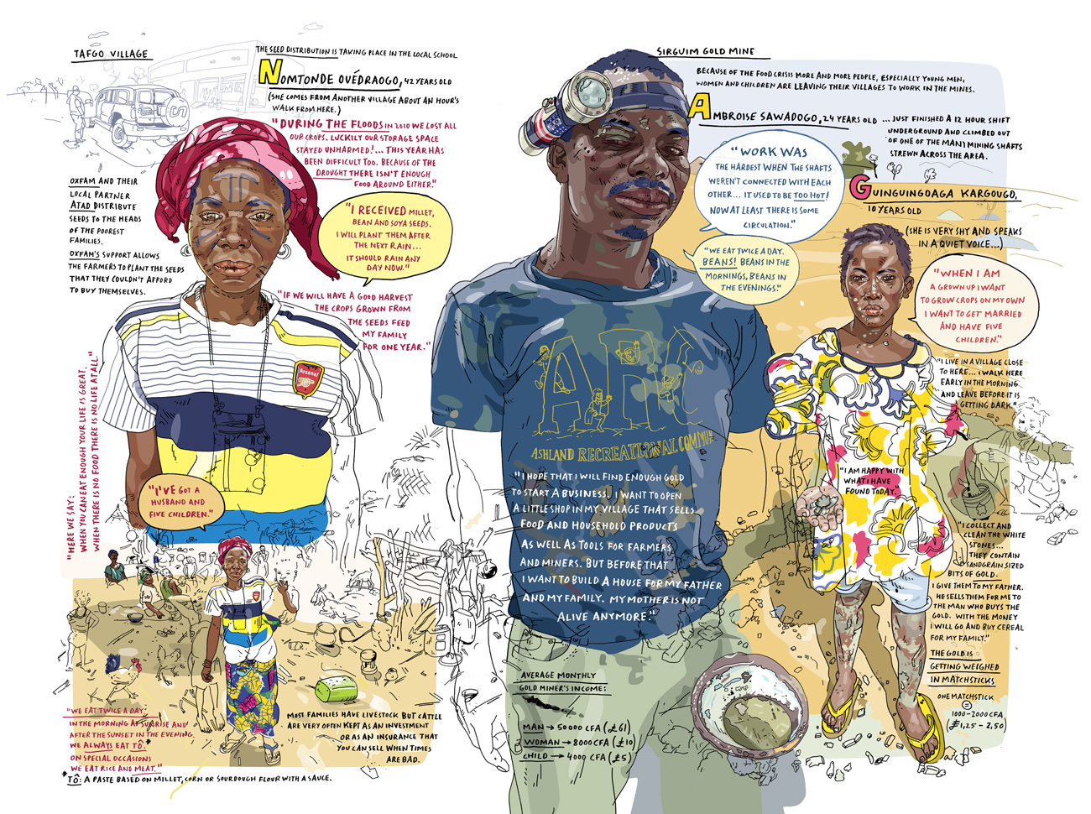

Slide 9
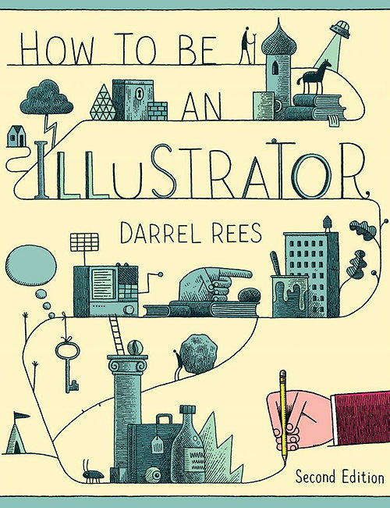

Slide 10
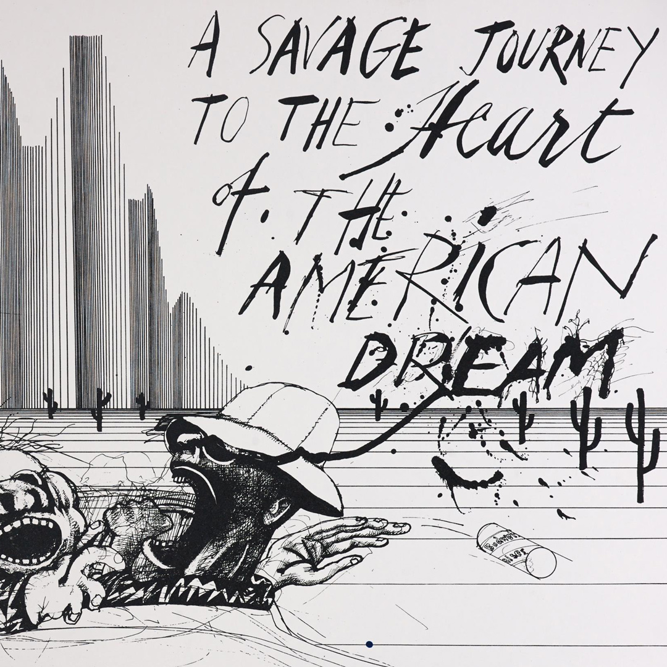
Ralph Steadman

Slide 11
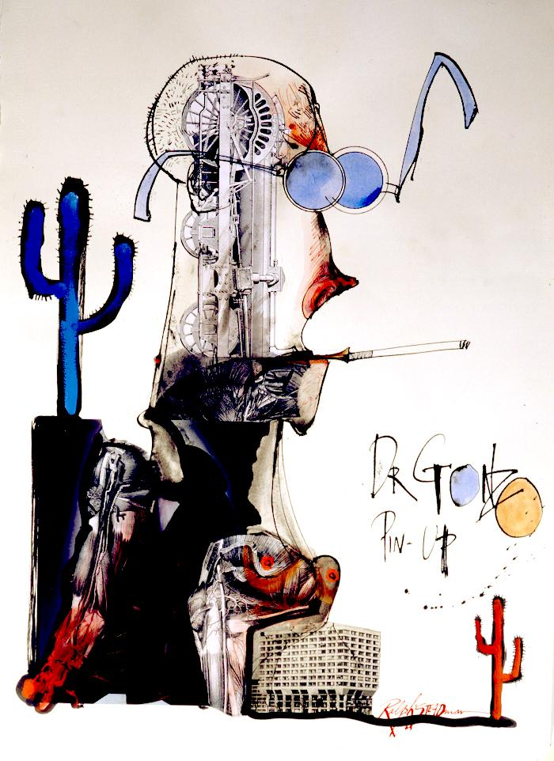

Slide 12
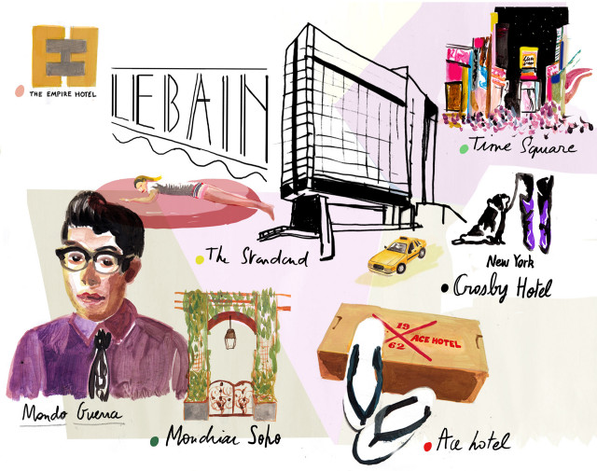
Nina Cosford

Slide 13
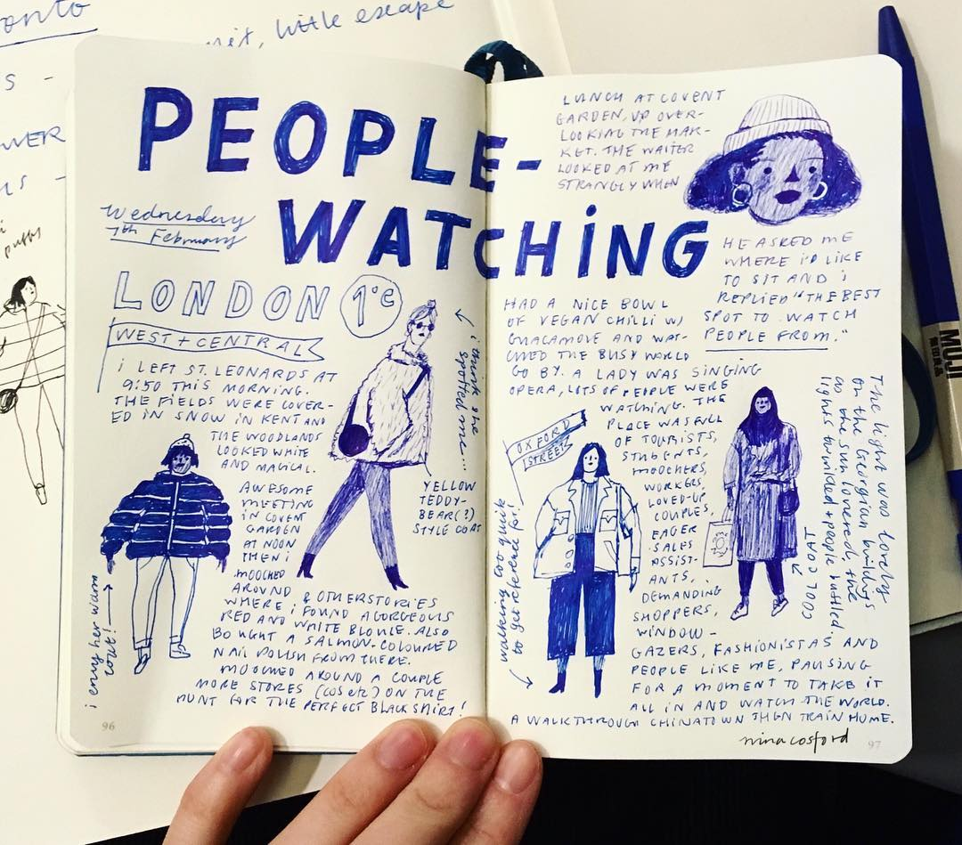
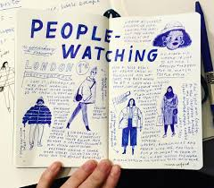

Slide 14
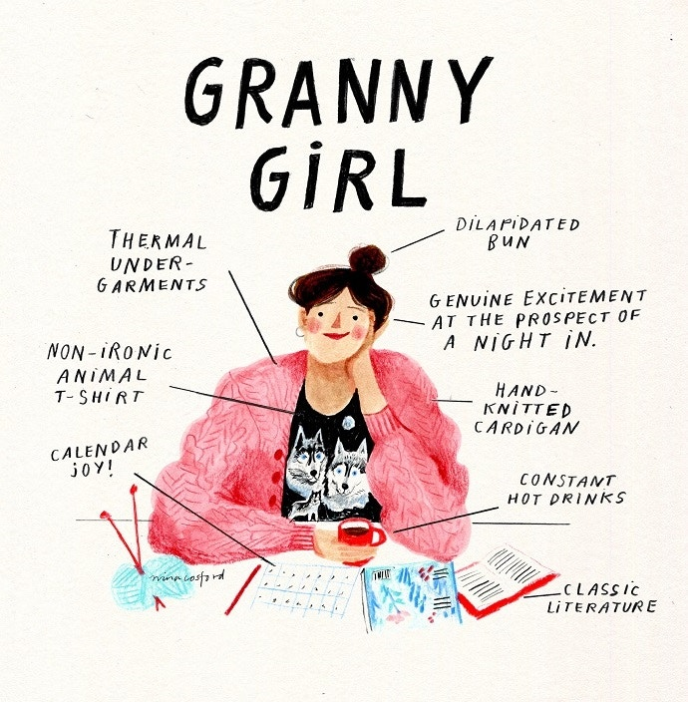

Slide 15
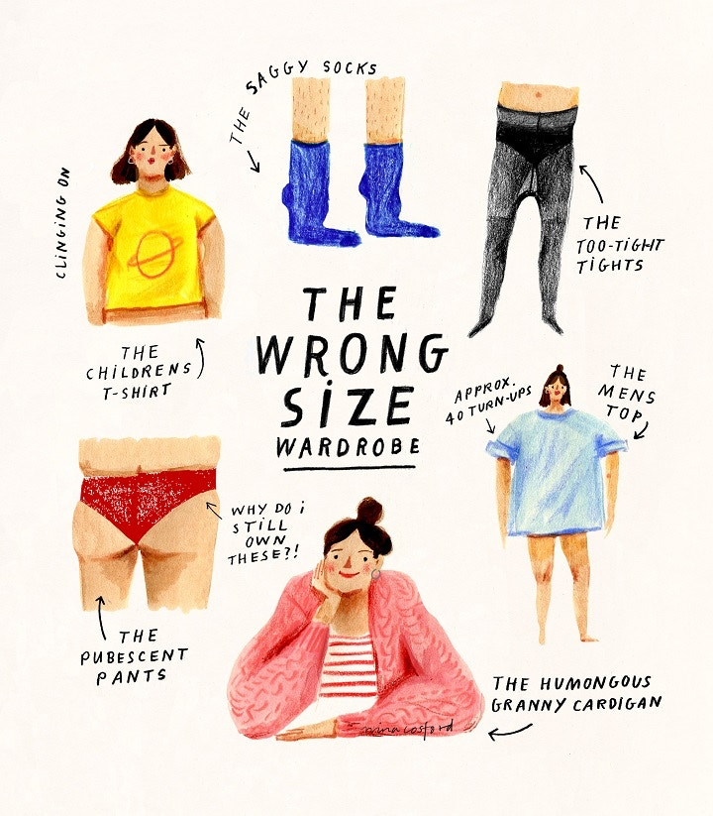

Slide 16
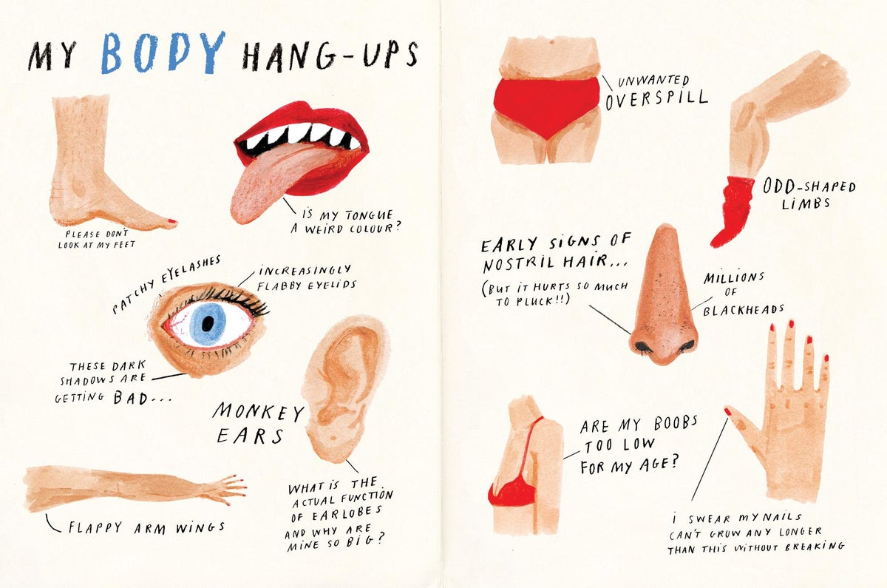

Slide 17
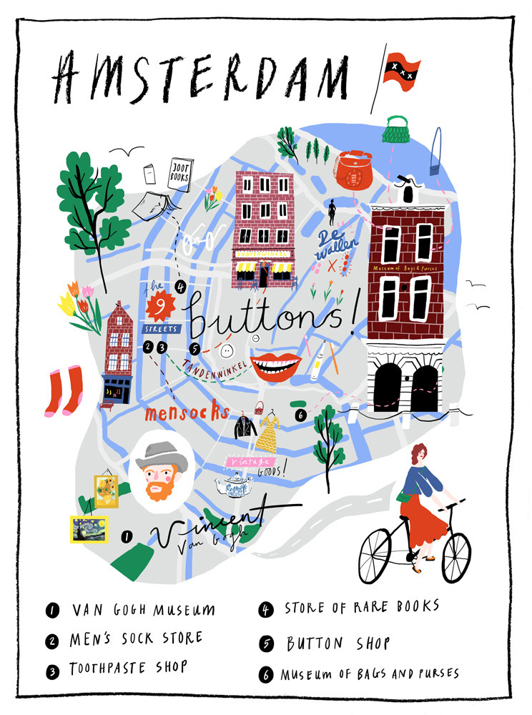

Slide 18
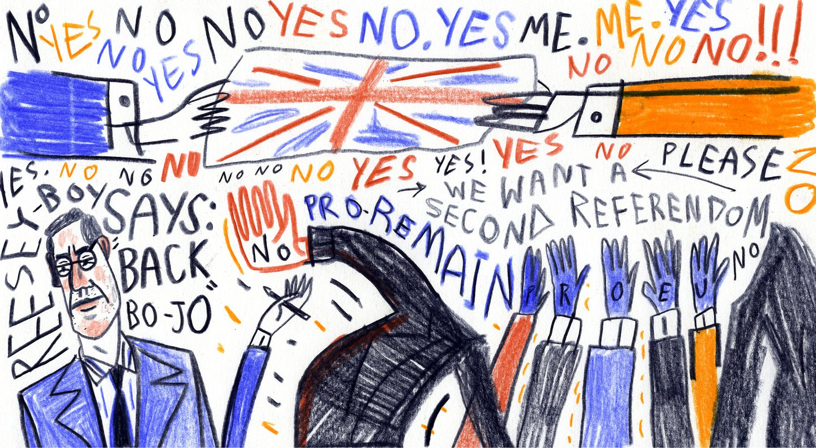

Slide 19
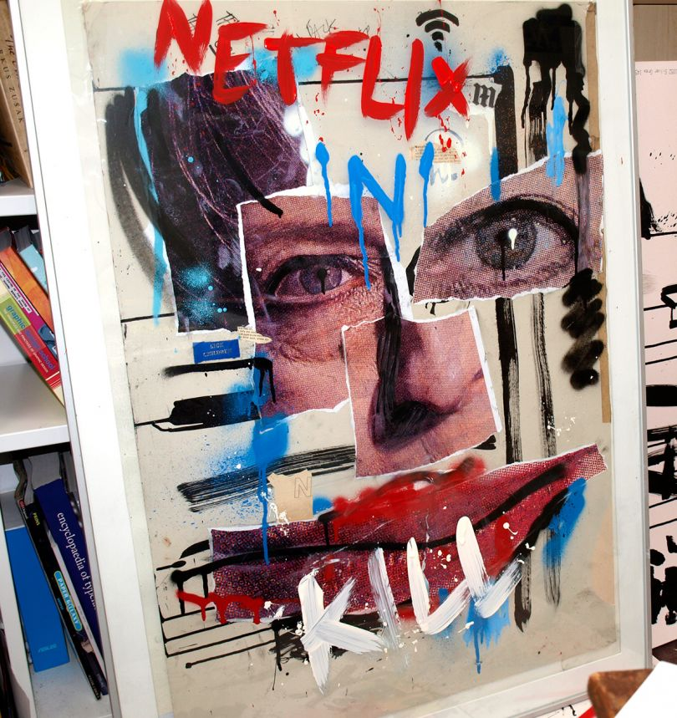

Slide 20
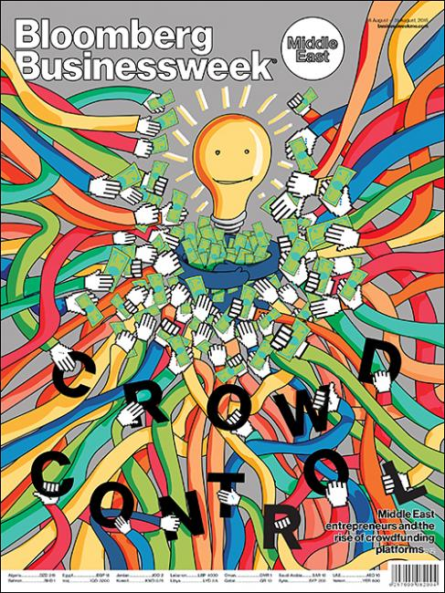

Slide 21
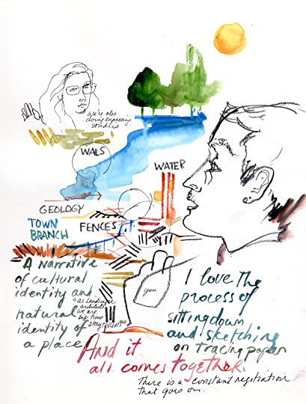
Veronica Lawler

Slide 22
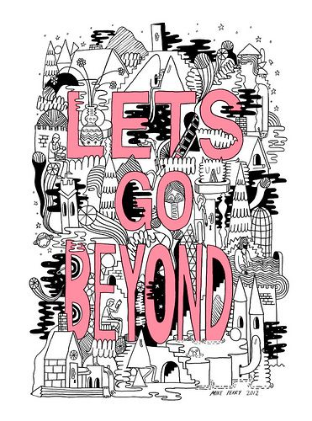

Slide 23
Scriberia

