Slide 1
Scriptwriting
M4X01654

Slide 2
Scriptwriting Module Recap
The Write Stuff

Slide 3
Stories as metaphor & ritual
Stories are metaphors for life
Stories are rituals
Stories use symbols and metaphor
Stories dramatise change and transformation

Slide 4
The monomyth
Ordinary world
Extraordinary world
Face challenges
Receive a gift
Return to ordinary world, transformed

Slide 5
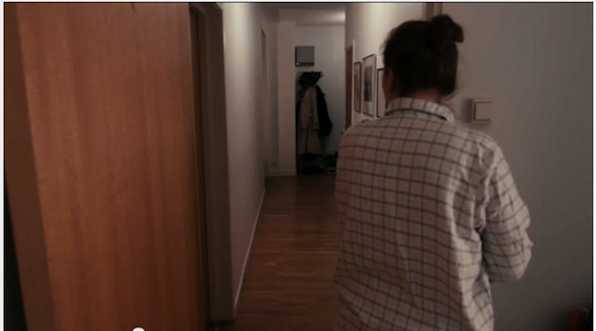
Lights Out (2013)
Notes:
https://www.youtube.com/watch?v=kNbJE0y29_c

Slide 6
Conflict
Protagonist struggles
Has goal(s) to achieve
Opposed by forces of antagonism
Without struggle, achievement lacks merit
Notes:
In a classical screen story, the protagonist is struggling to do something, they have a goal. Stopping them from achieving this goal are the forces of antagonism, often another person, the antagonist. Without this struggle, any achievement of the character lacks real merit (and real interest for a mainstream audience, it is argued).

Slide 7
Obstacles
Characters struggle against obstacles
Obstacles can be external or internal
Obstacles increase in magnitude
Notes:
Characters struggle against obstacles. The most immediate are physical ones that put the life of the character at risk; if they are killed they cannot achieve their goal. Because there is so much at stake, genres that have this form of conflict are always popular, although they can quickly lapse into cliché.

Slide 8
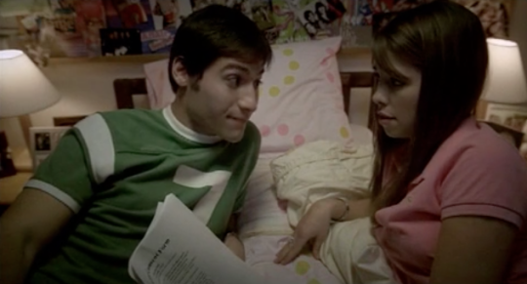
Consent (2004)
Notes:
https://www.youtube.com/watch?v=5B5NMN7GBA4

Slide 9
Meaning in conflict
Conflict is symbolic/metaphorical to the audience
Conflict is about something
Conflict can represent a moral argument
Notes:
Conflict is about something, it is symbolic or metaphorical to the audience. In Titanic, this is represented by Rose's internal dilemma, is about class and gender divides, and about the opportunity to
transcend these offered by new world of liberty, the USA, in contrast to the old world, Europe. It can help to think about this aspect of conflict as a moral argument, the protagonist and antagonist representing different sides. This can apply to any genre of narrative film.

Slide 10
Character - Robert McKee
Characterization – surface details
Character – what they do
Notes:
Robert McKee distinguishes between what he terms characterization and character. For McKee, characterization refers to the surface dctails, such as how they look and dress, how they express themselves, race, creed, accent. This extends to personal history, such as family background, education, love life and career. It's all the stuff that's happened to make them who they are at the start of the story. Distinct from this, is what McKee terms character. This is what someone does, and they reveal who they truly are, what they stand for, by what they do, by the actions they take during the course of a story.

Slide 11
Character
Goal – symbolic struggle
Goal can represent an outlook on the world
Divergent wants and needs (perceived goal versus actual goal)
Conflicting conscious & unconscious desires
Notes:
In addition to the attributes that McKee and Field outline, a main character in a mainstream film will have a clear goal, and their struggle for that goal not only drives the film but symbolises what it is about.
Other characters can personify concepts that the main character (and their goal) are in conflict with – when creating stories considering how characters might represent conflicting ideas can be a very useful tool.
Main characters will often have divergent wants and needs, the conflicting conscious and unconscious desires.

Slide 12
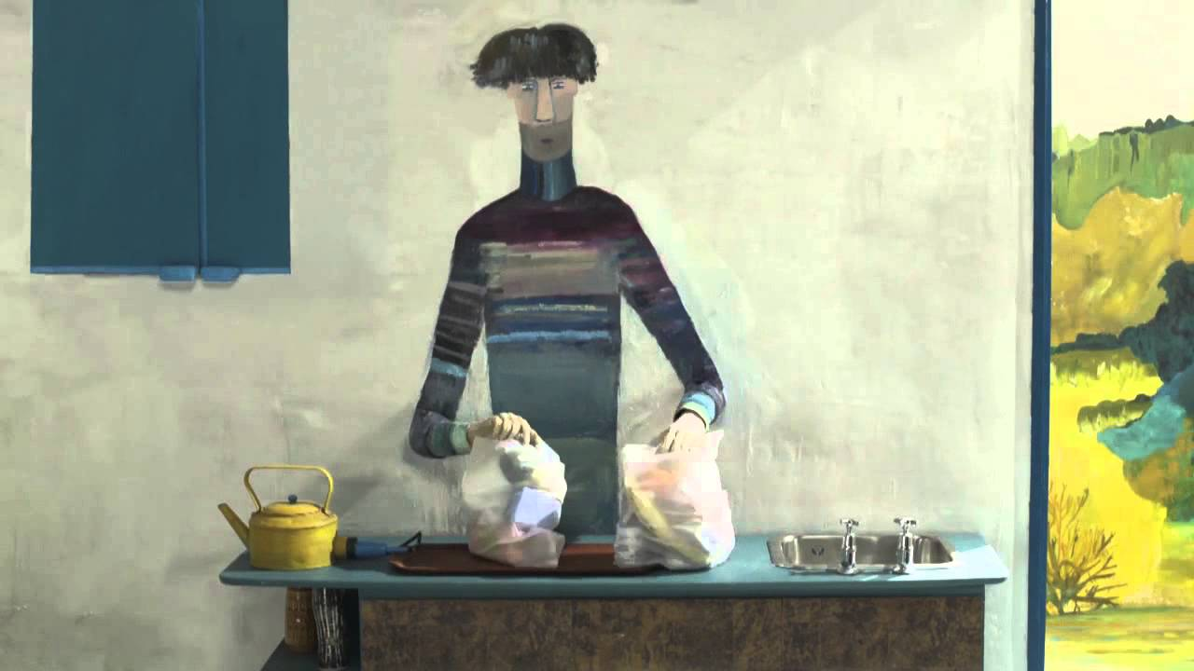
The Bigger Picture (2014)
Notes:
https://www.shortoftheweek.com/2017/07/13/the-bigger-picture/

Slide 13
Visual writing
Never write what a character thinks or feels
Find visual metaphors for characters' emotions
Never write shots or camera direction
Imply shots by writing style and layout
Use the Kuleshov effect – collisions of consecutive images

Slide 14
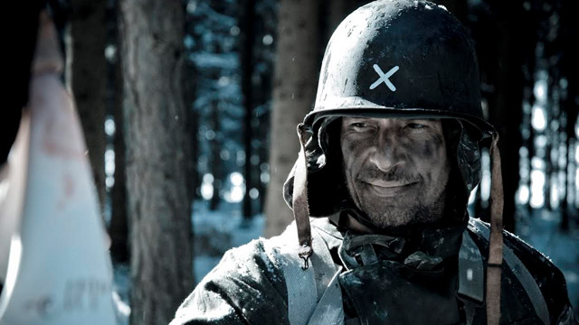
8 (2012)
Notes:
https://www.youtube.com/watch?time_continue=239&v=He9FeJZua20

Slide 15
Dialogue strategies
How does your dialogue reflect character & characterization?
How does your dialogue reflect conflict?
How does your dialogue employ subtext?
How does your dialogue respond to genre?

Slide 16
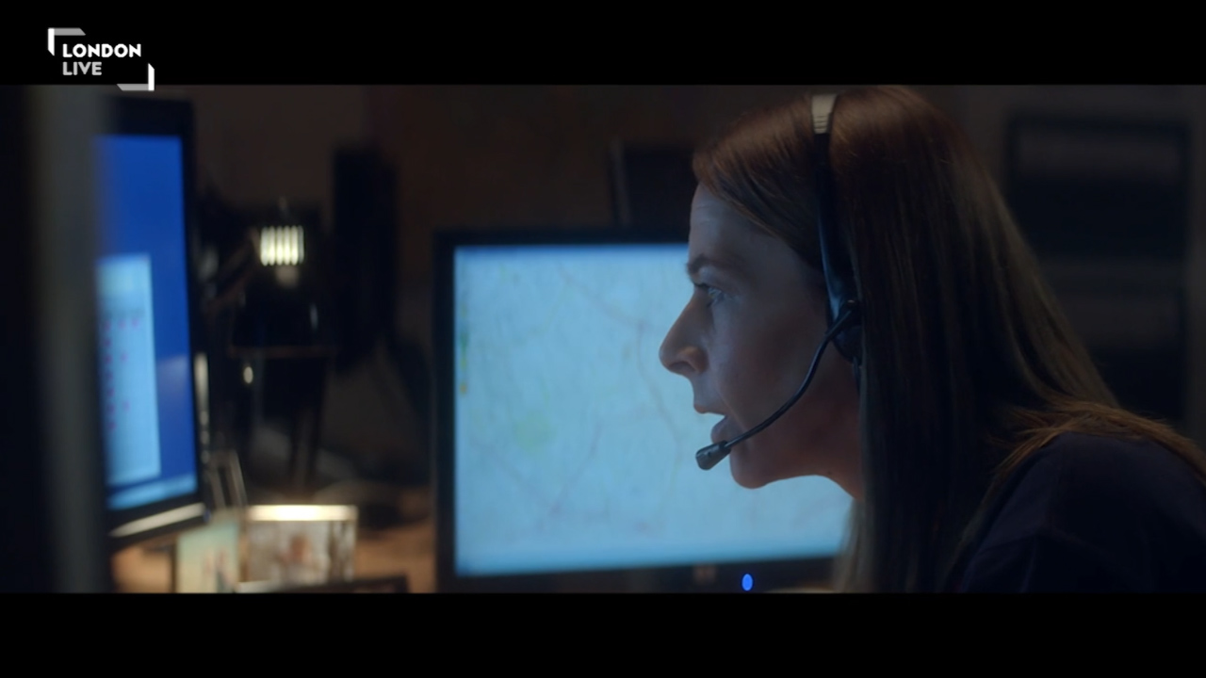
Operator (2015)
Notes:
https://www.shortoftheweek.com/2016/04/01/operator/

