Slide 1
Brynach Heffernan
BMSW6105_CARD
Coaching and Mentoring

Slide 2
Module Aim
To develop understanding of the skills, principles and practice of effective management coaching and mentoring and the benefits they bring to business
Notes:
Coaching and mentoring can be effective approaches to developing employees. Both have grown in popularity, with many employers using them to enhance the skills, knowledge and performance of their people around specific skills and goals.

Slide 3
Learning Outcomes
Upon the successful completion of this module, the student should be able to:
Critically evaluate the purpose of coaching and mentoring within an organisational context;
Critically analyse the skills, behaviours, attitudes, beliefs and values of an effective coach or mentor;
Apply strategies to effectively coach or mentor at an appropriate level.

Slide 4
Indicative Content
Introduction to and definitions of coaching and mentoring.
Differences and overlaps of coaching, mentoring, counselling and training and selecting the most appropriate methodological approach.
Individual and organisational benefits of coaching and mentoring.
Costs and benefits of coaching and mentoring.
Alternative strategies for developing and supporting employees.
Corporate objectives and the contribution of coaching and mentoring.
Organisational, operational and individual barriers and strategies to overcome them.
Knowledge, skills and behaviours of an effective coach and mentor.
Notes:
Please see Scheme of Work for specifics of each week.

Slide 5
Scheme of Work
On Moodle

Slide 6
Assessment
Part A: Peer Coaching Exercise (November)
15 mins each
Part B: Written Reflection (Due: December)
2,500 words
Holistic marking so only one mark given for module

Slide 7
Lecture 1
Introduction to module and run through assignment
Definitions of coaching and mentoring
The similarities and differences of coaching and mentoring
The business case for and against internal coaching programmes v external coaching programmes.
Other learning interventions

Slide 8
1. Defining Coaching & Mentoring
Coaching
“A process by which the coach, through direct discussion and guided activity, helps an individual to solve a problem, or do a task better than would otherwise have been the case”
(Clutterbuck & Megginson, 1999)
Notes:
Coaching on the other hand is not generally performed on the basis that the coach has direct experience of their client’s formal occupational role unless the coaching is specific and skills focused.
Having said this, there are professionals offering their services under the name of mentoring who have no direct experience of their clients’ roles and others offering services under the name of coaching who do.
So, it is essential to determine what your needs are and to ensure that the coach or mentor can supply you with the type and level of service you require, whatever that service is called.

Slide 9
1. Defining Coaching & Mentoring
Mentoring
“Off-line help by one person to another in making significant transitions in knowledge, work or thinking”
(Clutterbuck & Megginson, 1999)
Notes:
Mentoring, particularly in its traditional sense, enables an individual to follow in the path of an older and wiser colleague who can pass on knowledge, experience and open doors to otherwise out-of-reach opportunities.

Slide 10

1. Defining Coaching & Mentoring
Coaching & Mentoring
What is your experience of coaching others or being coached?
What is your experience of mentoring or being mentored?

Slide 11
1. Defining Coaching & Mentoring
Coaching in a business context
“Unlocking a persons potential to maximise their own performance. It is helping them to learn rather than teaching them” (Whitmore, 2017)
“A collaborative, solution-focused, results orientated and systematic process in which the coach facilitates the enhancement of work performance, life experience, self-directed learning and personal growth of the coachee” (Grant, 1999)

Slide 12
1. Defining Coaching & Mentoring
Similarities
Facilitate the exploration of needs, motivations, desires, skills and thought processes to assist the individual in making real, lasting change.
Use questioning techniques to facilitate an individual’s own thought processes in order to identify solutions and actions, rather than take a wholly directive approach
Support the individual in setting appropriate goals and methods of assessing progress in relation to these goals
Observe, listen and ask questions to understand the individual’s situation

Slide 13
1. Defining Coaching & Mentoring
Similarities
Creatively apply tools and techniques which may include one-to-one training, facilitating, counselling & networking.
Encourage a commitment to action and the development of lasting personal growth & change.
Maintain unconditional positive regard for the individual, is at all times supportive and non-judgemental, of views, lifestyle and aspirations.
Ensure that clients develop personal competencies and do not develop unhealthy dependencies on the coaching or mentoring relationship.

Slide 14
1. Defining Coaching & Mentoring - Differences
Coaching
Mentoring
Short Term – Time Bound
Task Based
Performance Driven – Non Directive
Long Term
Relationship Based
Development Driven - Directive
Notes:
Short Term – Time Bound
A coach can successfully be involved with a coachee for a short period of time, maybe even just a few sessions. The coaching lasts for as long as is needed, depending on the purpose of the coaching relationship.
Long Term
Requires time in which both parties can learn about one another and build a climate of trust creating an environment in which the mentee can feel secure in sharing issues that impact success. Mentoring relationships typically last nine months to a year.
Task Based
The focus is on concrete issues, such as managing more effectively, speaking more articulately, and learning how to think strategically. This requires a content expert (coach) who is capable of teaching the coachee how to develop these skills.
Relationship Based
The mentee shares issues affecting professional and personal success. Learning goals or competencies may be used as a basis for creating the relationship but goes beyond this to include work/life balance, self-confidence, self-perception, and how the personal influences the professional.
Performance Driven – Non Directive
The purpose of coaching is to improve the individual's performance on the job. This involves either enhancing current skills or acquiring new skills. Once the coachee successfully acquires the skills, the coach is no longer needed.
Development Driven - Directive
Its purpose is to develop the individual not only for the current job, but also for the future. This distinction differentiates the role of the immediate manager and that of the mentor.

Slide 15
1. Defining Coaching & Mentoring
Clarifying the difference
Coaching aims to produce optimal performance and improvement at work. It focuses on specific skills and goals, although it may also have an impact on an individual’s personal attributes such as social interaction or confidence. The process typically lasts for a defined period of time or forms the basis of an on-going management style.
Mentoring in the workplace tends to describe a relationship in which a more experienced colleague shares their greater knowledge to support the development of an inexperienced member of staff. It calls on the skills of questioning, listening, clarifying and reframing that are also associated with coaching. One key distinction is that mentoring relationships tend to be longer term than coaching.

Slide 16
1. Coaching & Mentoring as a Learning Solution
Coaching
Mentoring
When seeking to develop employees in specific competencies, using performance management tools and involving the immediate manager
You have talented employees who are not meeting expectations
When introducing a new system or programme
When you have a small group of individuals (5-8) in need of increased competency in specific areas
When a leader or executive needs assistance in acquiring a new skill as an additional responsibility
When seeking to develop its leaders or talent pool as part of succession planning
Development of diverse employees to remove barriers that hinder their success
Development of employees in ways that are additional to the acquisition of specific skills/competencies
Retain internal expertise and experience residing in its baby boomer employees for future generations
Creating a workforce that balances the professional and the personal
Notes:
Baby boomers – born after second world war.

Slide 17
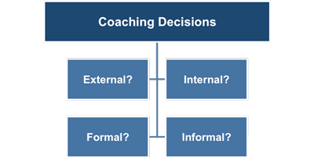
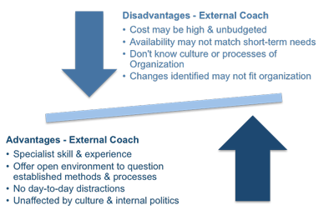
2. Approaches to Coaching
Internal v’s External coaching
Notes:
External relationships are almost always formal.
External
The coach or mentor is completely impartial
The employee may feel more secure about confidentiality
The coach or mentor will have outside expertise they can share to avoid an insular mindset creeping in
The coach or mentor will dedicate quality time without internal distractions from day-to-day work pressures

Slide 18
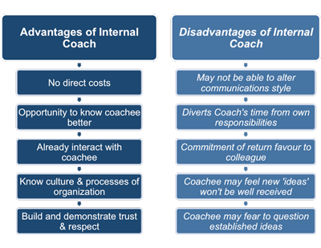
2. Approaches to Coaching
Internal v’s External coaching
Notes:
Can be formal or informal depending on who is doing the coaching.
Internal:
More cost affective
Retain the expertise in-house
Logistics of organising the sessions and training is less problematic and costly
Information can be more easily fed back to other Departments such as HR/L&D
The coach/mentor will have a grasp of opportunities and challenges facing the business
Professional code of practice reviewed and upheld

Slide 19
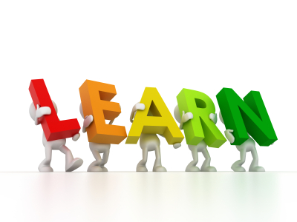
3. Other learning initiatives
Counselling
Wellbeing programmes
Employee engagement programmes
E-learning
Self-directed learning
Focus groups
Peer support groups
Community work / team-building days
Any others?
Notes:
How does each initiative compare to coaching and mentoring? Can it work alongside or replace coaching or mentoring?
What does research tell us? Deloitte report / Google book / HR Report = suggest many of the learning initiatives of the past are falling short of the mark in terms of encouraging application of learning which is directly attributable to business growth.
Counselling – where does this fit with coaching / mentoring? – Knowing when to sign post people to further support.
Wellbeing - is a huge area for organisations to consider now – Youtube clip on “wokeness”
Employee engagement programmes – employee voice. MacLeod’s 4 Enablers, Purcell’s Building Blocks, Guest ….
E-Learning, what are the pros and cons?
Self-Directed learning – the responsibility for employees to seek out information from Intranet/Portals/Hubs themselves
Focus Groups – great for sharing technical & practical experience.
Peer Support Groups – Google employees can hold internal workshops on topics that they are interested in to share knowledge with peers/subordinates and superiors.
Something that was always part of the third sector, private companies are now engaging in community work – Tata Steel employees painted the local old people’s home when the Blast Furnace was being re-lined and there was spare capacity

Slide 20
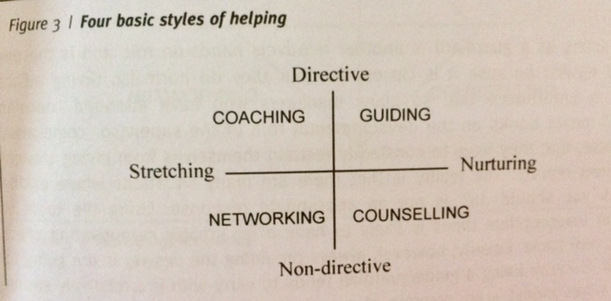
3. Four Basic Styles of Helping
Clutterbuck, D. (2014) Everyone Needs a Mentor Fostering Talent in Your Organisation 5th e.d. London: Chartered Institute of Personnel and Development.

Slide 21
Summary of Lecture 1
Introduction to module and run through assignment
Definitions of coaching and mentoring
The similarities and differences of coaching and mentoring
The business case for and against internal coaching programmes v external coaching programmes.
Other learning interventions

