Slide 1
TRSK5001
Research Methods for Theology and Religious Studies
Visual Images

Slide 2
Films
photographs,
drawings,
cartoons,
graffiti
maps
diagrams
signs and symbols
television
computer media

Slide 3
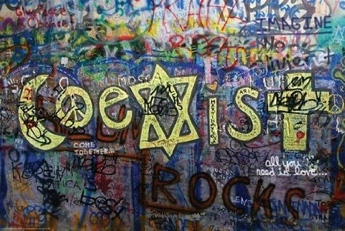
Notes:
Religious Tolerance poster: $7.95

Slide 4
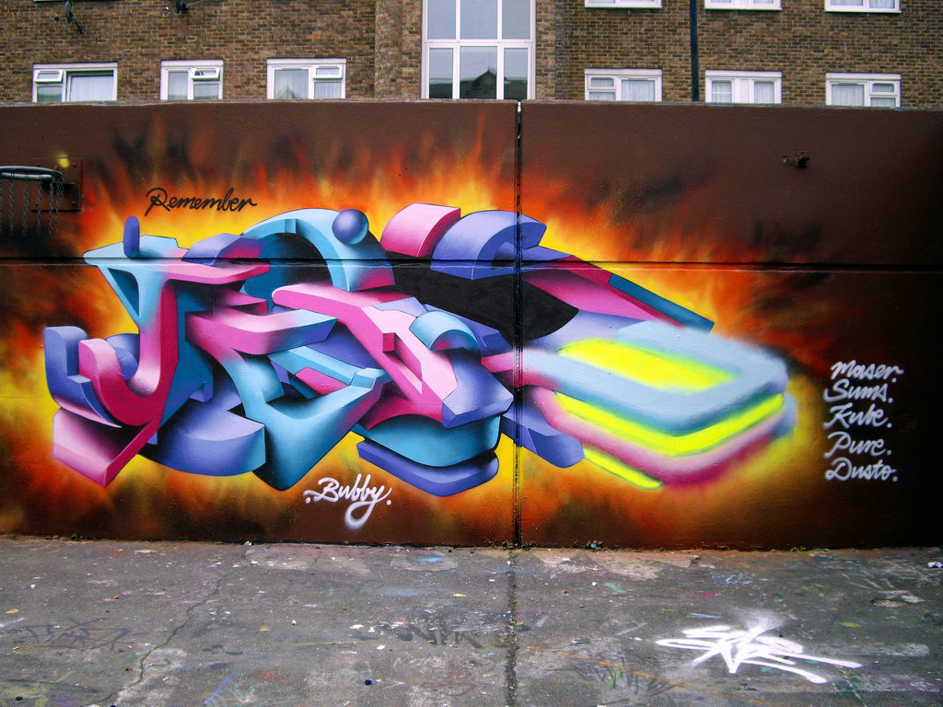
Notes:
Today I found something really exciting that I wanted to share. I found an interview with one of our favorite Christian Graffiti artists, Lovepusher, on The Times’ Website! I think it’s so great how Lovepusher is getting out into the secular world and public places with graffiti, but it all being about God, and there being no compromise about that! You can read the interview on the Times Online Website.

Slide 5
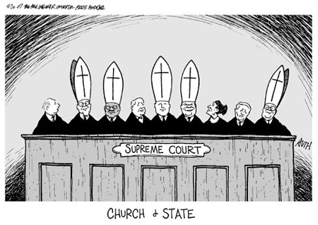
Notes:
Is This Cartoon Anti-Religious?
In the wake of a Supreme Court abortion ruling, a political cartoon about five judges' faith has angered Catholics.
In wake of a 5-4 ruling that upheld the Partial Birth Abortion Ban Act, critics say the five justices in the majority may have been influenced by their Catholicism. Does the judges' faith matter? Two writers weigh in:

Slide 6
Content
Objects displayed
Location in space
Location in time
Narrative function
Notes:
Simply what is included in the frame of the picture. This is sometimes obvious and sometimes requires some careful examination.
CONTEXT: space and time
What story is being told? This might be a matter of knowing, researching and/or imagination.

Slide 7
Function of image
Public or private
Illustrative or document
Notes:
Public / private
Illustrative – (an illustration demonstrates or makes a point) providing or conveying information; serving to instruct or enlighten or inform
Document - Something, such as a recording or a photograph, that can be used to furnish evidence or information.

Slide 8
Expressive aim
Emotions represented
Emotions meant to be evoked
Notes:
The author of the picture – what was intention; describe what is represented; what is purpose of picture
The viewer of the picture

Slide 9
‘Meaning’
Figurative meaning
Explicit or implicit associations
Explicit or implicit suggestions
Rhetorical-moral meaning
Political lesson
Moral lesson
Notes:
Associations – what are real connections
Suggestions – what are possible connections (what does it make you think of)
Political – social
Moral - personal

Slide 10
‘Meaning’
Societal or Period meaning
Issues, matters, ideas, conflicts, circumstances of the period that are revealed or suggested
Comparative meaning
Objects juxtaposed to bring out similarities or differences in attributes
Notes:
at·tri·bute (ăt′rə-byo͞ot′)
1. A quality or characteristic inherent in or ascribed to someone or something.

Slide 11
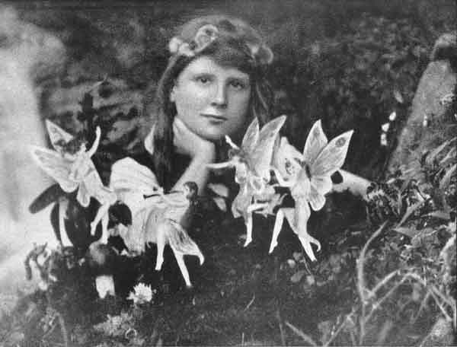
Notes:
Cottingley Fairies
In 1920 a series of photos of fairies captured the attention of the world. The photos had been taken by two young girls, the cousins Frances Griffith and Elsie Wright, while playing in the garden of Elsie's Cottingley village home. Photographic experts examined the pictures and declared them genuine. Spiritualists promoted them as proof of the existence of supernatural creatures, and despite criticism by skeptics, the pictures became among the most widely recognized photos in the world. It was only decades later, in the late 1970s, that the photos were definitively debunked.
Skeptics noticed many problems with the photos, in addition to the obvious one that the fairies look like bits of paper. For instance, in the first photo why is Frances not looking at the fairies? (The girls claimed they were so used to the fairies that they often paid them no attention.) And why does the second fairy from the left not have wings? In the second photo, why is Elsie's hand bizarrely elongated? (Frances attributed this to "camera slant.") In the fourth photo, why is the fairy dressed in the latest French fashions?

Slide 12
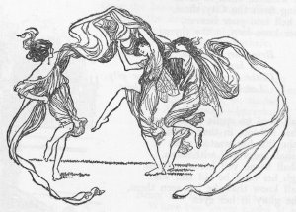
Notes:
It was not until 1978 that James Randi pointed out that the fairies in the pictures were very similar to figures in a children's book called Princess Mary's Gift Book, which had been published in 1915 shortly before the girls took the photographs.
Subsequently, in 1981, Elsie Wright confessed to Joe Cooper, who interviewed her for The Unexplained magazine, that the fairies were, in fact, paper cutouts. She explained that she had sketched the fairies using Princess Mary's Gift Book as inspiration. She had then made paper cutouts from these sketches, which she held in place with hatpins.

Slide 13
REPRESENTATION
TRUSTWORTHINESS
INTERPRETATION
REFLEXIVITY
Notes:
REPRESENTATION – content
TRUSTWORTHINESS – true
INTERPRETATION – meaning
REFLEXIVITY –
Reflexivity refers to circular relationships between cause and effect. A reflexive relationship is bidirectional with both the cause and the effect affecting one another in a situation that does not render both functions causes and effects. In sociology, reflexivity therefore comes to mean an act of self-reference where examination or action "bends back on", refers to, and affects the entity instigating the action or examination.

Slide 14
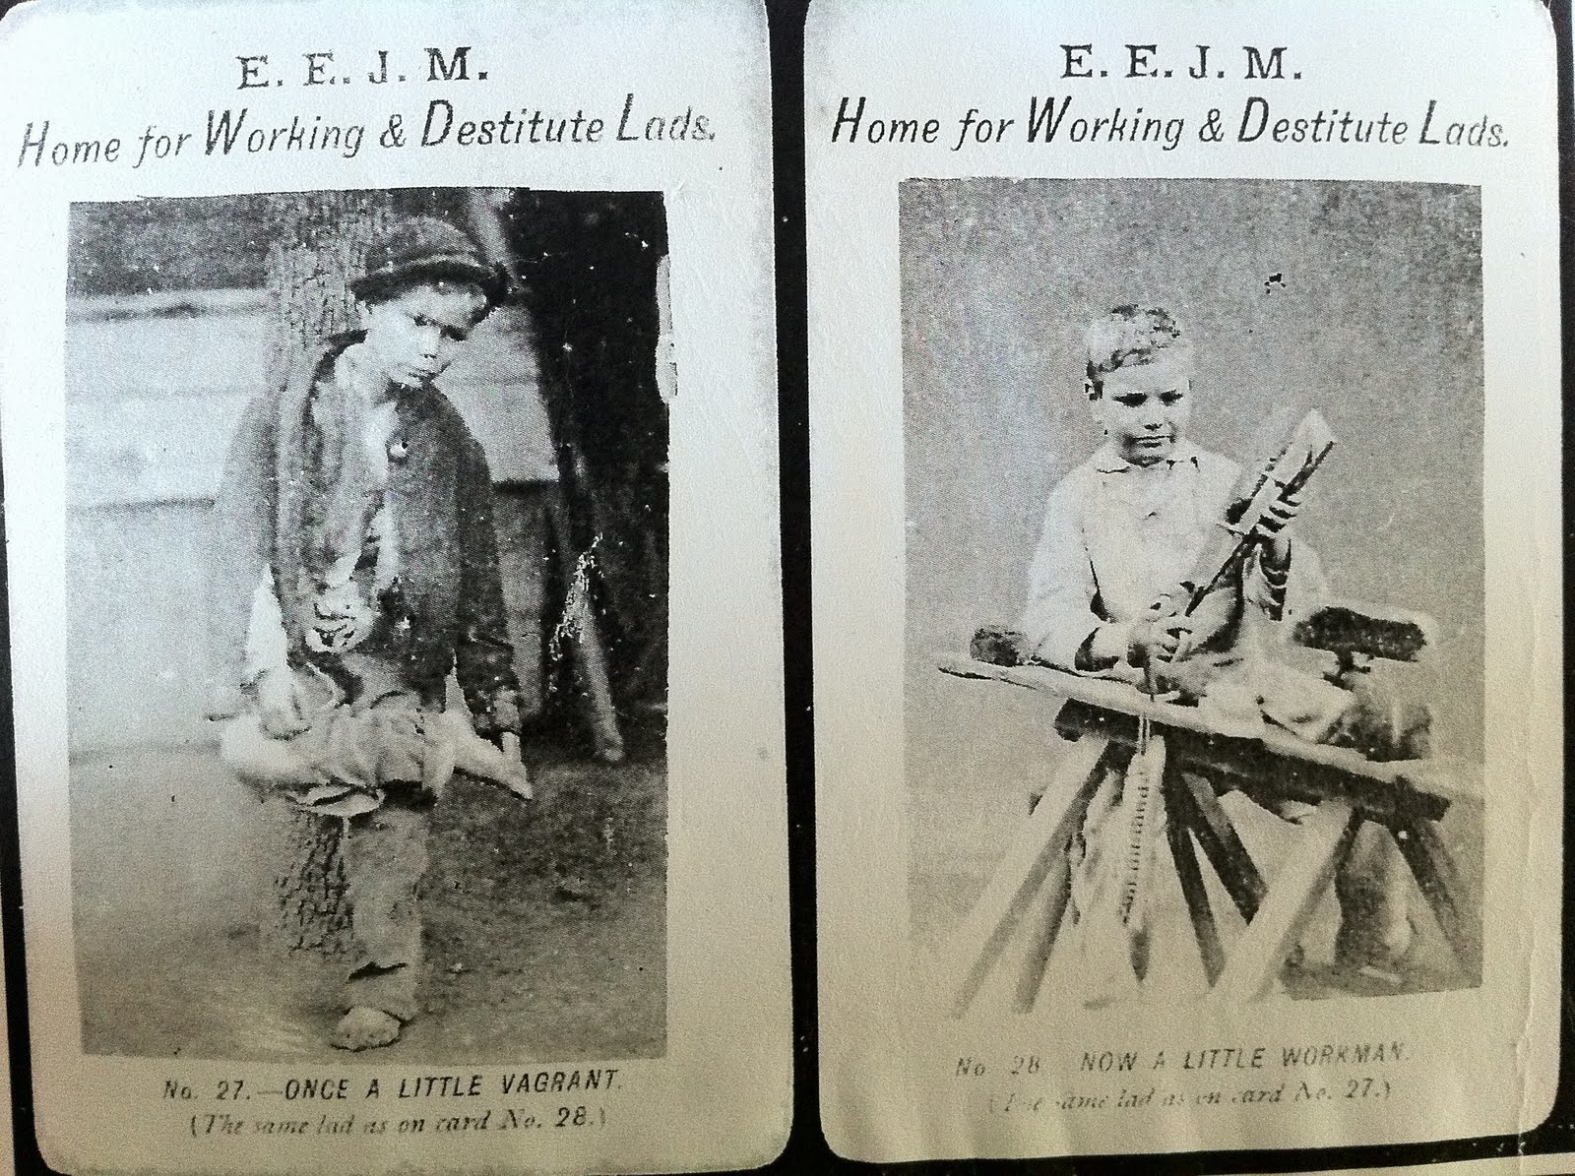
Notes:
Before and After (Barnados) 1870s

Slide 15
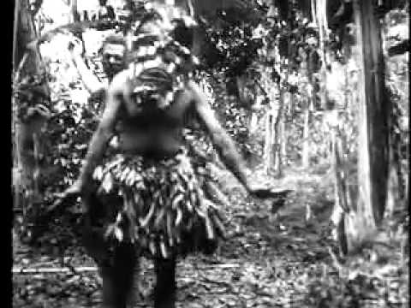
Notes:
C. Haddon, Anthropologist, 1898 in Torres Strait Islands (between Papua New Guinea and Australia)
Tried to gather data on the life of the Torres Strait Islanders as it was before European contact.
Filmed a short section of a ritual dance, connected with an initiation cult but it had already died out under missionary influence.
The film is in one sense a record of what happened – men wore masks and danced – and in another sense it is a fiction – an account of something that could not (or could no longer) be seen.

Slide 16
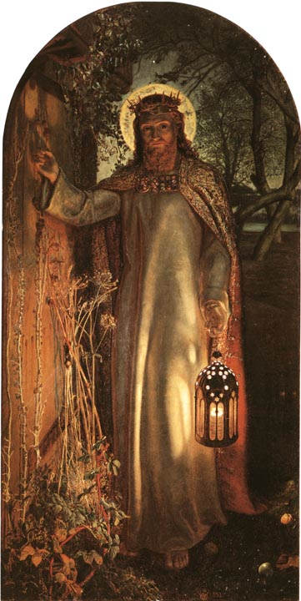
Notes:
Holman Hunt 1827-1910
Jesus the Light of the World (John 8;12)
Revelation 3:20
Behold, I stand at the door and knock. If anyone hears my voice and opens the door, I will come in to him and eat with him, and he with me.

Slide 17


