Slide 1
HPRS5907/6907
The Bible Contemporary Approaches
Dr Jessica M. Keady – j.keady@uwtsd.ac.uk

Slide 2
Gender / Feminism

Slide 3
Definition of Terms
Patriarchy / patriarchal
A social system in which the father is the head of the family, clan or tribe (literally, ‘under the authority of the father’), and men have authority over women and children.

Slide 4
Definition of Terms
Androcentrism / androcentric
A perspective centred on males or dominated by masculine interests.

Slide 5
The Bible as a Patriarchal and Androcentric Text
Male characters ‘control’ the narratives. Their lives and experiences shape a narrative’s framework.
1315 male names are listed in the Hebrew Bible (OT), but only 111 female names.
Many more women appear in the text but are nameless and identified in terms of their relationship to fathers or husbands
- ‘daughters of Lot’
- ‘the daughter of Jephthah’
- ‘the wife of Manoah’

Slide 6
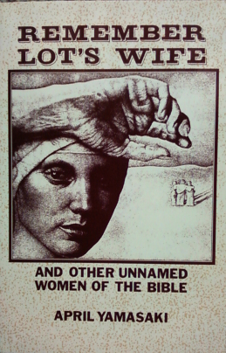
The Bible as a Patriarchal and Androcentric Text
Women are often minor characters in the story.
Patriarchal narratives: God reveals himself as the ‘God of Abraham, the God of Isaac, and the God of Jacob’ (Exodus 3:6).
Emphasis on narratives and settings with a masculine orientation (life of the tribe, war, kingship, cult).

Slide 7
The Hebrew Bible as a Patriarchal and Androcentric Text
Physical weakness is a feminine trait
‘The warriors of Babylon have given up fighting, they remain in their strongholds; their strength has failed, they have become women’ (Jer. 51:30).
‘On that day the Egyptians will be like women, and tremble with fear’ (Isa. 19:16).

Slide 8
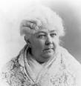
Early ‘Feminist’ Voices:
Elizabeth Cady Stanton
The Woman’s Bible (1895, 1898) - an ‘expurgated’ text of the Bible which sought to dismantle society’s sexism and to demolish Christian androcentrism.
The biblical laws relating to women are ‘from the obscene minds of a barbarous age’ (Cady Stanton).

Slide 9
Second Feminist Wave: 1960s and 1970s
Civil rights movement in the States, struggles against colonialism, rediscovery by women of their ‘feminist voice’.
Mary Daly, The Church and the Second Sex (1968); Beyond God the Father: Toward a Philosophy of Women’s Liberation (1973): calls for the abandonment of patriarchal religions in favour of a woman-centred spirituality.

Slide 10
An Example of a Definition of Feminism
‘A critical and constructive stance that claims for women the full humanity accorded to men, insisting that women be represented equally in all attempts to describe and comprehend human nature and that they be full participants in the assignment and regulation of social roles, rights and responsibilities’ (Phyllis Bird, Escaping Eden, page 124).

Slide 11
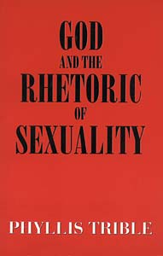
The Contribution of Phyllis Trible
God and the Rhetoric of Sexuality (1978): an attempt to ‘recover old treasures and discover new ones in the household of faith’.
A careful examination of the Hebrew Bible does not necessarily lead to rejection, but to a more variegated ‘appreciation’ of the biblical testimony about women.

Slide 12
Feminist Biblical Hermeneutics: Strategies
Reinterpretation of familiar biblical texts about women in order to challenge traditional (androcentric) readings. For example, see Phyllis Trible’s work on Genesis 1-3.
The aim is to recover and reclaim the biblical texts from patriarchal domination.

Slide 13
Feminist Biblical Hermeneutics: Strategies
Recovery of biblical texts and figures that have been marginalized in traditional readings of the Bible.
The Dictionary of Named and Unnamed Characters: 205 entries for named women in the HB and NT, 600 entries for unnamed women (‘daughter of..’, ‘wife of…’).
Highlighting of feminine metaphors for God.

Slide 14
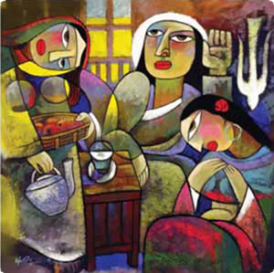
Feminist Biblical Hermeneutics: Strategies
Resisting androcentric tendencies in biblical texts: How are women’s stories narrated by males?
How do they reinforce patriarchal values and endorse women’s inferior status?
Biblical texts are examined with a ‘hermeneutic of suspicion’, a reading ‘against the grain’.

Slide 15
Feminist Biblical Interpretation: Tools and Methods
Historical Criticism: a quest for the world behind the text.
Literary Criticism: examination of the literary structures and techniques within the text.
Cultural Criticism: the reader analyses what is in front of the biblical text.

Slide 16
Historical Criticism
Biblical authorship and historical setting/audience of biblical texts.
Search for authorial meaning (what was the intention of the author).
Carol Meyers, Discovering Eve: Ancient Israelite Women in Context (1988): movement from an egalitarian to a more secondary status for women in ancient Israel.
Can we ‘trust’ what the biblical authors say? Importance of external evidence (archaeological data, ancient Near Eastern documents).

Slide 17
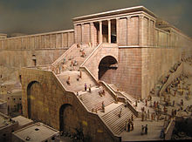
Historical Criticism
Acknowledgement that texts are varied in form and content (narratives, poems, laws, prophecies).
No uniform and static picture of the lives of women in Israel and the first-century Mediterranean world.
Portraits/images of women belonging to different periods and social circles.

Slide 18
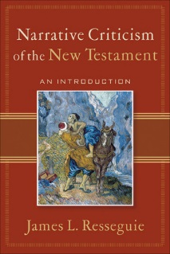
Literary Criticism
Appreciation of structural patterns, stylistic devices in order to highlight the role of female characters in biblical literature.
How do female characters act in contrast to male characters?
When are they present or absent, heard or voiceless?
What kind of dialogue is created for women?
Whose perspective is advanced?
What about gaps, ambiguities, sequences?

Slide 19
Cultural Criticism
What is the relationship between the text and the reader?
Can one speak of an objective, value-neutral, ‘true’ reading of a text?
Concern with social context (especially those who are marginalized) and power struggles in the formation of culture.
Study of a range of ‘cultural artefacts’ in different time periods and geographical locations: films, art, newspapers, internet, oral history.

Slide 20
Cultural Criticism
How has the Bible shaped culture and how has culture shaped the interpretation of biblical texts?
‘Cultural Criticism is a joint critical study of texts and readers, perspectives and ideologies with a focus on the flesh-and-blood reader: always positioned and interested; socially and historically conditioned and unable to transcend such conditions’ (Fernando Segovia, Reading from this Place, Volume 1: 28-29).

Slide 21
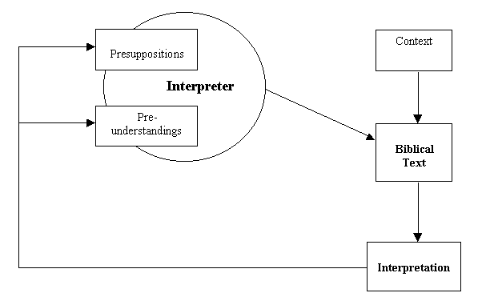
Interpreter and Intepretation

Slide 22
What is a Feminist Reading?
Is it a (re)assessment of female biblical characters and feminine images?
What about narratives/texts where women are absent or play no part in the social or religious agenda?
Why did such questions not matter then?
Why do they matter now?

Slide 23
What is a Feminist Reading?
Phyllis Bird (Escaping Eden, 124-131)
Step 1: Exegetical analysis (historical description) - a study of the texts in their ancient contexts.
Step 2: Feminist analysis, including a study of gender relations and a critique of values, expectations, relationships.

Slide 24
What is a Feminist Reading?
Pamela Thimmes (Escaping Eden, 132-140)
Can the historical/exegetical and feminist analytical tasks be separated? Thimmes notes four interrelated elements:
Feminism
Experience
Cultural location
Reading/Interpretation
Feminist hermeneutics interprets biblical texts in order to effect social, political and economic change.

Slide 25
To Complete
Gender Activity Readings
To determine your own concept of Gender and Sex

