Slide 1

Supervision
Ma: yEAR oNE

Slide 2



Lee is 32 and comes to Portia for therapy following a relationship breakdown. Brought up in foster care from the age of eight, he is desperately unhappy, terrified of being rejected and has developed a strong need to please, which masks deep feelings of worthlessness. Portia is in her early 40s and in an unfulfilling marriage. She has felt deep ​compassion for Lee since the first session, and, as their therapeutic relationship has deepened, has found herself looking forward to their weekly meetings and often thinking about him between sessions. In one session, Lee shares a recent dream, in which he and Portia are lying together, and Portia is cradling him. He tells her he wishes she could hold him in that ​way for real. In a rush of excitement and fear, portia says, ‘if I weren’t your therapist, I probably would.’ She feels guilty after the session, and wishes she could take back what she said, although she also thinks it is therapeutic for Lee to know that he is lovable and desirable. She finally decides she needs to come clean to her supervisor about what has happened.​
IF YOU WERE PORTIA’S SUPERVISOR, HOW WOULD YOU RESPOND?

Slide 3
Aims
To introduce the notion of supervision in counselling
To look at its format and functions

Slide 4
Indicative content
Format
Levels
Stages
Clinical Responsibility
Ethical Requirements
Legal obligations

Slide 5
What is Supervision?
Supervision is a formal relationship.
The Counsellor and Supervisor will explore the client work of the counsellor, but in addition the supervisor will impart expert knowledge, support and guidance for the counsellor.
The supervisor is also the gatekeeper for the profession.

Slide 6
What is Supervision?
It is can be an intensively supportive relationship.
It is focused and can parallel the client/counsellor process.
It allows the development of therapeutic competence for the Counsellor.

Slide 7
What is supervision?
Formal Relationship
Supportive
Discussion
BACP/NCS Requirements
Reflection
Space
Support
Welfare
Notes:
Formal relationship between counsellor and an experienced counsellor (supervisor).
It is supportive and restorative.
Counsellors should be able to discuss work without judgement or disapproval from supervisor.
BACP require members to have formal and regular supervision
Supervision gives the counsellor:
the opportunity to reflect and consider his/her work
Space to explore new ideas and thoughts and learning
Get support for difficult problems, ethical concerns or self care issues.
Promotes the welfare of the client

Slide 8
Three functions:
  Support
  Develop
  Monitor
Notes:
The supervisor’s role is to encourage the autonomy of the practitioner within safe boundaries and limits and to provide a relationship and process that will enable the practitioner to develop their own way of working effectively with clients.

Slide 9
Supervision
Role of the Supervisor
Supervision Relationship
What is it not?
Types of Supervision
Notes:
Good supervisors will:
Challenge the supervisee
Highlight practice issues
Support the supervisee to manage workload
Help the supervisee to find personal resources for their work
Good relationship supports effective supervision.
Unsatisfactory supervision relationship hinders the openness and exploration of supervisee
What is it not? Training, Personal therapy, Line management
Types: One-to-one supervision, Group Supervision, Co-supervision

Slide 10
Format of Supervision
Frame:
  Contract
  Time, place etc.
  Boundaries
  Confidentiality
  Accountability
  Expectations
  Codes of Ethics
Notes:
Time, place, frequency and duration of supervision
Fees
Accountability and Responsibility

Slide 11
Functions of Supervision
Growth and progression of therapist:
Development of skills
Exploration of Client work
Exploration of Counsellor resources
Quality of the work
Notes:
Become aware of own reactions and responses to clients
Understand client and therapist reactions and dynamics
Explore interventions
Explore other ways of working.
Resources: Explore the emotional side of working with clients, use of empathy particularly when working with emotional work
Particularly if a new or trainee counsellor. Allows us to recognise blind spots. Explore ethical Standards.

Slide 12
Supervision Models
Developmental Model: Stoltenberg and Delworth (1987, 2010)
Functions Model: Inskipp and Proctor (1987, 2001)
Process Model: Hawkins and Shohet (2012)
Therapy Specific Models

Slide 13
Stoltenberg and Delworth
Nine areas for the supervisee to work on:
Intervention
Skill competence
Assessment techniques
Interpersonal assessment
Client conceptualisation
Notes:
Counsellor will move from the interventions that the supervisor suggests, to being more confident in their own intuition and interventions
As the counsellor becomes more confident and the relationship between counsellor and supervisor grows, the will be more autonomy and independence. This will be seen in how the supervisee treats the supervision session and also how the supervisor views the supervisee
Assessment techniques
The supervisee will be more confident in their work and have more space to look at what goes on between him/her and their client, as well as with the supervisor
As above, it will become more natural, as time passes, to think about what the client is doing, why they are doing it and how to work with them through the session

Slide 14
Cont'D.
Individual differences
Theoretical orientation
Treatment goals and plans
Professional ethics
Notes:
6. The supervisee will be able to notice and work through difference, such as sex, age, religion, culture and how to enhance their knowledge and practice so as to best help the client, without colluding or causing harm
7. Development from the supervisor simplifying theories to help toe supervisee, to the supervisee mentioning theories that they find useful and how they are justifying their interventions
8. Treatment goals and plans
9. Ethical issues will come up in sessions, more with some clients than others. Supervision is there to support this discussion

Slide 15
Developmental Model
Level 1: Self Centred
Level 2: Client Centred
Level 3: Process Centred
Level 4: Process in Context Centred

Slide 16
Level 1 | Level 2 | Level 3 | Level 4
Child | Adolescent | Early Adulthood | Maturity
Dependant on Supervisor | Fluctuating Autonomy | Increased Self Confidence | Autonomous
Anxious/Insecure | Fluctuating Confidence | Increased Insight | Personal Security
Difficulty in Self-Evaluation |  |  | Self Aware
Motivated | May become disillusioned and blame supervisor | Stable Motivation | Stable Motivation
Single focused on Specifics not whole | Aware of Complexity of therapy | Sees client in wider context | Addresses personal and professional issues in context
Developmental Model

Slide 17
Developmental Models
Can guide supervisors in assessing needs
Emphasises aim of development
Emphasises need for supervision process to develop with trainee
If used too prescriptively may detract from individual nature of supervision
Supervisors developmental process not a focus

Slide 18
Functions Model
(Inskipp and Proctor,2008):
Normative-maintenance of professional standards and managerial issues
Restorative- support and stress reduction
Formative- skills and knowledge development
Notes:
Normative: Managerial, but also looking at ethical frameworks, supervisor may assess the counsellor’s practice and whether they are adhering to the frameworks/
Restorative: Supportive aspect of supervision. It focuses on the supervisee’s health and wellbeing. We are constantly working with emotions and this can leave us feeling emotionally drained and can lead to burn out. Supervision is aa space whereby we can talk about what we might be carrying, process this and reflect on emotions
Formative: therapist’s development of their knowledge and skills, practical element of supervision,

Slide 19
Process models: e.g. The Seven eyed model
Devised to help across all helping professions
Doesn’t attempt to structure session/s, but is used to clarify the process of supervision

Slide 20
Seven-Eyed Model of Supervision
Focus on the Client
Explore strategies and interventions used by supervisee
Focus on the supervisee
Focus on the supervisory relationship
The supervisor focusing on their own process
Focus on the Supervisor’s “fantasy client” relationship
Focus on the wider context

Slide 21
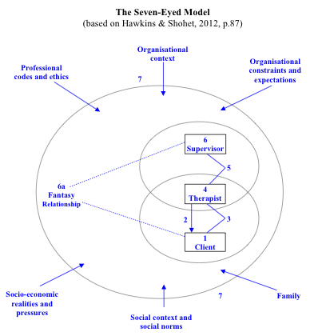
Notes:
Focus on the client
Focus on the intervention
Focus on the client-supervisee relationship
Focus on the Supervisee
Focus on the supervisee-supervisor relationship
Focus on the Supervisor’s process
6a. Focus on the Supervisor’s ‘Fantasy Relationship with the client
7. Focus on the wider context.

Slide 22
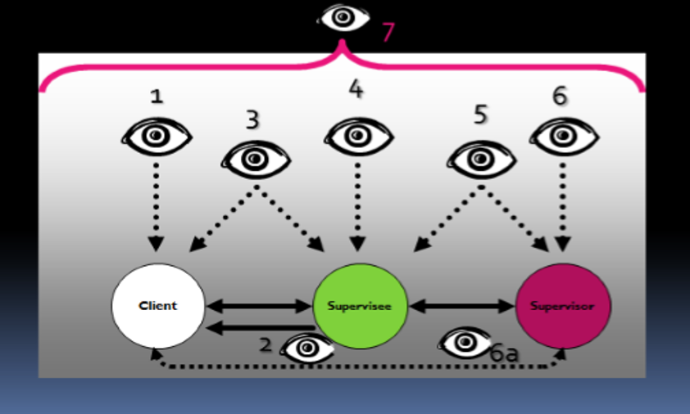
The ‘Seven Eyed’ Supervision Model
(Taken from Dudley and Walsall, Mental Health Partnership, NHS Trust)

Slide 23
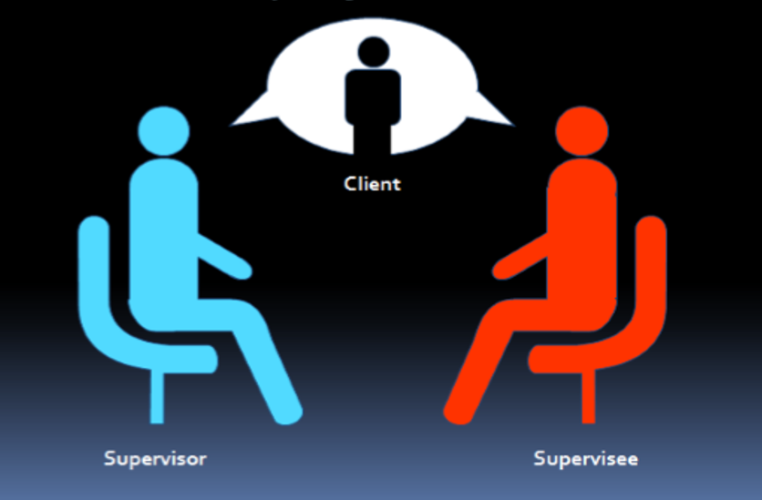
Meet the players …

Slide 24
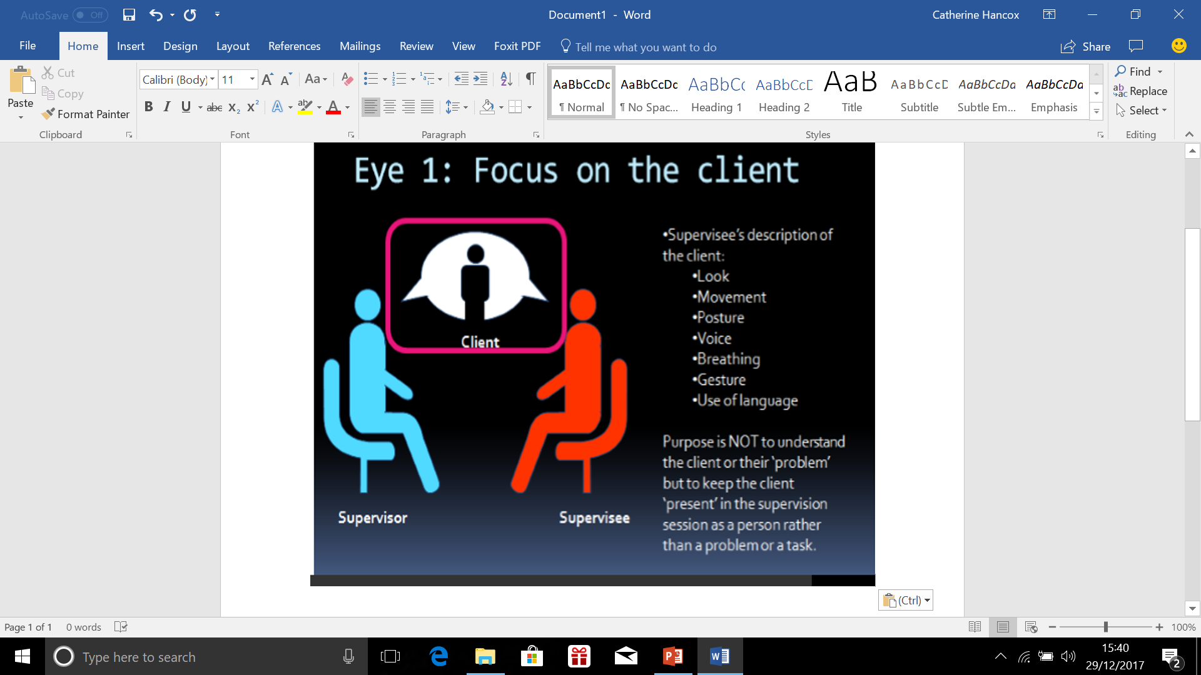
Eye 1: Focus on the client
Supervisee’s description of the client:
    Look
    Movement
    Posture
    Voice
    Breathing
    Gesture
    Use of language
Purpose is NOT to understand the client or their ‘problem’ but to keep the client present in the supervision session as a person rather than a problem or a task.

Slide 25
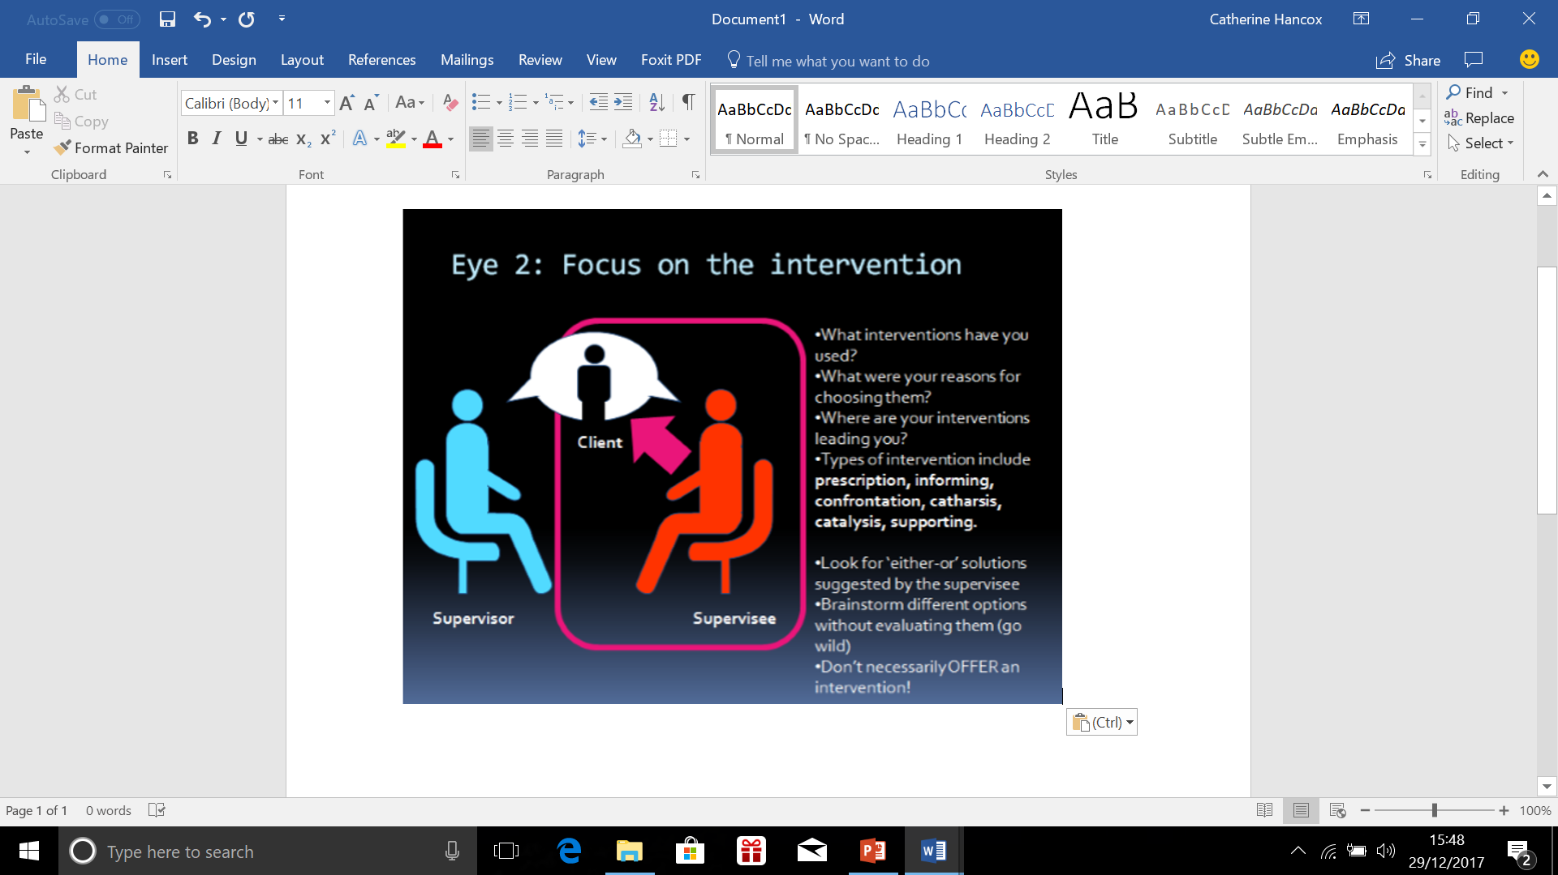
Eye 2: Focus on the Intervention
What interventions have you used?
  What were your reasons for choosing them?
  Where are your interventions leading you?
  Brainstorm different options without evaluating them (go wild!)
  Don’t necessarily OFFER an intervention

Slide 26
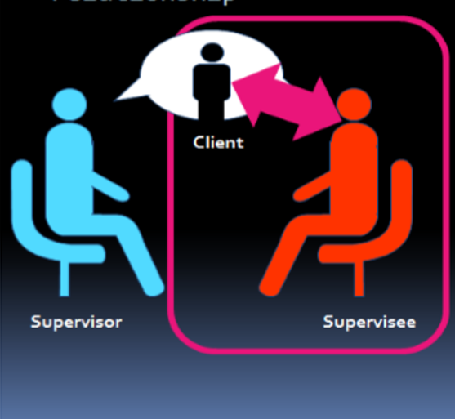
Eye 3: Focus on the client- supervisee relationship
The supervisor focuses on the perspectives of BOTH people:
  What is the system that the supervisee and the client create together?
  Find an image or metaphor to represent the relationship.
  Imagine the sort of relationship you would have in different circumstances.
  If you were a fly on the wall looking at your last appointment, what would you notice?
  Client transference on to the supervisee.
  Supervisee counter transference onto the client.

Slide 27
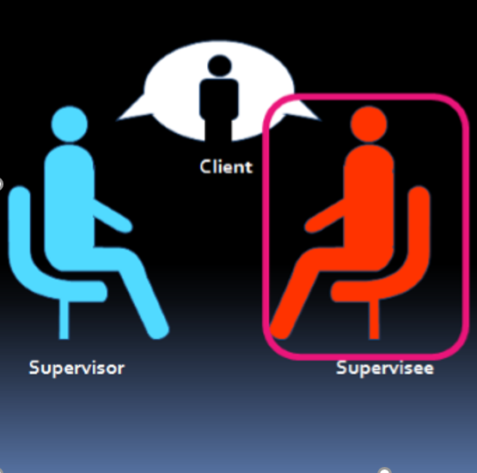
Eye 4: Focus on the supervisee
How is the supervisee affected, internally (especially emotionally) by the client?
  Does the relationship with the client remind the supervisee of another relationship?
  How does the supervisee respond to the ‘role’ imposed by the client on them?
  Does the supervisee want the client to change for their own sake rather than the client’s?

Slide 28
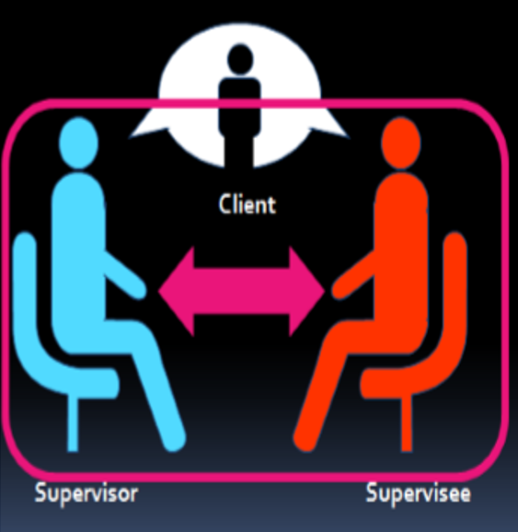
Eye 5: Focus on the supervisor-supervisee relationship
Parallel Processes:
Looking for ways in which the supervisor-supervisee relationship resembles the client-supervisee relationship.
  In a parallel process, the supervisee acts like the client and the supervisor acts like the supervisee.
  E.g. the supervisee withholds feelings from the supervisor like the client does or responds negatively to support or interventions like the client does.
  Supervisor-supervisee relationships may also be played out between the supervisee and the client!

Slide 29
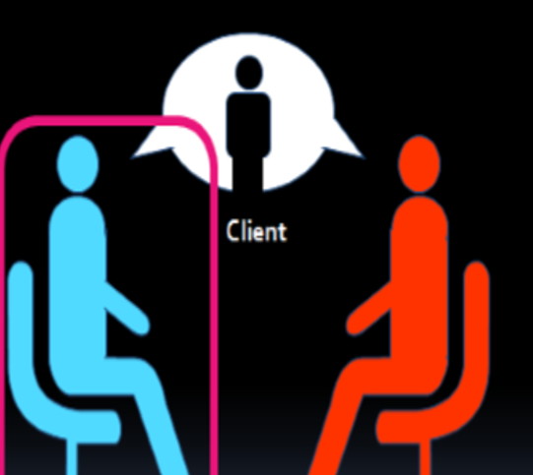
Eye 6: Focus on the supervisor’s processes
Noticing sudden changes that ‘come over us’, such as fatigue, interest, annoyance, fear.
  Images that spring to mind.
  Reflectiveness – knowing one’s internal states well enough to know whether this feeling is coming from this experience or another one outside the supervisor-supervisee relationship.
  Does the response reflect basic feelings about the supervisee, or about the material they are discussing?

Slide 30
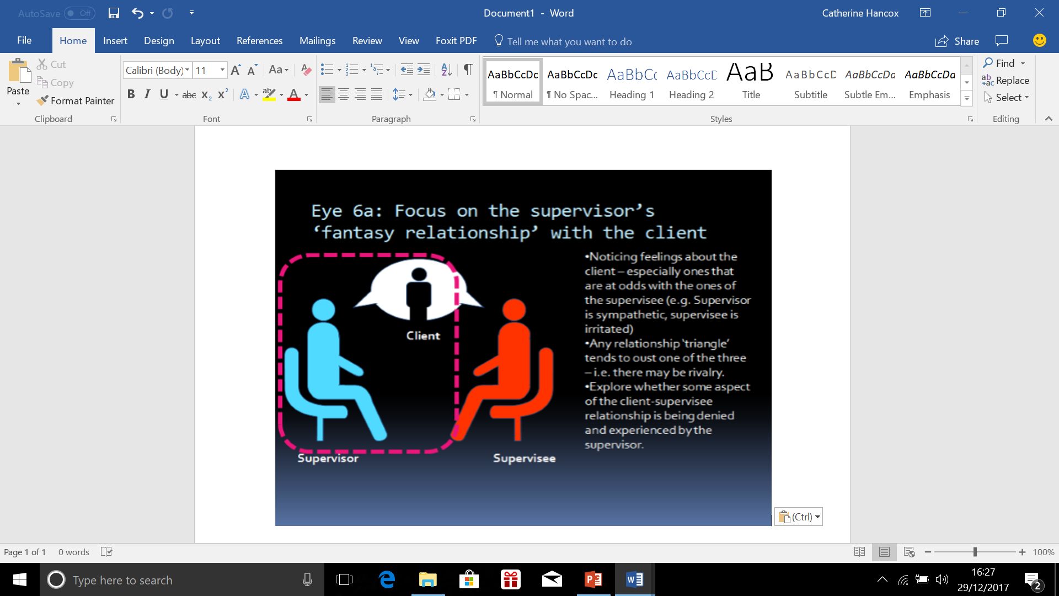
Eye 6a: Focus on the supervisor’s ‘fantasy relationship’ with the client
Noticing feelings about the client – especially ones that are at odds with the ones of the supervise (e.g. supervisor is sympathetic, supervisee is irritated).
  Any relationship ‘triangle’ tends to oust one of the three – i.e. there may be rivalry.
  Explore whether some aspect of the client-supervisee relationship is being denied and experienced by the supervisor.

Slide 31
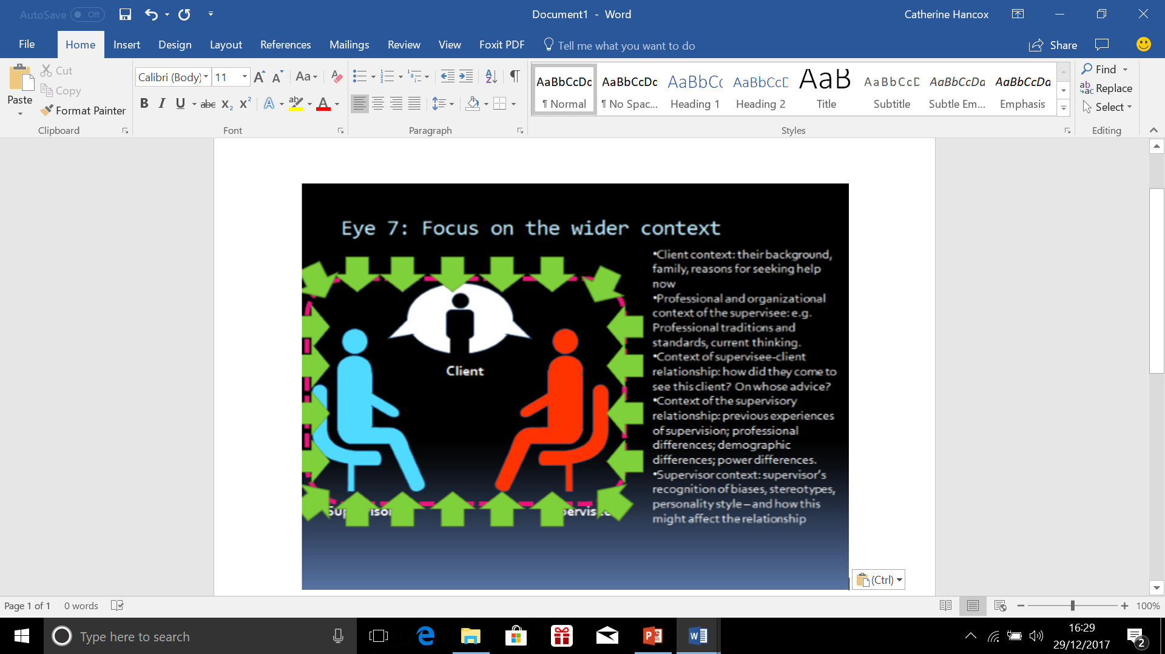
Eye 7: Focus on the wider context
Client context – their background, family, reasons for seeking help now.
Professional and organisational context of the supervisee, e.g. professional traditions and standards, current thinking.
Context of supervisee-client relationship – how did they come to see the client? On whose advice?
Context of the supervisory relationship – previous experiences of supervision, professional differences, demographic differences, power differences.
Supervisor context, supervisor’s recognition of biases, stereotypes, personality style and how this might affect the relationship.

Slide 32
Structure and Process Models
An example of this ‘combination’ model is the Cyclical Model (Page and Wosket, 2001).
Main concepts:
Contracting
Focus
Space
Bridge
Review
Each concept contains 5 further elements, all of which need to be addressed for the supervision to be effective

Slide 33
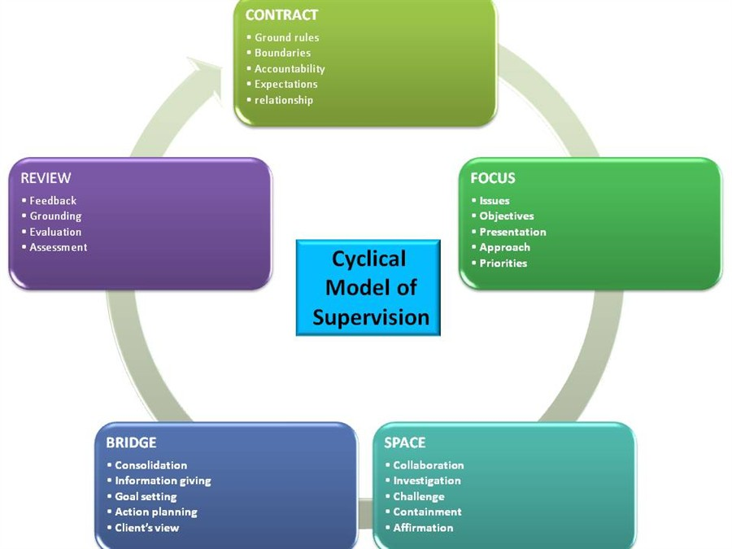
Contract :
ground rules, boundaries, accountability, expectations, relationship.
Focus:
Issues, objectives, presentation, approach, priorities.
Space:
Collaboration, investigation, challenge, containment, affirmation.
Bridge:
Consolidation, information giving, goal setting, action planning, client’s perspective.
Review:
Feedback, grounding, evaluation, assessment, re-contracting.

Slide 34
3 Step Method
Structuring the supervision session
Step 1
Focus on facts
What is going on? What are you bringing to the session?
Step 2
Focus on feelings
The reflective process is aided and supported by identifying and exploring the supervisee’s feelings about the work.
Step 3
Focus on Action
What will you do now you have found out what you wanted to know from supervision?

Slide 35
Clinical Responsibility
Responsibility to the client
Fitness to work
Accountability
“Clinical Responsibility”
Responsibilities of Counsellors

Slide 36
Legal Responsibilities
Confidentiality
Contract
Provision of service
Data protection principles
Anti-discrimination

Slide 37
Ethical Issues
Client welfare
Time management
Boundaries
Intrusion of personal issues
Previous or unexplored client issues

Slide 38
Ethical Issues
Fidelity
Justice
Beneficence
Non-maleficence

Slide 39
Points for reflection (Hawkins & Shohet, 2012)
What would I least like my supervisor to know about work with this client?
Am I frightened of being judged and assessed? Have I tried checking out whether these fears are justified or not?
Can I confront my supervisor and give them feedback? If not, are the constraints internal or external?
Do I tend to blame others for what I myself can change? Supervisees can depower themselves by having an investment in believing that they cannot change what their supervisor or organisation does to support them. Many supervisees discover that more changes are possible than they previously believed.
Do I carry some of my supervisor’s anxieties and feel I have to look after them?
Is it feasible to have a more equal relationship? How is it appropriate and is it what I want, given that more equality means more responsibility?

Slide 40
Trainee non-disclosure in supervision: what are they not telling you? (Mehr et al, 2010)
Negative experience of supervision
Personal life concerns
Negative perception of supervisor
Reaction to evaluation
Theoretic differences
Concerns about professional inadequacy
Perceived mistakes make
Sexual attraction issues

Slide 41
The results of this study indicate that within a single supervision session, 84.3% of trainees withheld information from their supervisors.
Reasons for nondisclosure (i.e. fears of being viewed negatively; power imbalance)
The greater the anxiety experienced by the trainee, the greater amount of trainee nondisclosure and a lower overall willingness to disclose in the supervision session.

Slide 42
Implications and recommendations of this study
Supervisors need to be open to feedback from supervisees and demonstrate a willingness to change
Supervisors need to acknowledge the inherent power difference in the relationship
Supervisors need to give evaluative feedback to supervisees
Supervisors need to nurture supervisee’s development of self-confidence
Sometimes silence actually is golden – some non-disclosures are appropriate

Slide 43
Exercise – Balancing Awareness
10 minutes. In dyads, A and B.
A talks for 2 minutes
B focuses all their attention on A, what they say and how they say it
A stops talking. B focuses back on self – ask yourself:
    How am I experiencing this? What is going on for me?
B reflects this back to A
Swop roles

Slide 44
References:
Bernard, J. M. and Goodyear, R. K. (2014). Fundamentals of Clinical Supervision. Cambridge. Pearson.
Borders, L. D. and Brown, L. L. (2005). The New Handbook of Counseling Supervision. New Jersey. Laurence Erlbaum Associates, Inc.
Carroll, M. (1996). Counselling supervision. Theory, skills and practice. London: Cassell.
Falender, C. A. and Shaftranske, E. P. (2004). Clinical Supervision: A Competency-based Approach. Washington DC. American Psychological Association.
Hawkins, P. and Shohet, R. (2012). Supervision in the Helping Professions. (4th edn.) Buckingham. Open University Press.
Inskipp, F. and Proctor, B. (2001). The Art, Craft and Tasks of Counselling Supervision, Part 1: Making the Most of Supervision. (2nd edn). Twickenham. Cascade.
Mehr, et al (2010) Trainee nondisclosure in supervision: What are they not telling you? Counselling and Psychotherapy Research, June 2010; 10(2): 103113; cited Wosket, V. (2014). Supervising the Counsellor and Psychotherapist: A Cyclical Model. Abingdon, Oxfon. Routledge.
Page, S. and Wosket, V. (2001). Supervising the Counsellor: A Cyclical Model. (2nd edn). Hove. Brunner-Routledge).
Proctor, B. (2008). Group Supervision: A Guide to Creative Practice. (2nd edn.) London. Sage Publications.
Stoltenburg, C.D. and McNeil, B.W. (2010). IDM Supervision. New York: Routledge

