Slide 1
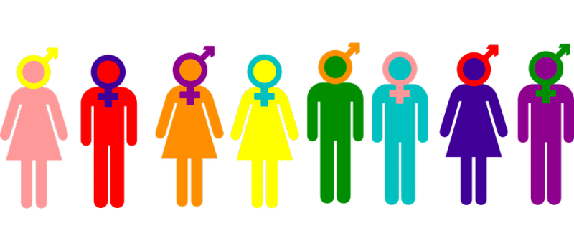
Gender, Race, Religion and Crime
Week 2 – Understanding Gender
Jane 2025
j.davies2@UWTSD.ac.uk

Slide 2
Workshop Task:
Look at the remarks from various groups around Rishi Sunak’s speech at the Conservative Party conference to underscore his government’s views on gender:
Rishi Sunak: 'A man is a man and a woman is a woman, that’s just common sense' - YouTube
  Might want to consider other Conservative members thoughts
  Where does this leave the Party?
  What about LGBTQ+ groups? – what their opinion?
  Social Media?
  Good / Bad / Fall out of this comment!
  Your belief’s?
Notes:
Rishi Sunak: 'A man is a man and a woman is a woman, that’s just common sense' - YouTube

Slide 3
President Trump 2025
Defending Women From Gender Ideology Extremism And Restoring Biological Truth To The Federal Government – The White House
RESTORING BIOLOGICAL TRUTH TO THE FEDERAL GOVERNMENT ORDER
Thoughts on the order by Trump and his Administration

Slide 4
Key Topics
Feminism
Feminist Theory
Gender (binary, spectrum, objective, socially constructed?)
Sex (binary, spectrum, objective, socially constructed?)
Sexuality

Slide 5
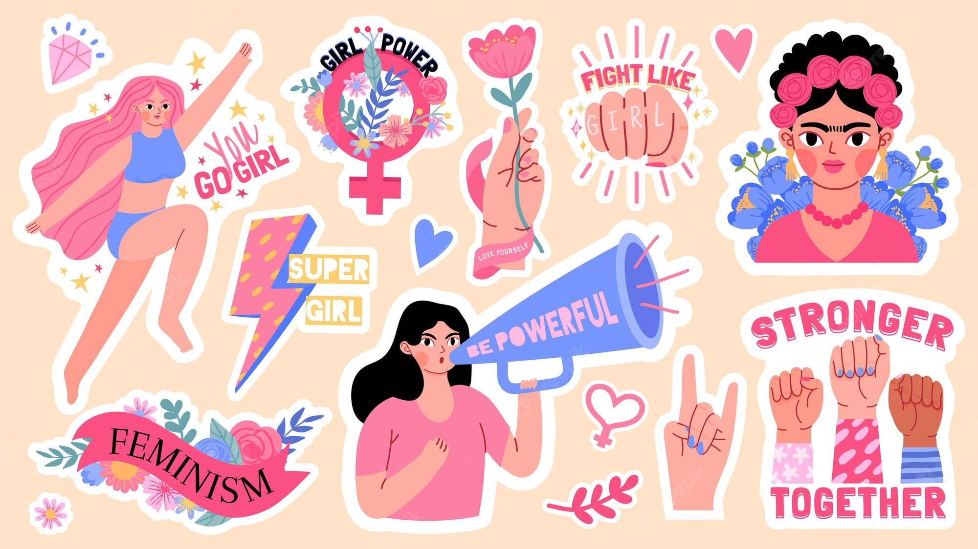
Feminism
What is “feminism”?
What is a “feminist”?

Slide 6
It is:
A social and political movement that:
Advocates for the rights of women on the grounds of political, social, and economic equality to men.
It seeks to address and dismantle systemic inequalities and injustices faced by women and other marginalised genders.
Feminism encompasses a range of ideologies and movements, each with its own focus and methods, but all share the common goal of achieving gender equality.

Slide 7
Key Aspects of Feminism
Feminism is the belief in and advocacy for the political, economic, and social equality of the sexes.
It seeks to address the inequalities and discrimination faced by women and other marginalised genders
Equality: core feminism strives for equal rights and opportunities for all genders, challenging traditional gender roles and stereotypes
Advocacy: Feminism involves movements aimed at promoting women's rights and interests, such as campaigns for voting rights, equal pay, and reproductive rights
Intersectionality: Modern feminism recognises the importance of intersectionality, which considers how different aspects of a person's identity (e.g., race, class, sexual orientation) intersect and impact their experiences of discrimination and privilege
Global Movement: While feminism has its roots in Western traditions, it has evolved into a global movement

Slide 8
Defining Feminism
As with everything else, it’s a lot more complex thank it first seems
“[Defining feminism] poses some serious problems. Not that we would want to end up by demanding a definition of what feminism is and, therefore, of what one must do, say, and be, if one is to acquire that epithet; dictionary meanings are suffocating, to say the least”
Jardine, A in Thompson, D. (1994) 'Defining Feminism', Australian Feminist Studies, 20(9), pp.171-192.
Notes:
Feminism is an interdisciplinary approach to issues of equality and equity based on gender, gender expression, gender identity, sex, and sexuality as understood through social theories and political activism. Historically, feminism has evolved from the critical examination of inequality between the sexes to a more nuanced focus on the social and performative constructions of gender and sexuality.

Slide 9
Defining Feminism
“It is certainly possible to construct a base-line definition of feminism and the feminist which can be shared by feminists and non-feminists. Many would agree that at the very least a feminist is someone who holds that women suffer discrimination because of their sex, that they have specific needs which remain negated and unsatisfied, and that the satisfaction of these needs would require a radical chance (some would say a revolution even) in the social, economic and political order. But beyond that, things immediately become more complicated.”
Delmar, R. (2001) 'What is Feminism', in A. Herman and A. Stewart (ed.) Theorizing Feminism. London: Routledge, pp.8-33.

Slide 10
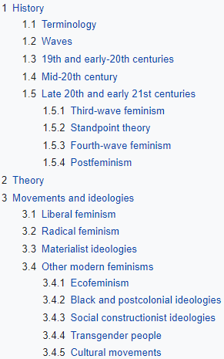
Different Strands of Feminism
There are countless different strands, waves, ideologies, and flavours of feminism.
None are the “correct” feminism, but all are interesting in the perspective the bring to the debate around gender equality in society

Slide 11

Feminist
is someone who supports and advocates for feminism
Has the belief in and pursuit of gender equality.
Feminists work towards addressing and challenging the inequalities and injustices that women face
Feminists can be of any gender and come from diverse backgrounds.
Their approaches and focuses may vary, but they all share the common goal of achieving gender equality.

Slide 12
Defining Feminism
“Very few women, however deeply engaged in fighting for women’s rights, would have described themselves as ‘feminists’. When women began to organize again in the 1960s and 1970s, the movement called itself Women’s Liberation (borrowing the term from black, Third World, and student movements).”
Walters, M. (2005) Feminism: a very short introduction. Oxford: Oxford University Press.

Slide 13
Defining Feminism
Why do you think people are resistant to labelling themselves as “feminist”?
What about the label “Women’s Liberation” seems better suited?
What does the label “feminist” do to someone’s identity?
[Labelling Theory – Becker]
[Symbolic Interactionism – Blumer and Mead]

Slide 14
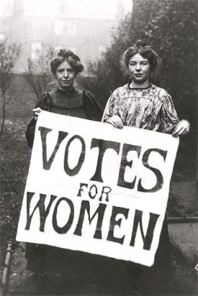
Waves of Feminism
First Wave Feminism (19th and early 20th Century):
  Focused on legal issues, particularly securing the right to vote
  Mary Wollstonecraft, a key writer of the movement, was inspired by Jean-Jaque Rousseau and the enlightenment philosophy. She noticed that while the enlightenment was focused on a society based on the equality of men, women were often ignored or side-lined. She wanted to expand this idea to gender equality.

Slide 15
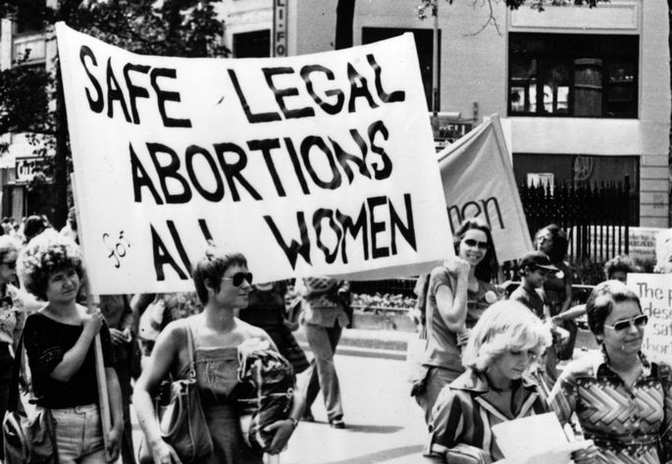
Waves of Feminism
Second Wave Feminism (1960s-1980s):
  Categorised by a broadening inclusion of women’s issues, like reproductive rights, family, domestic roles, the work place and sexuality
  Critiqued the patriarchal “Hegemony”; The male-dominated institutions and cultural practices of society.
  Criticised for focusing on white middle class values

Slide 16
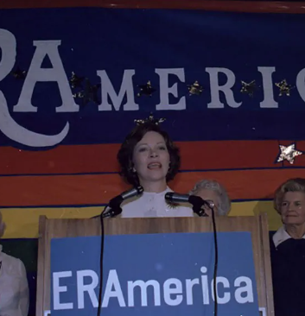
USA 1977 Conference on Women’s Rights
The 1972 Supreme Court case Eisenstadt v. Baird gave unmarried women legal access to birth control.
1973, Roe v. Wade made abortion legal across the country
The Equal Rights Amendment (ERA), which aimed to give men and women equality in all aspects of life
1972, conservative leader Phyllis Schlafly launched a movement whose goals—protecting women’s place as homemakers, fighting against abortion, and limiting government welfare and social support
Notes:
Equal Rights Amendment (ERA), a proposed amendment to the U.S. Constitution that would invalidate many state and federal laws that discriminate against women; its central underlying principle is that sex should not determine the legal rights of men or women.
Mrs America

Slide 17
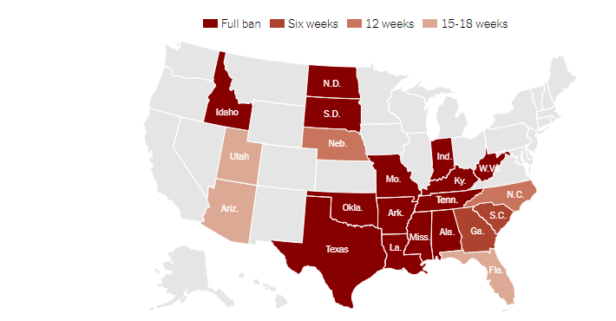
Where Abortion Is Illegal Now – USA States changes Roe v. Wade case
Notes:
UK 23 weeks and 6 days
Abortion Bans Across the Country: Tracking Restrictions by State - The New York Times

Slide 18

USA
Trump on Abortion | American Civil Liberties Union
A second Donald Trump presidency would present an existential threat to abortion access nationwide, effecting the ability of anyone to get an abortion anywhere in the country under any circumstance.
In 2016, Trump promised to appoint Supreme Court justices who would overturn Roe v. Wade.

Slide 19
The Abortion Act 1967 UK
Allowed legal abortion on a number of grounds within the UK
Free provision through the NHS &came into effect on 27 April 1968.
The C v S case in 1987 confirmed that, at that time, between 19 and 22 weeks a foetus was not capable of being born alive.
The 1967 Act required that the procedure must be certified by two doctors before being performed.
Self-abortion is illegal
Notes:
Abortion Rights » History of Abortion Law in the UK

Slide 20
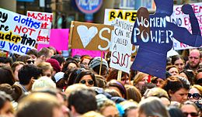
Waves of Feminism
Third Wave Feminism (1990s-2010s):
  Focused on redefining what it mean to be a ‘feminist’.
  Strove for individualism and diversity in women to be embraced.
  Emergence of new feminist undercurrents like sex positivity, vegetarian ecofeminism, transfeminism, intersectionality and postmodern feminism.
  Acted as a reaction to some critiques of second wave feminism

Slide 21

Waves of Feminism
Fourth Wave Feminism (2010s - Current):
  Focused on the empowerment of women and the interrogation of gender norms in society
  Bound up with things like the “me too” movement, this wave of feminism attempted to give voice to those experiencing sexual abuse, harassment, violence, objectification and sexism in the workplace.
  Greater use of internet technologies to organise and enact change
Notes:
Third-wave feminism emerged in the early 1990s and is characterised by its focus on diversity, individualism, and intersectionality
The term "third wave" was popularized by Rebecca Walker in her 1992 article "Becoming the Third Wave". This wave was partly a response to the Anita Hill hearings in 1991, where Hill testified about sexual harassment by Supreme Court nominee Clarence Thomas. Third-wave feminists emphasized the importance of embracing a wide range of identities and experiences, including those based on race, class, sexuality, and gender – more inclusive.
Riot Grrrl Movement: A feminist punk subculture that emerged in the early 1990s, promoting female empowerment and addressing issues like sexism and patriarchy through music and art.

Slide 22

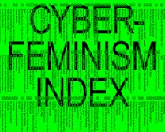

Continues
cyberfeminism
Notes:
The term cyberfeminism is used to describe the work of feminists interested in theorising, critiquing, and making use of the Internet, cyberspace, and newmedia technologies in general. The First Cyberfeminist International (FCI) in Germany, participants found it hard to provide a definition.
Cyberfeminism is considered to be a predecessor of ‘networked feminism’, which refers generally to feminism on the Internet: for example, mobilising people to take action against sexism, misogyny or gender-based violence against women.
Cyberfeminism, Technology, and International 'Development' on JSTOR

Slide 23
Cyberfeminism
Cyberfeminism is a branch of feminism that explores the relationship between gender and digital technology
It emerged in the early 1990s and focuses on how technology can both challenge and reinforce gender inequalities.
Art and Activism: Cyberfeminism is also expressed through art and activism, with many artists and activists using digital media to explore and challenge gender norms
female robots - Google Search
male robots - Google Search

Slide 24
Feminist Theory
Liberal Feminism
  From the second wave, liberal feminism looks for “explanations of gender inequalities in social and cultural attitudes”
  They do not view “women’s subordination as a part of a larger system or structure”. The instead “focus on the many separate factors” which cause inequalities between men and women in society – Sexism, discrimination, the glass ceiling, unequal pay.
  They do not see these as connected to a larger system of oppression, but individual obstacles for women to over come.
  Giddens, A. (2001) Sociology. 4th Edn Cambridge: Polity Press.
Notes:
The glass ceiling theory refers to the invisible barriers that prevent women and other marginalized groups from advancing to higher levels of leadership and professional success, despite having the necessary qualifications and experience.

Slide 25
Liberal Feminism
Nobody benefits from existing inequalities: both men and women are harmed
The explanation for gender inequality lies not so much in structures and institutions of society but in its culture and values.
Socialisation into gender roles has the consequence of producing rigid, inflexible expectations of men and women
Discrimination prevents women from having equal opportunities.
Liberal Feminists do not seek revolutionary changes: they want changes to take place within the existing structure.
The creation of equal opportunities through policy is the main aim of liberal feminists – e.g. the Sex Discrimination Act and the Equal Pay Act.
Liberal feminists try to eradicate sexism from the children’s books and the media.
Liberal Feminist ideas have probably had the most impact on women’s lives – e.g. mainstreaming has taken place – FOCUS ON THE SYSTEM

Slide 26
Feminist Theory
Radical Feminism
  A central belief that “men are responsible for and benefit from the exploitation of women”.
  Patriarchy is a universal phenomenon that exists across time and culture
  The family is a primary source of women’s oppression; men exploit women for free domestic labour in the home, and deny them access to power and influence in society.
  Male violence against women (domestic abuse, sexual harassment, rape) are part of the systematic oppression of women, not just individual cases.
  Daily life interactions – “non-verbal communication, patterns of listening and interrupting, and women’s sense of comfort in public – contribute to gender inequality.
  Giddens, A. (2001) Sociology. 4th Edn Cambridge: Polity Press.

Slide 27
Radical Feminism
Society is dominated and ruled by men – men are the ruling class, and women the subject class.
Blames the exploitation of women on men. It is primarily men who have benefitted from the subordination of women. Women are ‘an oppressed group.
Rape, violence and pornography are methods through which men have secured and maintained their power over women (Andrea Dworkin (1981))
Radical feminists have often been actively involved in setting up and running refuges for women who are the victims of male violence.

Slide 28
Postmodern Feminism
Women are not seen as a single homogenous group.
There are differences in the experiences of working class and middle class women, women from different backgrounds and women of different sexualities.
Criticise preceding feminist theory for claiming a ‘false universality’ (white, western heterosexual, middle class)
Notes:
The term "homogeneous" refers to something that is uniform or consistent in composition, structure, or nature. In other words, a homogeneous entity is made up of parts or elements that are all of the same kind or similar in nature

Slide 29
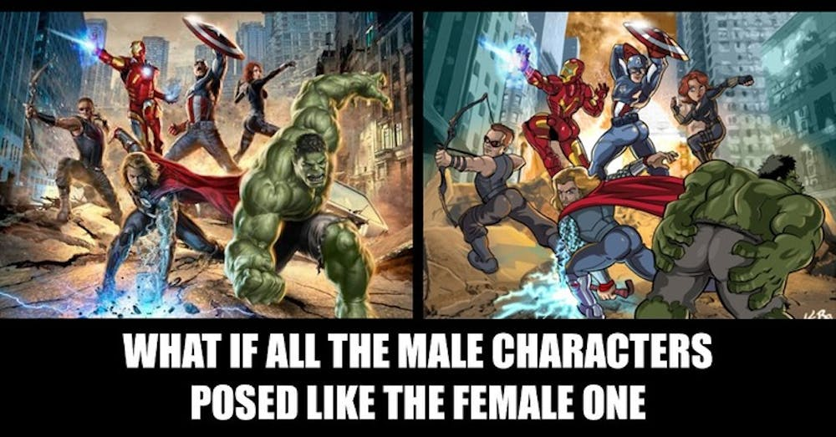
The Male Gaze

Slide 30
The Male Gaze
This concept suggests that the majority, if not the totality of culture is oriented around the male view of women.
Women’s beauty standards, behaviour and attitudes are enforced by men through power, patriarchy, media
Do you think this is true?
Can you think of any examples?

Slide 31
Gender – Class discussion
What is gender?
What is sex?
How are the two different?
How are the two socially constructed?

Slide 32
Sex
Refers to the different biological and physiological characteristics of males and females
reproductive organs, chromosomes, hormones
Male = YX Females = XX
Assigned at birth – some assigned later when sex characteristics do not clearly indicate the sex of the baby, for example in the case of ‘intersex’ people
Sex can change - transsexual people, who are born with the sex characteristics of one sex and gender identity of the other, sex reassignment surgeries are performed. This includes a change of sex organs and the administration of hormones.
Notes:
Caster Semenya | Sport | The Guardian

Slide 33
Sex
Remember though, although the definitions of sex are complex, socially constructed and much more flexible than often taken for granted, that does not mean they are not important and real.
The influence and impact of sex and gender are apparent everywhere. Understanding that even biological sex is not entirely boiled down to the expected binary does not mean that being a “woman”, in any sense of the meaning, isn’t a real identity with real social, biological, political and health implications.

Slide 34

Gender
A social, psychological and cultural construct and it is developed in the process of socialisation.
Different societies and cultures may therefore have different understandings of what is ‘masculine’ or ‘feminine’.
Norms and expectations related to gender are learned
All of these influences impose certain roles and patterns of behaviour on everyone within society.
Gender norms – often limited to notions of masculinity and femininity

Slide 35
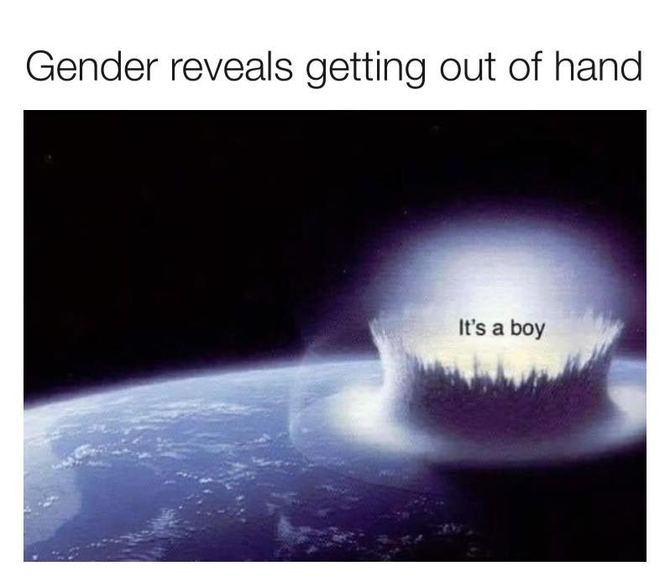
Gender
“Gender refers to the varied and complex arrangements between men and women, encompassing the organization or reproduction, the sexual division of labour and cultural definitions of femininity and masculinity”
Bradley, H. (1996) Fractured Identities. Cambridge: Polity Press.

Slide 36
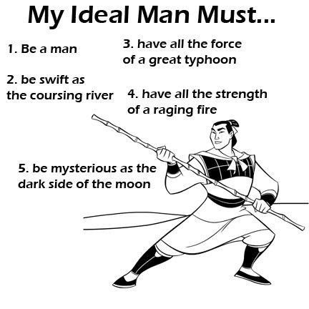
Gender
Can you make a list of “masculine” traits and a list of “feminine” traits?

Slide 37
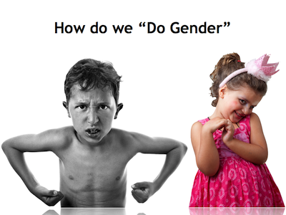
Gender
According to symbolic interactionists, Woman or Man is something you DO not something you are. These are verbs, not nouns.
How do you “do” your gender day to day?

Slide 38

Men
The academic study of gender and sex often tend to focus around the discussion of women, as a historically marginalised and overlook group.
While this is a necessity based on the overwhelming priority of men in academic, social and political life, it does sometimes appear as if the category of men is overlooked and presumed to be the neutral standard.
There are academics from all fields who specifically investigate “men” as a topic, looking at how the social, political and structural implications of patriarchy affect men.

Slide 39
Men
Men are bound by specific masculine cultural forms, just as women are bound by the feminine.
The media promotes a specific masculine subjectivity, which they are supposed to adhere to.
There are a multitude of different “masculinities”, each with their own norms and their own differences from the masculine hegemony
There is a hierarchy and domination of one masculinity over others
Terms like “Toxic Masculinity” are often used to describe these hegemonic masculine traits which have negative affects on women and non-binary people, but also other men which do not adhere in totality with the hegemonic masculinity enforced by society.
Ghaill, M & Haywood, C. (2007) Gender, Culture and Society: Contemporary Femininities and Masculinities. Hampshire: Palgrave Macmillan.

Slide 40
Sexuality – Queer Theory
“…primarily interested in how such categories as ‘heterosexual’, ‘gay’ and ‘lesbian’ came to be seen as stable identities and, in the process, reveals them as fragile constructs, constantly reliant on the successful performance of gender. It is important therefore, to see ‘queer’ as another strand of theorizing which follows a general trend of interrogating the historical and cultural positioning of the unified ‘self’ (a self endowed with a coherent identity including gendered identity), characteristic of the Western constitution of the subject.”
Watson, K. (2005) 'Queer Theory', Group Analysis, 38(1), pp. 67-81.

Slide 41
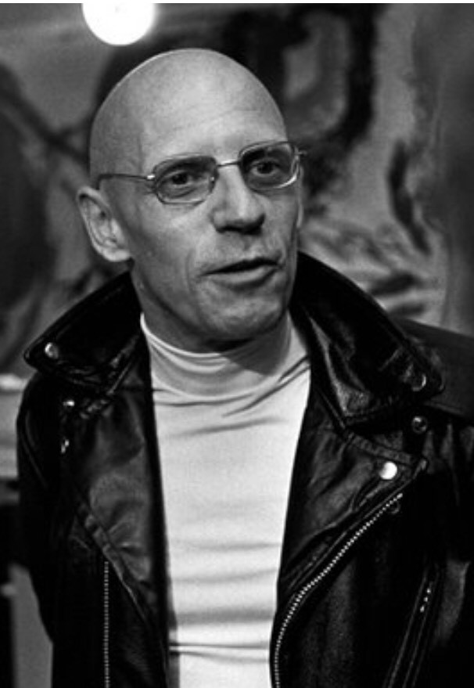
Sexuality – Queer Theory [Foucault]
“Foucault’s genealogical method illustrated that some experiences (madness, sexuality, illness, crime, etc.) have become the objects of particular institutional knowledges (psychiatric, medical, penal, sexological). This meant that by examining historical discourses, it was possible to understand how certain identities(such as the homosexual) were attached to individuals instead of acts/behaviours, and these individuals were then constituted as an object of knowledge (through scientific statements about ‘types’ and ‘traits’) and thus subject to disciplinary power. Identity, in Foucault’s writings, is therefore clearly culturally and historically constituted (as opposed to a view of ‘human nature’ as ahistorical).”
Watson, K. (2005) 'Queer Theory', Group Analysis, 38(1), pp. 67-81.

Slide 42
Sexuality – Queer Theory
You will often hear the word “queer” being used academically as a verb; how do you “queer” a certain topic?
By this we mean, how do we problematize something that is normative/accepted.
  We know there is an assumed societal split between men and women/gay and straight people/trans and cis people; how is that split created and maintained?
Discussion Point: In groups/pairs, pick one of those binaries (or make up your own) and explain what assumptions we have about them and how they are enforced in society through “disciplinary power”

Slide 43
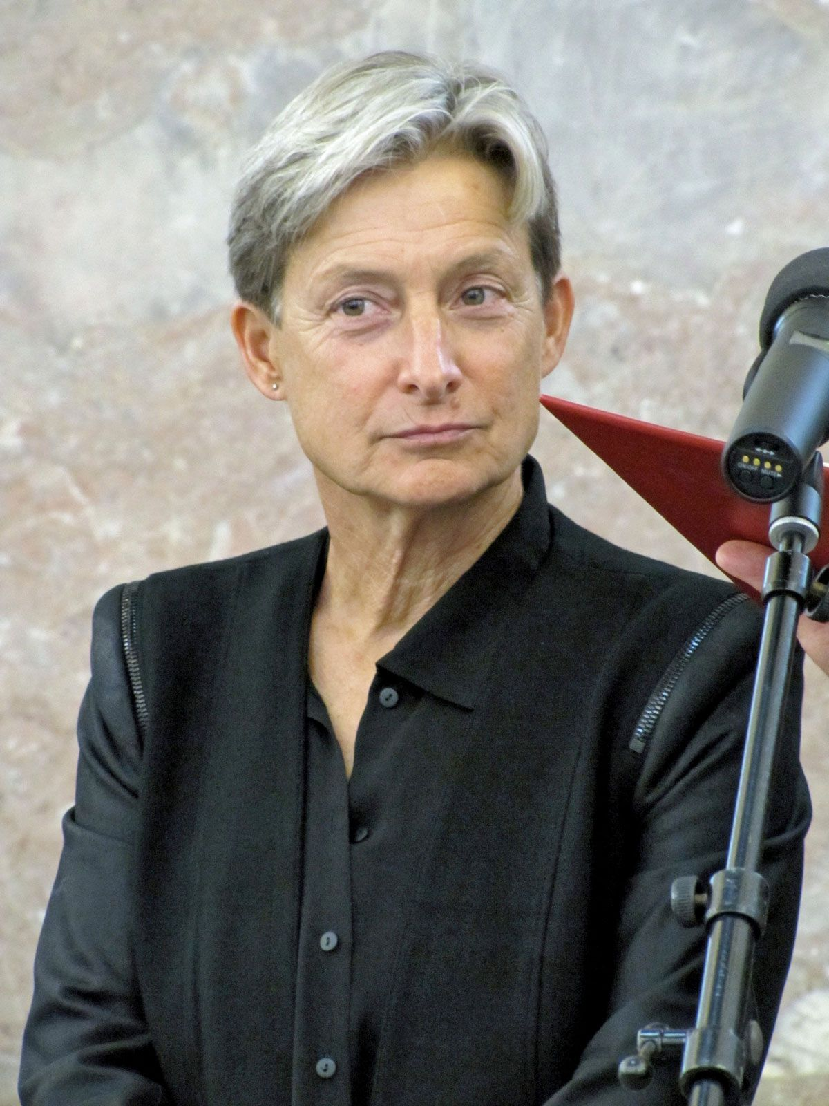
Sexuality – Queer Theory [Butler]
“Judith Butler (1990, 1993) took the debate further by examining how culture actually informs our understanding of biology precisely through presuming the priority of gender. For Butler, then, any notion of identity is mediated through categories already culturally available: there is no such thing as the ‘pre-cultural’ body. Whilst she did not dismiss the materiality of the body, she argued that words and language bring this body into being. Individuals are always already gendered prior to any element of choice for or against gender identity. Butler thus introduced the idea that ‘gender’ and ‘heterosexuality’ are performative and repetitive. Bodily gestures, movements and clothing all signify gender at every moment.”
Watson, K. (2005) 'Queer Theory', Group Analysis, 38(1), pp. 67-81.

Slide 44
Sexuality – Queer Theory [Butler]
In much of Butlers work, she has focused on the power of words and language.
She uses terms to explain how language causes or produces real world changes.
What kinds of language or rhetoric do we use day to day to enforce gender and sexuality, and how can we unpack exactly what we mean/do when we say those things?
Discussion Point: in groups or pairs, think of language you or others use day to day to create and maintain assumptions about gender and sexuality (e.g. “you hit like a girl”)

Slide 45
Concluding thoughts
Gender, Sex and Sexuality are important concepts that make real tangible impacts on the way we live.
Although we have discussed how malleable and fragile those concepts are as socially constructed categories, these identities are fundamental to us as individuals and society as a whole.
Having a keen understanding on the ways Gender, Sex and Sexuality are formed and maintained in society gives us a solid grounding on which to build our ideas about how they interact with crime, policing and the law.
It is in these arenas where Gender, Sex and Sexuality have the most far reaching and impactful effects on our day to day lives.

Slide 46
Prof Stock "makes trans students unsafe".
Professor Stock, questioning the idea that gender identity is more "socially significant" than biological sex
Prof Stock tweeted that students shouldn't "just expect to hear their own thoughts reflected back at them".
resigned from her position at the University of Sussex in October 2021
Notes:
Professor Kathleen Stock, a feminist philosopher, resigned from her position at the University of Sussex in October 2021 following a campaign by students who accused her of making trans students feel unsafe
. The controversy centred around her views on gender identity and transgender rights. Stock has expressed the belief that gender identity should not outweigh biological sex in matters of law and policy, and she has opposed amendments to the Gender Recognition Act that would allow trans people to self-identify
.Students and activists argued that her views were transphobic and harmful to the safety and well-being of trans students. Protests, posters, and online campaigns called for her removal, claiming that her presence on campus created an unsafe environment for trans individuals
. Despite the university's defence of her academic freedom and freedom of speech, Stock decided to resign, citing the difficulty of continuing in her role under such circumstances1

Slide 47
Any Questions?
About the content?
About the Assessment?
About anything else?

Slide 48
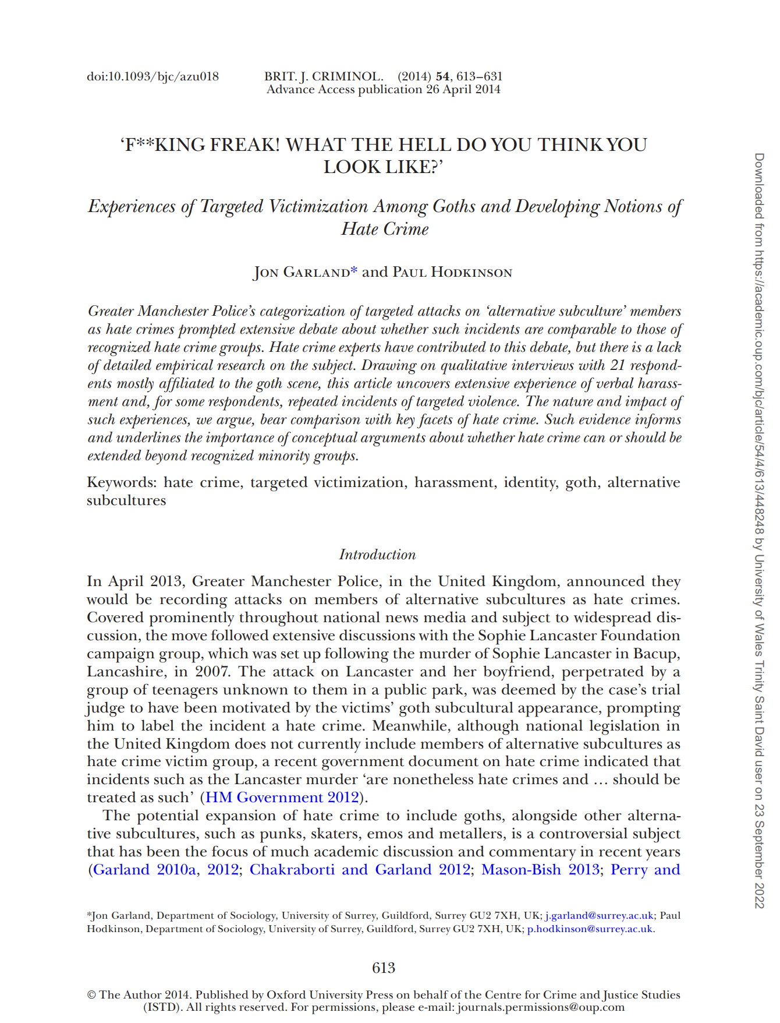
Hate Crime
Task:
For Friday ready the Journal
Summarise and evaluate what
the authors are saying –
To discuss on Friday
Notes:
Microsoft Word - hate crime.docx
'FKING FREAK! WHAT THE HELL DO YOU THINK YOU LOOK LIKE?': Experiences of Targeted Victimization Among Goths and Developing Notions of Hate Crime - University of Wales Trinity Saint David (uwtsd.ac.uk)

Slide 49

Week 2 complete!
Thank you for listening!
See you all next week!
Task

Slide 50
References
Bradley, H. (1996) Fractured Identities. Cambridge: Polity Press.
Delmar, R. (2001) 'What is Feminism', in A. Herman and A. Stewart (ed.) Theorizing Feminism. London: Routledge, pp.8-33.
Ghaill, M & Haywood, C. (2007) Gender, Culture and Society: Contemporary Femininities and Masculinities. Hampshire: Palgrave Macmillan.
Giddens, A. (2001) Sociology. 4th Edn Cambridge: Polity Press.
Jardine, A in Thompson, D. (1994) 'Defining Feminism', Australian Feminist Studies, 20(9), pp.171-192.
Karkazis, K. (2019) 'The misuses of "Biological Sex"', The Lancet, 394(10212), pp. 1898-1899.
Walters, M. (2005) Feminism: a very short introduction. Oxford: Oxford University Press.
Watson, K. (2005) 'Queer Theory', Group Analysis, 38(1), pp. 67-81.

