Slide 1
MOLES, chemical equations AND STOICHIOMETRY
Lecture 4
ACDB4011
HNC, 2023
Dr Ewa Kazimierska
e.kazimierska@uwtsd.ac.uk
Notes:
Relative mass must be known

Slide 2

introduction
Mole and molar mass
Calculations using moles and MM
Mass % composition
Balancing chemical equations
Stoichiometric calculations
  Mole-to-mole
  Mass-to-mass
Notes:
This module is designed to cover most of the stoichiometry needed to do calculations associated with chemical reactions. It includes:
The mole
Compare reactions (e.g. fuels)
Work out concentrations (e.g. acids)
Work out how much material is needed (e.g. mass balance

Slide 3
The mole
the fundamental unit of measurement used to deal with large numbers of atoms/molecules
Dozen = 12 used to count eggs easily
7 dozen eggs =
7 × 12 = 84 eggs
Mole = 6.02 × 10²³
used to count submacroscopic particles (atoms, molecules, ions, etc) easily
7 moles of carbon atoms =
= 7 × 6.02 × 10²³ = 4.21 × 10²⁴ C atoms
N_{A} = 6.02 × 10²³ - Avogadro’s number
7 moles of CO₂ molecules =
= 7 × 6.02 × 10²³ = 4.21 × 10²⁴ CO₂ molecules
N = n × 6.02 × 10²³
N – number of particles (molecules, atoms, etc)
n – number of moles [mol]
Notes:
Lets star with some real life examples…
If I asked you, how many eggs in dozen, you would tell me straight away … 12.
If I asked you how many years in decade … 10
Do you have other examples? Pair… Century… gallon…
1 mol of objects (atoms, ions, molecules, electrons, etc) always means 6.02x10^23of those objects
This magic number is called Avogadro’s number
Molecular quantities are minuscule - scaling up to convenient quantities involve confusing numbers
It would be inconvenient to refer to large numbers like 2.5 x 10^25 atoms.
Chemists use mole to report the huge numbers of atoms or molecules in a visible sample.
To visualise a 1 mole of pounds won in lottery the day you were born and spent a billion every second of your life , you would still have more than 99.999% of the prize money left when ou die at 90.
Lets get back to the eggs. You wouldn’t have any problem to calculate number of eggs in 7 dozen, would you?
So can you calculate number of C atoms is 7 moles of carbon?
What about number of CO2 molecules in 7 moles of CO2?
The general relationship between number of particles and moles can be written as…
Moles provide a way to quantify the amount of a substance. In OME, accurately determining the number of moles of a particular explosive or component is essential for ensuring proper handling, storage, and transportation.
The knowledge of moles allows for precise measurements of OME materials during manufacturing processes, enabling the production of consistent and reliable explosives.
By understanding the number of moles involved in a reaction, it becomes possible to predict the yield of an explosive, evaluate its potency, and control its effects in a controlled detonation.

Slide 4
The mole
the fundamental unit of measurement used to deal with large numbers of atoms/molecules
Dozen = 12 used to count eggs easily
30 eggs to dozen:
30 ÷ 12 = 2.5 dozen
How many moles of ammonia, NH₃, are present in the sample that contains 8.14 x 10²³ ammonia molecules?
8.14 × 10²³ ÷ 6.02 × 10²³ = 1.35 mol NH₃
n = N ÷ 6.02 × 10²³
N – number of particles (molecules, atoms, etc)
n – number of moles [mol]
Notes:
we can also convert from numbers of particles to the number of moles.
Lets look again at dozen of eggs as our analogy.
If I aske you how many dozen are 30 eggs, without hesitation you would divide 30 by 12 to find that 30 egss are actually 2.5 dozen
But what if I asked you …
And the general expression to calculate number of moles from known number of particles is…
I hope this is clear.
So lets complicate the things a bit and introduce the definition of 1 mol

Slide 5
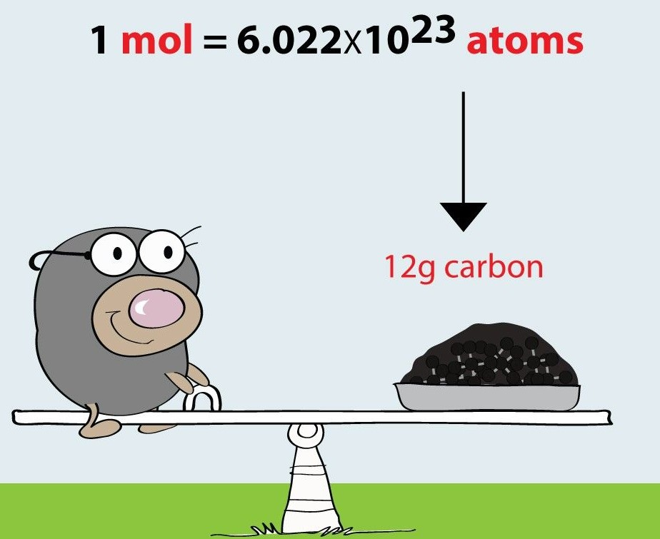
The mole - definition
mole - the amount of substance that contains the same number of particles (atoms/ ions/ molecules, etc.) as there are atoms in exactly 12 g of carbon-12
1 mol N₂ = 6.022 x 10²³ N₂ molecules
1 mol N = 6.022 x 10²³ N atoms
https://chemistry.analia-sanchez.net/igcse-chemistry/igcse-topics/the-mole/the-mole-notes/
Notes:
Another complication is that we cannot count moles as we count candies for example, but we can weigh moles.
1 mole of any substance has a specific mass that is called a …

Slide 6
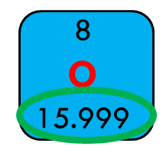
Molar mass
The molar mass of an element is the mass of the element per mole of its atoms
MM of carbon = 12.0 g/mol
MM of copper = 63.5 g/mol
MM of oxygen = 16.0 g/mol
The molar mass of a molecular compound is the mass of the element per mole of its molecules
relative masses
Notes:
The molar mass of element is defined as…
MM © = mass of Avogadro number of C atoms
MM Cu =
MM O =
These are called relative masses and can be found in PT under the symbol of the element.

Slide 7
Molar mass of molecular compound
1 mole of a pure substance weighs the relative mass in grams
H atom
relative mass
O atom
1 mole of H atoms weighs 1.0 g
molar mass = 1.0 g/mol
6.02 × 10²³ H atoms weigh 1.0 g
1
H
1.008
8
O
15.999
1 mole of O atoms weighs 16.0 g
molar mass = 16.0 g/mol
6.02 × 10²³ O atoms weigh 16.0 g
H₂O molecule
2 × 1.0 + 1 × 16.0 = 18.0
molar mass of H₂O = 18.0 g/mol
1 mole of H₂O weighs 18.0 g
6.02 × 10²³ H₂O molecules weigh 18.0 g
molar mass – (molecular weight) mass of 1 mole of a substance in g/mol calculated as a sum of atomic masses of constituent atoms in g/mol
Notes:
In other words …
Lets take a look at two elements, H and O which, combine together to form
We need molar mass to determine the number of moles of particles in a sample

Slide 8
Molar mass – sample problem
What is the molar mass (molecular weight) of:
1. Carbon dioxide
2. Aluminium nitrate
3. Magnesium phosphate
CO₂: 1 mole of C atoms weighs 12.0 g 1 mole of O atoms weighs 16.0 g
molar mass = 12.0 g/mol molar mass = 16.0 g/mol
In 1 mol CO₂ there is 1 mol of C and 2 mol of O
Mass of 1 mole CO₂ = mass of 1 mol C + mass of 2 mol O = 12.0 + 2 x 16.0 = 44.0 g
MM CO₂ = 44.0 g/mol
Al(NO₃)₃: 1 mole of Al atoms weighs 27.0 g 1 mole of N atoms weighs 14.0 g 1 mole of O atoms weighs 16.0 g
molar mass = 27.0 g/mol molar mass = 14.0 g/mol molar mass = 16.0 g/mol
In 1 mol Al(NO₃)₃ there is 1 mol of Al, 3 mol of N and 9 mol of O
Mass of 1 mole Al(NO₃)₃ = mass of 1 mol Al + mass of 3 mol N + mass of 9 mol O = 27.0 + 3 x 14.0 + 9 x 16.0 = 213.0 g
MM Al(NO₃)₃ = 213.0 g/mol
Mg₃(PO₄)₂: 1 mole of Mg atoms weighs 24.0 g 1 mole of P atoms weighs 31.0 g 1 mole of O atoms weighs 16.0 g
molar mass = 24.0 g/mol molar mass = 31.0 g/mol molar mass = 16.0 g/mol
In 1 mol Mg₃(PO₄)₂ there are 3 mol of Mg, 2 mol of P and 8 mol of O
Mass of 1 mole Mg₃(PO₄)₂ = 3 x 24.0 + 2 x 31.0 + 8 x 16.0 = 262.0 g MM Mg₃(PO₄)₂ = 262.0 g/mol

Slide 9
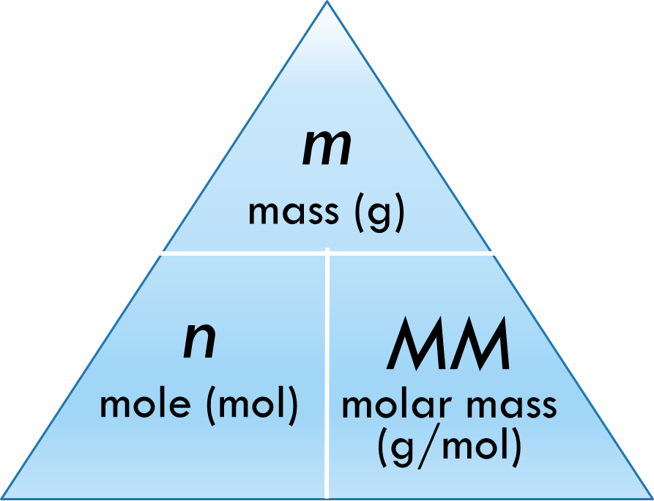
moles to mass/Mass to moles
1 bag of sugar weighs 3.0 kg
4 bags of sugar weigh 4 x 3.0 = = 12.0 kg of sugar
7.0 kg of sugar ???
7.0 kg ÷ 3.0 kg/bag = 2.33 bags of sugar
1 mole of water weighs 18.0 g
4 moles of water weigh 4 x 18.0 = = 72.0 g of water
45.0 g of water ???
45.0 g ÷ 18.0 g/mol = 2.5 moles of water
m = n x MM
n = m ÷ MM
MM = m ÷ n
Notes:
So, although the mole is a fundamental unit of measurement used to deal with large numbers of atoms/molecules, we cannot take 1,2, 5 moles of any substance unless we convert these moles into actual mass. This must be done by using the molar mass. How? Lets move from eggs to sugar now and …
If 1 bag …, how much would 4 bags weigh?
Now if you had 7 kg of sugar, how many bags would it be?
Can we extrapolate this on moles? Of course we can!
If 1 mole of water ….
How many moles of water are there in 45 g of water?
The general relationships are represented by this mole formula triangle …
MM which is used to convert between the mass of sample and the moles of the substance it contains

Slide 10
Practice problems
Practice problem 1: What is the mass of 0.45 mol of potassium nitrate, KNO₃?
we know: n = 0.45 mol, MM KNO₃ = 39.0 + 14.0 + 3x16.0 = 101.0 g/mol
we need: m = ?
m = n x MM = 0.45 mol x 101.0 g/mol = 45.5 g KNO₃
Practice problem 2: How many moles of silver azide, AgN₃, are contained in 32.5 grams of AgN₃?
we know: m = 32.5 g, MM AgN₃ = 108.0 + 3x14.0 = 150.0 g/mol
we need: n = ?
n = m ÷ MM = 32.5 g ÷ 150.0 g/mol = 0.22 mol AgN₃

Slide 11
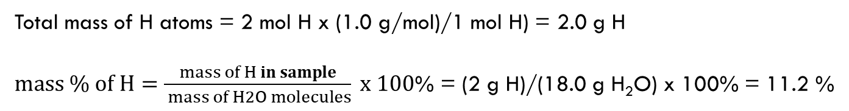
Mass % composition
Mass % composition is the fraction of the total mass contributed by each element present in a compound and expressed as a percentage
$mass \% of element=\frac{mass of element in sample}{total mass of sample} x 100$%
EXAMPLE: Hydrogen can be generated from water to use as a fuel. What is the mass % of hydrogen in water?
MM (H₂O) = 18.0 g/mol
Total mass of H atoms = 2 mol H x (1.0 g/mol)/1 mol H) = 2.0 g H
$mass \% of H=\frac{mass of H in sample}{ mass of H2O molecules} x 100$% = (2 g H)/(18.0 g H₂O) x 100% = 11.2 %

Slide 12
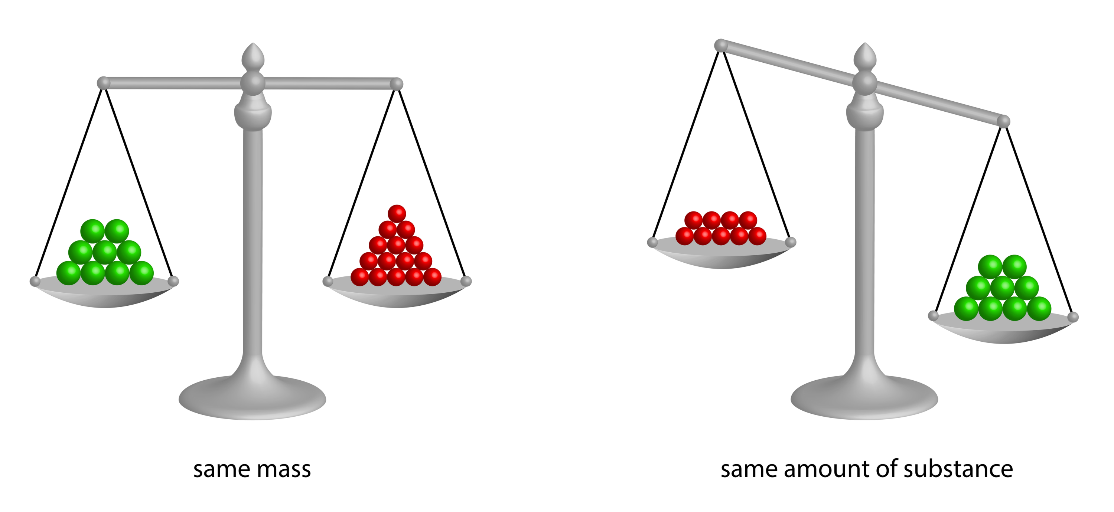
Why moles not mass?
https://chemistrymadesimple.net/episode/15/

Slide 13
Chemical reaction
Chemical reaction is a process that leads to the chemical transformation of one set of chemical substances to another
Reactants Products
starting material
substances formed in a chemical reaction
chemical reaction aways brings a chemical change
Notes:
Moles are very important when we talk about chemical reactions.
What is the chemical reaction?
The arrow pointing from reactants to products symbolises a chemical reaction.

Slide 14
Chemical equation
Chemical reaction – actual process that is described by chemical equation which sumarises the reaction in terms of chemical formulas and quantities
Chemical equation shows how atoms are rearranged in chemical reaction
Qualitative – identity of reactants and products (chemical formulas)
Quantitative – law of conservation of mass, law of fixed proportions, stoichiometric ratios

Slide 15
law of conservation of mass - matter cannot be created nor destroyed in a chemical reaction; atoms only change their ‘partners’
law of definite proportions - a given chemical compound always contains the same elements in the exact same proportions by mass
stoichiometry - the relationship between relative quantities of substances taking part in a reaction or forming a compound, typically a ratio of whole integers
stoichiometric ratio - the ratio of chemical substances necessary for a reaction to occur completely

Slide 16
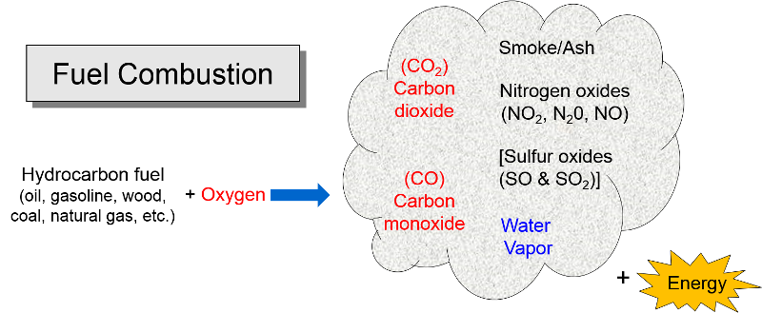
Combustion reaction in Ome
https://sphweb.bumc.bu.edu/otlt/MPH-Modules/PH/RespiratoryHealth/RespiratoryHealth7.html
Notes:
Combustion is a reaction with oxygen. Fuels provides carbon, sulfur, hydrogen (combustible species); oxygen is the oxidiser; when combined there is cgemical reaction that releases energy in the form of heat, light and gas expansion

Slide 17
Example of combustion reaction
Propane gas burns in oxygen gas to give water vapor and carbon dioxide gas.
This is a MACROSCOPIC description
At the submicroscopic level:
C₃H₈ (g) + O₂ (g) H₂O (g) + CO₂ (g)
reactants: propane, C₃H₈ AND oxygen O₂
products: water vapour, H2O AND carbon dioxide, CO₂
THIS CHEMICAL EQUATION IS NOT BALANCED !!!

Slide 18
Steps to balance chemical equation
1. Write the ‘skeletal’ equation (use the chemical formulas)
2. Count each type of atoms on both sides. If the same – happy days, if not – not balanced
3. Apply the law of conservation of mass => Add coefficients, as needed, in front of the symbols or formulas to increase the number of atoms or molecules
4
3
C₃H₈ + O₂ H₂O + CO₂
(g) (g) (g) (g)
5
C 3 1
3
8
H 8 2
O 2 3
10 10
Notes:
The numbers multiplying ENTIRE chemical formula is called stoichiometric coefficient
1 we don’t write
Because the relationship is valid no matter how large the sample, we can multiply through by the Avogadro number and conclude that
Stoichiometric coefficients
We can add additional useful information to a chemical equationby indicating the physical state of each reactant and product with a state symbol
An equation must never be balanced by changing the subscript in the chemical formulas

Slide 19
Few more rules
C₃H₈ (g) + 5 O₂ (g) 4 H₂O (g) + 3 CO₂ (g)
1. Start balancing atoms that appear only once on each side of the equation.
2. Use the smallest, whole number coefficients possible.
3. Never change the subscripts in chemical formulas !!! Changing subscripts changes the substances involved in the reaction. Change only the coefficients.

Slide 20
Stoichiometric coefficients
C₃H₈ (g) + 5 O₂ (g) 4 H₂O (g) +3 CO₂ (g)
THIS CHEMICAL EQUATION IS NOW BALANCED
5, 4 and 3 are called stoichiometric coefficients and they tell us the relative number of moles of reactants and products taking part in the reaction
They are chosen to show that atoms are neither created nor destroyed in the reaction
Notes:
The numbers multiplying ENTIRE chemical formula is called stoichiometric coefficient
1 we don’t write
Because the relationship is valid no matter how large the sample, we can multiply through by the Avogadro number and conclude that
Stoichiometric coefficients
We can add additional useful information to a chemical equationby indicating the physical state of each reactant and product with a state symbol
An equation must never be balanced by changing the subscript in the chemical formulas

Slide 21
incomplete combustion
If there is a limited amount of oxygen the products of the combustion are CO (carbon monoxide) or C (carbon)
C₃H₈ (g) + O₂ (g) H₂O (g) + CO (g)
7/2 4 3
C₃H₈ (g) + O₂ (g) H₂O (g) + CO (g)
2 7 8 6
2 4 3
C₃H₈ (g) + O₂ (g) H₂O (g) + C (s)

Slide 22
Practice problems
Practice Problem 1: When the following equation is balanced with the lowest ratio whole number coefficients, what is the coefficient of CO₂ ?
__ C₄H₁₀(g) + __ O₂(g) => __ CO₂(g) + __ H₂O(l)
Practice Problem 2: Write a balanced equation (with smallest set of coefficients) for the following:
__ C₇H₁₄(g) + __ O₂(g) => __ CO (g) + __ H₂O(l)
__ C₇H₁₄(g) + __ O₂(g) => __ C (s) + __ H₂O(l)
C₄H₁₀(g) + 13/2 O₂(g) => 4 CO₂(g) + 5 H₂O(l)
2 C₄H₁₀(g) + 13 O₂(g) => 8 CO₂(g) + 10 H₂O(l)
C₇H₁₄(g) + 21/2 O₂(g) => 7 CO(g) + 7 H₂O(l)
2 C₇H₁₄(g) + 21 O₂(g) => 14 CO(g) + 14 H₂O(l)
C7H14(g) + 7/2 O2(g) => 7 C(g) + 7 H2O(l)​
2 C7H14(g) + 7 O2(g) => 14 C(g) + 14 H2O(l)

Slide 23
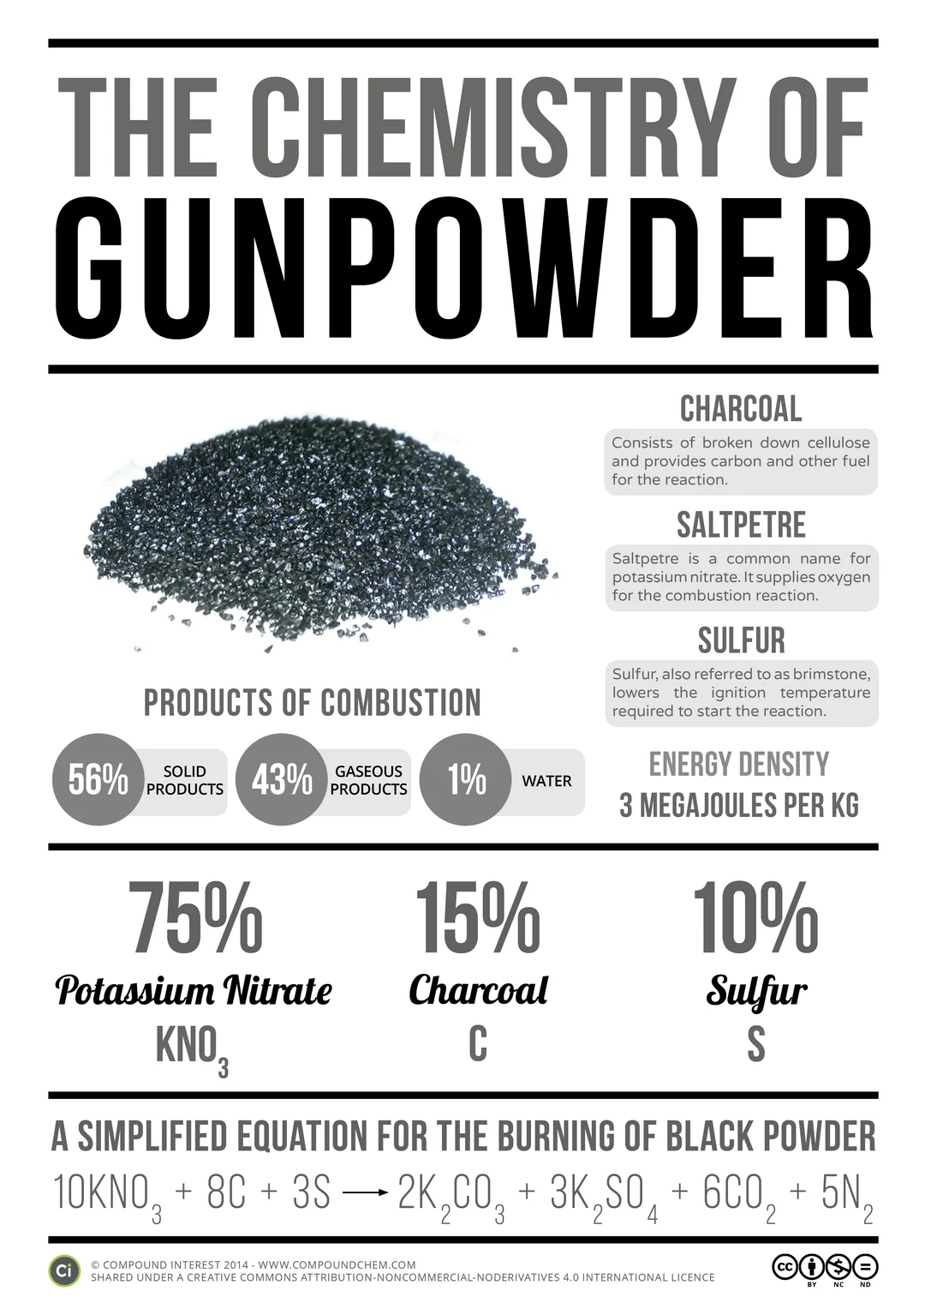
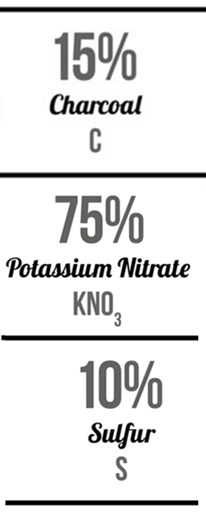
The chemistry of gun powder

Slide 24
The chemistry of gunpowder, cont
YouTube video: The Science of Fireworks - with Chris Bishop
74 KNO₃ + 96 C + 30 S + 16 H₂O →
→ 35 N₂ + 56 CO₂ + 14 CO +3 CH₄ + 2 H₂S + 4 H₂ + 19 K₂CO₃ + 7 K₂SO₄ + 8 K₂S₂O₃ + 2 K₂S + 2 KSCN + + (NH₄)₂CO₃ + C + S
https://www.youtube.com/watch?v=rmtK2BgmGCw

Slide 25
How to use reaction stoichiometry
Mole-to-mole calculations
The balanced chemical equation for a reaction is used to set up the conversion factor from one substance to another. That conversion factor, called the mole ratio for the reaction, is applied to the moles given to calculate the moles required.
Mass-to mass calculations
In mass-to-mass calculation, convert the given mass to moles, apply the mole-to-mole conversion factor to obtain the moles required and finally convert moles required to mass.

Slide 26
Mole-to-mole calculations
Stoichiometric coefficients can be interpreted in terms of numbers of moles
C₃H₈ + 5 O₂ 4 H₂O + 3 CO₂
1 mole 5 mole 4 mole 3 mole
3 moles 15 moles 12 moles 9 moles
10 moles 50 moles 40 moles 30 moles
x moles 5x moles 4x moles 3x moles
Stoichiometric relation:
1 : 5 : 4 : 3

Slide 27
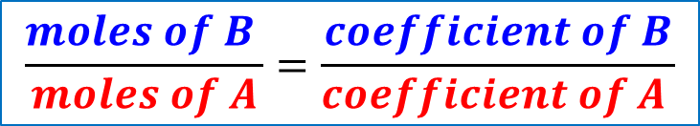
The numbers of moles of reactants actually used in a reaction are usually different from the stoichiometric coefficients in the equation
How much water is formed when 0.25 mol O₂ reacts with C₃O₈?
B (required): water ?
A (given): oxygen 0.25 mol
C₃H₈ + 5 O₂ 4 H₂O + 3 CO₂
stoichiometric
relation:
1 : 5 : 4 : 3
0.25 : ?
ACTUAL
relation:
Mole ratio:
$$\frac{moles of B }{moles of A}=\frac{coefficient of B}{coefficient of A }$$
B – substance required
A – substance given
moles of H2O / 0.25 mol O2 = 4 / 5
Moles of H2O = 0.25 x 0.8 = 0.2 mol H2O

Slide 28

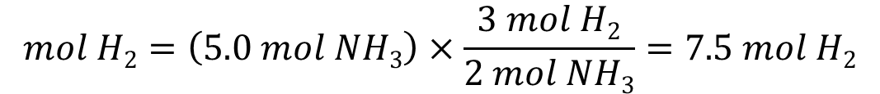
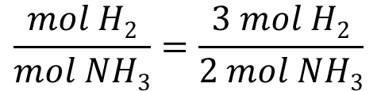
example
Find the number of moles of H₂ needed to produce 5.0 mol NH₃ by reaction with N₂
Strategy: Write the balanced chemical equation , identify the mole ratio between N₂ and NH₃ and use it as a conversion factor
B=?
A
1: N₂ (g) + 3 H₂ (g) → 2 NH₃ (g)
2: 3 mol H₂ produce 2 mol NH₃
B (required): ? mol H₂
A (given): 5 mol NH₃
$$\frac{moles of B}{moles of A}=\frac{coefficient of B}{coefficient of A }$$
3:
$$\frac{mol H2}{mol NH3}=\frac{3 mol H2}{2 mol NH3}$$
$$mol H2=\left(5.0 mol NH3\right)×\frac{3 mol H2}{2 mol NH3}=7.5 mol H2$$
Mole ratio

Slide 29

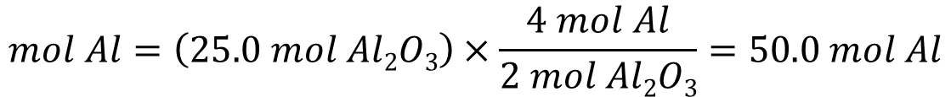
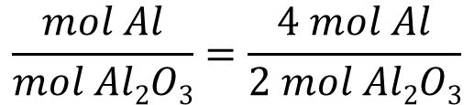
Practice problem
Aluminium metal reacts with molecular oxygen gas to form solid aluminium oxide. How many moles of aluminium are required to produce 25 mol Al₂O₃?
Strategy: Write the balanced chemical equation , identify the mole ratio between N₂ and NH₃ and use it as a conversion factor
1: 4 Al (s) + 3 O₂ (g) → 2 Al₂O₃ (g)
2: 4 mol Al produce 2 mol Al₂O₃
B (required): ? mol Al
A (given): 25 mol AlO₃
$$\frac{moles of B}{moles of A}=\frac{coefficient of B}{coefficient of A }$$
3:
$$\frac{mol Al}{mol Al2O3}=\frac{4 mol Al}{2 mol Al2O3}$$
$$mol Al=\left(25.0 mol Al2O3\right)×\frac{4 mol Al}{2 mol Al2O3}=50.0 mol Al$$
Mole ratio

Slide 30
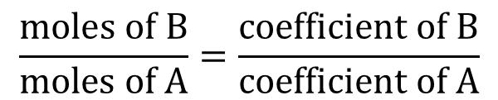
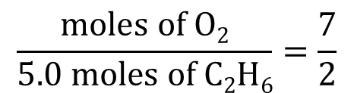
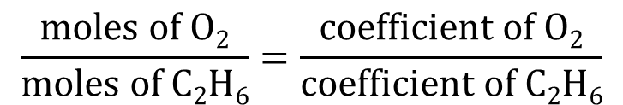
Another example
Ethane burns in oxygen gas to give water vapor and carbon dioxide gas. How many moles of oxygen gas are needed to completely burn 5.0 mol of ethane?
C₂H₆ + O₂ H₂O + CO₂
3 ½
3
2
x2
2 C₂H₆ + 7 O₂ 6 H₂O + 4 CO₂
A
B=?
$$\frac{moles of B}{moles of A}=\frac{coefficient of B}{coefficient of A}$$
$$\frac{moles of O2}{moles of C2H6}=\frac{coefficient of O2}{coefficient of C2H6}$$
$$\frac{moles of O2}{5.0 moles of C2H6}=\frac{7}{2}$$
moles of O₂ = 17.5 mol

Slide 31
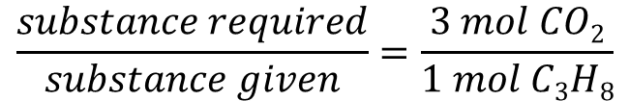

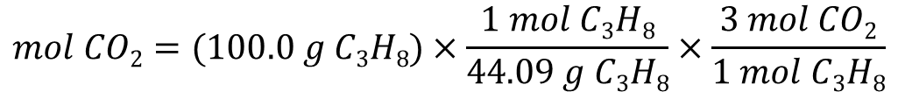
Mass-to-mass calculations
Propane is a common camping fuel. Calculate the mass of carbon dioxide produced when 100.0 of propane is burned in a camp stove
1. Write the balanced chemical equation:
C₃H₈ (g) + 5 O₂ (g) → 3 CO₂ (g) + 4 H₂O (l)
2. Calculate the molar mass of propane and carbon dioxide:
C₃H₈ = 44.09 g/mol and CO₂ = 44.01 g/mol
3. Find the stoichiometric relation:
$$\frac{moles of B}{moles of A}=\frac{coefficient of B}{coefficient of A }$$
$$\frac{substance required}{substance given}=\frac{3 mol CO2}{1 mol C3H8}$$
4. Use this mole ratio to convert from mol C₃H₈ to mol CO₂
$$mol CO2=(100.0 g C3H8)×\frac{1 mol C3H8}{44.09 g C3H8}×\frac{3 mol CO2}{1 mol C3H8}$$
converts mol C₃H₈ to mol CO₂
converts mass to mol C₃H₈

Slide 32
Mass-to mass calculations
5. Convert this amount of CO2 into mass in grams
$$mass of CO2=\left(100.0 g C3H8\right)×\frac{1 mol C3H8}{44.09 g C3H8}×\frac{3 mol CO2}{1 mol C3H8}×\frac{44.01 g CO2}{1 mol CO2}=299 g CO2$$

Slide 33
Practice problem
Calculate the mass of oxygen needed to react with 0.450 g of hydrogen in the reaction 2 H₂ (g) + O₂ (g) → 2 H₂O (l) (3.57 g)

Slide 34
Importance of moles in ome
Moles: provide a way to accurately quantify the amount of substance
  critical in manufacturing process for production of consistent and reliable explosives.
  by understanding the number of moles involved in a reaction, it becomes possible to predict the yield of an explosive, evaluate its potency, and control its effects in a controlled detonation.
  allows comparison between e.g. efficiency of fuels
MOLAR MASS: mass of one mole of a substance and is crucial for various calculations in OME
  to determine the precise amount of an explosive or a component required for a specific reaction or formulation
  essential for calculating the stoichiometry of reactions, ensuring that the correct proportions of reactants are used to achieve desired outcomes while minimizing the risk of unintended reactions or inadequate detonation
AVOGADRO’S NUMBER: represents the number of atoms, ions, or molecules in one mole of a substance
  allows for the conversion between the macroscopic scale (mass, volume) and the microscopic scale (number of particles).
  by utilizing Avogadro's number, it becomes possible to determine the number of atoms, ions, or molecules involved in OME reactions, leading to a better understanding of the explosive behaviour and the optimization of formulation and performance.

