Slide 1
Recap on Last Week
Wynne Jones

Slide 2
Comparison – State Response
Sicarii - State brutality
- Miscarriage of Justice
- Military
- Corruption
Narodnaya Volya - Police brutality
- Security Crackdown (Intelligence – Led)

Slide 3
Comparison – State Response
      Northern Ireland - Police brutality
- Miscarriages of Justice
- Military

Slide 4
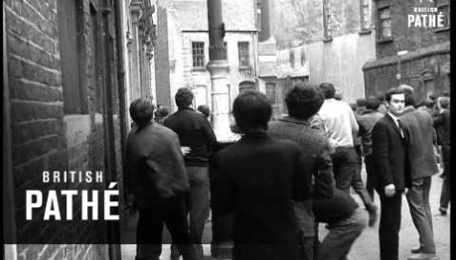

Slide 5
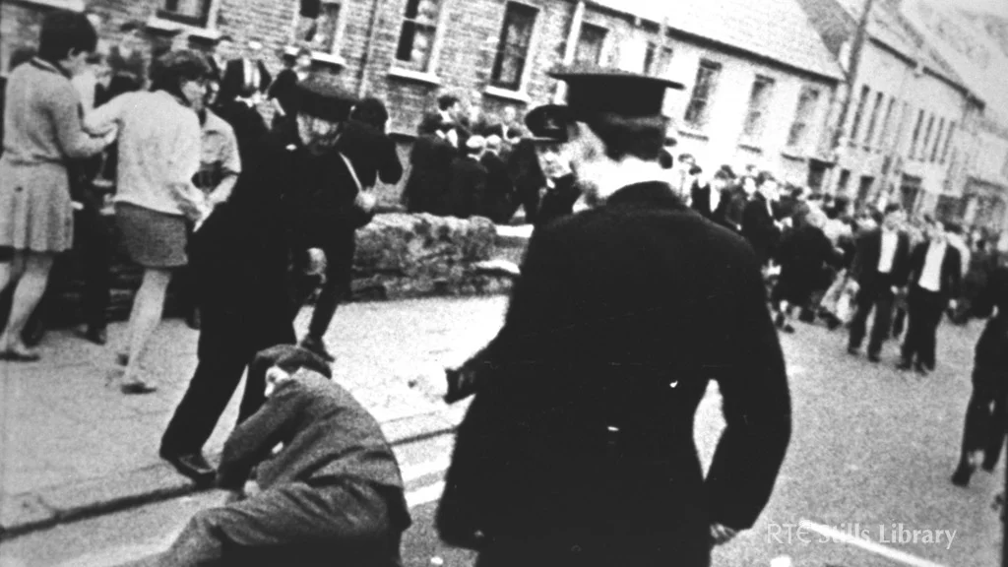
Police Brutality in NI
“On 5th October 1968 I was sitting watching TV …when the news clearly showed RUC officers brutally attacking Civil Rights marchers in Derry.
We saw officers kick, punch, and baton completely defenceless and peaceful marchers. We were totally shocked by the naked hatred and violence of some of the police”

Slide 6
Police Brutality in NI
“That event had a huge effect on me. All of my sympathy was with the marchers ……..my two friends and I who sat and watched the events of that day were all to join the Provisional IRA”.

Slide 7


Slide 8
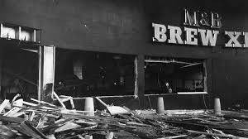
The Birmingham Pub bombings
The Birmingham Pub bombings took place on 21st November 1974 two bombs exploded in two pubs in central Birmingham 21 people were killed and 182 were injured.

Slide 9
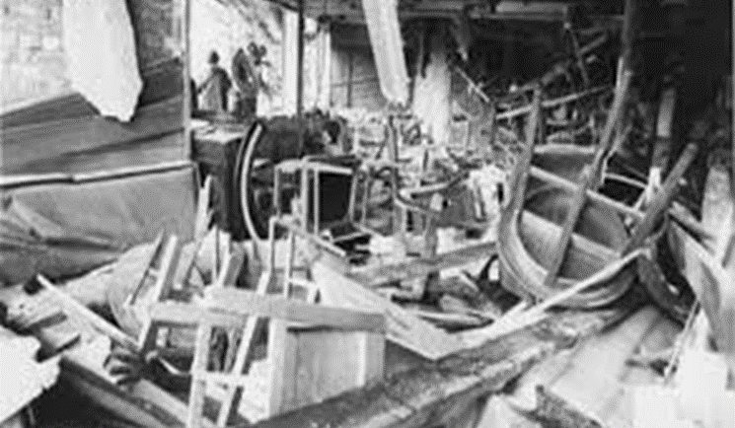
The Birmingham Pub bombingse
The Birmingham Pub bombings took place on 21st November 1974 two bombs exploded in two pubs in central Birmingham 21 people were killed and 182 were injured.

Slide 10
The Birmingham Pub bombingse Birmingham Pub bombings
Six Roman Catholic men were arrested shortly after the bombings, all six had lived in Birmingham since the 1960s.
Five of the men were en-route to the funeral of a PIRA member who had accidentally killed himself whilst planting a bomb at a telephone exchange in Coventry.
The five men were stopped at Heysham port (Lancashire) and subjected to a stop and search when asked about the purpose of their travel they lied and were arrested.

Slide 11

The Birmingham Pub bombings
Following forensic samples being taken the men were transferred into the custody of the West Midlands Serious Crime Squad. One of the six claims to have been assaulted by a WMSCS officer.
The defendants later claimed to have been deprived of food and sleep, that they were interrogated for long periods without a break; threats were made against them and they were beaten.
Four of the men confessed to the bombings.

Slide 12
The Birmingham Pub bombings
The central evidence on which the case hinged was the finding by a forensic examiner of explosive traces on the hands of two of the suspects, though the defence challenged the evidence the jury convicted all Six.
On 14th March 1991 all Six men were released when it was found that the convictions were unsafe on the grounds of police suppression of evidence and doubt over the presence of explosive traces on the hands of the suspects.

Slide 13
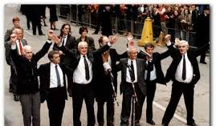
Miscarriages of Justice……
Guildford Four
Maguire Seven
Birmingham Six

Slide 14
Comparison – State Response
Military Intervention
Narodnaya Volya – Military Security Crackdown on Leadership (in tandem with reforms)
Northern Ireland – Deployment of up to 20,000 soldiers and 8000 armed police officers

Slide 15
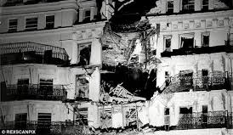
Comparison - Tactics
Surprise Attacks – Used by almost all terrorist groups (IRA ‘warnings’ for some attacks)
Improvised Explosive Devices (IED)concealed in building used by Narodnaya Volya in attempts to assassinate Tsar and by PIRA in attempt to assassinate Thatcher Government.

Slide 16
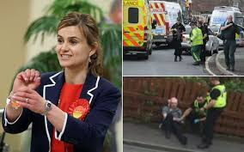

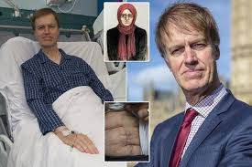
Other Tactics…
Remember Vera Zasulich the Narodnaya Volya supporter who walked into the public meeting being held by Governor-General Trepov and shot him!
Remember also Stephen Timms the labour MP stabbed at his surgery by Roshonara Choudhry an AQ extremist,
And Jo Cox murdered by Thomas Alexander Mair on her way to her surgery as he viewed her as “one of the traitors to white people”.

Slide 17
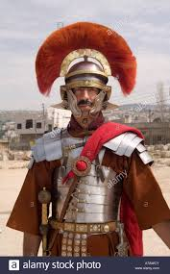
Sicarii – Collaboration….
Remember the group targeted those who assisted the Romans in any way, not only assisting militarily as perhaps an informant would but extending this to ‘secondary targeting’ to those who sold goods to, fraternised with etc.

Slide 18
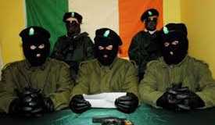
PIRA - Collaboration
17 January 1992 County Tyrone
Roadside bomb kills eight men and injured 6 construction workers who were repairing British Army base in Omagh.
Provisional Irish Republican Army (PIRA) claimed responsibility citing the grounds that “the workers were collaborating with the forces of occupation”.

Slide 19
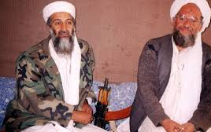
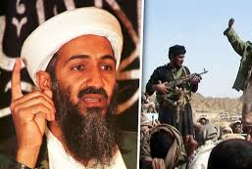
Al - Qaeda
A new entity?
Religious Ideology
Co-ordinated Suicide attacks
Using planes as flying bombs?

Slide 20
Next time……
Terrorist Tactics Strategies and Support

Slide 21



