Slide 1
Evaluation of vulnerable youth being forced into illegal activities by others.
Student Name: Elena Cristina Martinica

Slide 2
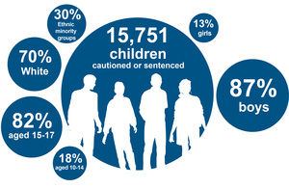
Introduction
Bui and Deakin (2021) note that the quality which is not desirable and that recognises individuals to be susceptible to harm or unacceptable behaviour is known as particular vulnerability.
This presentation will evaluate how vulnerable people get pushed into illegal activities.
Vulnerable people management and its different approaches will be studied in this presentation.
Source: (World Health Organisation, 2022)
Notes:
Note: Vulnerability is often considered to be an undesirable quality that makes a person susceptible to being harmed or having behaviour which is unacceptable. In this presentation how illegal activities are related to vulnerability among people and its factors will be evaluated while focusing on different approaches to vulnerability management.

Slide 3
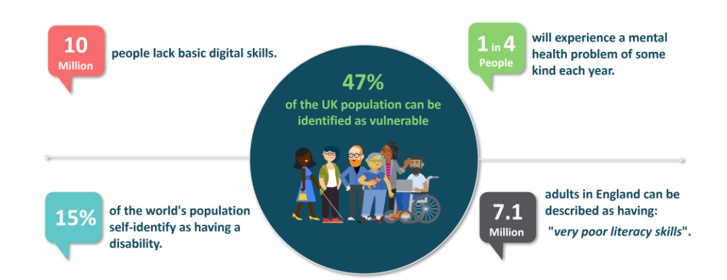
Vulnerability: A concept
Vulnerability is defined as a condition determined by physical, environmental and socioeconomic factors (World Health Organisation, 2022).
These factors increase the susceptibility of an individual to hazardous impacts (World Health Organisation, 2022).
Vulnerable factors include health, disability, age, gender, sexual orientation, religion and many more.
Vulnerability can leave an individual at risk of physical and psychological harm.
Source: (Peter Terna, 2021)
Notes:
Note: vulnerability is defined to be a condition of and determined by physical, socioeconomic and environmental factors that expose individuals to hazardous impacts. It is often exacerbated by factors such as health, disabilities, sexual orientation, religion, gender and age.

Slide 4
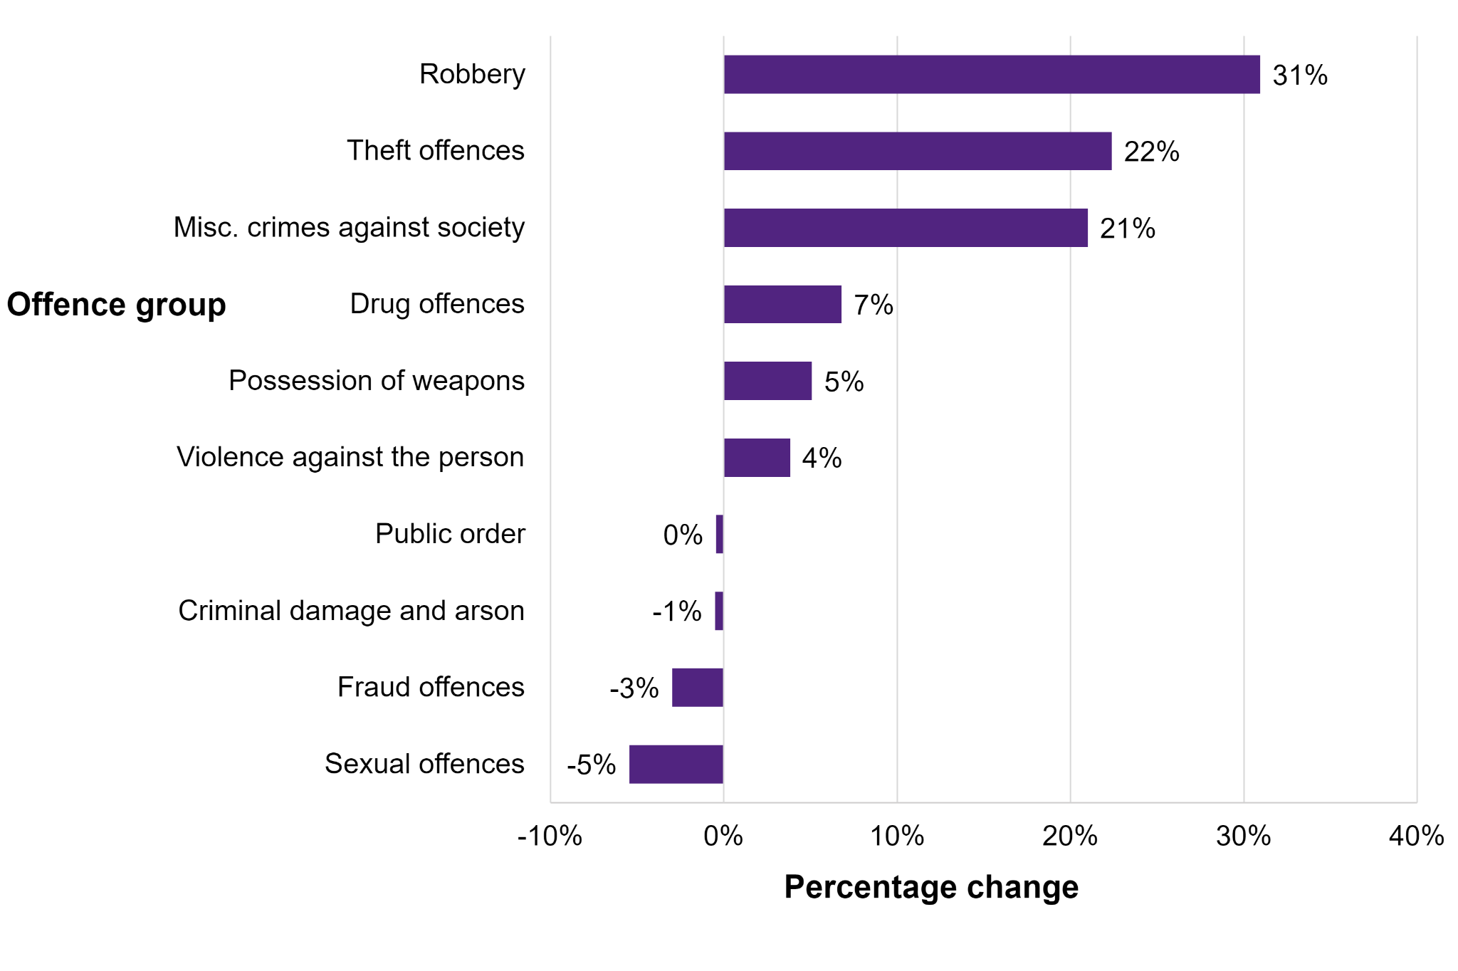
Vulnerable People and categories
Different scenarios and circumstances can cause people to feel exposed to harm whether psychologically or physically.
Physical vulnerability happens when individuals have no access to effective health facilities, security, electricity, clean water or means of communication (Peter Terna, 2021).
Political vulnerability reflects a lack of electoral or democratic process for citizens (Peter Terna, 2021).
Social vulnerability is a state of crisis due to rapid growth of population, poverty and hunger, low education level and gender inequality (Peter Terna, 2021).
The economic vulnerability occurs due to unemployment, disparity between individual income levels and inflation (Peter Terna, 2021).
Environmental vulnerability is an after-effect of any natural disaster leaving people exposed to harm (Peter Terna, 2021).
Source: (Yates, 2023)
Notes:
Note: vulnerability is a result of different scenarios and circumstances which expose people to psychological or physical harm. There are different categories which include physical, political, social, economic and environmental vulnerability. These categories often reflect how circumstances such as lack of effective health facilities, democratic rights, poverty, unemployment and natural disasters can expose people to risk.

Slide 5
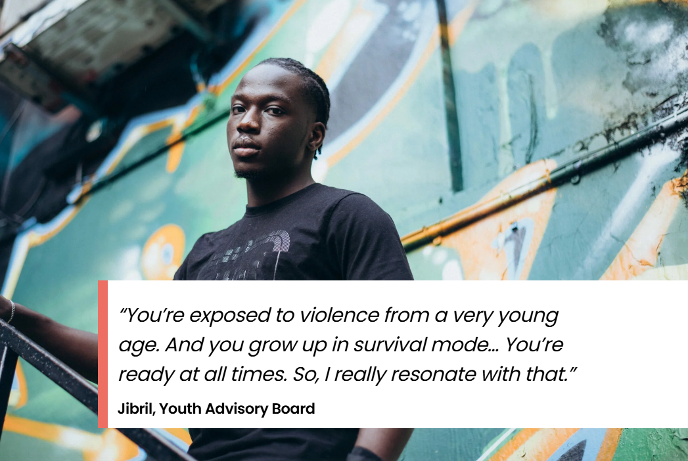
Importance of focusing on young people
16% of teenage children have been a victim of violence in the last 12 months (Yates, 2023).
47% of teens have been a victim or witness of violence in the last year (Yates, 2023).
68% of children were victims who had experienced violence that led to physical injuries (Yates, 2023).
These above percentages reflect that UK youth are highly susceptible to violence.
Therefore it is noted that the youth requires interventions from the government and the police.
Source: (Yates, 2023)
Notes:
Note: in the UK 16% of teenage children have been victims of violence since last year. 47% of teens have been a victim and witness to violence. 68% have experienced violence that led to physical injuries. This reflects that the UK youth is highly susceptible to vulnerability because of violence.

Slide 6
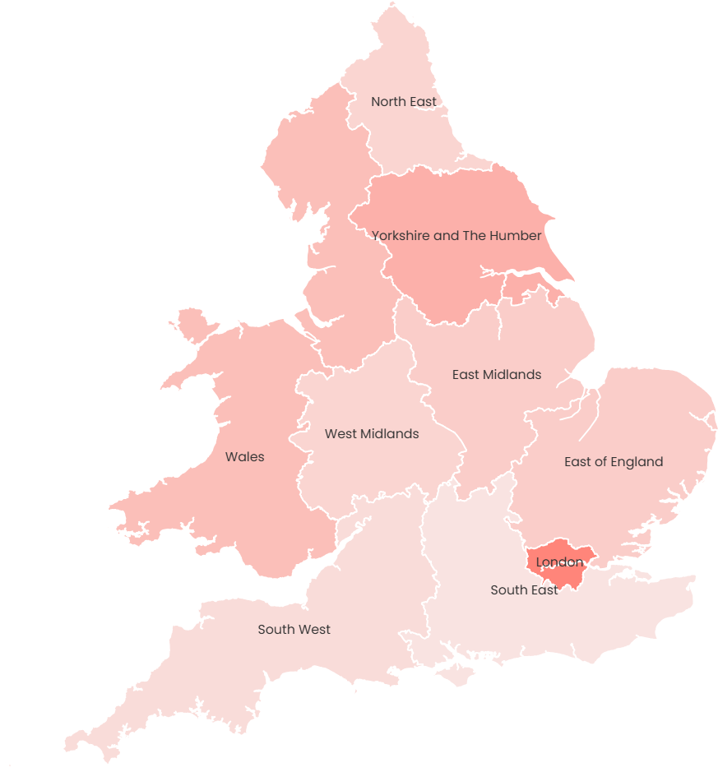
Contributing Factors in Youth Vulnerability
Socioeconomic and familial factors cause young people in the UK to be vulnerable.
Easy access to weapons, substance abuse, peer pressure and lack of parental guidance push young people to criminal activities.
Post trauma can also have adverse effects on mental health that can expose young people to psychological vulnerability.
Source: (Yates, 2023)
Notes:
Notes: past trauma, socioeconomic factors, familial factors, easy access to weapons substance abuse, peer pressure and lack of parental guidance are contributing factors in youth vulnerability.

Slide 7
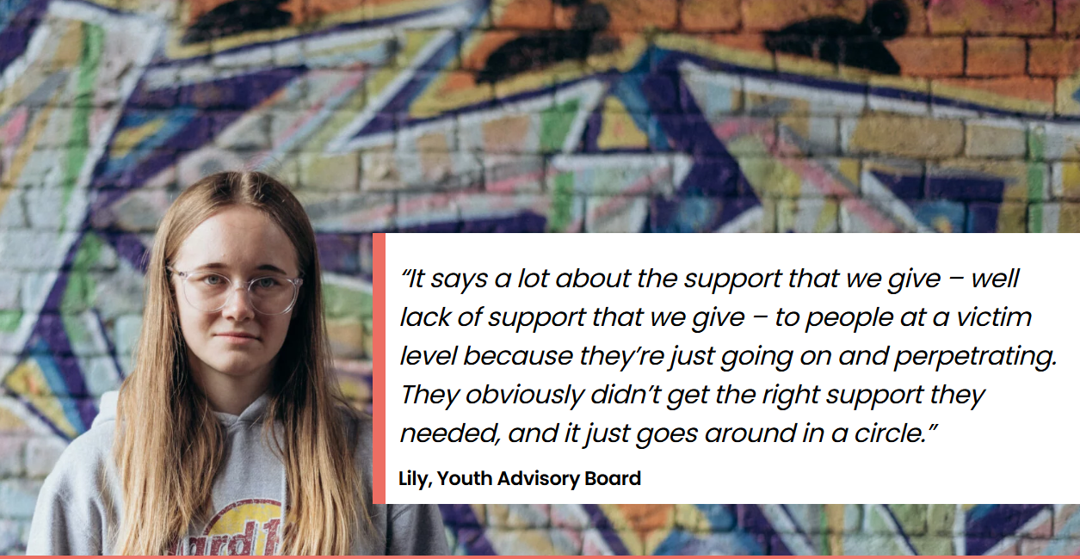
Case Study 1: Exploitation through Country Lines
Country lines is a criminal exploitation that targets youth.
Criminals befriend children offline or online and manipulate them into drug dealing.
The ‘lines’ refer to mobile phones used for controlling the child in drug delivery.
Criminals target young people aged between 14 to 17.
London, Greater Manchester and Birmingham are well-known areas of country line exploitation.
Source:(Yates, 2023)
Notes:
Notes: country line exploitation is a criminal exploitation which targets children between 14 to 17. Criminals often befriend children through online or offline mediums to manipulate them into drug dealing through mobile phone lines.

Slide 8
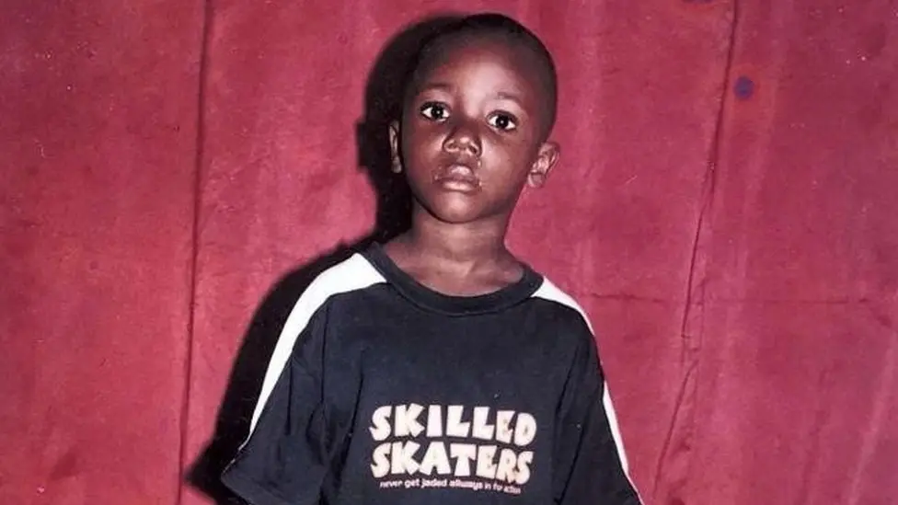

Case Country Lines

Slide 9
Country lines
‘I was nine when drug dealers recruited me’.(Bbc 2024).
Sosa Henkoma was 9 years old when a dealer of drugs and guns recruited him.(Bbc 2024).
‘

Slide 10

Case Study 2: Online Grooming
Online grooming crimes against young people have increased by 89% in 6 years (NSPCC, 2024).
Over 7000 sexual communication with a child offence was recorded by police last year (NSPCC, 2024).
48% of the crimes were caused on the online platform of Snapchat (NSPCC, 2024).
81% of grooming cases were against girls and also primary school children (NSPCC, 2024).
Source: (NSPCC, 2024)
Notes:
Note: An increase of 89% in 6 years in online grooming crimes against young people. Over 7000 sexual communications with child offenders have been recorded last year by police. 48% of the crimes were committed on Snapchat. 81% of the cases were against young girls and primary school children.

Slide 11
Online grooming
‘Snapchat 48%
WhatsApp (Meta) 12%
Facebook and Messenger (Meta) 10%
Instagram (Meta) 6%
Kik 5%.’(NSCPP, 2024).

Slide 12
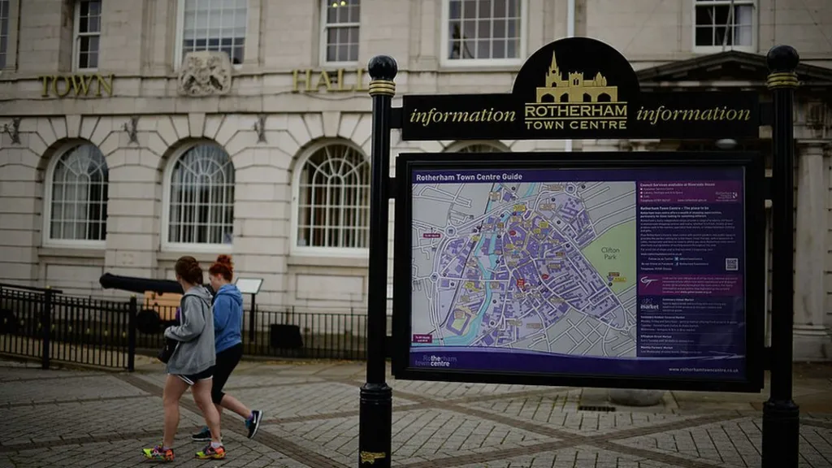
Case Study 3: The Scandal of Rotherham
Alexis Jay discovered 1400 children while sexually abused between 1997 and 2013 (BBC News, 2022).
These children were targeted by grooming grands who sexually exploited children (BBC News, 2022).
Young girls aged 11 and below were raped, abducted, trafficked, beaten and intimidated by men of Pakistani Heritage (BBC News, 2022).
47 officers were investigated for their conduct out of which 8 had misconduct cases and 6 had gross misconduct (BBC News, 2022).
Source: (BBC News, 2022)
Notes:
Note: The Rotherham CSE Scandal reported 1400 children who were sexually exploited and abused between the time of 1997 to 2013. Young girls aged 11 and below were abused by men belonging to Pakistani heritage. A significant amount of officers were also investigated for their misconduct

Slide 13

Response of Police to Vulnerability
Police often use intelligence-based approaches to prevent cases of severe youth violence.
The Metropolitan Police Service uses a system known as Insight to analyse intelligence about location, victims and offenders.
Hence it can be interpreted that police officers must immediately respond to any calls of youth vulnerability.
Therefore, it can be expected that the police remain clear-headed and sensitive while dealing with a vulnerable child or young person.
Source: (BBC News, 2022)
Notes:
Note: police are known for using intelligence-based approaches like Insight to acquire significant information on location victims and offenders. They are expected to immediately respond to calls with clarity and firmness. The UK police are required to have appropriate clarity, understanding and sensitivity when dealing with a case of vulnerable children.

Slide 14
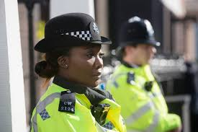
Police Handling: A Criticism
The response of the UK police service surrounding youth crimes and sexual exploitation has been ineffective.
The police force of the country does not have enough understanding to navigate the present concerns with sexual exploitation and criminal activities of children.
The police are known for victim blaming in several instances and do not have adequate urgency to deal with missing children cases.
The UK police force does not have robust training and understanding of vulnerability mitigation practices.
Source: (NSPCC, 2024)
Notes:
Notes: The UK Police Force has not been able to appropriately address the present warning issues surrounding youth violence criminal activities, sexual exploitation and criminal activities increasing youth vulnerability. The police force lacks sensitivity training, is known for victim blaming; do not have enough urgency to deal with missing children cases. They do not have enough understanding or training on vulnerability mitigation practices.

Slide 15
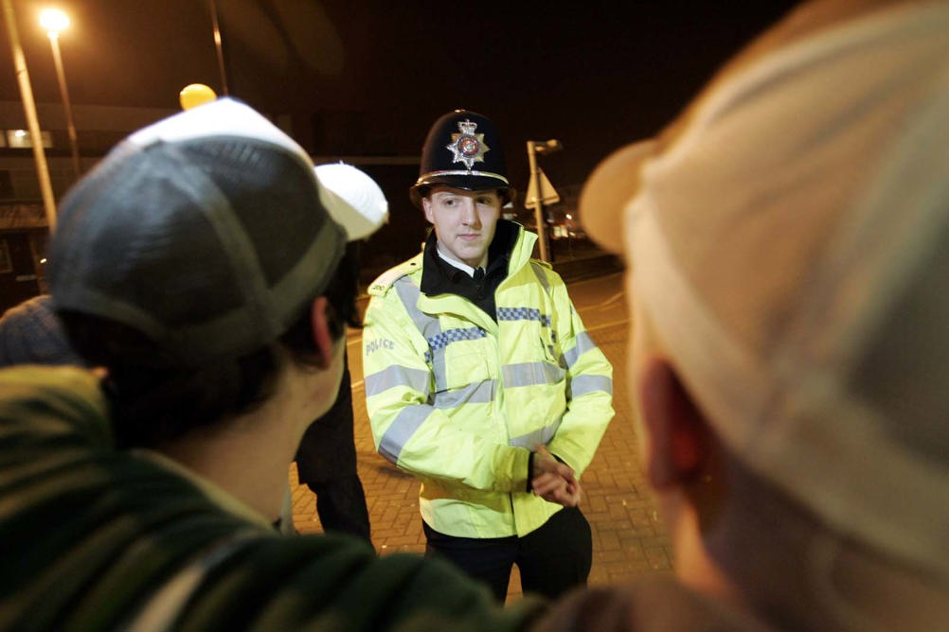
Partnership Initiatives
To reduce isolation-based trauma or issues among young people community-driven activities are suitable.
The introduction of relevant frameworks that provide young people with a safe environment at schools and homes is essential.
Government programs which focus on youth crime prevention are also essential as it helps skill building.
Providing government incentives and funding to poor families will also help reduce socioeconomic barriers.
Source: (NSPCC, 2024)
Notes:
Notes: Community-driven activities help address any trauma that can be a result of isolation. The introduction of appropriate frameworks to provide young people, especially teenagers, with a safe environment at home and school is essential for maintaining their mental health. Government-based programs to focus on the prevention of youth crime are also relevant in skill building. The provision of government incentives and funding to poor families will also alleviate socioeconomic barriers.

Slide 16
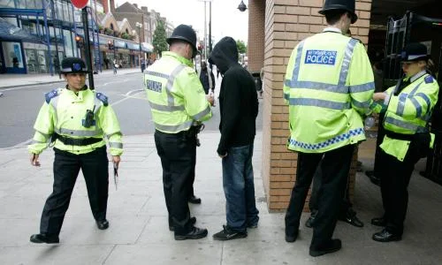
Recommendations
The government must focus on developing training and development programmes for its Police Force.
Sensitivity training is also recommended to be incorporated as an essential part of the police training regimen.
Regular anonymous background checks and evaluations of the police and their conduct are recommended.
Source: (BBC News, 2022)
Notes:
Note: From the above analysis it is recommended that the government especially focuses on improving the credibility of the Police Force through appropriate training and development programs. It is especially recommended to incorporate sensitivity training to deal with delicate vulnerability cases. Additionally, it is recommended to conduct regular background checks on the police officers to evaluate their conduct.

Slide 17
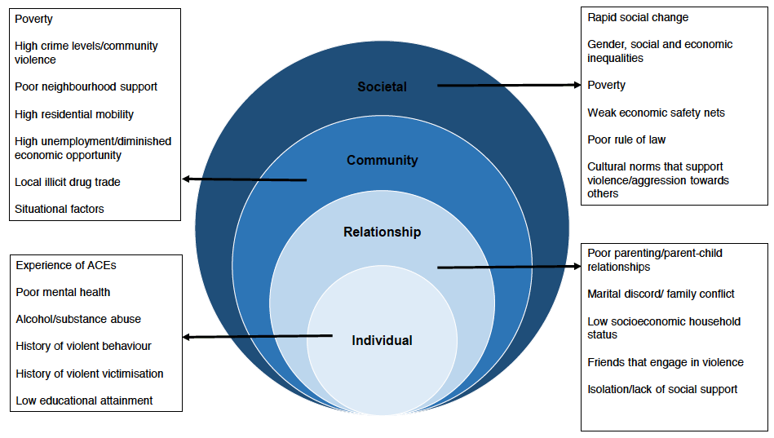
Conclusion
It can be concluded that vulnerability among youth requires immediate intervention from the government.
The police should be trained and health responsible for their role in intervening and mitigating this issue.
Source: (Bui and Deakin, 2021)
Notes:
Note: It can be concluded that to navigate youth vulnerability cases it is essential that the government holds the police responsible for appropriate intervention. This will help lower the spike in the number of cases in recent years.

Slide 18
Reference
BBC News (2022) Rotherham abuse scandal: How we got here, (online) Available at: https://www.bbc.com/news/uk-england-south-yorkshire-61868863 (Accessed 10 Dec. 2024).
Bbc New (2024). I was nine when drug dealers recruited me’ . Available at:County lines: 'I was nine when drug dealers recruited me' - BBC News . (Accessed 15 January 2025).
Bui, L. and Deakin, J, (2021), What we talk about when we talk about vulnerability and youth crime: A narrative review. Aggression and Violent Behavior, 58, p.101605.
NSPCC (2024) Online grooming crimes against children increase by 89% in six years, (online) Available at: https://www.nspcc.org.uk/about-us/news-opinion/2024/online-grooming-crimes-increase (Accessed 10 Dec. 2024).
Peter Terna, I, (2021), Vulnerability: Types, Causes, and Coping Mechanisms, International Journal of Science and Management Studies (IJSMS), 4(3), pp.187–194.
World Health Organisation (2022) Vulnerability and Vulnerable Populations. (online) Available at: https://wkc.who.int/our-work/health-emergencies/knowledge-hub/community-disaster-risk-management/vulnerability-and-vulnerable-populations (Accessed 10 Dec. 2024).
Yates, J. (2023). Children, violence & vulnerability 2023 Summary. (online) Available at: https://youthendowmentfund.org.uk/reports/children-violence-and-vulnerability-2023/summary/ (Accessed 10 Dec. 2024).

Slide 19


