Slide 1
Dissertation Module
(LCMB7020)
Literature Review
Dr Ehsan Khajeh
Email: e.khajeh@uwtsd.ac.uk

Slide 2
Learning Outcomes
You will be able to:
• Understand what is expected from you in terms of a
critically written literature review chapter.
• Differentiate between the types of reading techniques
that lead to efficient critical review of literature.
• Select relevant sources for your literature review chapter.
• Understand the steps of writing a critical literature
review chapter.

Slide 3
Topics of Discussion
Aims of dissertation
Objectives of the dissertation
The nature of the dissertation
The purpose of research
The research process
Typical structure of a dissertation
Choosing a dissertation topic
Identifying a research problem
Research methodology
Literature review/theoretical framework
Data collection and analysis
Research proposal

Slide 4
Objectives of Dissertation
To allow you to
  Use, compare and contrast theories about business so that you are able to critically evaluate their applicability to a specific issue/problem
  Carry out relevant desk and field research, using appropriate methodology
  Produce a substantial, written research-based report of high quality

Slide 5
The Purpose of Research
To review and synthesise existing knowledge
To investigate some existing situation or problem
To provide solutions to problems
To explore or analyse more general issues
To construct or create new procedures or systems
To explain a new phenomenon
To generate new knowledge
A combination of any of the above

Slide 6
Or in a nutshell… it shows you can…
Research independently
Collect information
Organise information
Apply theories
Analyse and evaluate the information collected
Manage your time

Slide 7
The Research Process
Identify research topic
Define research problem
Determine how to conduct research
Collect research data
Analyse and interpret research data
Write dissertation

Slide 8
Typical structure of a dissertation
Introduction 10-15%
Literature review 25%
Methodology 20%
Results/findings 15-20%
Analysis and discussion 20-25%
Conclusions and Recommendation 10-15%
References/bibliography
Appendices

Slide 9
Choosing a dissertation topic
List any business problems that you/your company want to find answers for
Use brainstorming or secondary research to generate a list of the most promising topic areas
List any personal objectives that your project might be made to serve
e.g. choose a sector/company that you would like to work for next
List any personal criteria which are important to you in your choice of topic
e.g. use survey data or interview data

Slide 10
Choosing a dissertation topic
Draw a mind map or a diagram to represent the field of related topics in which you are considering doing research
List three business problems of which you have been aware of during the last six months and which are faced by one or more organisations with which you are familiar

Slide 11
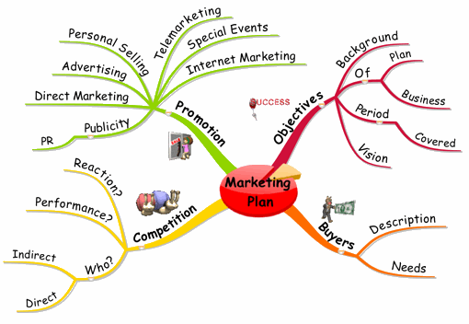
Mind map - example

Slide 12
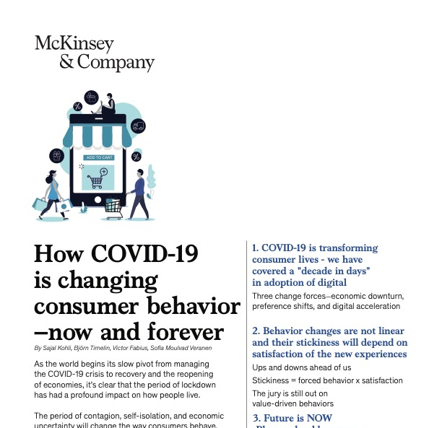
Identifying a Research problem
Research must address a specific research problem or issue
Classic approach
  Consider the literature on your area of research and identify any gaps
  e.g. How Covid-19 is changing consumer behavior now and forever

Slide 13
Choosing a dissertation topic
Think of three changes within an organisation you know, or to which you might be able to gain access, and consider whether they are important and what are their causes and consequences
Think of three changes within the business environment (local, national or international) and consider why they are important, what is their cause, and what might be their consequences

Slide 14
McDonald’s examples
McDonald’s is designing voice-activated drive-throughs and robotic deep-fryers, as the burger giant works to streamline its menu and operations to speed up service.
The company is testing voice-recognition software at a drive-through in suburban Chicago.
Inside the restaurant, a robot also tosses chicken, fish and fries into vats of oil.
Both technologies are meant to shorten customer wait times.

Slide 15
New store format & the use of high-tech
McDonald‘s to Go - A new store format in London, with no seating areas and serves only takeout.
McDonald's Investment in High-Tech 2min –
McDonald’s Corp., in its largest acquisition in 20 years, bought a decision-logic technology company to better personalized menus in its digital push.

Slide 16
Service innovations
McDonald’s previous innovations, such as drive-throughs, McCafe, and healthier menu choices, have helped the brand to maintain competitive advantage in the sector of fast-food restaurants.

Slide 17
Example - Tesla overtakes Toyota as the world’s most valuable automaker
Tesla Inc. displaced Toyota Motor Corp. as the world’s most valuable automaker (The Economic Times, 2020).
Chief Executive Officer Elon Musk has ignored or broken many of the established auto industry’s rules and norms in the 10 years since he took Tesla public, selling cars online and assembling vehicles in high-cost California.
A possible research topic – Business strategies of Tesla versus Toyota

Slide 18
You can choose a topic related to an innovative product
What is the most innovative product in your opinion?

Slide 19
Customer Experience Trends
You can choose one of the 8 Customer Experience Trends (Forbes, 2021)
Think about what Research Objectives you can form to understand the impact of your chosen trend on consumer behaviour

Slide 20
A good project idea
Focuses on a narrow area
Can gain information easily
Can be related to previous research
Provides a clear research question
Makes some use of academic theory
Provides “new ideas”
Can be studied in the given time
Keeps you interested

Slide 21
A worked example
The re-branding of some McDonalds outlets to include McCafe
TITLE:
The localisation of McCafe in Hong Kong. How to change a winning formula?
The title asks a question

Slide 22
Aims
The reasoning behind the localisation of the McCafe brand in Hong Kong.
Why has the most successful fast food chain in the world felt the need to introduce a new brand? Has the brand been successful?
To what extent should McCafe be localised in Hong Kong?

Slide 23
Draft dissertation objectives
To understand the reasons behind the introduction and localisation of the McCafe brand
To assess the success of the McCafe brand

Slide 24
SMART
Are the objectives,
S – specific?
M – measurable?
A – achievable?
R – realistic?
T – time based?

Slide 25
Dissertation objectives (revised and finalised!)
To evaluate the reasoning behind the introduction of the McCafe brand
To assess the financial performance of the McCafe brand in Hong Kong in 2020
To assess whether the customers regard the McCafe brand as a success in Hong Kong
To examine to what extent should McCafe localise its menu choices in Hong Kong
Note the use of verbs, such as evaluate /assess, indicate a higher
level of analysis than: what/ explain/ identify

Slide 26
Example: Sports Fashion in the UK
(Mintel report)
Research objectives:
To evaluate consumer attitudes on sports fashion
To examine consumer interest in experiences and see if that helps drive athleisure market
To identify if athleisure has gone from a trend to a permanent fixture
To investigate ……..

Slide 27

Summary
What is research? 4min

Slide 28

Questions -
Do you have any research ideas for your dissertation?
What research aims and objectives do you have for that research idea?
Think about…
Who can be benefited by the findings of your research project?

Slide 29
Question -
You can use your proposal in your dissertation.
True or false?
Think about….
What is the difference between proposal and dissertation?

Slide 30
Literature Review
A summary of previous research studies that is relevant to your proposed project
Understanding of a variety of theories, concepts and models which you may be able to use (test, apply etc.) in your project

Slide 31
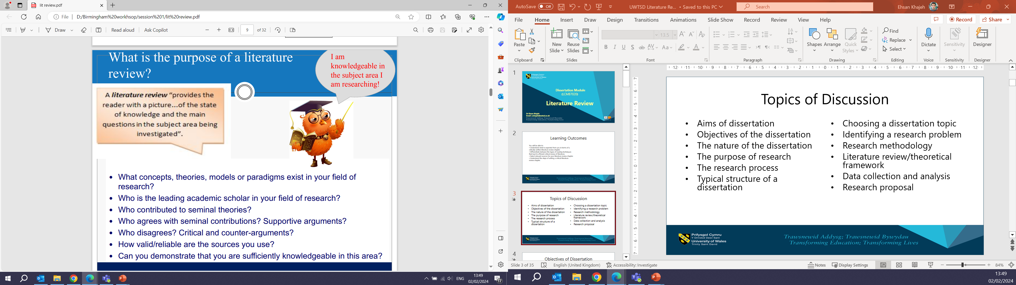

Slide 32
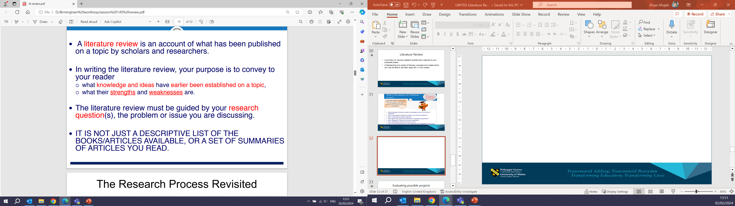
What is critical literature review?

Slide 33
Evaluating possible projects
Is the project researchable, given time, resources and availability of the data?
Is it sufficiently interesting to you?
Will the project contribute towards your career goals?
Is data available?
Are there any barriers to its data collection? i.e. online questionnaire response rate

Slide 34
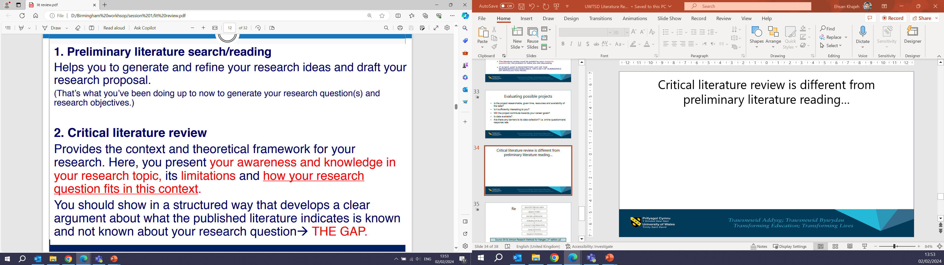
Critical literature review is different from preliminary literature reading…

Slide 35
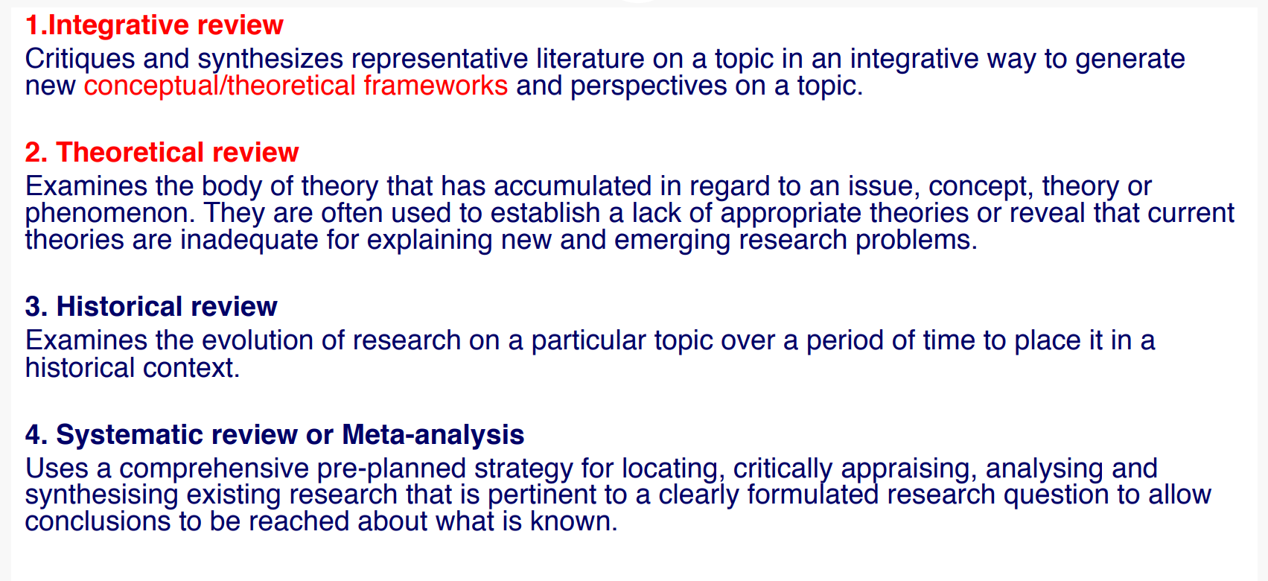
Types of critical reviews

Slide 36
Useful steps for creating a literature review
9 useful steps for creating a literature review
https://www.linkedin.com/pulse/9-steps-creating-research-essay-literature-review-paper-rosenberg/

Slide 37
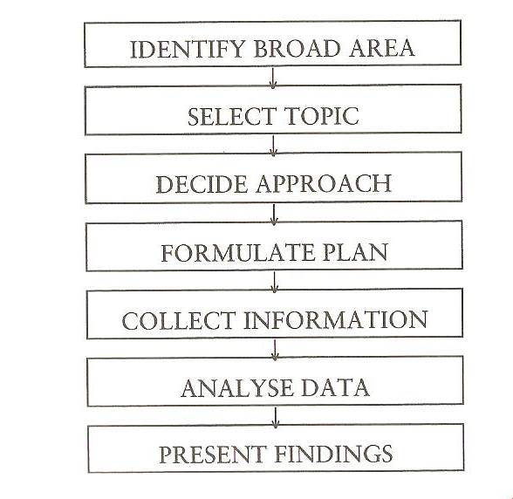
Research Sequence
Source: Gill & Johnson Research Methods for Mangers, 2nd edition, p3

Slide 38
Two questions to ask yourself
Is there literature on the topic area?
Is data available?
If the answer to these two questions is yes,
then you have a topic that you can
successfully complete a piece of research on

Slide 39
Projects that go wrong
Structure
  Weak projects have little or no evidence of:
    Academic content
    Analysis
    Conclusions
Descriptive, not analytical
Plagiarism
Poor time management
Ineffective use of supervisor
Cover too wide of an area

Slide 40
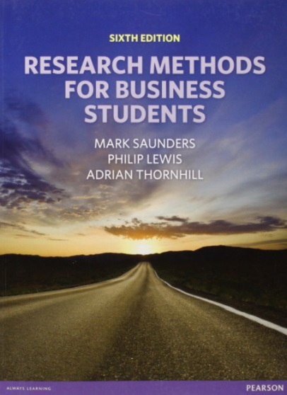
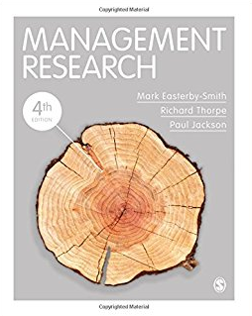


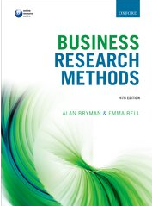
Research textbooks…

