Slide 1


Apple Inc.
Teodor Katrandzhiev (2124415)
Enes Mustafov (2007660)
Marius Mateescu (2029319)

Slide 2







First Computer was
SOLD
Steve Jobs was discharged
1985
1974
1976
1984
The idea for Apple was
BORN
The Macintosh was
INTRODUCED

Slide 3

IPad
Iphone
IPod
IMac
Macintosh

Slide 4



New Product and Services for
Apple
New Function for their devices.
Apple Electric Cars.

Slide 5
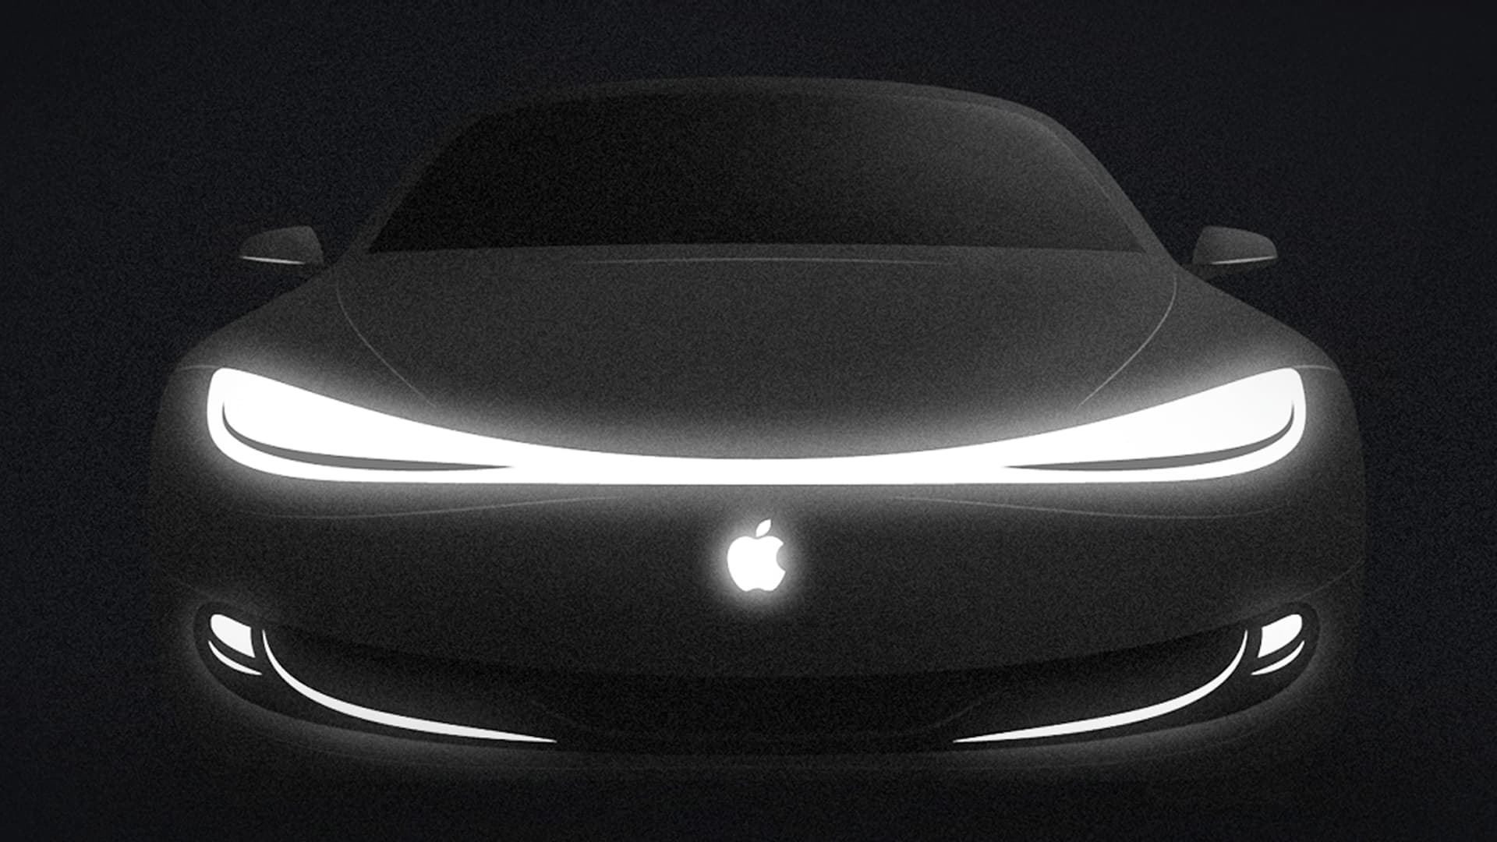

Apple Electric Cars
Pros
Cons

Slide 6



New Function for their devices
From this
To this

Slide 7

Remove Background
(Iphone Camera Function)

Slide 8

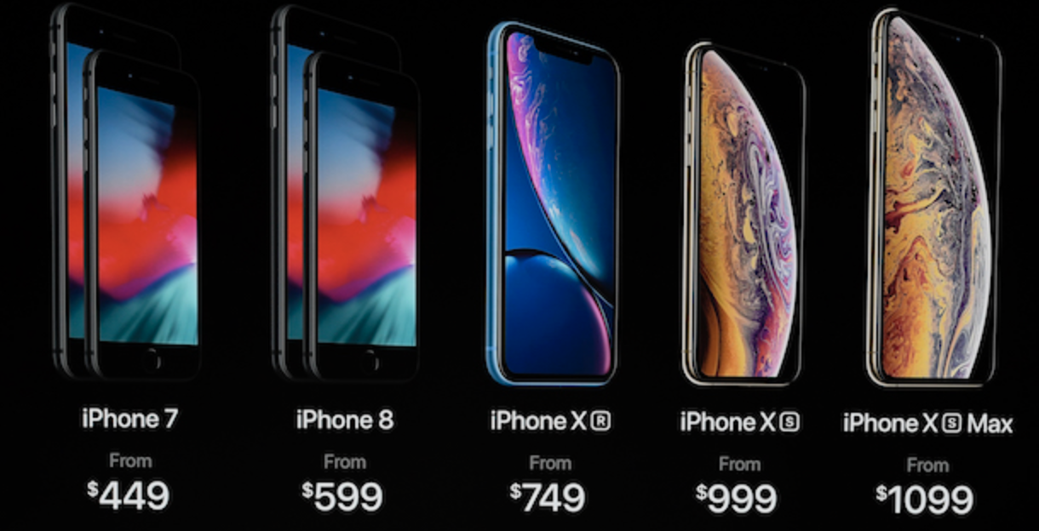
Potential Growth for Apple

Slide 9

New services/Products
=
More Customers
(Business Growth)

Slide 10
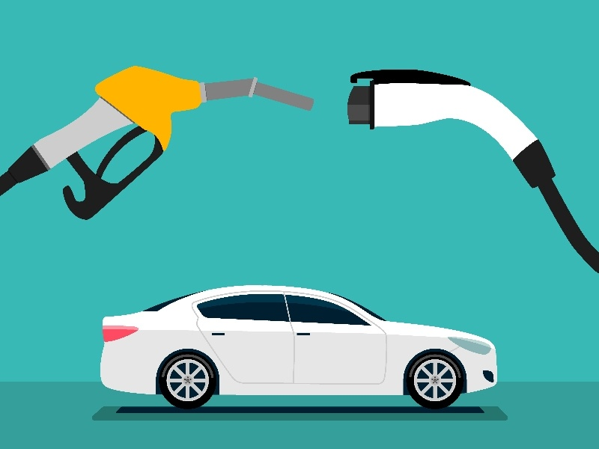
(Electric Cars)
Big opportunity for Apple

Slide 11
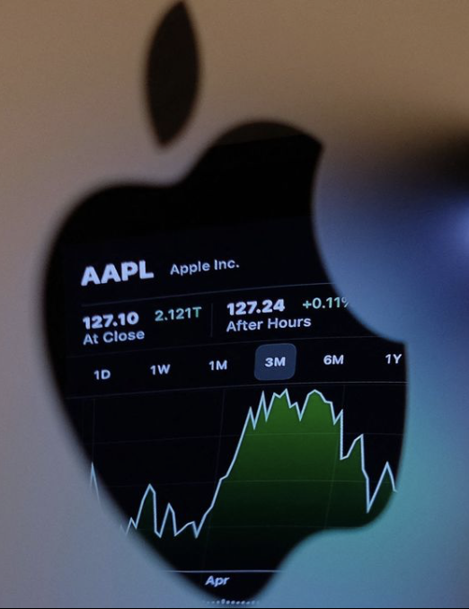
Apple Stock (AAPL)
New Ideas
=
More Investors

Slide 12

Thank you for your time!

