Slide 1
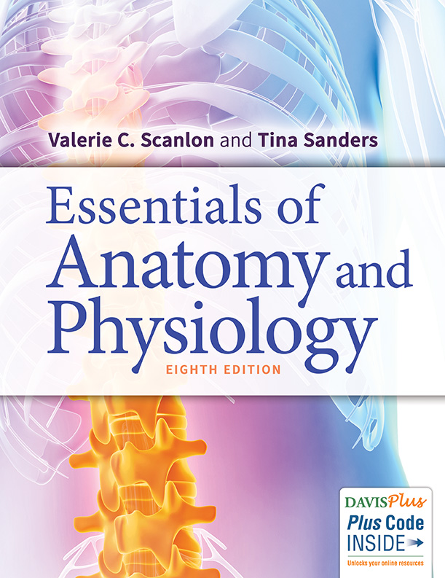
Chapter 1
Organization and General Plan of the Body

Slide 2
Anatomy—the study of structure:
Physiology—the study of function:
Pathophysiology—the study of disorders of function:

Slide 3
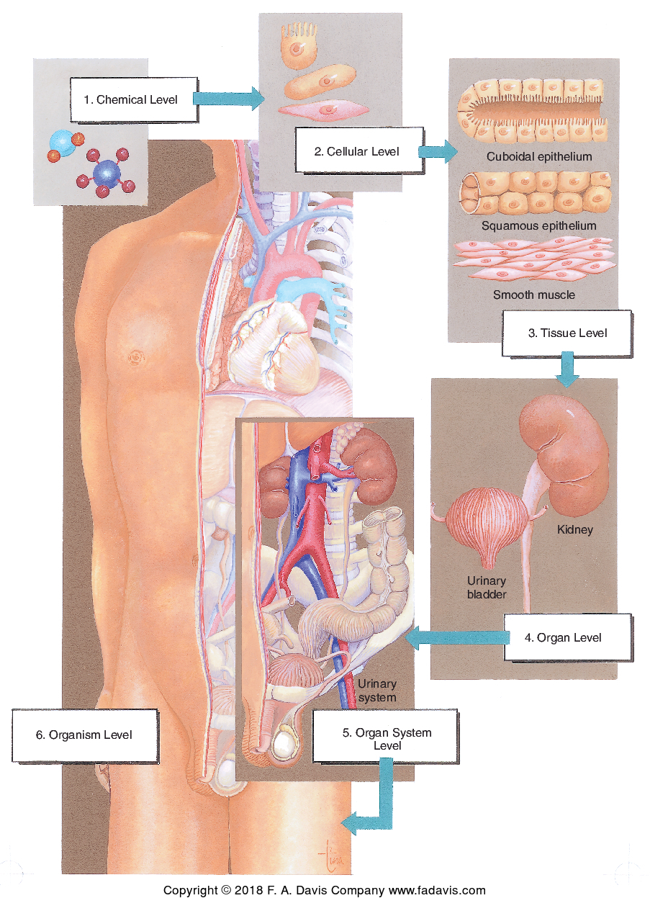
Levels of Organization

Slide 4
Levels of Organization (continued_1)
Chemical level
  Inorganic
  Organic—all contain carbon
Cellular level
  Cells—living

Slide 5
Levels of Organization (continued_2)
Tissue level—a tissue is a group of cells with similar structure and function.
  Epithelial tissue—covers or lines surfaces:
  Connective tissue—connects, supports, and transports:
  Muscle tissue—contracts and moves a body part:
  Nerve tissue—transmits regulatory electrochemical impulses:

Slide 6
Levels of Organization (continued_3)
Organ level—an organ is a group of tissues that contribute to a particular function or functions.
Organ system level—a group of organs that contribute to a particular function or functions.
(see Table 1–1)
All of the organ systems functioning properly =

Slide 7
Questions
Give examples of organs.
Give examples of organ systems.

Slide 8
Answers
Examples of organs are the heart, the brain, the liver, the mandible, a femoral vein, a kidney, the ulnar nerve, the thyroid gland, the biceps brachii, and the skin, to name only a few.
Examples of organ systems are the skeletal, muscular, nervous, circulatory, respiratory, digestive, and urinary systems.

Slide 9
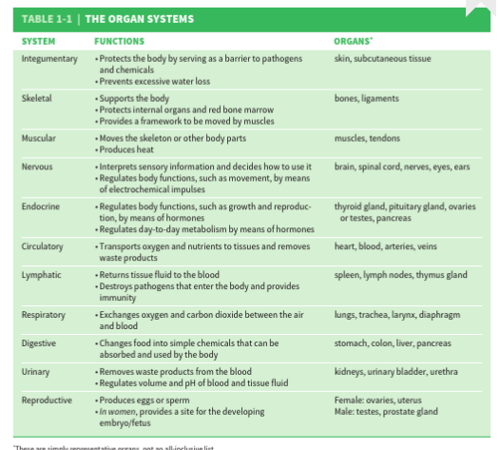

Slide 10
The Rest of “Us”
Every human being coexists with an enormous population of microorganisms—our microbiota (or normal flora or resident flora).
Microbiomes are the sites colonized by bacteria, viruses, fungi, and protozoa and include the skin, oral cavity, and intestines, especially the large intestine.
The term microbiome may also refer to the population of a particular site.

Slide 11
The Rest of “Us” (continued_1)
In their usual sites, our normal flora inhibit the growth of pathogens.
Some intestinal bacteria produce vitamins such as vitamin K.
Other benefits are the subject of much ongoing research.

Slide 12
The Rest of “Us” (continued_2)
Metabolism
All of the chemical reactions and physiological processes that take place within the body
Metabolic rate:
Homeostasis
The state in which the internal environment of the body remains relatively stable by responding appropriately to changes; a state of good health
Examples:

Slide 13
Negative Feedback Mechanism
A control system in which a stimulus initiates a response that reverses or decreases the stimulus, thereby stopping the response until the stimulus occurs again
The mechanism is a cycle that contains its own “brake.”
Example:
Notes:
Insulin

Slide 14
Positive Feedback Mechanism
A control system that requires an external event to stop or control the stimulus
The mechanism needs a “brake” imposed from outside.
Has the potential to become a self-perpetuating and harmful cycle
Example:
Notes:
Oxytocin

Slide 15
Terminology and Plan of the Body
Parts and areas—body parts have standard names.
  Examples: occipital, orbital, deltoid, lumbar, femoral (see Table 1–2)
Location or position—standard directional terms are used for descriptions.
  Examples: superior, inferior, lateral, medial, proximal, distal, anterior, posterior (see Table 1–3).

Slide 16
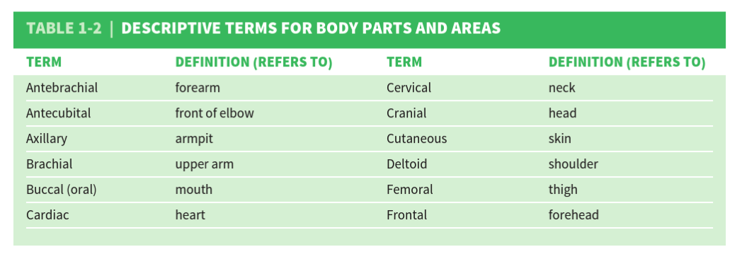
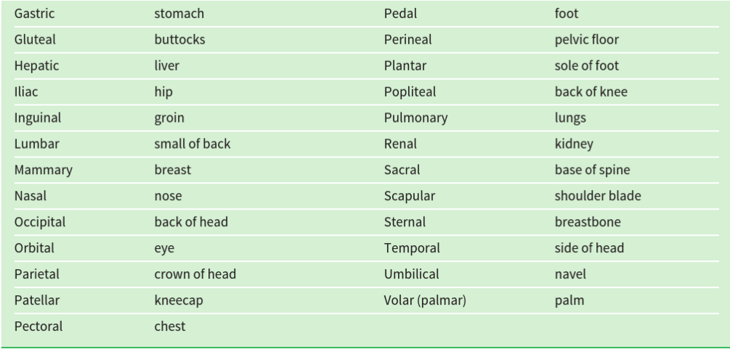

Slide 17
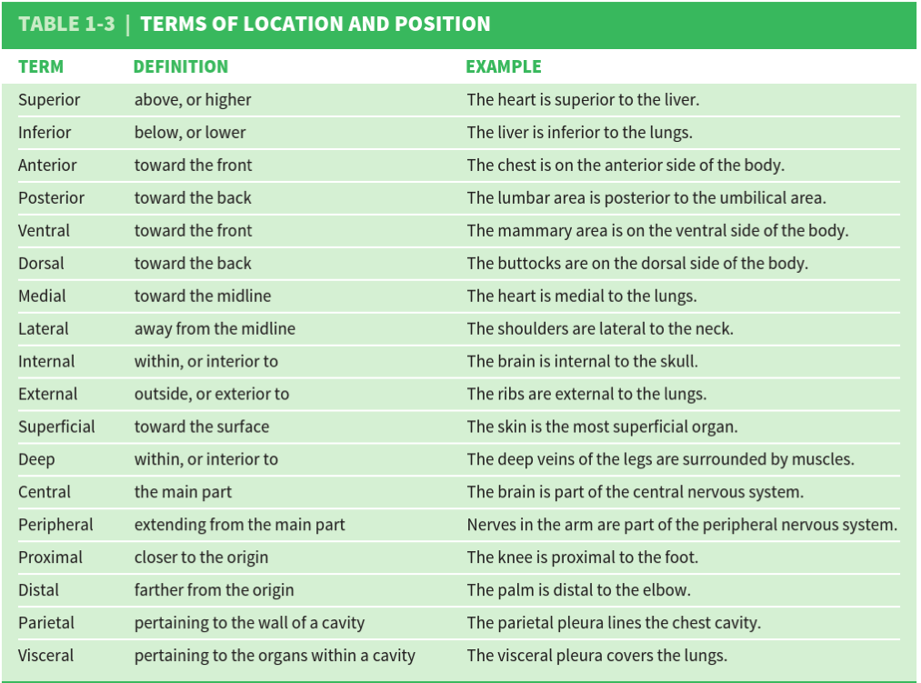

Slide 18
Body Cavities
Cranial and spinal cavities—enclosed by bone; lined with meninges. Organs:
Thoracic, abdominal, and pelvic cavities—within the trunk
  Thoracic—lined with the parietal pleura; visceral pleura covers the lungs. Organs:
  Abdominal—lined with the peritoneum; mesentery covers the abdominal organs. Organs:
  Pelvic—inferior to the abdominal cavity. Organs:

Slide 19
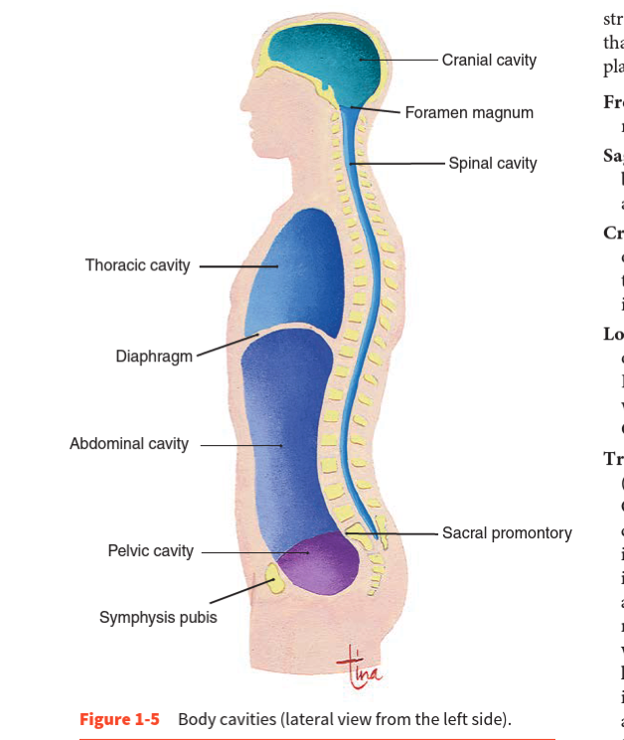

Slide 20
Planes and Sections
Plane—an imaginary flat surface that separates two parts
Section—the cutting of the body or a body part to make internal structures visible
  Frontal (coronal)—
  Sagittal—
  Transverse—
  Cross-section—
  Longitudinal—

Slide 21
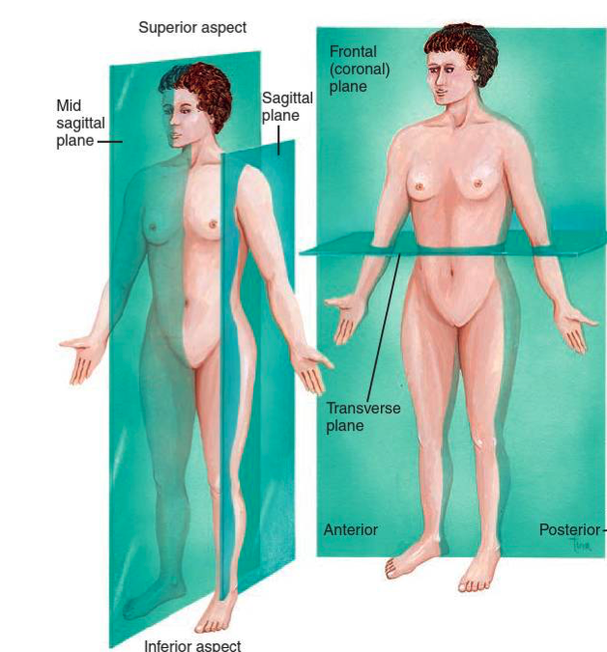

Slide 22
Wrap-Up Question
Give the proper term for each brief description.
1. Organ system that moves the body
2. A state of good health
3. Toward the midline
4. Feedback mechanism with its own brake
5. The sole of the foot
6. A section that separates left and right sides

Slide 23
Wrap-Up Question (continued)
7. The cavity that contains the lungs
8. The shoulder area

Slide 24
Answers
1. Organ system that moves the body—muscular
2. A state of good health—homeostasis
3. Toward the midline—medial
4. Feedback mechanism with its own brake—negative
5. The sole of the foot—plantar

Slide 25
Answers (continued)
6. A section that separates left and right sides—sagittal
7. The cavity that contains the lungs—thoracic
8. The shoulder area—deltoid

