Slide 1
Module : Professional Development within Health and Social Care
Module code: LCHS4009
Topic: Communication skills in health and social care
Lecturer:
Student Name: Nikita Nana Angelina Wilson
Student ID: 2506894

Slide 2

Introduction
The presentation title is: “Communication skills in health and social care”.
The presentation highlights how to improve communication based on Tuckman's model.
Gibson's Lodge Limited was chosen after targets were identified in the area of communication interests within the records.
Communication problems and approaches towards their resolution have been outlined.
Source: https://res.cloudinary.com/jerrick/image/upload/v1752675926/6877b6564bdddb001da509c8.jpg
Notes:
In this presentation, the focus will be on communication skills in health and social care. The objective is to look at the communication problems and understand how the Tuckman communication model can help them improve. Gibson's Lodge Limited were chosen as the case organisation as CQC had identified concerns about practices with respect to how care records are documented and information recorded. The importance of communication, the main barriers to communication and some ideas as to what can be done to improve communication will be discussed.

Slide 3
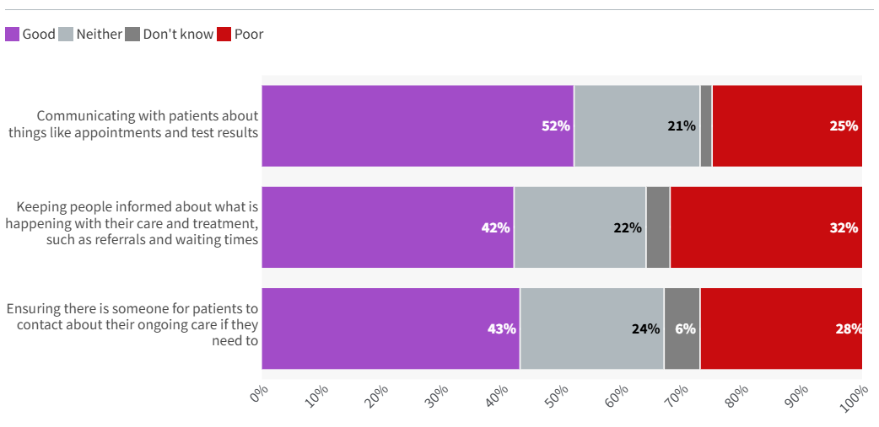
Importance of the skill in the Health and Social care
Care documentation contained inaccurate information, affecting person-centred communication (National Institute for Health and Care Research, 2026).
Communication aids in different aspects related to the process of record keeping and cooperation in delivering care.
Problems at the NHS regarding communicating messages – 55% of 55% – within five years (Brunton-Douglas et al., 2026).
Communication reduces errors and improves care continuity.
Source: Kings Fund, 2025
Notes:
CQC found information was incomplete and unrecorded on some of the care record files at Gibson's Lodge. This led to communication issues with regard to person-centred care. Properly communicating helps you to document everything properly, clear the information and foster effective team collaboration. This is important because 55% of people had trouble with communication in the last five years according to evidence from NHS. The use of enhanced communication skills can, therefore, prevent mistakes, enhance the functioning of coordinating services and contribute to safer care provision in health and social care services.

Slide 4
Relevance of communication skill with the professional practice
Communication makes the process of correct exchange of information in providing care possible.
Communication improves the cooperation of the multi-disciplinary healthcare team members (Durham, 2025).
Communication should be considered not only as interacting with others but also behaving according to individual needs.
Professional accountability and ethical decision-making relate to communication (Mohamed, 2026).
Communication Improvements
Information Exchange
Cooperation
Behavioural enhancement
Professional Accountibility
Source: Author
Notes:
Communication is an essential aspect of professional work in health and social care. Good information sharing promotes high-quality care by professionals at all times. Effective communication also promotes collaboration among the healthcare workers, which allows them to share up-to-date information with one another and allows them to coordinate work properly. Additionally, communication assists in the understanding of the preferences and needs of the person and therefore helps to implement person-centred care. It also helps staff to be accountable through clear communication which allows them to inform families about decisions made, uphold professional codes of behaviour and meet their ethical obligations to people in their care.

Slide 5
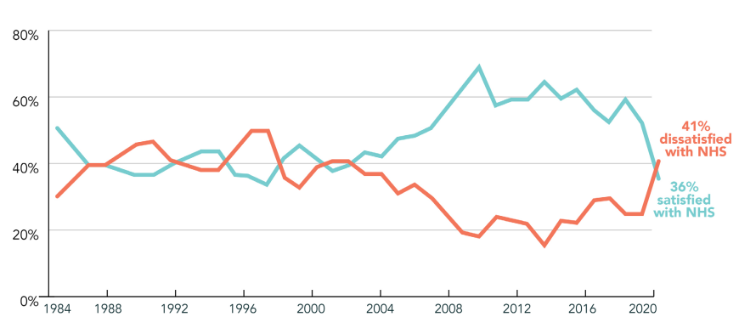
Common Barriers observed because of lacking communication in Health and Socialcare
Information on the case records was not adequate enough to foster person-centered communication.
Problems in communication due to errors on an administrative level were faced in relation to the efficient distribution of information by NHS (BBC, 2023).
41% of people believed that barriers to communication were responsible for the delay in delivery of care (Brunton-Douglas et al., 2026).
They create issues pertaining to safety, efficiency, and effectiveness of healthcare services.
Source: (Brunton-Douglas et al., 2026)
Notes:
The CQC has found out that record keeping of patient care is not always good enough in Gibsons’ Lodge; it leads to difficulties with communication. There can be many barriers in the NHS which lead to communication difficulties; for instance, there can be some defects within the administrative systems or the digital systems used by the NHS.

Slide 6
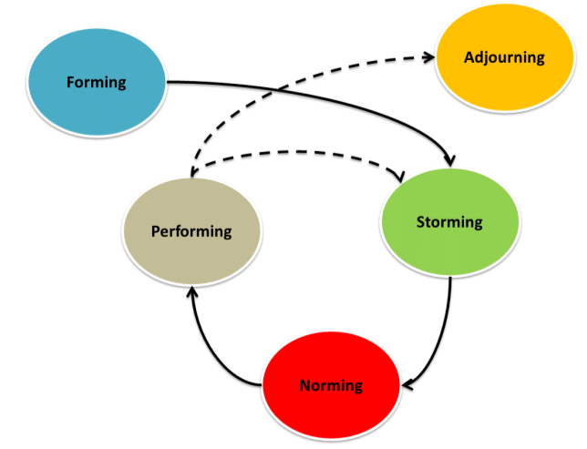
Application of the Tuckman’s communication model to resolve the problem of Gibson's Lodge Limited
It will enhance consistency in communication and documentation and facilitate the application of Tuckman's theory.
Better communication can occur in four phases, namely formation, storming, norming, and performing (Aquino et al., 2022).
Repeated cross training on communications will help develop good records management.
Audits in digital communication will assist in highlighting and solving any information gaps that have already been identified, for instance, the existing gap in the information of Gibson's Lodge Limited (CQC, 2026).
Source: https://www.researchgate.net/figure/The-stages-of-group-development-by-Tuckman_fig1_220619933
Notes:
The Tuckman model gives the framework to enhance the methods of communication in Gibson's Lodge. The Forming stage sets boundaries for communication and the Storming stage points out preexisting problems. Norming sets agreed communication standards; Performing provides teamwork and effective information sharing. To support this process, regular communication training can enhance the quality of documentation; and communication audits could help identify any areas for improvement to ensure consistent communication is maintained throughout the care home.

Slide 7

Conclusion
Emphasis during the presentation has been placed on Communication Skills.
The study focused on the role of communication in professional practice.
Communications difficulties that existed within Gibson's Lodge Limited were highlighted.
The Tuckman model of communications was presented.
Source: https://trainingexpress.org.uk/communication-in-health-and-social-care/
Notes:
This presentation highlighted the significance of communication in health-care work and social care. It explored the role of communication for good professional practice and barriers to communication and documentation. The communication-related issues were discussed based on the Gibson's Lodge Limited case. The final part created a model of the communicating process as a structured framework to assist with improving communication and building teams within care settings.

Slide 8
References
Aquino, J.F., Riss, R.R., Multerer, S.M., Mogilner, L.N. and Turner, T.L. (2022) ‘A step-by-step Guide for Mentors to Facilitate Team Building and Communication in Virtual Teams’, Medical Education Online, 27(1). Available at: https://doi.org/10.1080/10872981.2022.2094529.
BBC (2023) ‘IT failures causing patient deaths, says NHS safety body’, www.bbc.com, 15 December. Available at: https://www.bbc.com/news/health-67503126 (Accessed: 9 June 2026).
Brunton-Douglas, T., De, A., Patti, C., Gomez, G., Brightwell, A. and Levin, M. (2026) NOVEMBER 2023 ‘I L VE THE NHS, BUT…’ PREVENTING NEEDLESS HARMS CAUSED BY POOR COMMUNICATIONS IN THE NHS. Available at: https://demos.co.uk/wp-content/uploads/2023/11/Preventing-needless-harms-caused-by-poor-comms-in-the-NHS-1.pdf?dm_i=21A8 (Accessed: 9 June 2026).
CQC (2026) Gibson’s Lodge Limited HTML report for assessment AP21111 - Care Quality Commission, Cqc.org.uk. Available at: https://www.cqc.org.uk/location/1-167331245/reports/AP21111/overall (Accessed: 9 June 2026).
Duran, I. (2025) ‘Multidisciplinary Collaboration and Collaboration Overload in Healthcare Services: Literature Review and Institutional Implications’, Research on Education and Psychology, 9(2), pp. 540–555. Available at: https://doi.org/10.54535/rep.1816152.
Mohamed, S. (2026) ‘Contextualizing Clinical Communication Models for Ethical Practice: A Comprehensive Narrative Review with Implications for Health Professions Education’, Health Sciences Review, p. 100267. Available at: https://doi.org/10.1016/j.hsr.2026.100267.
National Institute for Health and Care Research (2026) NIHR Evidence - Communication problems are top of patients’ concerns about hospital care - Informative and accessible health and care research, evidence.nihr.ac.uk. Available at: https://evidence.nihr.ac.uk/alert/communication-problems-are-top-of-patients-concerns-about-hospital-care/ (Accessed: 9 June 2026).

Slide 9


