Slide 1
Module: LCHS7002 Health Care System Organization and Leadership
Leadership- Introduction- Week 1

Slide 2
Learning outcomes
LO1- Understand key concepts in health leadership including, governance, health systems, systems thinking, service development and efficiency measurement.
LO2- Demonstrate knowledge on how leadership influences the planning, functioning, and structuring of local and global health systems and policy and influence outcomes in various health and social care systems.
LO3- To show an application of systems thinking and analysis which can improve health and social care outcomes.

Slide 3
Aims of todays Lesson
Understand module ground rules
Understand Connected Leadership Framework
Understand module rationale
Understand module learning objectives
Specifically
Improve your ability to get the most out of life
Strengthen your leadership toolkit
Practice and apply system thinking to plan for change.

Slide 4
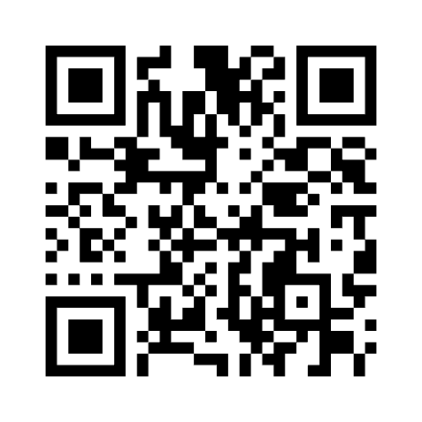
Ice breaker
Use a word to describe good leader/leadership

Slide 5

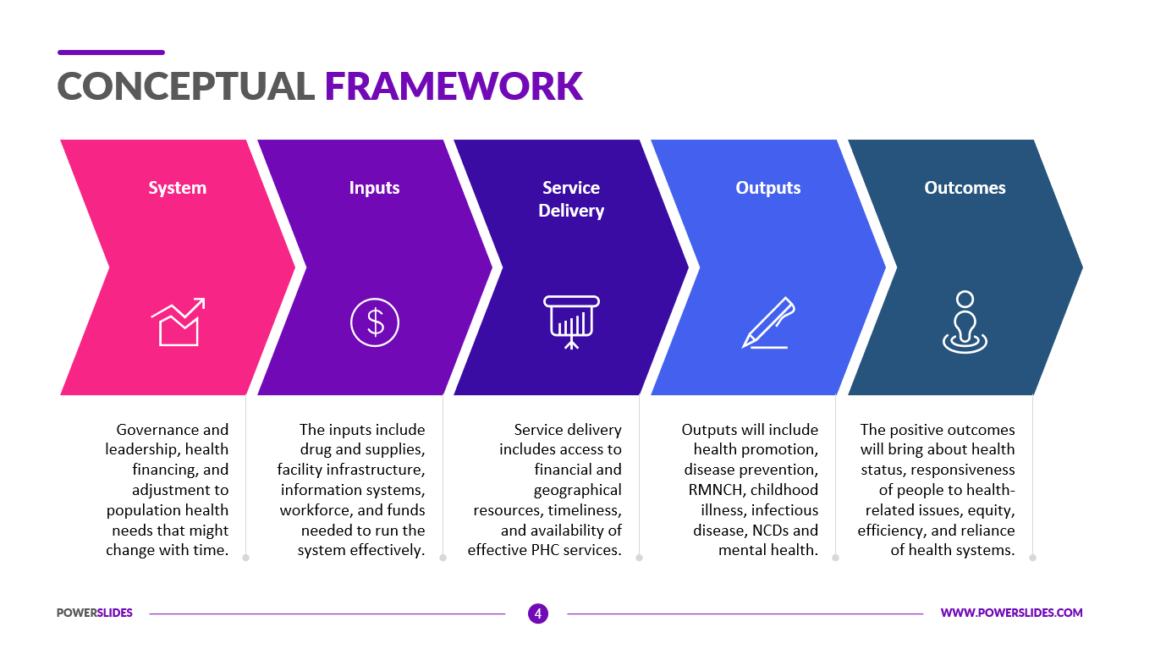
Framework
Definition from the Cambridge dictionary
  a supporting structure around which something can be built
  a system of rules, ideas, or beliefs that is used to plan or decide something

Slide 6
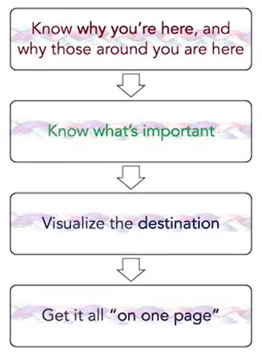

Slide 7
SO,
You're at your best as a leader when you know why you're here and why those around you are here.
That you know what's truly important to be spending time on, and be very clear of the intended destination of what's important.
You then drive your actions on these first three steps. And whenever you can you get it written down and on one page.
Getting everything on one page allows you to internalize your goals and more effectively share them with others.
So while this flow is relatively simple, it's often hard to do, especially as we progress through life with larger and more complex goals.

Slide 8
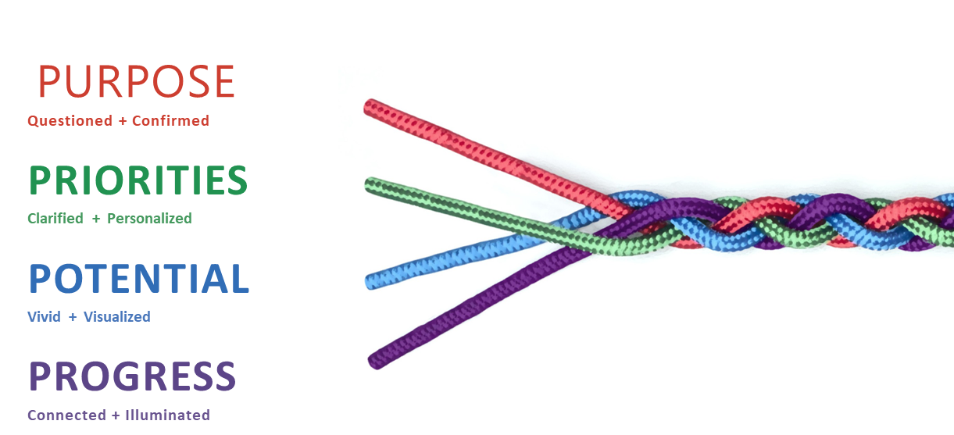
Leadership is organized into four parts.
Which I call the 4 Ps, questioning and confirming your purpose, clarifying and personalizing what is most important, your priorities.
Creating a vivid view of the future you've spent time visualizing and want to help create your potential.
And then ensuring you progress forward by illuminating where you have come from and where you are going, creating a high performance you connected to the first 3 Ps.
Notes:
I love physical analogies as they help us internalize and remember.
You could think of connected leadership as a rope made up of four fibers.
Our ability to thrive as a purpose driven leader is only as strong as the weakest
of these fibers, being present and intentional across all four of these Ps,
makes a stronger rope than being strong in some areas and weaken others.

Slide 9
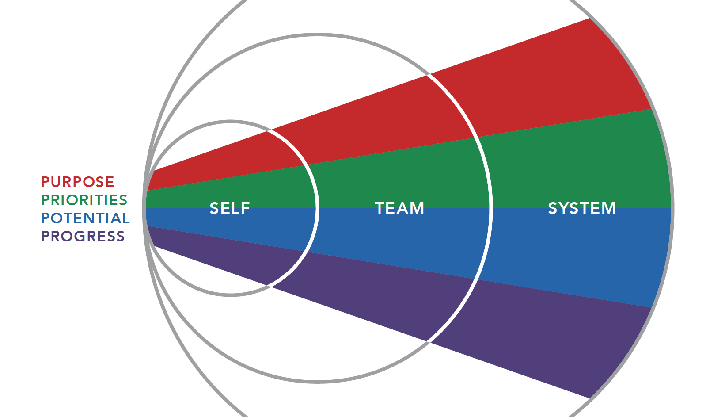
Notes:
These 4 Ps can apply across all levels as we rise out of the individual or
self level, to the team level, through to the world around us or system level.

Slide 10
Unpacking "Connected" + "Leadership"
Notes:
let's then take a moment to
unpack what we mean by these two words.

Slide 11
Activity
Question
Take a moment to write down your thoughts about the word "leadership". What associations does it carry for you? Include both positive and negative associations.
Notes:
let's then take a moment to
unpack what we mean by these two words.

Slide 12
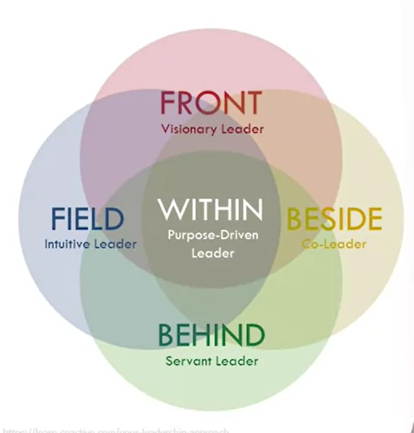
We are all leaders
Visionary Leader
often charismatic and persuasive
articulate vision effectively, inspire team to work towards common goals
Purpose-driver Leader
align goals with passions and values
model the way for others to do the same
Collaborative Leader
value input of all team members
encourage open communication, mutual respect and collaboration
Intuitive Leader
quickly assess situations and make decisions based on their instincts, experience, and knowledge
Servant Leader
focuses on serving team members needs, well-being and growth
empathy, humility, and a genuine desire to help others succeed
Notes:
A common feeling is that we're not truly leaders until
we're out front or on top of the organization chart.
But when you cultivate your leadership ability,
you can lead from any position.
In your current professional or personal life.
You might have the opportunity to lead in
the field or define the steps to achieve a goal,
a project with parameters to be
determined by you and your investigation.
Or you might lead from the side,
creating consensus on goals that
you and your partners will work together to achieve.
Equally important is being able to lead
from behind and serve as the coach,
educator, or advisor who guides the course of a project.
A purpose-driven, connected leader,
nearly always leads from within.
We'll cover this in this course as
leading from within suits all four positions well,
and you are stronger and more
effective when anchored to your individual purpose.
You can then lean towards
the different leadership positions
depending on what is appropriate for the situation.
In my own professional life,
I've been involved with projects that have needed
my leadership from each of these areas.
Sometimes the situation is obvious and I had
no choice but to
lead from the position I found myself in.
But other times, I have
a conscious choice and I can
adapt my leadership style for the situation.

Slide 13
Activity
What is the difference between Leaders and Manager?

Slide 14
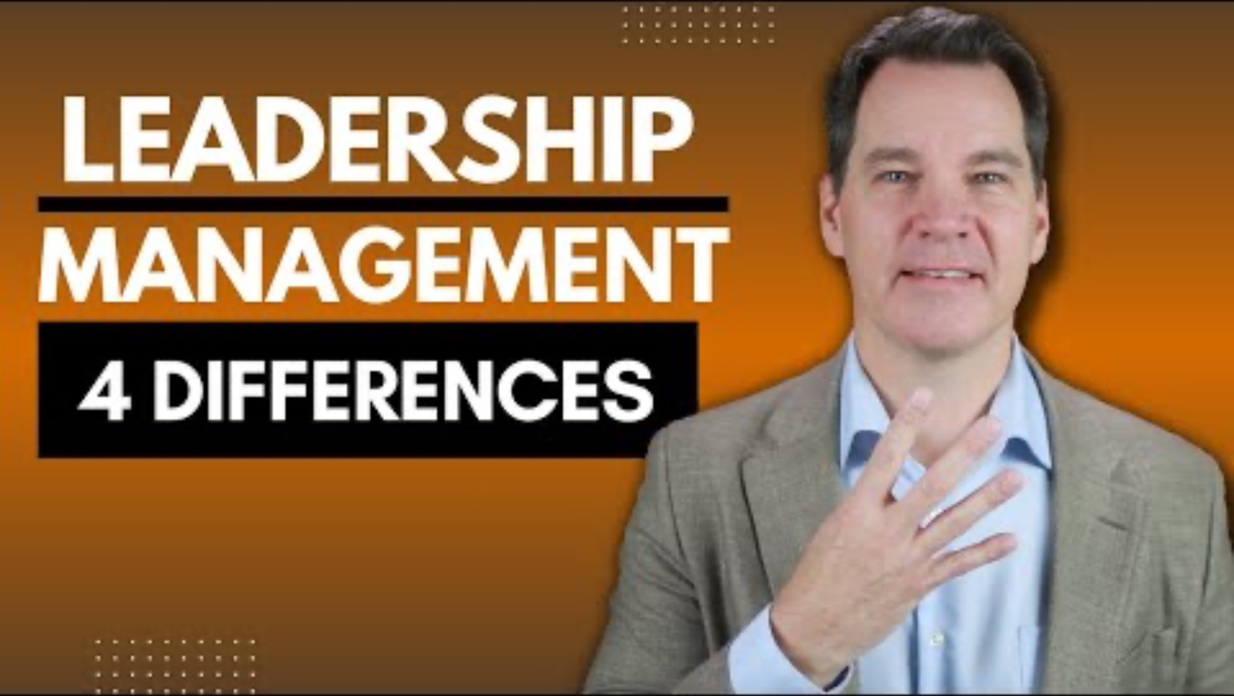
Leadership vs Management
Sources of power
Vision vs. Administration
Risk vs. Maintenance
Communication

Slide 15
Activity
Now,
Craft your definition of leadership………………….

Slide 16
Leadership Defined
“ Leadership is a socially-constructed process in which an individual is either given or takes increased responsibility or accountability in empowering others to collectively solve problems in alignment with an organisations or teams purpose.”
Notes:
I'd like to start by giving you a definition of leadership. Now, there are many definitions of leadership and different ways to conceptualize leadership. But by giving you this specific definition, this is going to help set you up for your own leadership development. Defining leadership helps us to determine where we are as leaders, how we are as leaders, and why we are as leaders. It helps us craft our leadership. Here's a definition that we will use throughout this course. Leadership is a socially-constructed process in which an individual is either given or takes increased responsibility or accountability in empowering others to collectively solve problems in alignment with an organizations or teams purpose. Now, that's a lot. We're going to deconstruct this a little bit and talk a bit about each part of this definition. First, leadership is a socially-constructed process. We've talked about how leadership is essentially a relationship between two people. A leader has other people involved. Leadership emerges from those relationships and situations. It emerges out of the meaning that we make in those situations, how we take roles, the behaviors we engage in. That means it's socially constructed. Every time we lead, it's going to feel and be different based on the people and the context involved. Social constructionism, as it pertains to leadership, basically means that how we evaluate and understand leadership is context and relationship dependent. How we conceptualize leadership relies on the role we are in and the culture we're in at the moment. You can imagine that taking on the responsibilities of a team, lead in a group without define leadership roles is very different from stepping into the role of say, a VP at a large organization. These are both leadership, but the effectiveness and the evaluation of the people in these positions is going to vary drastically based on the context, the people involved in the basic elements of the culture. No, absolutely. I mean, leadership is a really interesting field because on the one hand, it is so incredibly important. On the other hand, there are a lot of different ways that one can go about being an effective leader. What's effective in this context may not be effective in that context. It's the age-old thing about does the history make the person? Does the person make history? It's both. These things are interacting constantly. Having said that, there are principles, whether those principles come from psychology or sociology or just things about human behavior experience we've learned about what makes organizations healthy versus unhealthy, a really valuable to know about being exposed to. But unfortunately, it's not a simple recipe. I've worked in consulting, I've worked in tech, and I have now I'm an academic, so context matters in a few ways. The task matters the task at hand, the people you're working with Matt also. Your leadership style cannot be the same with an intern or a fresh trainee as it is with, say, in sometimes you're in a situation where the people who are working with you, or just a skill just as knowledgeable, just as qualified as you. You happen to be in this position where you are taking the leadership for a project. I think the styles have to be very different in both these contexts. The second element of this definition is given or takes increased responsibility and accountability. We think about leadership often in terms of power. Someone who takes a formal role has leadership, but you don't have to have formal power. You do have to have responsibility and accountability. It's worth noting that leadership can be given to you in some role, but you can also take advantage of an opportunity to be a leader. You can step up and be a leader in any situation and people will follow those whom they admire and respect regardless of whether or not they are in formal leadership roles. You don't necessarily have to be in a status of leadership to be a leader. You can be a leader at any level with your peers, with new hires that are coming in with people that you might be on a project on. It doesn't necessarily relate to what it is that you do in your day to day. I think it's how it goes beyond what your job title is or what your job role is. I agree on the control being sort of a tough thing to wrap around. I think being a leader is more about being an influencer than having control, or control is more of an org chart notion than truly inspiring people and making change. Well, if we step back again and we think about who are we influenced by? Who can influence people when they don't have any sort of positional or legitimate power? It gets back to issues of power. When there's no clear hierarchy, people will follow people who they like and respect or generally find that they have some expertise. The next element in this definition is empowering others. Leadership is not about command and control. It is not about telling others what to do. Rather it's about giving others the space to grow to be the best version of themselves and to help them solve the problems they have been hired to solve. I think the other thing I've probably really learned over time is how to really empower others that I work with. Again, I'm type A personality. I tend to believe that I can do it all and I can do it all myself. I really learned like that's not the best approach. Like yes, I could do it all and I could probably do it all myself. But it doesn't make me an effective leader at all. It probably makes me a very ineffective leader. Because if you empower people that report to you, if you empower those that you work with and you empower your staff, like you can do amazing things together and it's much more fun than trying to do something on your own. The next element is collectively solve problems. Working in businesses, working in teams is really about solving problems. You're solving problems all day and so leaders need to think about their work in terms of helping people solve problems and creating cultures of problem-solving. People who are ready to engage in problem-solving at any moment. At one point, particularly when I was into the role of being a leader and I had these lean principles and concepts in mind, my thought of leadership was to say I have to impose these lean concepts on the organization. It's changed because I realized now that it's really about leaders building a framework for problem-solving and engaging a social change process so that people can feel the energy in the success of some of these principles by testing them and trying them. Most leaders believe that their job is to tell people what to do. That's not what this is about. This is leaders have to embrace the opportunity to develop a culture that allows people to think and act from within to solve problems. Instead of telling people what to do, you deploy problem responsibility in this very trusting environment and allow them to practice and make mistakes and share their thoughts without fear. The last element of this definition is, in alignment with an organization or team's purpose. Leaders help people know what direction they're going. Leaders have to have vision. They can be the inspiration, they have the bigger picture. At any level, leaders need to help people get together on the same page so they know the purpose, they know why, they know where they're headed with their overall goals. For me, I think a lot about how a leader engages other people to work together towards collective goals. That's how I think about it. What does it mean to engage other people. What motivates them? What informs them? What encourages them to want to act? What does it mean to work together as opposed to not together or not together. Lots of different ways of not being effective collectively. Then what does it mean to have shared goals? Who sets those goals? How do we understand them, buy into them and then what happens with the bumps along the way? Do we adjust, pivot and so forth. To me, engaging others to work together toward collective goals is mostly what we try to do as a leader. Leadership is a socially constructed process in which an individual is either given or takes increased responsibility or accountability in empowering others to collectively solve problems in alignment with an organizations or teams purpose. This definition of leadership reminds us that leadership is socially constructed, so context and relationships matter for how we evaluate effectiveness. It highlights that we do not have to have formal authority to lead that our job is to empower others to solve problems and to see the goals that guide the group or organization toward its purpose. There is space for each of us in any capacity to learn about leadership and grow as leaders ourselves. This definition encourages us to pay attention to the factors that we know are important to effective leadership, like relationships, context, and purpose.

Slide 17
Socially-constructed process
leadership exists between two or more people
leadership emerges from the social situation and relationships they are in
evaluating and understanding leadership is context and relationship dependent

Slide 18
Responsibility and/or accountability
leadership involves power, formal or informal
leader has fluence and (some) control on others (thoughts, behaviours, etc.)
leader has legitimacy to allocate resources (and power) to complete tasks
therefore leader is often assumed responsibilities and accountabilities

Slide 19
Collectively solve problems
leader lead team or organization to accomplish tasks and solve problems; by:
  telling people what to do
  delegating power and responsibilities to people
  developing trustful culture that allows people to think and act
  sometimes, allowing mistakes

Slide 20
Alignment with organisation / team purpose
leader helps people know what direction to go - Vision
leader informs, motivate and empower people to act, in alignment with common interests and purposes of ogranisation/team

Slide 21
let's also consider the meaning contained within connected.
Connected leadership involves working with others.
Connected leader being fully present with those around them, bringing their authenticity and naturally unintentionally encouraging others to do the same.
“You might have heard of the window or mirror schools of management. ”
Notes:
You might have heard of the window
or mirror schools of management.
A contrast between the leader who views
the situation through the window
or the one that looks in the mirror.
This draws the distinction between a leader who tends to
look out from their building and see
others from a distance,
but not really look at themselves and
the leader who reflects
first on their own role in the team effort,
both positively and negatively.

Slide 22
Importance of Leadership
In 2018, if you enter leadership development into Google, you get 636 million hits. The leadership development industry in 2015 deemed to be worth around about $31 billion.
According to a Deloitte Research Report of 2016, when companies were asked how important leadership is to them, 89 percent chose either very important or important, and 57 percent of all companies said that leadership was very important to them.

Slide 23
The word development is important, and you'll see why as we go further through these lessons. It's important because it makes us understand that leadership is not something that is fixed, not something that you're born into, not something that is natural, there's no fixed mindset of leadership. Instead, it has a growth mindset.

Slide 24
There's a distinct difference between a fixed mindset in that you can't get beyond the levels of which you were born at, and a growth mindset in that you can grow into the task.
However, although leadership is seen as very important, it doesn't seem as we're very good at it. Only seven percent of companies that they're excellent at developing millennial leaders. Only 13 percent of companies, just at the excellence in developing global leaders, and only 14 percent of companies, any succession planning in place of future leaders. What does it mean….

Slide 25
To Know Thyself

Slide 26
Term “To know thyself”
To know thyself is to understand how you will act in various different situations. It doesn't mean by knowing yourself that you just know a deep inner you, you might have multiple versions of yourself that act out in different ways, in different situations. This is what we mean by adapting your leadership style. You might find you have multiple styles, multiple versions of you, and you can move between them fluidly without any psychological distress in your various leadership roles.
Notes:
we're going to frame
this through the term know thyself.
It's an understanding of knowing
how we are going to lead.
It's one of the original ideas of
what it means to be human going
as far back as Socrates time.
To know thyself is to understand how you will
act in various different situations.
It doesn't mean by knowing
yourself that you just know a deep inner you,
you might have multiple versions of yourself
that act out in different ways, in different situations.
This is what we mean by adapting your leadership style.
You might find you have multiple styles,
multiple versions of you,
and you can move between them fluidly without
any psychological distress in
your various leadership roles.

Slide 27
Now this can be quite a complex idea (TO KNOW THYSELF), the fact that you're not just oneself but multiple selves adapting to different situations. Prior to going into these deeply complex issues, let's look at what the common sense perspective of leadership is and where you might be coming from. The common sensical level, there seems to be five essential elements of leadership.

Slide 28
Leadership theories

Slide 29
Leadership Theories
Trait theories (1920s-30s)
Behavioural theories (1940s)
Situational/Contingency theories (70s onwards)

Slide 30
Trait Theories
differentiating personal characteristics of leaders from non-leaders – physical buildup, appearance, social class, etc.
later attempts identified 7 traits consistently associated with leadership (i.e. process, not person)
    Drive, the desire to lead, honesty and integrity, self-confidence, intelligence, job-relevant knowledge, and extraversion.
X

Slide 31
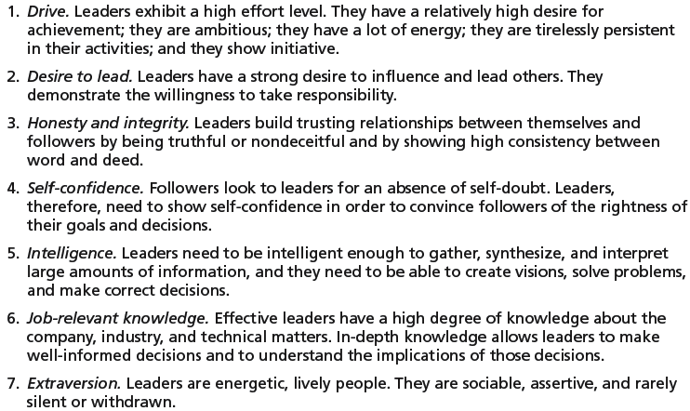
Seven Traits Associated with Leadership
Source: S. A. Kirkpatrick and E. A. Locke, “Leadership: Do Traits Really Matter?” Academy of Management Executive, May 1991, pp. 48–60; T. A. Judge, J. E. Bono, R. llies, and M. W. Gerhardt, “Personality and Leadership: A Qualitative and Quantitative Review,” Journal of Applied Psychology, August 2002, pp. 765–780.

Slide 32
Behavioural Theories
University of Iowa Studies (Kurt Lewin)
  3 leadership styles:
    Autocratic style: centralized authority, low participation
    Democratic style: involvement, high participation, feedback
    Laissez faire style: hands-off management
  Research findings: mixed results
    no specific style was consistently better for producing better performance
    employees were more satisfied under a democratic leader than an autocratic leader

Slide 33
Ohio State Studies
  Identified two dimensions of leader behavior
    Initiating structure: the role of the leader in defining his or her role and the roles of group members
    Consideration: the leader’s mutual trust and respect for group members’ ideas and feelings
  Research findings: mixed results
    Hhgh-high leaders generally, but not always, achieved high group task performance and satisfaction
    evidence indicated that situational factors appeared to strongly influence leadership effectiveness

Slide 34
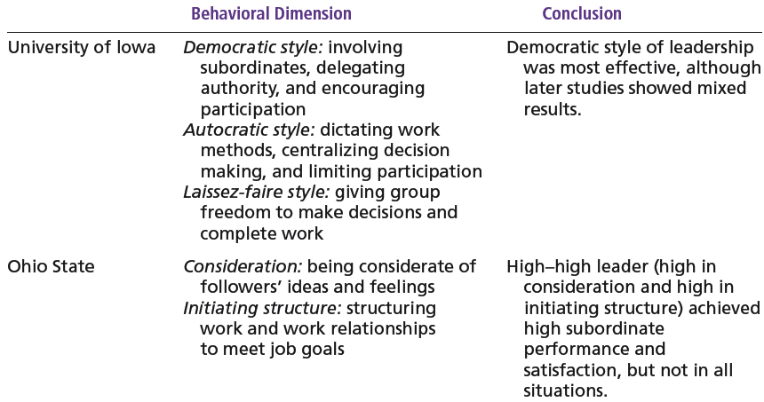
Behavioral Theories of Leadership

Slide 35
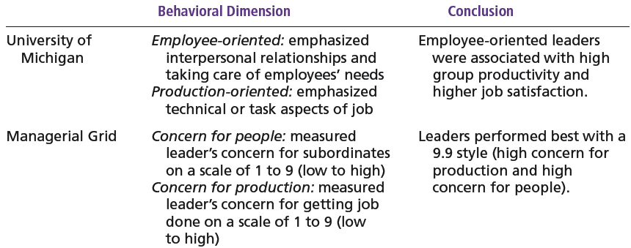
Behavioral Theories of Leadership

Slide 36
University of Michigan Studies
  Identified two dimensions of leader behavior
    Employee oriented: emphasizing personal relationships
    Production oriented: emphasizing task accomplishment
  Research findings:
    Leaders who are employee oriented are strongly associated with high group productivity and high job satisfaction

Slide 37
The Managerial Grid
Appraises leadership styles using two dimensions:
  Concern for people
  Concern for production
Places managerial styles in five categories:
  Impoverished management
  Task management
  Middle-of-the-road management
  Country club management
  Team management

Slide 38
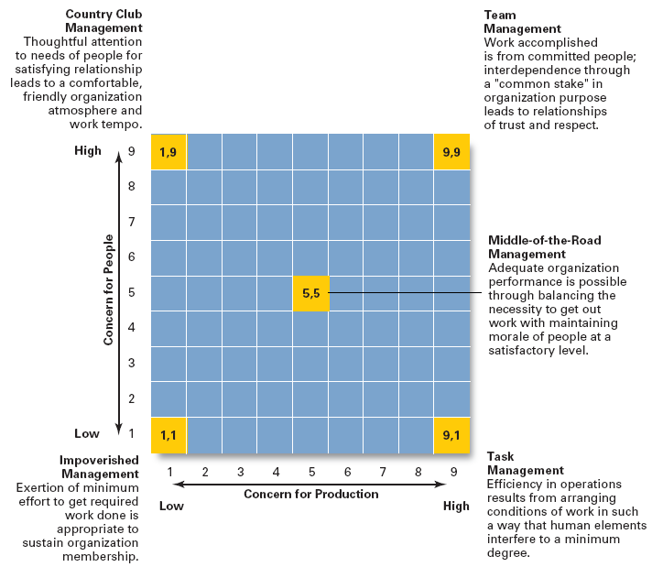
Source: Reprinted by permission of Harvard Business Review. An exhibit from “Breakthrough in Organization Development” by Robert R. Blake, Jane S. Mouton, Louis B. Barnes, and Larry E. Greiner, November–December 1964, p. 136. Copyright © 1964 by the President and Fellows of Harvard College. All rights reserved.

Slide 39
Contingency Theories
Example 1 - The Fiedler Model
  effective group performance depends upon proper match between leader’s style of interacting with followers and degree to which the situation allows the leader to control and influence
  situational factors in matching leader to the situation:
    Leader-member relations
    Task structure
    Position power

Slide 40
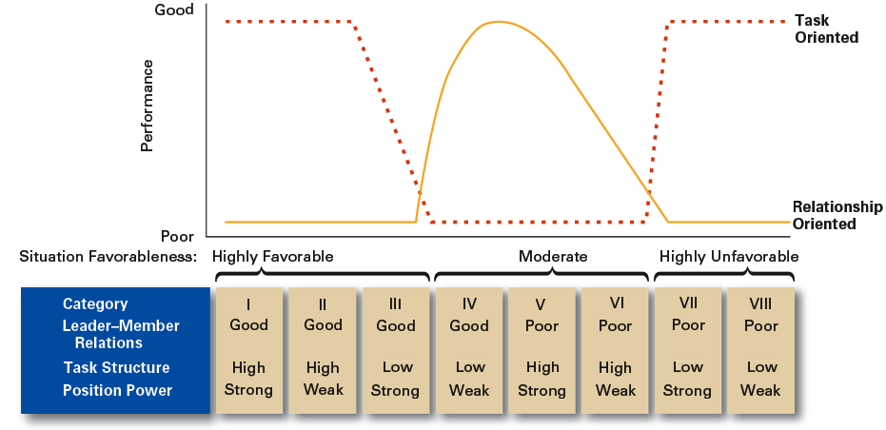
Findings of the Fiedler Model

Slide 41
Example 1 - Hersey and Blanchard’s Situational Leadership Theory (SLT)
  successful leadership is achieved by selecting the right leadership style which is contingent on the level of the followers’ readiness
    Acceptance: leadership effectiveness depends on whether followers accept or reject a leader
    Readiness: the extent to which followers have the ability and willingness to accomplish a specific task
  Leaders must relinquish control over and contact with followers as they become more competent

Slide 42
4 specific leadership styles incorporating two leadership dimensions:
  Telling: high task-low relationship leadership
  Selling: high task-high relationship leadership
  Participating: low task-high relationship leadership
  Delegating: low task-low relationship leadership
Participating / supporting
Selling / coaching
Relationship focus
Delegating
Telling / directing
Task focus

Slide 43
essential elements of leadership

Slide 44
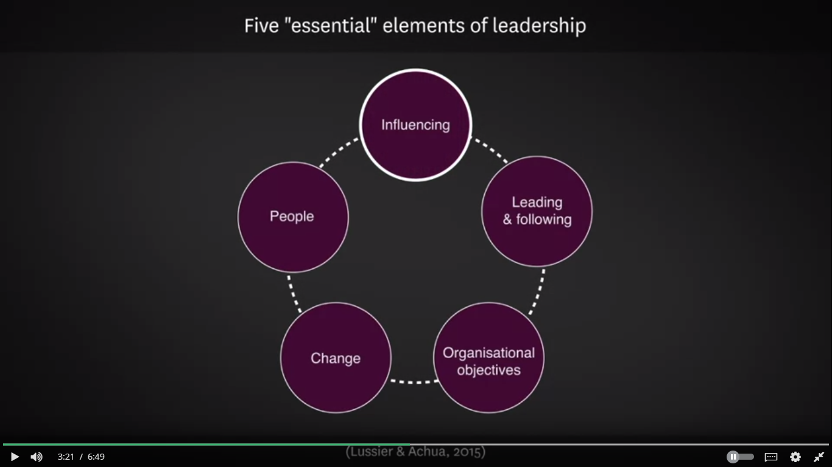
(Lussier & Achua, 2015)
Notes:
The first of those is influencing,
is the idea that a leader influences and motivates
followers to do their bidding or to
go on some kind of transformational journey.
The second relates to followers.
In order to be a leader, you
have to have some kind of follower.
There's this deep relationship
between leader and a follower,
and that's something that is absolutely
required in order to be a good leader,
to generate these good relationships with your followers,
and then yet again, take them where you're going.
Now, for some people,
leadership just means you have
a formal leadership position.
But for others, we're having an idea of
thought leadership and influences
in the wider social world.
These are people who are actually leading
movements who don't really have any formal authority.
They have a whole bunch of
followers who are choosing to follow them.
This is an important concept.
You have leadership because you have
the position of leadership or the position of authority,
but you also have leadership where
followers are choosing to follow you.
Then we might have three very
organizational elements of leadership.
There's the idea of organizational objectives.
How do you get people to do
good work and deliver the objectives of the organization?
We then have the idea of change.
How do you get people working in an organization
to adapt and change to the external environment?
Finally, the idea of leading people themselves,
and it go back to relationships.
How do you develop deep enduring relationships
with the people you are leading?
They are the five essential elements of leadership,
the thing that all leaders actually are
having to do on an ongoing basis.

Slide 45
Essential leadership skills
technical skills
move up and have interpersonal skills, and finally,
high-end leaders will have complex decision-making skills

Slide 46
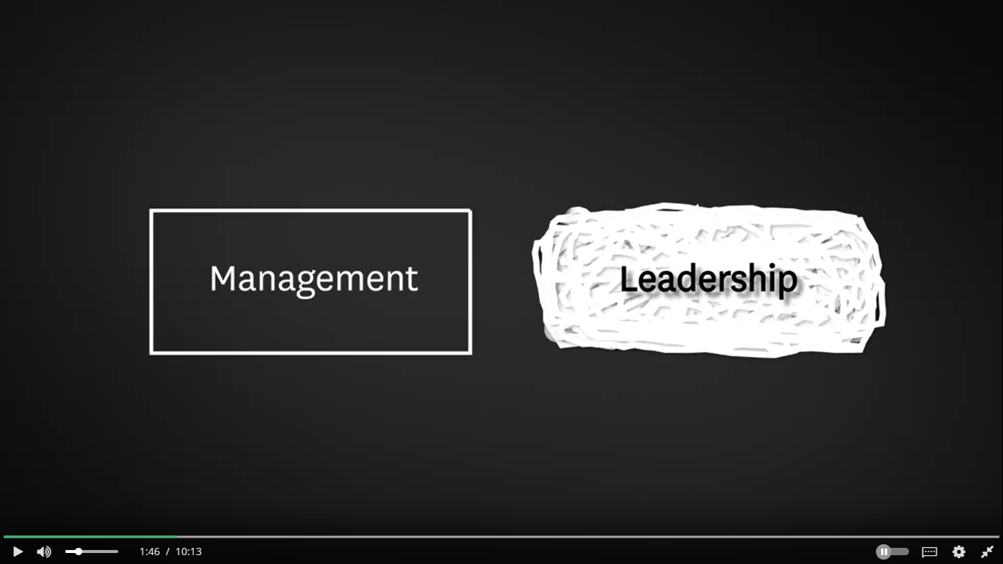
Summary
Leader
Leadership
Leadership vs. Management
Brief history of leadership theory development
Essential leadership skills

Slide 47
References
Hamel states that we need to find ways to "unleash the latent leadership talent" within organisations. Mintzberg says, "from everywhere... come little insights that can emerge into big strategies." What does this mean from your perspective? How do they propose this can be achieved? What leader behaviours does Birkenshaw identify that might support this "unleashing"?:
Hamel, G. (2013). A conversation with Gary Hamel: Transformation of leadership, step-by-step. McKinsey & Company. (4:52)
Birkinshaw, J. (2016, September 7). The ambidextrous leader: when to step in and how to step back. What's best: dictatorial top-down leadership or empowering from the bottom up? London Business School.
Mintzberg, H. (2017, March 22). Some half-truths of management.
Lebowitz uses the OCEAN model to predict leadership emergence and effectiveness; while Grant (2014, Sept) reports that EQ is an ineffective prediction measure. How reasonable and justifiable are these claims?:
Goleman, D. (2012). Emotional Intelligence. Big Think. (5:31)
Global Leadership Foundation (2002). The global emotional intelligence test – sampler.
Lebowitz, S. (2016, December 8). The 'big 5' personality traits could predict who will and won't become a leader. Business Insider.
Which motivation techniques does Pink identify? Which, if any, are used in your current team or organisation? Are they applied effectively? Which would you like to apply to your current team or organisation and why?:
Pink, D. (2010, April 1). Drive: The surprising truth about what motivates us. The Royal Society for the encouragement of Arts, Manufactures and Commerce (RSA). (10:47)

