Slide 1
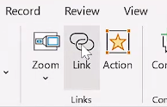
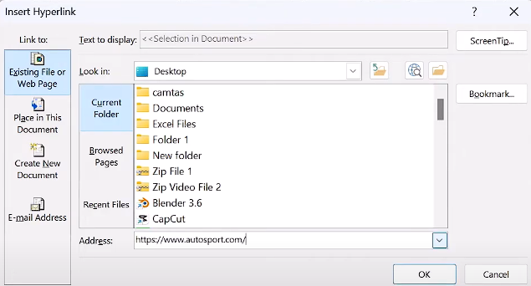
HYPER LINK
How to insert a Hyperlink in Powerpoint.
Whats a Hyperlink? Hyperlinks help us move quickly between slides or to other websites. In this presentation I show step by step how to insert hyperlinks
FIRST STEP
SECOND STEP
THIRD STEP
FOURTH STEP
Highlight the text or click the object
Start by choosing the text, image, or shape that you want to turn into a hyperlink. Click on the item to select it. This step is important because powerpoint needs to know exactly what content you want to link to another location or resource.
Go to the insert tab
Go to the Insert tab at the top of the Powerpoint window. Click on link or hyperlink. You can also right click on the selected item and choose Link from the menu. This will open a window where you can set up the hyperlink.
Click link or hyperlink
In the hyperlink window, choose where the link should go. You can link to a website, another slide in your presentation, a file, or an email address. Type or paste the correct information in the space provided, then click OK to save the link.
Enter the link and click OK
To make sure your link works, go into Slide Showmode and click on the linked item. It should take you to the destination you selected.

