Slide 1
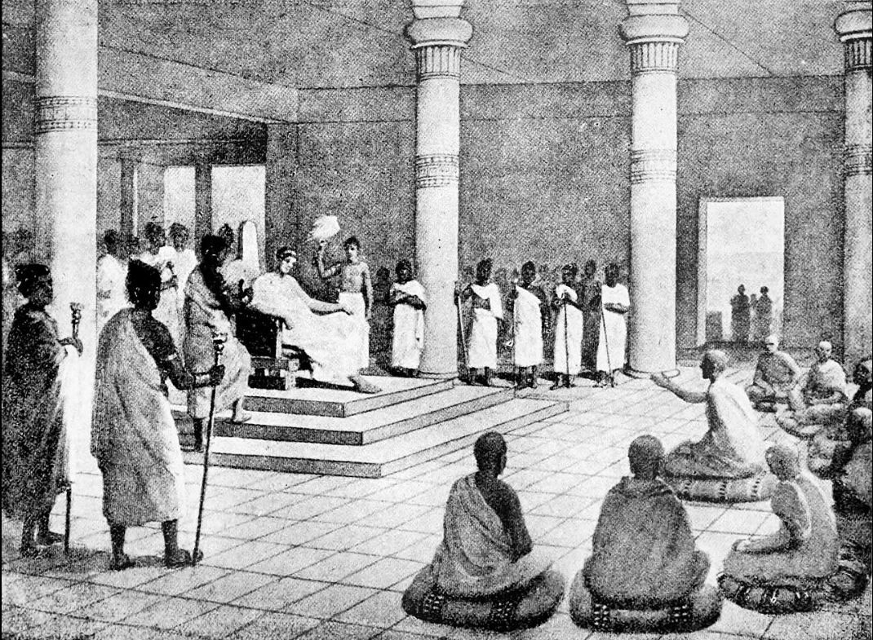
Early Buddhist Teaching on 'Non-Self'
Milindapañha (lit. ‘Questions of Milinda’) (between 100 BCE and 200 CE)
King Milinda
Venerable Nâgasena
Milinda the king ：‘What is your name?’
Venerable Nâgasena:
'I am known as Nâgasena. But
Nâgasena is only a generally
understood term, for there is no
permanent individuality (no soul) involved in the matter.'
Milindapañha: https://sacred-texts.com/bud/sbe35/sbe3504.htm

Slide 2
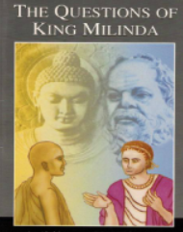
Early Buddhist Teaching on 'Non-Self'
Milinda: 'If there be no permanent
Individuality involved in the matter, who is it
who gives to you members of the Order your robes and food
and lodging and necessaries for the sick? Who is it who
enjoys such things when given? Who is it who lives a life of
righteousness? Who is it who devotes himself to meditation?
Who is it who attains to the goal of the Excellent Way, to
the Nirvâna of Arahatship?. . . ?'

Slide 3
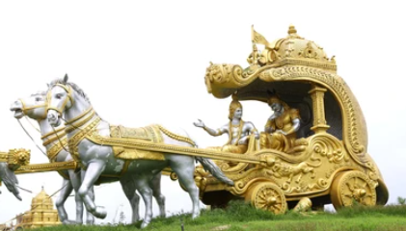
Nâgasena: ‘ . . . How did you come, on foot, or in a carriage?'
Milinda: 'I came in a carriage.’
‘If you came in a carriage, explain to me what that is. Is it the pole that is the charriage?’
‘No, it is not.'
pole
'Is it the axle that is the charriage?'
'Certainly not.’
‘ . . . Is it all these parts of it
that are the charriage?'
axle
'No, Sir.'
'But is there anything outside them that is the charriage?’
'No, Sir.'

Slide 4

‘ . . . What then is the charriage you say you came in?'
‘It is on account of its having all these things--the pole, and the axle, the wheels, and the framework . . . -- that it comes under the generally understood term of "charriage.“’’
'Very good! Your Majesty has rightly grasped the meaning of "charriage." And just even so it is on account of all those things you questioned me about . . . that I come under the generally understood term of "Nâgasena."
'Most wonderful, Nâgasena, and most strange.
Well has the puzzle put to you, most difficult
though it was, been solved. Were the Buddha
himself here he would approve your answer.
Well done, well done, Nâgasena!'
Vibhajyavāda：‘The doctrine that analyses’

Slide 5
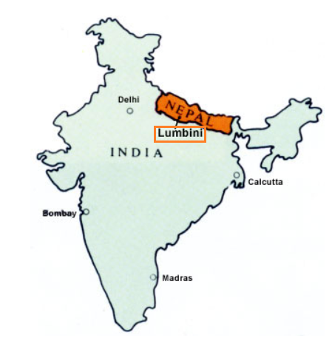
Early Buddhist Teaching on 'Non-Self'
· What is Buddhism? Why was Buddhism founded?
· Why is Non-Self the core teaching in early Buddhism?
The story of the Buddha
Prince Siddhārtha Gautama was born in Lumbini in what is now Nepal, to royal parents of the Shakya clan during the 6th or 5th century BCE.

Slide 6
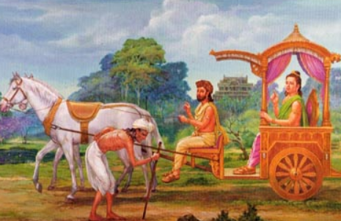
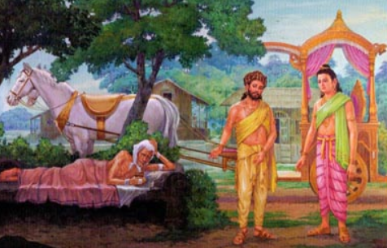
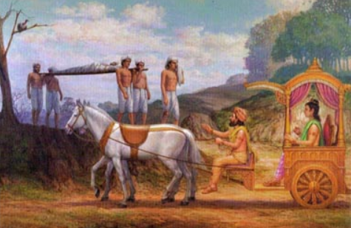
Early Buddhist Teaching on 'Non-Self'
Prince Siddhartha grew up in an environment of luxury and pleasure. However, as he grew older, he discovered the suffering of aging, sickness, and death in the human world. In search of a way to overcome these forms of suffering, he left the palace and renounced worldly life to pursue spiritual practice.

Slide 7
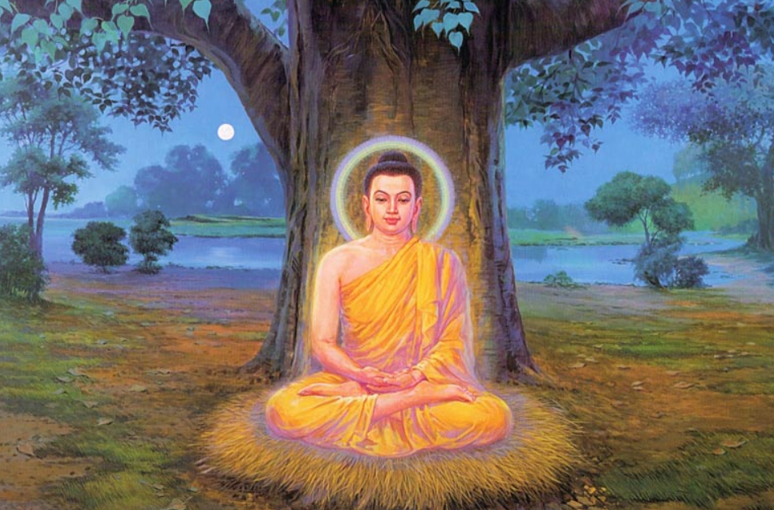
Early Buddhist Teaching on 'Non-Self'
Later he realised enlightenment and became a Buddha, which is defined as "a person who has achieved full enlightenment."

Slide 8
Early Buddhist Teaching on 'Non-Self'
Dhammapada Verses 153 and 154
I, who have been seeking the builder of this house (body), failing to attain Enlightenment which would enable me to find him, have wandered through innumerable births in saṃsāra. To be born again and again is, indeed, dukkha (suffering)!
Oh house-builder! You are seen, you shall build no house (for me) again. All your rafters are broken, your roof-tree is destroyed. My mind has reached the unconditioned (i.e., Nirvāna); the end of craving has been attained.

Slide 9
Early Buddhist Teaching on 'Non-Self'
These two verses are expressions of intense and sublime joy the Buddha felt at the very moment of his attainment of Enlightenment.
I, who have been seeking the builder of this house (body), failing to attain Enlightenment which would enable me to find him, have wandered through innumerable births in saṃsāra. To be born again and again is, indeed, dukkha (suffering)!
Craving (Tanha)
the body

Slide 10
Early Buddhist Teaching on 'Non-Self'
Oh house-builder! You are seen, you shall build no house (for me) again. All your rafters are broken, your roof-tree is destroyed. My mind has reached the unconditioned (i.e., Nirvāna); the end of craving has been attained.
You are seen: I have seen you now that I have attained the all comprehending wisdom with my own Insight.
No house shall be built again: You shall not build another house (for me) in this round of rebirths.
All your rafters are broken: I have destroyed all the remaining mental defilements.

Slide 11
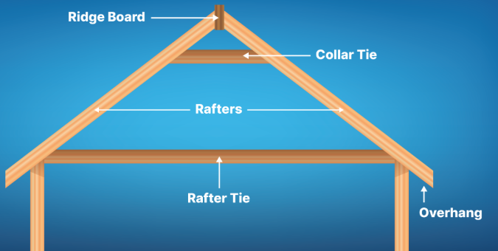
Early Buddhist Teaching on 'Non-Self'
Oh house-builder! You are seen, you shall build no house (for me) again. All your rafters are broken, your roof-tree is destroyed. My mind has reached the unconditioned (i.e., Nirvāna); the end of craving has been attained.
Rafters, roof-tree: all the mental defilements, such as greed, hatred, conceit, jealousy, etc., originate from Ignorance (misconceptions about "Self").
My mind has reached the Unconditioned, having Nirvāna as its object, my mind has
realised Nirvāna.
The end of craving has been attained.
I have attained Arahatta Fruition.

Slide 12
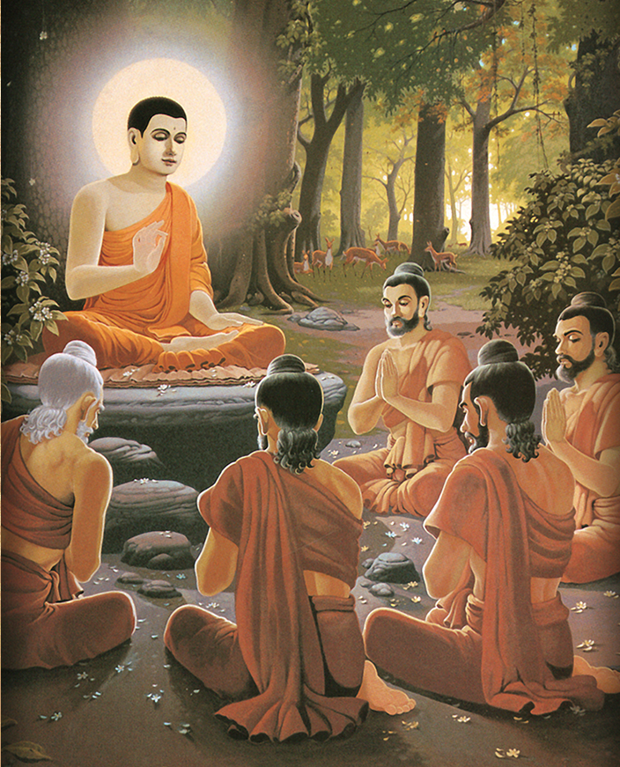
Early Buddhist Teaching on 'Non-Self'
This first sermon has been preserved as the Dhammacakkappavattana Sutta (The Setting in Motion of the Wheel of the Dharma Discourse) and centers on the Four Noble Truths. The Buddha prescribed a path of practice through which people can realise enlightenment for themselves. The main topic of this sutta is the Four Noble Truths.
Dhammacakkappavattana Sutta: Samyutta Nikkaya 56.11 PTS: S v 420 CDB ii 1843
https://www.accesstoinsight.org/tipitaka/sn/sn56/sn56.011.than.html

Slide 13
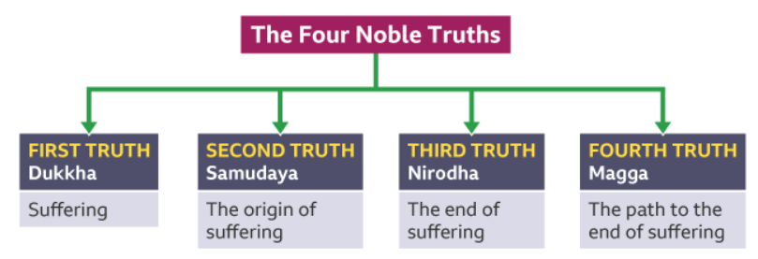
Early Buddhist Teaching on 'Non-Self'
effect
cause
effect
cause
mundane
supramundane

Slide 14

Early Buddhist Teaching on 'Non-Self'
Dhammacakkappavattana Sutta
——The Setting in Motion of the Wheel of the Dharma Discourse
The First Noble Truth –dukkha (suffering)
“Now this, monks, is the noble truth of suffering: Birth is suffering, aging is suffering, death is suffering; sorrow, lamentation, pain, distress, & despair are suffering; association with the unbeloved is suffering, separation from the loved is suffering, not getting what is wanted is suffering. In short, the five clinging-aggregates are suffering.”

Slide 15
Early Buddhist Teaching on 'Non-Self'
Three kinds of suffering:
1. Dukkha-dukkha – the suffering due to pain.
2. Vipariṇāma-dukkha – the suffering due to change.
3. Saṅkhāra-dukkha – the suffering due to conditioned existence.
Three kinds of feeling:
Painful feeling
Pleasant feeling
Neutral feeling
Three realms:
Desire realm
Form realm
Formless realm.

Slide 16
Early Buddhist Teaching on 'Non-Self'
The five aggregates of clinging (Pañcupādānakkhandhā), the five material and mental factors that take part in the rise of craving and clinging. They are also explained as the five factors that constitute a sentient being’s person.
The five aggregates of clinging are:
1. material form (rupa)
2. sensations (or feelings) (vedana)
3. perceptions (samjna)
4. mental formations (saṅkhāra: including all the wholesome and unwholesome
mental factors)
5. consciousness (vijnana).

Slide 17
Early Buddhist Teaching on 'Non-Self'
effect
cause
effect
cause
mundane
supramundane

Slide 18
Early Buddhist Teaching on 'Non-Self'
The Second Noble Truth – samudayan (the origin of suffering)
“And this, monks, is the noble truth of the origin of suffering: the craving that makes for further becoming — accompanied by passion & delight, relishing now here & now there — i.e., craving for sensual pleasure, craving for becoming, craving for non-becoming.”

Slide 19
Early Buddhist Teaching on 'Non-Self'
the desire realm
the form realm
There are three types of craving:
· Kāma-taṇhā (sense-craving): craving for sense objects which provide pleasant feeling, or craving for sensory pleasures.
· Bhava-taṇhā (craving to be): craving for a fixed identity or existence and not accepting that life is impermanent.
· Vibhava-taṇhā (craving not to be): craving to not experience of the world, and to be nothing.
the formless realm

Slide 20
Early Buddhist Teaching on 'Non-Self'
Taṇhā is related to the three unwholesome roots (three poisons) as follows:
· Avidyā or Mohā (ignorance; delusion) is the root of all mental defilements (kleshas); hence it is the basis for raga (greed) and dosa (hatred), and is also the basis for taṇhā.
· Rāga (attachment; greed) is equivalent to bhava-taṇhā (craving to be) and kāma-taṇhā (sense-craving).
· Dosa (aversion; hatred) is equivalent to vibhava-taṇhā (craving not to be).

Slide 21
Early Buddhist Teaching on 'Non-Self'
Avidya or Mohā (ignorance): ignorance of the nature of reality
_Anguttara Nikaya 4.49
“Monks, there are these four perversions of perception, mind, and view. What four?
Taking impermanence as permanence.
Taking suffering as happiness.
Taking not-self as self.
Taking ugliness as beauty.
These are the four perversions of perception, mind, and view. “

Slide 22
Early Buddhist Teaching on 'Non-Self'
Visuddhimagga (Path of Purification):
The three rounds (vaṭṭa)
Origin of suffering
Mental defilements
Suffering
Results (suffering)
(five aggregates)
Actions (karma)

Slide 23
Early Buddhist Teaching on 'Non-Self'
Five aggregats
Mental defilements
Actions
effect
cause
effect
cause
mundane
supramundane

Slide 24
Early Buddhist Teaching on 'Non-Self'
Dhammacakkappavattana Sutta
——The Setting in Motion of the Wheel of the Dharma Discourse
The Third Noble Truth – nirodha (the end of suffering)
‘Now this, bhikkhus, is the noble truth of the cessation of suffering: it is the remainderless fading away and cessation of that same craving, the giving up and relinquishing of it, freedom from it, non-reliance on it.

Slide 25
Early Buddhist Teaching on 'Non-Self'
The Third Noble Truth – nirodha
Nirvāna (Pali: nibbāna) is ‘blowing out’ or ‘quenching’ of the activities of the worldly mind and its related suffering. Nirvāna is the goal of the Buddhist path and marks the release from worldly suffering and rebirths in saṃsāra. Nirvāna has commonly been interpreted as the extinction of the ‘three fires’, or ‘three poisons’, greed, hatred and ignorance. When these fires are extinguished, release from the cycle of rebirth (saṃsāra) is attained.

Slide 26
Early Buddhist Teaching on 'Non-Self'
Nirvāna is regarded as an uncompounded or unconditioned (asankhata) dhamma (phenomenon) which is ‘transmundane’ and which is beyond our normal dualistic conceptions.
Nirvāna is the highest state of profound well-being a human is capable of attaining. The mind awakens from delusion, is liberated from bondage, is cleansed of all its defilements, becomes entirely at peace, experiences the complete cessation of suffering, and is no longer reborn.

Slide 27
Early Buddhist Teaching on 'Non-Self'
There are two stages in Nirvāna:
Nirvāna with remainder: Nirvāna is attained during one's life, when the fires are extinguished. There is still the ‘residue’ of the five aggregates, which however is not ‘burning’. Nirvāna-in-this-life is believed to result in a transformed mind with qualities such as happiness, freedom of negative mental states, peacefulness and non-reactiveness.
Nirvāna without remainder: This is the final Nirvāna, or pariNirvāna or "blowing out" at the moment of death, when there is no fuel left.
Nirvāna: https://en.wikipedia.org/wiki/Nirvāna_(Buddhism)

Slide 28
Early Buddhist Teaching on 'Non-Self'
effect
cause
effect
cause
mundane
supramundane

Slide 29
Early Buddhist Teaching on 'Non-Self'
Dhammacakkappavattana Sutta
——The Setting in Motion of the Wheel of the Dharma Discourse
The Fourth Noble Truth – magga (the path to the end of suffering)
“And this, monks, is the noble truth of the way of practice leading to the cessation of suffering: precisely this Noble Eightfold Path — right view, right resolve, right speech, right action, right livelihood, right effort, right mindfulness, right concentration.”

Slide 30

Early Buddhist Teaching on 'Non-Self'

Slide 31
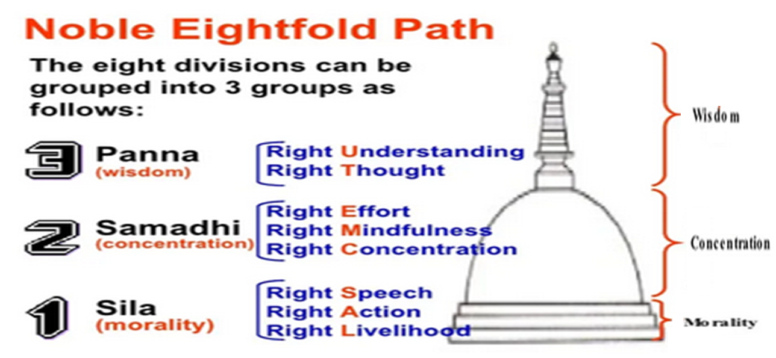
Early Buddhist Teaching on 'Non-Self'

Slide 32
Early Buddhist Teaching on 'Non-Self'
Seven stages of purification (The Path of Purification; Visuddhimagga: https://www.urbandharma.org/udharma14/pathpure.html)
7. Purification by knowledge and vision (nanadassana-visuddhi)
6. Purification by knowledge and vision of the course of practice (patipada–nanadassana-visuddhi)
5. Purification by knowledge and vision of what is path and not-path (maggamagga-nanadassana-visuddhi)
4. Purification by overcoming doubt (kankha-vitarana-visuddhi)
3. Purification of view (ditthi-visuddhi)
2. Purification of mind (citta-visuddhi)
1. Purification of conduct (sīla-visuddhi)
Wisdom training
——Concentration training
——Morality training

Slide 33
Rupa kalapa—tiny material particles
Early Buddhist Teaching on 'Non-Self'
Materiality
Compactness of continuity
Compactness of grouping
Compactness of function
Material elements
Earth element
Water element
Fire element
Wind element
Seven stages of purification (The Path of Purification; Visuddhimagga: https://www.urbandharma.org/udharma14/pathpure.html)
7. Purification by knowledge and vision (nanadassana-visuddhi)
6. Purification by knowledge and vision of the course of practice (patipada–nanadassana-visuddhi)
5. Purification by knowledge and vision of what is path and not-path (maggamagga-nanadassana-visuddhi)
4. Purification by overcoming doubt (kankha-vitarana-visuddhi)
3. Purification of view (ditthi-visuddhi)
2. Purification of mind (citta-visuddhi)
1. Purification of conduct (sīla-visuddhi)
Functions of elements
Earth-solidity
Water-cohesion
Fire-temperature
Wind-motion
Mentality
Compactness of continuity
Compactness of grouping
Compactness of function
Compactness of object
Thought moments
Consciousness and mental factors
Functions of mentalities
Mentalities to be discerned

Slide 34
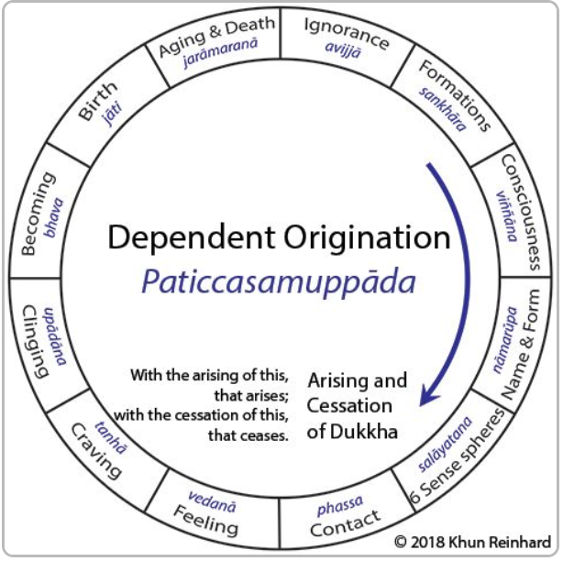
Future life
Previous life
Early Buddhist Teaching on 'Non-Self'
Seven stages of purification
Mental defilements
7. Purification by knowledge and vision (nanadassana-visuddhi)
6. Purification by knowledge and vision of the course of practice (patipada–nanadassana-visuddhi)
5. Purification by knowledge and vision of what is path and not-path (maggamagga-nanadassana-visuddhi)
4. Purification by overcoming doubt (kankha-vitarana-visuddhi)
3. Purification of view (ditthi-visuddhi)
2. Purification of mind (citta-visuddhi)
1. Purification of conduct (sīla-visuddhi)
Results
Actions
Present life

Slide 35
Future life
Previous life
Early Buddhist Teaching on 'Non-Self'
Seven stages of purification
Mental defilements
7. Purification by knowledge and vision (nanadassana-visuddhi)
6. Purification by knowledge and vision of the course of practice (patipada–nanadassana-visuddhi)
5. Purification by knowledge and vision of what is path and not-path (maggamagga-nanadassana-visuddhi)
4. Purification by overcoming doubt (kankha-vitarana-visuddhi)
3. Purification of view (ditthi-visuddhi)
2. Purification of mind (citta-visuddhi)
1. Purification of conduct (sīla-visuddhi)
Results
Actions
Present life

Slide 36
Future life
Previous life
Early Buddhist Teaching on 'Non-Self'
Seven stages of purification
Mental defilements
7. Purification by knowledge and vision (nanadassana-visuddhi)
6. Purification by knowledge and vision of the course of practice (patipada–nanadassana-visuddhi)
5. Purification by knowledge and vision of what is path and not-path (maggamagga-nanadassana-visuddhi)
4. Purification by overcoming doubt (kankha-vitarana-visuddhi)
3. Purification of view (ditthi-visuddhi)
2. Purification of mind (citta-visuddhi)
1. Purification of conduct (sīla-visuddhi)
Results
Actions
Present life

Slide 37
Early Buddhist Teaching on 'Non-Self'
Seven stages of purification
7. Purification by knowledge and vision (nanadassana-visuddhi)
6. Purification by knowledge and vision of the course of practice (patipada–nanadassana-visuddhi)
5. Purification by knowledge and vision of what is path and not-path (maggamagga-nanadassana-visuddhi)
4. Purification by overcoming doubt (kankha-vitarana-visuddhi)
3. Purification of view (ditthi-visuddhi)
2. Purification of mind (citta-visuddhi)
1. Purification of conduct (sīla-visuddhi)

Slide 38
Early Buddhist Teaching on 'Non-Self'
Seven stages of purification
7. Purification by knowledge and vision (nanadassana-visuddhi)
6. Purification by knowledge and vision of the course of practice (patipada–nanadassana-visuddhi)
5. Purification by knowledge and vision of what is path and not-path (maggamagga-nanadassana-visuddhi)
4. Purification by overcoming doubt (kankha-vitarana-visuddhi)
3. Purification of view (ditthi-visuddhi)
2. Purification of mind (citta-visuddhi)
1. Purification of conduct (sīla-visuddhi)

Slide 39
Early Buddhist Teaching on 'Non-Self'
Realising Nirvāna
Seven stages of purification
7. Purification by knowledge and vision (nanadassana-visuddhi)
6. Purification by knowledge and vision of the course of practice (patipada–nanadassana-visuddhi)
5. Purification by knowledge and vision of what is path and not-path (maggamagga-nanadassana-visuddhi)
4. Purification by overcoming doubt (kankha-vitarana-visuddhi)
3. Purification of view (ditthi-visuddhi)
2. Purification of mind (citta-visuddhi)
1. Purification of conduct (sīla-visuddhi)

Slide 40
Early Buddhist Teaching on 'Non-Self'
Anguttara Nikaya 4.49
“There are these four corrections of perception, mind, and view. What four?
Taking impermanence as impermanence.
Taking suffering as suffering.
Taking not-self as not-self.
Taking ugliness as ugliness.
These are the four corrections of perception, mind, and view. “

Slide 41
Early Buddhist Teaching on 'Non-Self'
The path leading to the end of suffering
The three rounds (vaṭṭa)
The end of suffering
Mental defilements
Results (suffering)
Actions (karma)

Slide 42
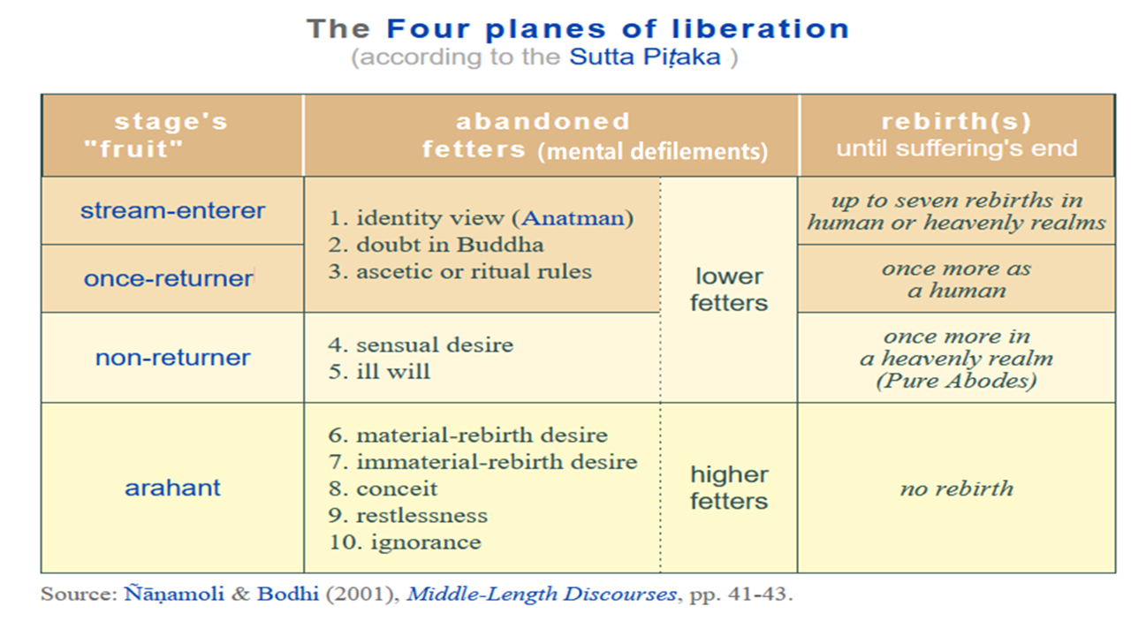

Slide 43
Early Buddhist Teaching on 'Non-Self'
Anattalakkhana Sutta: The Characteristic of Nonself
“Bhikkhus, form is nonself. For if, bhikkhus, form were self, this form would not lead to affliction, and it would be possible to have it of form: ‘Let my form be thus; let my form not be thus.’ But because form is nonself, form leads to affliction, and it is not possible to have it of form: ‘Let my form be thus; let my form not be thus.’
Samyutta Nikkaya 22.59
_https://suttacentral.net/sn22.59/en/sujato?layout=plain&reference=none&notes=asterisk&highlight=false&script=latin

Slide 44
Early Buddhist Teaching on 'Non-Self'
“Feeling is nonself…. … Perception is nonself…. Volitional formations are nonself…. Consciousness is nonself. For if, bhikkhus, consciousness were self, this consciousness would not lead to affliction, and it would be possible to have it of consciousness: ‘Let my consciousness be thus; let my consciousness not be thus.’ But because consciousness is nonself, consciousness leads to affliction, and it is not possible to have it of consciousness: ‘Let my consciousness be thus; let my consciousness not be thus.’

Slide 45
Early Buddhist Teaching on 'Non-Self'
“What do you think, bhikkhus, is form permanent or impermanent?”—“Impermanent, venerable sir.”—“Is what is impermanent suffering or happiness?”—“Suffering, venerable sir.”—“Is what is impermanent, suffering, and subject to change fit to be regarded thus: ‘This is mine, this I am, this is my self’?”—“No, venerable sir.”

Slide 46
Early Buddhist Teaching on 'Non-Self'
“Is feeling permanent or impermanent?… Is perception permanent or impermanent?… Are volitional formations permanent or impermanent?… Is consciousness permanent or impermanent?”—“Impermanent, venerable sir.”—“Is what is impermanent suffering or happiness?”— “Suffering, venerable sir.”—“Is what is impermanent, suffering, and subject to change fit to be regarded thus: ‘This is mine, this I am, this is my self’?”—“No, venerable sir.”

Slide 47
Early Buddhist Teaching on 'Non-Self'
“Therefore, bhikkhus, any kind of form whatsoever, whether past, future, or present, internal or external, gross or subtle, inferior or superior, far or near, all form should be seen as it really is with correct wisdom thus: ‘This is not mine, this I am not, this is not my self.’

Slide 48
Early Buddhist Teaching on 'Non-Self'
“Any kind of feeling whatsoever … Any kind of perception whatsoever … Any kind of volitional formations whatsoever … Any kind of consciousness whatsoever, whether past, future, or present, internal or external, gross or subtle, inferior or superior, far or near, all consciousness should be seen as it really is with correct wisdom thus: ‘This is not mine, this I am not, this is not my self.’

Slide 49
Early Buddhist Teaching on 'Non-Self'
“Seeing thus, bhikkhus, the instructed noble disciple experiences revulsion towards form, revulsion towards feeling, revulsion towards perception, revulsion towards volitional formations, revulsion towards consciousness. Experiencing revulsion, he becomes dispassionate. Through dispassion his mind is liberated. When it is liberated there comes the knowledge: ‘It’s liberated.’ He understands: ‘Destroyed is birth, the holy life has been lived, what had to be done has been done, there is no more for this state of being.’”

Slide 50
Early Buddhist Teaching on 'Non-Self'
That is what the Blessed One said. Elated, those bhikkhus delighted in the Blessed One’s statement. And while this discourse was being spoken, the minds of the bhikkhus of the group of five were liberated from the taints by nonclinging.

