Slide 1


Reflection Presentation
Catalin Ionel Mirica 1920075

Slide 2

Has the Innovation Concept Provided Companies with Business Advantage?

Slide 3
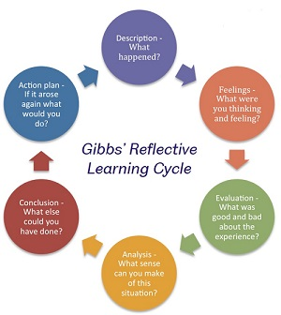
Gibbs’ Reflective Learning Cycle
(Gibbs and Andrew, 2001)

Slide 4

Introduction
To assess my level of understanding of the concept of creativity and innovation and how are those important to provide business advantage to companies, I will conduct a reflection using Gibbs’ Reflective Learning Cycle for each of the lessons.

Slide 5

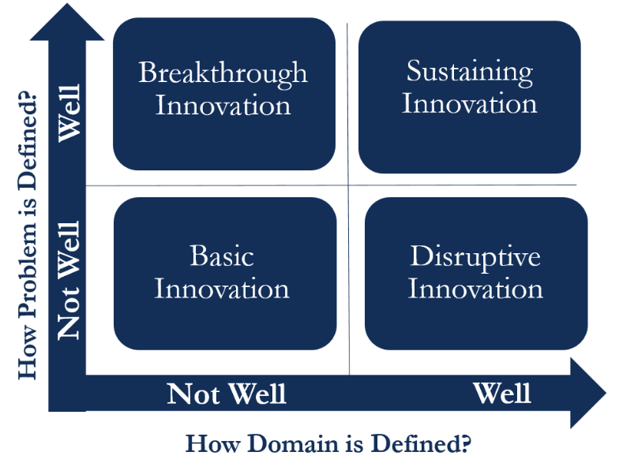
Lecture 1. What is Innovation?
The Innovation Matrix determine what type of innovation companies use and helps them to identify innovative opportunities (Fabbri, Manceau and Moatti, 2016)

Slide 6

Lecture 2. What is Creativity?
Creativity is only the first step in Innovation, which is to come up with the ideas. However, the innovation is the entire process (Çokpekin and Knudsen, 2012).

Slide 7
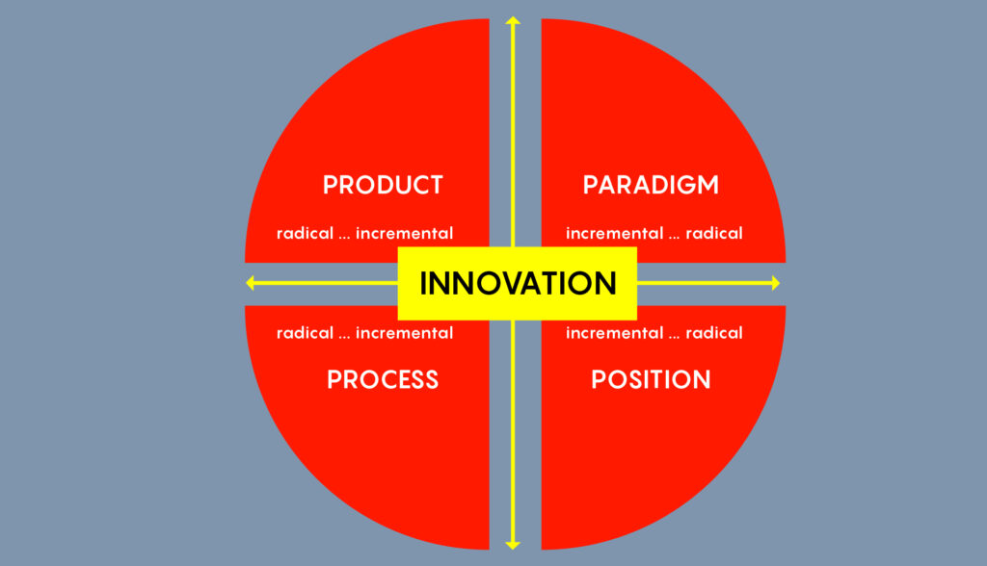
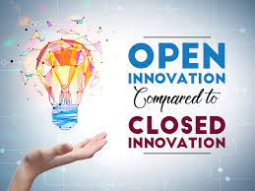
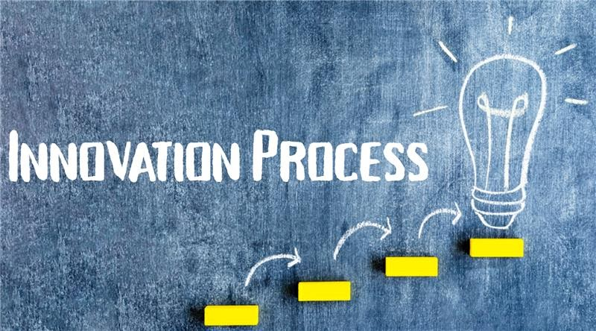
Lecture 3. Models of Innovation
Closed Innovation comes from inside the company (e.g., employees) while Open Innovation comes from external sources (e.g., customers) (Aylen, 2009).
The Innovation Process is a strategy used to be able to successfully implement the innovation (Niemczyk, 2011).
The 4 P’s of Innovation shows that Innovation can take place only in certain areas and still offer competitive advantage (Tidd and Bessant, 2021).

Slide 8

Lecture 4. The Innovative Organisations
Force Field Analysis helps to identify the ‘aids’ and the ‘barriers; of implementing an innovative change (Capatina et al., 2017).

Slide 9

Lecture 5. Where do Ideas Come from?
Six Thinking Hats is a model often used to show six different perspectives of the same idea (Lakshmi, 2017).

Slide 10

Lecture 6. Leadership and Management
Tushman and Nadler (1986) argued that leadership is extremely important for innovation as the leader must always find ways of implementing new innovative ideas.

Slide 11


Slide 12
Reference List
Aylen, J. (2009). Open versus closed innovation: development of the wide strip mill for steel in the United States during the 1920s. R&D Management, 40(1), pp.67–80. doi:10.1111/j.1467-9310.2009.00576.x.
Capatina, A., Bleoju, G., Matos, F. and Vairinhos, V. (2017). Leveraging intellectual capital through Lewin’s Force Field Analysis: The case of software development companies. Journal of Innovation & Knowledge, 2(3), pp.125–133. doi:10.1016/j.jik.2016.07.001.
Çokpekin, Ö. and Knudsen, M.P. (2012). Does Organizing for Creativity Really Lead to Innovation? Creativity and Innovation Management, 21(3), pp.304–314. doi:10.1111/j.1467-8691.2012.00649.x.
Fabbri, J., Manceau, D. and Moatti, V. (2016). Enter The Open Innovation Matrix : how to (fully) open innovation processes ? Gestion 2000, 33(4), p.77. doi:10.3917/g2000.333.0077.
Gibbs, G. and Andrew, C. (2001). Learning by doing: a guide to teaching and learning methods. Geography Discipline Network.
Hickson, H. (2011). Critical reflection: reflecting on learning to be reflective. Reflective Practice, 12(6), pp.829–839. doi:10.1080/14623943.2011.616687.
Lakshmi, B.R. (2017). Book-Six Thinking Hats. Adarsh Journal of Management Research, 10(1), p.80. doi:10.21095/ajmr/2017/v10/i1/115203.
Mládková, L. (2021). INNOVATIVE MANAGEMENT MODELS, EXAMPLES OF THREE COMPANIES. Acta academica karviniensia, 21(1), pp.56–66. doi:10.25142/aak.2021.005.
Niemczyk, J. (2011). A Strategy as an Innovation - A New Strategy Concept. Organization and Management, 2011(5 (148)). doi:10.2478/v10166-011-0007-1.
Teck Foo, C. (2012). Steve Jobs, Ch’an Buddhism and innovation. Chinese Management Studies, 6(1). doi:10.1108/cms.2012.32306aaa.002.
Tidd, J. and Bessant, J.R. (2021). Managing innovation : integrating technological, market and organizational change. 7th ed. Hoboken, Nj: Wiley.
Tushman, M. and Nadler, D. (1986). Organizing for Innovation. California Management Review, 28(3), pp.74–92. doi:10.2307/41165203.

Slide 13


