Slide 1
NHS App
Student Name: Nadia Akther
Student Number: 1914510
Teacher Name: Zakiyyah Ahmed
Moodle Code: (BMHP6026_BIRM)
Moodle Name: Digital Transformation in the Health and Care Professions

Slide 2
Introduction: Evaluating the NHS App (SWOT analysis)
What is the NHS App? (Brief)
  Free mobile app launched by NHS England
  Centralised access to NHS services
Purpose of this presentation
  Critically evaluate the NHS App using SWOT analysis
  Focus on its impact in Service Delivery and Patients/Service Users
SWOT
  Strengths Weaknesses Opportunities Threats
Notes:
The innovation I’ll be evaluating today is the NHS App; this is a free digital app launched by NHS England, which aims to be a central point for a range of health services. This is a major step forwards in the NHS’s long term goal of a “Digital first primary care”.
In this presentation, I’ll use a SWOT analysis (Strengths – pros, Weaknesses – cons, Opportunities – what be improved and Threats – risks and barriers) to evaluate the app and its impact, with specific focus on impact on service deliverability and impact on service users.
Ill start by explaining the app and its core functionality to assess its impact supported by evidence and relevant policy and conclude with a set of recommendations

Slide 3
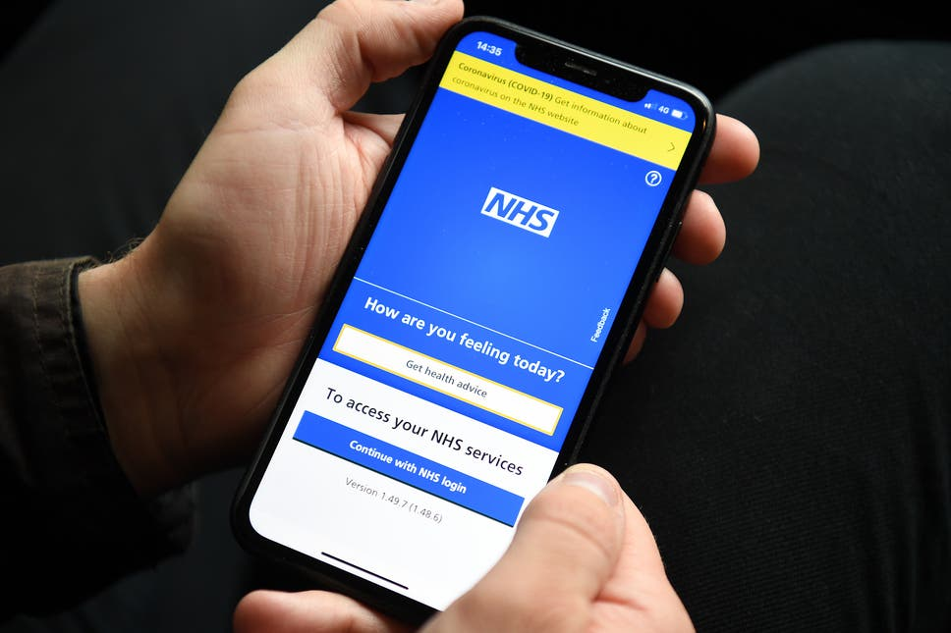
What is the NHS App?
Overview:
  Launched by NHS England (2018)
  Free app for Android & iOS users in the UK
Key Features:
  Book/cancel GP appointments
  Order repeat prescriptions
  Access NHS 111 and symptom checker
  View GP health records
  View test results
  Register organ donation preferences
  Secure access via NHS login
Notes:
The NHS App is a national platform developed by NHS England in 2018 to help patients manage their healthcare through a central app on their phone. Some of its core features include the ability to book or cancel appointments, order repeat prescription, access NHS 111 services and view GP records. (NHS, 2025). Patients can update preferences such as organ donation and health alerts. It also includes dynamic features such as the COVID Pass during the pandemic (NHS Digital, 2025).
The app was developed in line with the NHS long terms plan commitment to a digital first approach. The aim is to reduce pressure on front-desk staff while giving penitents more control over their care. In theory it streamlines the process and reduces resources needed, however its actual implementation has had mixed results
NHS (2025) NHS Long Term Plan.
NHS Digital (2025) NHS App Management Information.
NHS England (2025) Modern General Practice Model.

Slide 4
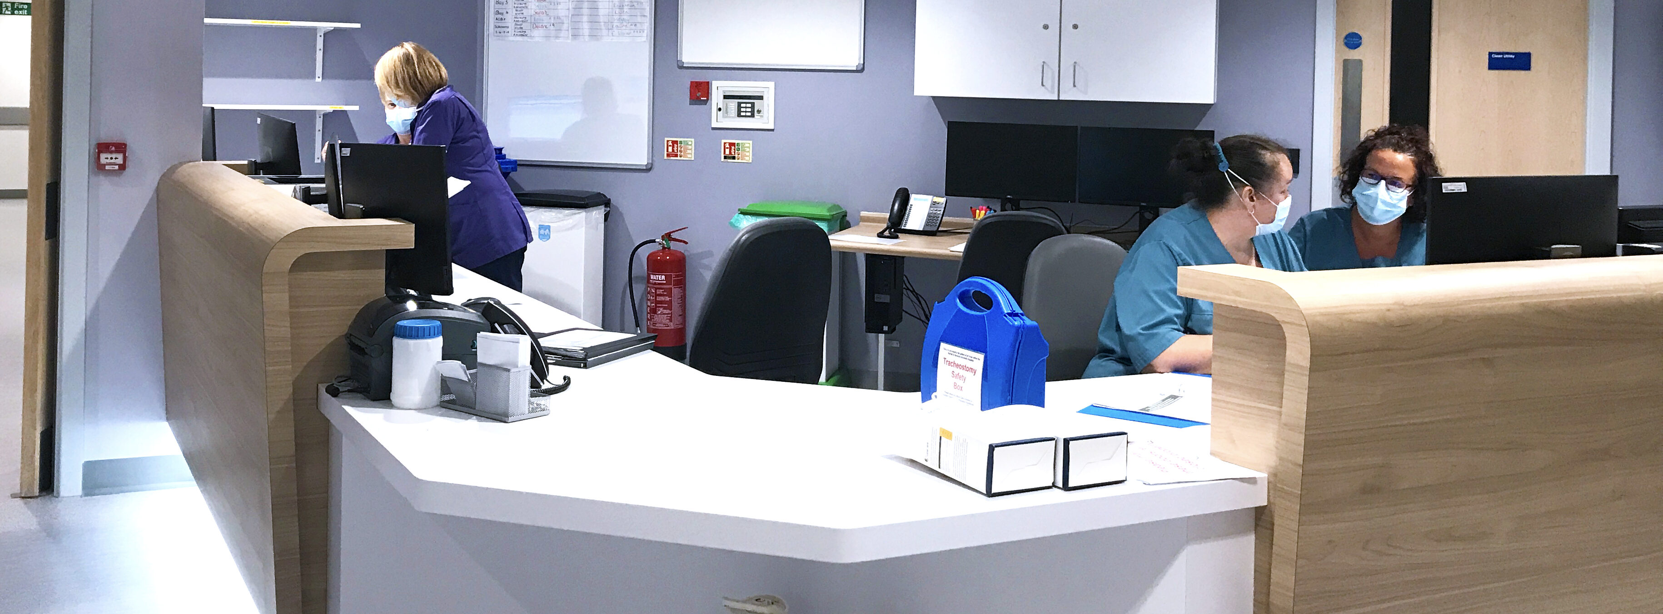
Strengths – Service Delivery
Efficiency & Cost Savings:
    Saved £622 million by reducing 1.5M missed appointments (NHS England, 2024)
    66.1 million repeat prescriptions processed online
    Saves 3 minutes for admin staff and 18 minutes for patients per prescription (NHS England, 2024)
Improved Workflow:
  Reduces pressure on front desks staff
  Supports Modern General Practice Model – “optimising contact channels” (NHS England, 2025)
Centralised Access:
  One app for multiple services (appointments, prescriptions, GP records)
Notes:
The NHS App has been successful since its deployment back in 2018 with key strengths in efficiency and cost saving potential as statistics from NHS England and the NHS App case study suggested
According to NHS England 622 Million pounds was saved by preventing 1.5M million appointments, this means 5.7 million staff hours was saved from time used for admin tasks such as rescheduling and wasted clinic time.
While its prescription service processed over 66 million orders between 2018 to 2023. This saved on average 3 mins for admin staff, and 18 mins for patients waiting in long queues.
This supports the NHS’s Modern General Practice Model of optimising content channels as shown by the significant time savings for staff and patients by its centralised design

Slide 5

Strengths – Patient/User Benefits
Patient Autonomy & Engagement:
  Access to test results, GP notes, and recorded health info
  Supports self-management and preparation for appointments (Reidy et al., 2025)
Convenience & Flexibility:
  Available 24/7 – no need to call or visit in person
  Helps those with work/life constraints, avoiding 8am call rush (Patient Coalition, 2024)
User Satisfaction:
  81% found it easy to use
  70% said it provided meaningful impact in their care (Patient Coalition, 2024)
Self-service tools:
  Organ donation registration, NHS 111 access
  Enhanced patient-centred care (Kuppanda & Jenkins, 2023)
Notes:
Now, from a patient's standpoint the NHS App has various strengths as it improves autonomy and enhances engagement, especially with long term conditions. Patients can view test results, GP notes and their medical history, this can help prepare patients for appointments, so are able to better explain their concerns as highlighted by Reidy et al. (2025).
The app makes care convenient and flexible which the traditional services lack. For example, patients don’t need to call in during work hours, avoiding the notorious 8 am queues, and allows for treatment to work around the patient's schedule – a point raised by Patient Coalition in 2024.
Overall, 81% found the app was easy to use and 70% felt the app had meaningful impact to their care (Patient Coalition, 2024). With this the NHS app was able to provide an Enhanced patient-centred care.

Slide 6

Weaknesses – System & Delivery Issues
Postcode Lottery:
  App features vary by local GP practice – not all services are enabled
  39% couldn't access test results; 36% lacked record access (Digital Coalition, 2025)
Outdated Infrastructure:
  Built on fragmented systems; adds complexity rather than solving it (Tony Blair Institute, 2025)
Shifts, Not Reductions in Workload:
  Staff must redact records, manage confused patients, and handle increased queries
  New tasks create admin/clinical burden (BJGP, 2023)
Inconsistent Implementation:
  Lack of staff training and clear protocols
  Creates confusion therefore an inconsistent implementation (BJGP, 2023)
Notes:
Despite its strengths, the NHS App has a lot of system-level weaknesses that holds the app’s potential back
The main issue is the postcode lottery, while the app’s interface is standardised, the functionality heavily depends on what local GP practices enable. A survey from the Digital Coalition found that 39% of users coundnt access test results, while 36% unable to see medical records. This is not a limitation of the app advertised but due to the local clinic not enabling it.
This is partially due to the app running on top of existing infrastructure that is outdated, fragmented and inefficient as noted by the Tony Blair Institute. This means the app in some cases is adding more complexity and work.
In practice the NHS app is only automating existing inefficiencies rather than improving the system, a sort of productivity paradox. With workloads being shifted to new tasks such as having to explain to patients misconceptions that come from the increased access to records.
Finally, the biggest issue is the lack of standardisation training between clinics, leading to unclear protocols leading to confusion and inconstant implementation as noted by the BJGP.

Slide 7

Weaknesses – Patient/User Challenges
Digital Divide:
  4.3 million fewer downloads in deprived areas (Zhang et al., 2023)
  Reinforces health inequality – “digital-first” may exclude the most vulnerable
Digital Precarity in Minoritised Groups:
  South Asian, Black, and elderly patients face:
    Poor internet access
    Low digital literacy
    Device-sharing or language barriers (Islam et al., 2024; Ramasawmy et al., 2024)
Dependency on Others:
  Older users often rely on younger relatives → privacy risks (Ramasawmy et al., 2024)
App Accessibility Issues:
  Poor design for users with visual or motor impairments
  Small text, non-intuitive touch navigation (Ramasawmy, 2024)
Notes:
From the patient standpoint the app's benefits are not equally distributed. the most major issue being a digital divide. In a study by Zhang in 2023, They found out that in deprived areas there were about 4.3 million fewer downloads highlighting the concern that digital first may increase inequalities in healthcare
This problem is further compounded as minoritized and elderly groups often find the app confusing and hard to use.
Finally as mentioned by Ramasawmy due to the app being digital a stable Internet connection is required with access to a suitable device and decent digital literacy which can be a barrier for some groups.
Another concern is older patients, particularly South Asians, there was a heavy reliance on younger, more literate relatives, helping them use the app which introduces privacy concerns as the NHS app uses sensitive medical data.
Lastly the app has access ability design flows such as small fonts and poor touch navigation which can make using the app difficult for patients with visual or physical imparity‘s making it difficult to use independently.

Slide 8
Opportunities – Future Development & Inclusion
Digital Inclusion Initiatives:
  Target elderly, minoritised, and low-income groups
  Training & onboarding support to close the adoption gap (Islam et al., 2024)
Enhanced Accessibility Features:
  Add in-app controls (text size, contrast, voice navigation)
  Custom screen reader support – not reliant on device defaults (NHS, 2024)
Standardised Rollout Across Practices:
  Ensure equal feature availability nationwide
  End the postcode lottery (BJGP, 2023; NHS England, 2025)
Service Expansion & AI Integration:
  Potential to include digital triage, localised public health tools, reminders
Notes:
Despite the weaknesses, they are actionable
First, as Islam et al. (2024) suggested targeted digital inclusion programmes could help elderly and marginalised patients learn to use the app independently.
Second, enhancing accessibility features to make the app easier to use. The NHS app accessibility statement acknowledges existing limitations. Improvements that could be implemented is a custom screen reader as the current system often works poorly such as reading invisible elements of the page. Another feature could be font adjustments in the app instead of solely relying on the device’s software settings.
Most importantly, a standardised national rollout would address the postcode lottery issue and the complaint of there being a lack of standardised digital procedures making it less confusing for staff, which was a significant complaint noted by the BJGP.

Slide 9

Threats – Risks & External Barriers
Widening Digital Divide:
  Risk of excluding vulnerable groups as more services go digital
  Reinforces health inequality (Zhang et al., 2023)
Trust & Misinformation:
  COVID Pass rollout triggered surveillance fears among minoritised groups (Ramasawmy et al., 2024)
  Some fear tracking or misuse of data
Legal & Ethical Risks:
  Must comply with GDPR and Equality Act 2010
  Accessibility shortcomings risk non-compliance (Legislation.gov.uk, 2010; 2018)
NHS Brand at Risk:
  Public trust is tied to NHS branding – any misstep could damage credibility (Best, 2024)
Notes:
The final area for this analysis is the threats, given the reliance on the app and the fact the app contains sensitive patient data there are risk
First there is a concern that the move to digital will deepen the digital divide. Zhang et al. (2023) warned that deprived populations are less likely to use the app creating systemic inequalities in access to care.
Second, trust and misinformation is a concern as when the COVID Pass was added, some groups were concerned about tracking or surveillance enforcing the importance on trust and transparency (Ramasawmy et al., 2024).
Third, there are legal requirements to comply with the equality act, as highlighted earlier the current accessibility functions are not ideal and then there is a concern about patient's medical data being easily accessible, so the app needs to have robust ways to keep patient data secure (Legislation.gov.uk, 2010; 2018).
Finally, a big risk is the NHS brand as any failure in security and access to service can severely damage public trust as noted by Best (2024), this can make people more resistant to using the service.

Slide 10
Conclusion – Summary of NHS App
Strengths:
  Improves access, efficiency, and patient autonomy
  Reduces admin burden and missed appointments
Weaknesses:
  Unequal rollout; increased staff workload
  Accessibility and digital literacy issues
Opportunities:
  Inclusion initiatives, better accessibility, standardisation
  Potential for AI tools, expanded services
Threats:
  Digital divide, loss of trust, legal non-compliance
  Risk to NHS reputation if issues persist
Final Reflection:
  NHS App offers clear benefits but success depends on equitable, inclusive delivery

Slide 11
Recommendations – Improving the NHS App
1. Standardise Feature Access
  Require all GP practices to enable core functions (records, results)
  Address postcode lottery (BJGP, 2023; NHS England, 2025)
2. Staff Training & Protocols
  Equip staff to manage digital queries and patient data access
  Reduce workload redistribution (BJGP, 2023)
3. Targeted Digital Inclusion
  Offer tailored support for elderly, low-income, and ethnic minority users
  Reduce dependency on relatives (Islam et al., 2024)
4. Improve Accessibility
  Add customisable UI features: font size, voice controls, contrast modes
  Develop a built-in screen reader layer (NHS, 2024)
5. Maintain Transparency
  Clear communication on data use and privacy policies
  Build long-term public trust (Best, 2024; Ramasawmy et al., 2024)

Slide 12
Reference list p1
Best, J. (2019) ‘The NHS App: opening the NHS's new digital "front door" to the private sector.’, BMJ (Clinical Research ed.), 367, p. l6210. Available at: https://doi.org/10.1136/bmj.l6210.
Davidge, G., Brown, L., Lyons, M., Blease, C., French, D., van Staa, T. and McMillan, B. (2023) ‘Primary care staff's views and experience of patients' online access to their electronic health record: a qualitative exploration.’, The British Journal of General Practice: The Journal of the Royal College of General Practitioners, 73(731), pp. e418-e426. Available at: https://doi.org/10.3399/BJGP.2022.0436.
Department of Health and Social Care (2025) 10 Year Health Plan for England: fit for the future. Available at: https://www.gov.uk/government/publications/10-year-health-plan-for-england-fit-for-the-future (Accessed: 23 October 2025).
GOV.UK (no date) Data protection: The UK's data protection legislation. Available at: https://www.gov.uk/data-protection (Accessed: 23 October 2025).
Islam, F., Bailey, S. and Netto, G. (2024) ‘Digitalised primary care in the UK: a qualitative study of the experiences of minoritised ethnic communities.’, The British Journal of General Practice: The Journal of the Royal College of General Practitioners, 74(749), pp. e823-e831. Available at: https://doi.org/10.3399/BJGP.2024.0308.
Khan, N., Pitchforth, E., Winder, R., Abel, G., Clark, C.E., Cockcroft, E. and Campbell, J. (2024) ‘What helps patients access web-based services in primary care? Free-text analysis of patient responses to the Di-Facto questionnaire.’, BMC Primary Care, 25(1), p. 20. Available at: https://doi.org/10.1186/s12875-023-02257-5.
Kuppanda, P.M. and Jenkins, J. (2023) ‘Evaluation of Experiences and Attitudes of Patients Towards Patient Portal-Enabled Access to Their Health Information or Medical Records: A Qualitative Grounded Theory Study.’, Qualitative Health Research, 33(12), pp. 1080-1090. Available at: https://doi.org/10.1177/10497323231192379.
Legislation.gov.uk (2010) Equality Act 2010. Available at: https://www.legislation.gov.uk/ukpga/2010/15/contents (Accessed: 23 October 2025).
Legislation.gov.uk (2018a) Data Protection Act 2018. Available at: https://www.legislation.gov.uk/ukpga/2018/12/contents (Accessed: 23 October 2025).
Legislation.gov.uk (2018b) The Public Sector Bodies (Websites and Mobile Applications) (No. 2) Accessibility Regulations 2018. Available at: https://www.legislation.gov.uk/uksi/2018/952/contents/made (Accessed: 23 October 2025).

Slide 13
Reference list p2
NHS (2024) NHS App accessibility statement. Available at: https://www.nhs.uk/nhs-app/nhs-app-legal-and-cookies/nhs-app-accessibility-statement/ (Accessed: 23 October 2025).
NHS Digital (2025) NHS App case studies. Available at: https://digital.nhs.uk/services/nhs-app/case-studies (Accessed: 23 October 2025).
NHS Digital (2025) NHS App Management Information. Available at: https://digital.nhs.uk/data-and-information/publications/statistical/nhs-app-statistics (Accessed: 23 October 2025).
NHS England (2025) Modern general practice model. Available at: https://www.england.nhs.uk/gp/national-general-practice-improvement-programme/modern-general-practice-model/ (Accessed: 23 October 2025).
Patients Association (2023) Patients value NHS App – but not all users able to access information they want, finds new report from the Digital Coalition. Available at: https://www.patients-association.org.uk/news/patients-value-nhs-app-but-not-all-users-able-to-access-information-they-want-finds-new-report-from-the-digital-coalition (Accessed: 23 October 2025).
Ramasawmy, M., Sunkersing, D., Persson, D.R., Poole, L., Patel, K., Modha, S., Sajid, M., Gill, P., Stevenson, F., Khan, N. and Banerjee, A. (2024) ‘“If it all goes digital, we’ll have to learn”: facilitators and barriers to uptake of digital health in British South Asians with cardiometabolic disease’, BMC Digital Health, 2(1), p. 32. Available at: https://doi.org/10.1186/s44247-024-00083-y.
Reidy, C., Papoutsi, C., Kc, S., Gudgin, B., Laverty, A.A., Greaves, F. and Powell, J. (2025) ‘Qualitative evaluation of the implementation and national roll-out of the NHS App in England.’, BMC Medicine, 23(1), p. 20. Available at: https://doi.org/10.1186/s12916-024-03842-w.
Tony Blair Institute (2025) The NHS at a Crossroads: The App That Can Transform Britain's Health. Available at: https://institute.global/insights/public-services/the-nhs-at-a-crossroads-the-app-that-can-transform-britains-health (Accessed: 23 October 2025).
Zhang, J., Gallifant, J., Pierce, R.L., Fordham, A., Teo, J., Celi, L. and Ashrafian, H. (2023) ‘Quantifying digital health inequality across a national healthcare system.’, BMJ Health & Care Informatics, 30(1), p. e100809. Available at: https://doi.org/10.1136/bmjhci-2023-100809.

Slide 14
Reference list (Images)
https://eccweb.s3.ap-south-1.amazonaws.com/wp-content/uploads/2023/01/26103852/What-is-Digital-Security-Overview-Types-and-Applications-Explained.png
https://www.gannett-cdn.com/presto/2021/12/12/PBRE/570137dc-7522-40e8-91e3-bb1cee583734-GettyImages-1028961982.jpg?crop=2120,1193,x0,y107&width=2560
https://media.istockphoto.com/id/1330046034/photo/angry-female-doctor-have-problems-working-on-computer.jpg?s=612x612&w=0&k=20&c=Jx0jK4zm-emVf1T1Q7AbIgi61nNtqqgNv9MwuOSi8xA=
https://www.nnuh.nhs.uk/wp-content/uploads/2020/09/Reception-desk-e1600767462193.jpg
https://media.istockphoto.com/id/1450420291/photo/a-young-happy-woman-holding-a-smart-phone-and-a-pill-bottle.jpg?s=612x612&w=0&k=20&c=zAb7RhMN1ZZPFHNrxNT2nbXkkv93G697TcqJrUYzwJo=
https://www.humberprimarycare.nhs.uk/wp-content/uploads/2021/11/nhsapp-768x512.jpg

