Slide 1
Cyflwyniad Modiwl Traethawd Hir
Dissertation Module Introduction

Slide 2

Deilliannau dysgu - Learning outcomes
Provide an overview of the dissertation module
Explain the requirements of a ‘Dissertation proposal’

Slide 3
Cyflwyniad i'r modiwl - Module Introduction
What is a dissertation?
‘A long essay on a particular subject, especially written for a university degree’
‘A large research project undertaken at the end of a degree – involving in-depth consideration of a problem or question chosen by the student’
Notes:
How would you define or describe what a ‘dissertation’ is?
Your dissertation or project is probably the single most important written assignment that you will undertake or produce during your course.
It is often seen as a key indicator of a student’s capabilities as a student/researcher.
It differs to your other assignments in relation to the following:
Its word count – significant word count
Its structure – specific structure/format is required
And the fact that it is an independent piece of work of which the student has control – i.e. chooses the subject/topic, its direction and how it is undertaken

Slide 4

Degree Programme – dissertation/project
Aim – to enable students to undertake a major project of their choice, that includes research and enquiry into investigative practice, demonstrating conceptual and critical thinking, analysis, synthesis and evaluation of assumptions, abstract concepts and data through research design with a view to communicate their conclusions clearly to specialist and non-specialist audiences.
Notes:
The aim of your dissertation module is:
Aim – to enable students to undertake a major project of their choice, that includes research and enquiry into investigative practice, demonstrating conceptual and critical thinking, analysis, synthesis and evaluation of assumptions, abstract concepts and data (which may be incomplete) through research design with a view to communicate their conclusions clearly to specialist and non-specialist audiences.
Most university students will be required to undertake a project of their choice in their final year of studying.
This one piece of work is worth 40 credits – so it is a substantial piece of work

Slide 5
Advantages of undertaking a project/dissertation
Opportunity for you to identify and learn more about a particular topic that interest you
Personal development within a specialisation - current/future
Personal Ownership
Allocated supervisor
Notes:
There are a number of advantages of undertaking a project/dissertation – although it may not feel like it now!
e.g.
Great opportunity for you to identify and learn more about a particular topic that interest you
May help you develop in your role within a specialisation that you are currently employed within or in which you aspire to be in the future
Ownership – you take ownership – its independent study that you chose and you drive it - BUT you will be supported
Allocated supervisor with whom you will work on a one to one basis

Slide 6
The Assignment Brief
Write a 10,000 word project
Based on a topic of your choice – relevant to your degree programme
3 distinct parts:
  Project proposal (15%) – 1500 words
  Ethics (5%) – 500 words
  The project (80%) – 8000 words
Notes:
This is your assignment brief - I will circulate in a booklet format for you with specific guidance regarding content, structure, submission dates etc.
To produce a 10,000 word project on a topic of your choice which is related to your degree programme.
Your 10000 word project is divided into 3 distinct parts:
Project/dissertation proposal – 1500 words
Ethics form - 500 words
The project document – 100% marks – 8000 words

Slide 7
Submission - dates
Dissertation proposal
  23:59hrs 29th February 2024
Ethics form
  23:59hrs 29th February 2024
Dissertation
  23:59hrs 4th November 2024

Slide 8
Dissertation Support
Allocated a named supervisor
Time-tabled support
  6hrs as a group
  4hrs on an individual basis
Formative feedback opportunities
Notes:
One to one sessions can be either 30 mins or 1 hour – but cannot exceed 4hrs
Time-tabled March to November
It’s important that you attend these sessions and come fully prepared.
They will be diarised and agreed between you and me, it may not be possible to rearrange.
I will provide further information in relation to what the supervision sessions are and student responsibilities. The student will lead these sessions therefore it is important that they come prepared with any questions, queries or concerns to be discussed.
Draft submissions are encouraged – however each section can only be submitted once – advise will be provided in relation to any adjustments that should be made and that it is up to the student as to whether they take onboard that advice. Once returned with feedback it will not be subject to further feedback until it is finally submitted and graded/marked.

Slide 9
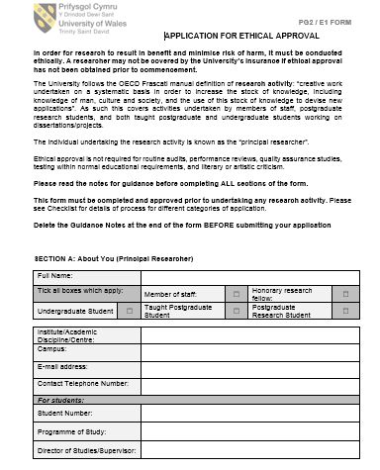
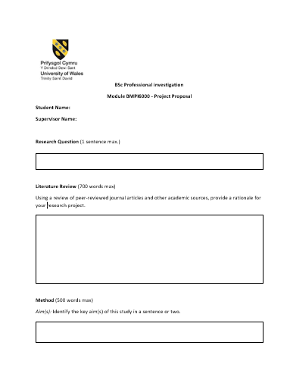
Presentation of work
Dissertation Proposal
Ethics form
Notes:
UWTSD template will be provided in relation to the Ethics form and I have put together a proposal template to assist you with structuring your proposal document
You are required to complete these and submit via Turnitin
DO NOT create your own templates
I will circulate the forms by email and they will be available on Moodle this week – have a look at them and get familiar with the contents.

Slide 10

Dissertation
Front sheet
Declarations
Acknowledgements
Contents
Abstract
Introduction
Literature review
Research methodology
Analysis of results
Conclusion and recommendations
Bibliography
Appendicies
Notes:
The university requires the submission of the dissertation to follow an agreed structure:
The following sections will appear in the final dissertation/project document submitted
( doesn’t include your proposal or ethics form) – keep to the accepted structure!
Front sheet
Declarations
Acknowledgements
Contents
Abstract
Introduction
Literature review
Research methodology
Analysis of results
Conclusion and recommendations
Bibliography
Appendicies

Slide 11
“Where do I start?”
Topic area – relevant to your course
Personal interest
Too wide – explore different aspects – narrow it down
Consider topical issues – in the media/in Force
Devise a question relevant to the topic area you want to research
Question may change BUT don’t change the topic area.
Notes:
Topic area – relevant to your course- Professional investigation
Personal interest – something you enjoy researching/discussing /reading about - it will keep you motivated
Too wide – explore different aspects – narrow it down – supervisor may assist you
If you are having difficulty choosing an area consider:
Current/topical issues – in the media/in Force
Once you have confirmed your area/topic you need to
Devise a question relevant to the topic area you want to research
Question may change BUT don’t change the topic area.

Slide 12
Project/Dissertation proposal
Identify issue/problem worthy of researching
To encourage you to read and understand the published literature, particularly peer-reviewed journal articles
Plan your project and consider potential difficulties
Opportunity to obtain formal feedback on your project so you can amend any issues before you complete your dissertation.

Slide 13
Project/Dissertation Proposal
WHAT?
What are you doing? (what is your focus)
WHY?
Why are you doing it? (why is this area important?)
HOW?
How are you going to do it?
  1500 words
  Template provided
  Submission by:
  23:59hrs 29 February 2024

Slide 14
Research Question
Should set proposal up for reader
Should also:
  narrow focus
  keep you on track
  give you a way of evaluating your answer
Think about (and discuss with supervisor):
  Step 1 – what interests you?
  Step 2 – explore the issue / read around for ideas
  Step 3 – focus your topic
  Step 4 – formulate a question
  Step 5 – refine question

Slide 15
Refining the Research Question
1. Debateable
Not an easy yes/no answer
Need to be able to explore the question and requires you to explain or defend answer using data.
2. Plausible
Can it be answered?
3. Consequential
Impact?
Notes:
Words that External Examiners like
Critical/critically
Analysis/Analyse
Evaluation/Evaluate
Synthesis/synthesise - A synthesis is a written discussion incorporating support from several sources of differing views. This type of assignment requires that you examine a variety of sources and identify their relationship to your dissertation

Slide 16
Project Aims & objectives
Over arching aim – be succinct
Objectives – the steps you are going to take to answer your research aim or question
A specific list of tasks needed to be done to accomplish the goals of the project
Must be clear & achievable
Usually numbered so that each reads as an ‘individual’ statement to convey intentions
The objectives, research question, literature review MUST be aligned
Notes:
Objectives should not be
Too vague or broad in scope – aims are often over-optimistic of what the project can achieve
Repeat each other in different terms
Be a list o fthings related to an unspecified way to your topic

Slide 17
Literature Review
Use chosen research question as basis for literature scope
You should review the related literature and provide a rationale for your own study - give your proposal purpose
Concise
  This will not necessarily include every study reported in a particular area but should be a selective account of major studies.
  It is NOT a history lesson for your reader

Slide 18
Methodology
The method section should describe the process of how you plan to conduct your research and follow a similar structure to the method section of your dissertation (just shorter).
  Justify your selection of research techniques and sampling
  Use previous research on same topic: what methods did they employ?
  Be realistic and appropriate
It should comprise a number of subsections, which are described below:
  Aim(s): Identify the key aim(s) of this study in a sentence or two.
  Objective(s): Bullet points of what you need to achieve to succeed in your aims
  Design: Quantitative or qualitative? Survey or secondary data approach?
  Sample: Who/what, how many, where from, sampling method.
  Ethics: Briefly cover any ethical issues that you need to consider.
  Analysis: What will you do with the data when you have collected it and why?
Notes:
This section is very important as it provides an overview of how you are going to carryout your research or how you plan to address your research question
It will provide a plan of your work and describe the activities you feel are necessary to complete your project
It should contain sufficient information fo the marker to determine whether the methodology is sound and appropriate
In this section you should make a case to show that your approach is the most appropriate and valid way of addressing the research question.
NO RESULTS are given at the proposal stage as you haven’t started on it yet – however you need to give some idea about what kind of data you will be collecting and what statistical procedures will be used in order to answer the question
Ethical issues and risks – you may mention the limitations and weaknesses of the research which may justify some issues that will occur ( e.g. COVID)
Every student will be required to submit an ethics form – so its relevant to highlight any issues you may have at this early stage and which can be addressed when you submit your ethics form

Slide 19
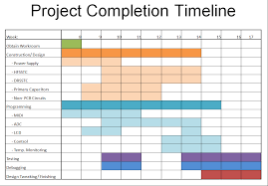
Proposed Timeline
Include a proposed timeline, using either a table format or a ghant chart, which clearly shows plan of action for completion of your dissertation with specified dates and tasks. For instance,

Slide 20

Outcomes
Who would be interested in your dissertation and its findings?
Is there potential for future research on the subject?
Does it provide new avenues of research? Support current strategies/decision-making?
Demonstrate your awareness of its contribution to that area of research
‘So what?’

Slide 21

Referencing
Use the Harvard referencing style
Start your reference list early on – from day 1 (excel spreadsheet/word document etc.)

Slide 22

Unrhyw bryderon - Any concerns?
What are your initial concerns?

Slide 23
Deilliannau dysgu - Learning outcomes
Provide an overview of the dissertation module
Explain the requirements of a ‘Dissertation proposal’

Slide 24


