Slide 1
Coaching and Mentoring
- Relationships

Slide 2
Role of the coach
“To facilitate the performance, learning and development of another”
Myles Downey

Slide 3
Relationships
Coaching where the coach is the line manager
Internal v external coaching and mentoring relationships
Mentoring evolving from coaching
Classic mentoring relationships

Slide 4
The four pillars of effective relationships
Trust
Honesty
Openness
Transparency

Slide 5
Coaching and Mentoring
- key Issues arising

Slide 6
Key issues
Managing expectations and conflicting objectives (individual and organisational)
Learning styles and coaching styles/approaches
Equality and diversity
Attitudes and values
Behaviour
Ethics

Slide 7
Positive attitudes
Pro-active – plans ahead
Practical – focuses on the achievable
Solution focused – looks for options
Self-starting – strong motivation
Responsible – sees the job through to the end
Takes initiative – makes decisions

Slide 8
Practice Pointers
Coaching which focuses on performance seems to be productive and grounded in business reality.
Focusing on both poor and good performance is a good way to ensure that coaching is not seen as a remedial intervention or a talent path for the gifted, but as a key intervention.
Integrating coaching with change management, performance and learning will ensure that coaching is delivering strategically as well.
CIPD Survey report “The Coaching Climate” Sept 2011

Slide 9
Ethics
– the study of morality i.e. practices and activities that are considered to be importantly right and wrong, together with the rules that govern those activities and the values to which those activities relate

Slide 10
Diversity
Diversity consists of visible and non-visible differences, which include sex, age, background, race, disability, personality and workstyle. Harnessing these differences will create a productive environment in which everybody feels valued, where their talents are being fully utilised, and in which organisational goals are met.

Slide 11
Coaching models and underpinning theories

Slide 12
Theories and approaches
Positive Psychology Approach - a consistent shifting of attention away from problems and weaknesses to opportunities and strengths. Uses a language of strength and vision in addition to the language of issues and concerns. Coaches focus their attention on energizing and pulling people forward.
Cognitive Behavioural Coaching - ‘Does not give people the answers to their difficulties but rather though collaborative processes- guided discovery- assists individuals to devise their own conclusions and solutions”
    Meggison and Cutterbuck, (2009:15)

Slide 13
Theoretical approaches (cont.)
Psychodynamic Coaching - makes the unconscious conscious, to increase self awareness to understand the subtle ways in which coachees can limit themselves. It helps the learner to approach new challenges with awareness and freedom.
Solution-focused Coaching - Assist client to define a desired future state and to construct a pathway in thinking and action that assists the client in achieving that state (not interested in pathology of problem). The coach helps by reframing the view and scaling the goal through appropriate questions.

Slide 14
Some other theories
Ontological
Gestalt
Transactional analysis
Narrative coaching
Etc. etc…

Slide 15
Coaching goals and processes
Coaching relates primarily to the performance improvement (often over the short term) in a specific skills area.
The goal, or at least the intermediate or sub goals, are typically set with or at the suggestion of the coach.
While the learner has primary ownership of the goal, the coach has primary ownership of the process.
Clutterbuck D. (2004: 4)

Slide 16
Why models?
Using tried and tested frameworks and models is one way of ensuring quality…
Connor and Pokora (2012:138)
Prevents the coaching conversations from deteriorating into an aimless chat

Slide 17
Popular Models
GROW
STRIDE
OSCAR
CLEAR
OSKAR

Slide 18

GOAL
REALITY
OPTIONS
WILL/WAY FORWARD
(Model by John Whitmore based on Graham Alexander)

Slide 19

STRIDE MODEL
STRENGTH
TARGET
REALITY
IDEAS/COMMIT
EVALUATE

Slide 20
OSCAR
OUTCOME (your destination)
SITUATION (your starting point)
CHOICES AND CONSEQUENCES (your route options)
ACTIONS (your detailed plan)
REVIEW (making sure you are on track)
Worth consulting

Slide 21
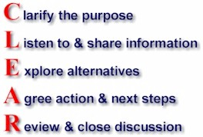
CLEAR

Slide 22
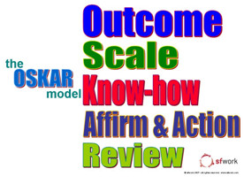
OSKAR

Slide 23
Possible disadvantages of models
Focus on skill and process rather than tuning into the client
Might affect relationship
Client might not fit or like model chosen
Your style as a coach might be inhibited by the model
Coach may overlook valuable hunch in pursuance of model
Adapted from Connor and Pokora (2012)

Slide 24
Coaching opportunities
delegation
addressing underperformance
project work
deputising
problem solving
changes to operating processes, procedures or systems
change of responsibilities
application of learning before and after attending a training course

Slide 25
The role of the workplace mentor is:
to provide a wider perspective
to offer friendship
to give an objective, impartial opinion
to provide support and encouragement
to build confidence
to act as a sounding board for ideas
to act as a role model
to assist with networking/making contacts/introductions

Slide 26
Opportunities for Mentoring
Context | Purpose
Induction | Helps people get up to speed
Support for development | Ensures effective learning
Career progression | Assist in identifying and supporting potential talent
On the job learning | To enhance job related knowledge and skills for the present
Equal opportunity programmes | To ensure proper integration and fairness of treatment
Redundancy and outplacement | To assist individual in managing the difficult transition
New projects | Help rapid assimilation and delivery
New job transition | Helps employee adjust
Within change programmes | To help people adjust to change

Slide 27
Alred’s Model
Exploration
New understanding
Action planning
Alred et al

Slide 28
Clutterbuck’s Developmental Mentoring Model
Coaching
Guiding
Networking
Counselling

Slide 29
The Generic mentoring process
Analysis for awareness of need, desire and self
Planning for
self responsibility
Implementing using styles techniques and skills
Evaluating success
Parsloe and Leedham 2009

Slide 30
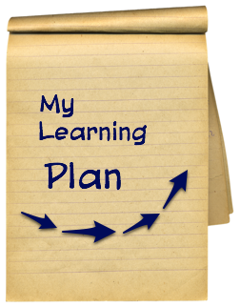



Corporate and qualification mentoring
Confirm the personal development plan
Encourage the self management of learning
Provide support during the PLP
Assist the evaluation for success and learning
Parsloe and Leedham 2009

