Slide 1
Structured Organisations
Dr J Rees

Slide 2
Structured Organisation – Essential Features
Organisation in a complex environment:-
  Forms a map via which the business can plan, direct and control
  Identifies Key activities for control & resource
  Provides definition, order objectivity
  Helps define role, duty, relationship
  Helps identify (and eliminate) duplication of effort & activity

Slide 3
  Provides viable means for allocation & control of costs, budget manpower
  Permits objective measurement against task, profit, quality
  Facilitates communication (data & instructions)
  Provides identity /group
  Speeds up response of business to extend stimuli
  Is a tuneable, refinable asset of the business

Slide 4
Common Organisational Patterns
Centralised
  Authority concentrated in one central position - makes all major decisions.
  Delegation via formal procedures and authority levels
Decentralised
  Decision making is dispersed into small units
Functional
  Resources & authority structured on the basis of recognised industrial and professional skills
  Head of function responsible for control of resources, standards, liaison and communications

Slide 5
Common Patterns cont.
Product
  Line management controls staff of many disciplines associated with a process or product
Matrix
  Both line authority and functional authority. Project oriented structure.

Slide 6
Basics – Product Structure
Head of Division
Deputy
Head of Beans
Head of Soups
Head of Insurance Services
Etc.
Products
Services

Slide 7
Product Structure
Benefits
  Clear authority
  Clear focus
  Clarity of purpose and responsibility
Issues
  Hierarchic – tendency to managerialism
  Risk of siloes developing
  Weakened professional relationships

Slide 8
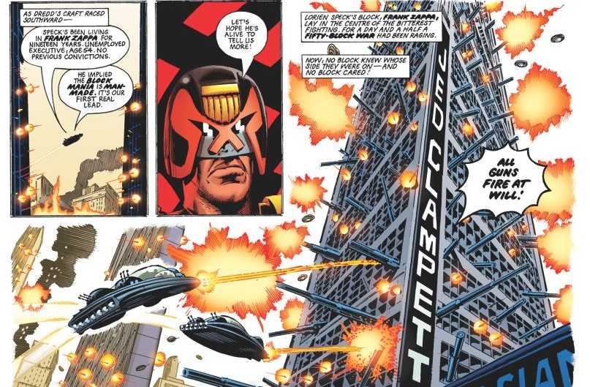
Silo Loyalty Can Lead to Conflict …

Slide 9

Basics – Functional Structure
Head of IT
Chief Engineer
Head of Finance
Systems Manager
Head of Programming
QA Manager
Team Leaders, etc.

Slide 10
Functional Structure
Benefits
  Strong professional relationships
  Clarity of functional responsibility
  Authority often combined with professional capability
Issues
  Lack of ownership of product/service
  Risk of clan behaviours
  More diffuse responsibility and purpose

Slide 11
Basics – Matrix Structure
Dual reporting relationship
e.g. Technical specialism
embedded in departmental
operations
Product line management
Functional line management
Faculty Accountant

Slide 12
Matrix Structure
Benefits
  Communication
  Clarity on both functional and product responsibility and ownership
  Clear strengths where role is complex
Issues
  Authority confusion
  Role conflict
  “Always somewhere to hide”

Slide 13
Uses
Many organisations have elements of product and functional structures
  Technical specialities overlaying product/service delivery (e.g. finance, estates, HR)
  Product focused teams in functional structures (e.g. DB2 database support team, the field applications support team for CISCO data centres)
Key is … WHATEVER WORKS BEST!

Slide 14
Span of Control
Max efficient no. of subordinates for one manager is 8-10
  Refer to Roman Cohorts
Too many, can’t retain sufficient knowledge of your people
  Why senior managers really don’t control the work
  We control, instead, the agenda and the resources

Slide 15
Key Organisational Principles
GROUPING OF ACTIVITIES
AUTHORITY & RESPONSIBILITY
WORKING RELATIONSHIPS

Slide 16
Determinants of Structure
Size of organisation
Sector and area of operations
  Type of product or service
Type of clients, requirements of clients
Mentality of governance tier
History
  Prior successes and problems, risk appetite, desire for change

Slide 17
Issues with Layered Organisation
Authority ≠ technical superiority
Prioritisation and delegation
Responsibility, accountability and authority
Upward and downward management
The “soap bubble” effect
Inertia
Hilaire Belloc
Notes:
And always keep a-hold of Nurse; For fear of finding something worse (Hilaire Belloc, quoted from “Jim”)

