Slide 1

SOLIDS & LIQUIDS
Lecture 9
ACDB4011
Y2
Dr Ewa Kazimierska
e.kazimierska@uwtsd.ac.uk

Slide 2
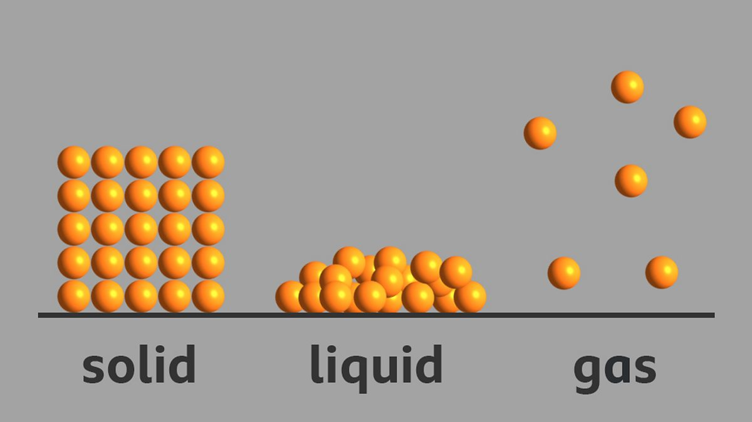
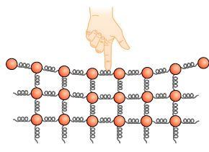
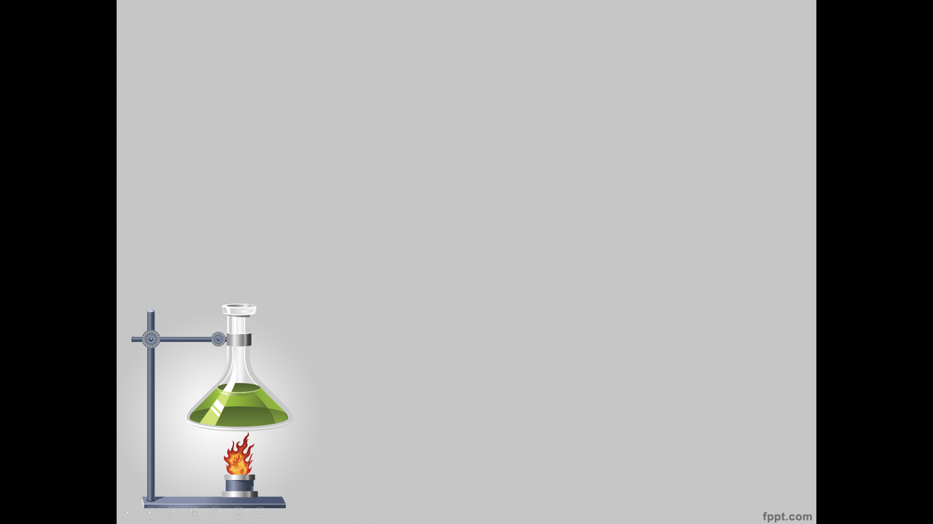
SOLIDS AND LIQUIDS
Phase
Macroscopic
Sub-microscopic
Definite volume
Definite shape
Particles attracted strongly
Regular arrangement/structure
‘balls held with springs’
Solid
Liquid
Definite volume
Shape of container
Particles attracted weakly
More random arrangement
‘balls held with wires/bands’
Gas
Volume of container
Shape of container
Particles not attracted at all
Totally random arrangement
‘balls not attached at all’
https://www.youtube.com/watch?v=KCL8zqjXbME&t=37s

Slide 3
INTERPARTICLE and INTERMOLECULAR FORCES
IONIC BONDS
METALLIC BONDS
COVALENT BONDS
Infinite Arrays (IPF)
Discrete molecules (IMF)
Two broad Categories
(focus on solids):
DIPOLE-DIPOLE
LONDON DISPERSION FORCES
HYDROGEN BONDING
Interparticle forces are the forces that hold molecules in infinite arrays
Intermolecular forces are the forces that hold molecules in a substance (between discrete molecules – relatively weak)

Slide 4
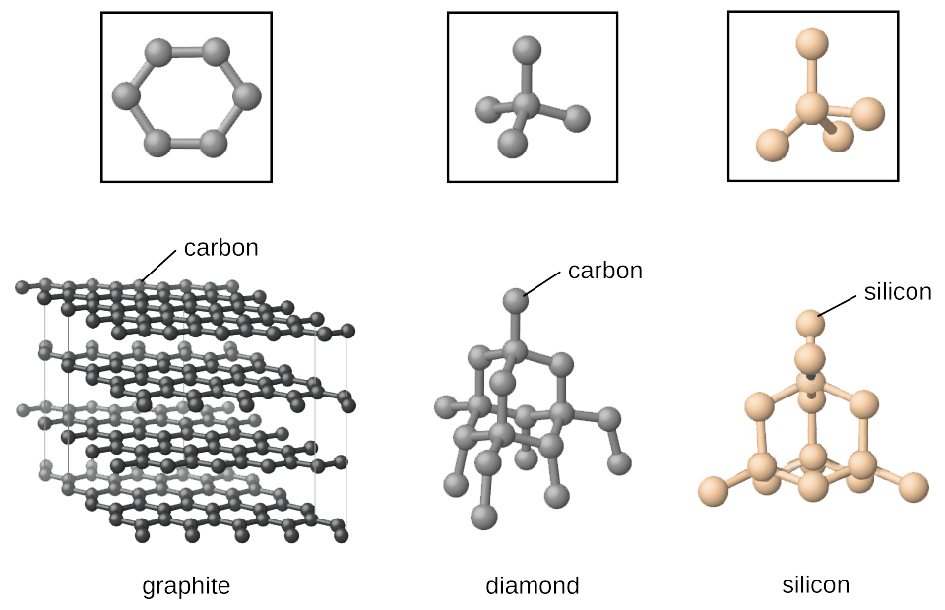
IPF – COVALENT BONDS
network covalent bonds found in large, rigid three-dimensional arrangements of atoms held together by strong covalent bonds
Si tetrahedral held by O atoms
trigonal planar
tetrahedral
allotropes
VERY, VERY STRONG

Slide 5
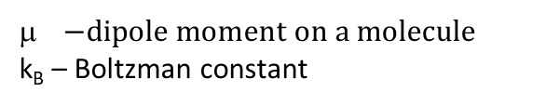
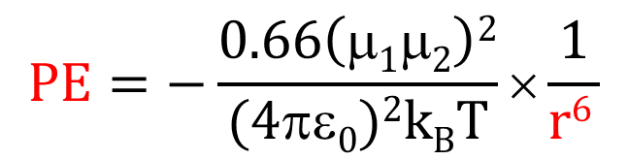
IMF – POLAR COVALENT MOLECULES
IMF – dipole-dipole forces
between two discrete molecules
whole molecule that has a dipole moment interacts with another dipole molecule
weaker than IPF
undirected, slightly negative interaction
affect the molecules
δ+
δ-
δ+
δ-
δ+
δ-
δ+
δ-
$$PE=−\frac{0.66\left(μ1μ2\right)2}{(4πε0)2kBT}×\frac{1}{r6 }$$
δ+
δ-
$−dipole moment on a molecule$
k_{B} – Boltzman constant
δ+
δ-
PE decreases when the distance increases r⁶
WEAK

Slide 6
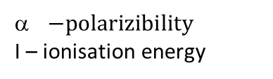
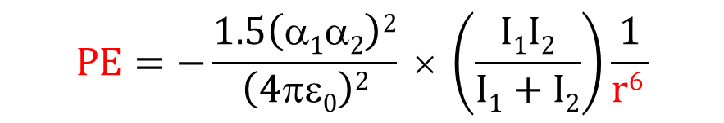
IMF – LONDON DISPERSION FORCES
Non-polar Covalent Molecules
the weakest intermolecular force
a temporary attractive force that results from temporary dipoles
Non-polar
Non-polar
POLARIZABILITY: relative tendency of an electron cloud of an atom or molecule, to be distorted from its normal shape by an external electric field, caused by the presence of a nearby molecule
‘Squishiness of molecules’
Bigger molecules more squishy
Larger LD forces
Induced dipole
Proximity of electron cloud
δδ-
δδ+
δδ-
δδ+
$$PE=−\frac{1.5\left(α1α2\right)2}{\left(4πε0\right)2} × \left(\frac{I1I2}{I1+I2}\right)\frac{1}{r6 }$$
$−polarizibility$
I – ionisation energy
Van der Waals forces are ALL intermolecular forces
London dispersion forces are an example of Van der Waals forces
VERY, VERY WEAK

Slide 7
HEATING CURVE
effect of IPF on microscopic behaviour of a substance upon heating
solid
melts
liquid
boils
gas
balls and springs balls and breaks balls
springs to wires wires wires unattached
Spring and wires represent IPF
T (K)
liquid→gas
gas
bp
Springs and wires ‘stretched’ when heating
Broken when melting/fusing and boiling/vaporising
Stronger these forces: Higher melting point Higher boiling point
liquid
mp
solid→liquid
solid
heat (J)
melting point - the constant temperature at which a solid changes into liquid
boiling point - the constant temperature at which a liquid starts changing into gas
DEPEND ON IPF !!!

Slide 8
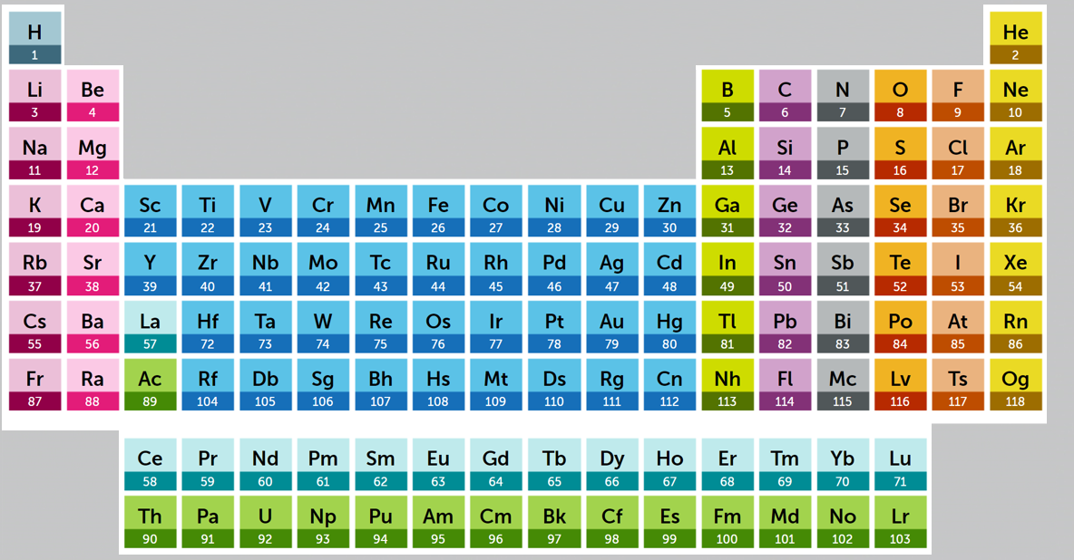
MELTING POINTS
melting point - constant temperature at which a solid changes into liquid
Lithium Fluoride 845 °C
Magnesium Oxide 2852 °C
strong IPF – high mp
IONIC
Tungsten 3422 °C
Mercury - 39 °C
liquid Hg – IMF weaker than in solid
METALLIC
Diamond 3550 °C
COVALENT NETWORK
Acetone -95 °C
Fluorine -220 °C
Chlorine -101 °C
Bromine -7 °C
Iodine 114 °C
polar
increase in mass
increase in polarizability
MOLECULAR
non-polar
In halogens there are only LD forces but high polarizability makes them strong
increase in melting point

Slide 9
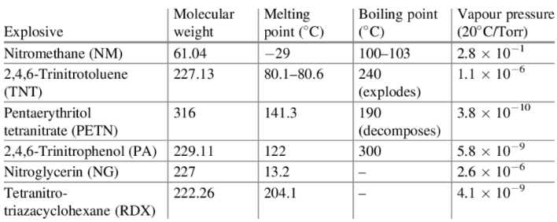
MELTING POINTS of VARIOUS EXPLOSIVES
Notes:
Knowing the melting point of a chemical is very important for its storage & transport. You probably do not want to store or transport a solid at a temperature close to or above its melting point in which case melting may cause leaking and severe consequences.
In addition to that, melting point is often used to predict the partition behavior of a chemical between solid and gas phases. A higher melting point indicates greater intermolecular forces and therefore less vapour pressure.
Melting point test is not required for every chemical. Usually it is conducted for solid materials under normal conditions. Under REACH, a vapor pressure test does not need to be conducted if the melting point of a substance is above 300 °C.

Slide 10
MELTING POINTS
hydrides
H₂O 0 °C
H₂S -82 °C
H₂Se -66 °C
H₂Te -49 °C
???
mp
mp increases with size but not for water
O
S
Se
Te
MM
polar molecules – dipole-dipole + LD
H₂S – gas at room temperature even though it has more electrons than water and so stronger LD forces

Slide 11
IMF – HYDROGEN BONDS
A hydrogen bond consists of a hydrogen atom lying between two small, strongly electronegative atoms with lone pairs of electrons (N, O or F)
••
••
Very polar O-H bonds
Small size of H
Small size of O
Very large charge density
Very directed
O
δ-
δ+
H
H
δ+
••
••
O
δ-
δ+
H
H
δ+
How does it form? – O-H bond is polar; the electronegative O pulls the electrons from H creating a large δ+ on H; such H is strongly attracted to the lone pair of electrons on O atom on other H₂O molecule to form a HYDROGEN BOND
DOMINATES ALL OTHER IMF !!!
BETTER THAN WEAK

Slide 12
MELTING POINTS
NH₃ -78 °C
PH₃ -133 °C
AsH₃ -111 °C
SbH₃ -88 °C
HF -84 °C
HCl -114 °C
HBr -87 °C
HI -51 °C
mp
O-H
Generally: N-H Hydrogen bonds
F-H
N
P
As
Sb
MM
NH₃ and HF have higher boiling points than PH₃ and HCl

Slide 13
PRACTICE PROBLEMS
PRACTICE PROBLEM 1: Which of ethane and ethanol experience London Dispersion forces in the solid and liquid states?
a) both ethane and ethanol
b) ethane only
c) ethanol only
d) neither ethane nor ethanol
PRACTICE PROBLEM 2: Which of the following substances has the highest melting point and why?
a) HCl
c) HBr
d) HF
PRACTICE PROBLEM 3: Which of the following substances are able to form hydrogen bonds?
a) HF
b) CH4
c) NH3
d) CH3OH

Slide 14
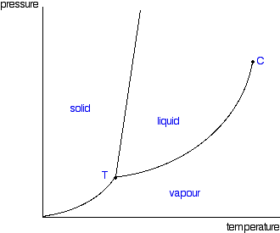
PHASE DIAGRAM
The phase diagram is a summary of the temperatures and pressures at which the various solid, liquid and vapour phases of pure substance exist/coexist
P
(water)
solid to liquid: both phases can coexist
freezing ←→ melting
almost vertical
mp hardly changes with pressure
SOLID
LIQUID
liquid to gas: both phases can coexist
condensation ←→ boiling/vaporisaton
very pressure dependent.
shows vapour pressure of liquid at different temperatures
bp when vp = external pressure.
1 atm
GAS
solid to gas: both phases can coexist
deposition ←→ sublimation
mp
bp
T

Slide 15
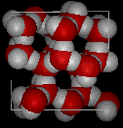
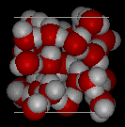
WATER
Ideal Hydrogen Bond Formation
H
Liquid 2-3 H bonds at a given time
tetrahedral
2 donor H bonds
2 acceptor H bonds
••
O
H
••
O
H
H
Less rigid
Closer together
More dense
O
Only in ice
Rigid
Further apart
Less dense
https://chem.libretexts.org/Courses/Sacramento_City_College/SCC%3A_Chem_309_-_General_Organic_and_Biochemistry_(Bennett)/Text/07._States_of_Matter_and_the_Gas_Laws/7.2%3A_Solids%2C_Liquids%2C_and_Gases

Slide 16
PHASE DIAGRAMS
Critical point: after this point gas cannot be condensed. Supercritical fluid
P
SOLID
LIQUID
1 atm
Triple point: at this point all 3 phases can coexist
GAS
mp
bp
T

Slide 17
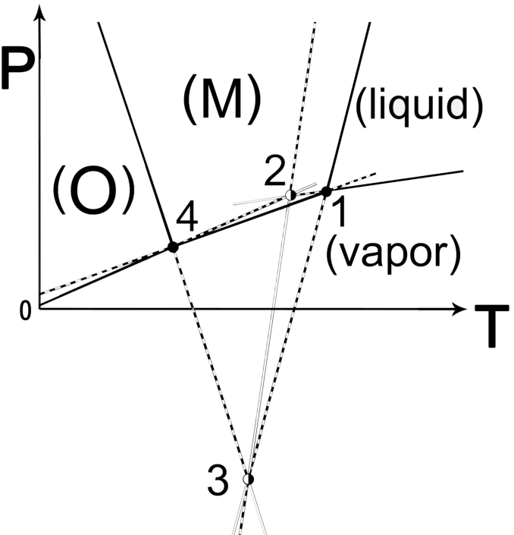
TNT PHASE DIAGRAMS
O - orthorhombic polymorph
M - monoclinic polymorph
Polymorphism describes the existence of a solid material in more than one form or crystal structure.
Topological pressure-temperature phase diagram of TNT representing the stability regions of forms O and M, the liquid (L) and the vapor (V) phase. Triple points: 1: M-L-V, 2: O-L-V, 3: O-M-L, 4: O-M-V. Stability ranking: solid black lines: stable, dashed lines: metastable, white lines: supermetastable
Notes:
The phase behavior of explosive substances is important for the proper design of stable explosive devices.
However, the equilibrium behavior of chemical compounds can be difficult to assess, because thermodynamic and kinetic behaviors are generally convoluted in the experimental results.The phase behavior of TNT is a case in point. A thorough review of the literature data demonstrates that the orthorhombic polymorph is the most stable under ambient conditions. Using the topological approach for the construction of a pressure-temperature phase diagram, it can be shown that all data is consistent with an overall enantiotropic system. Nonetheless, it is also clear that the differences between the orthorhombic and the monoclinic polymorphs are relatively small and that the driving force of interconversion between the two under ambient conditions is therefore limited

Slide 18
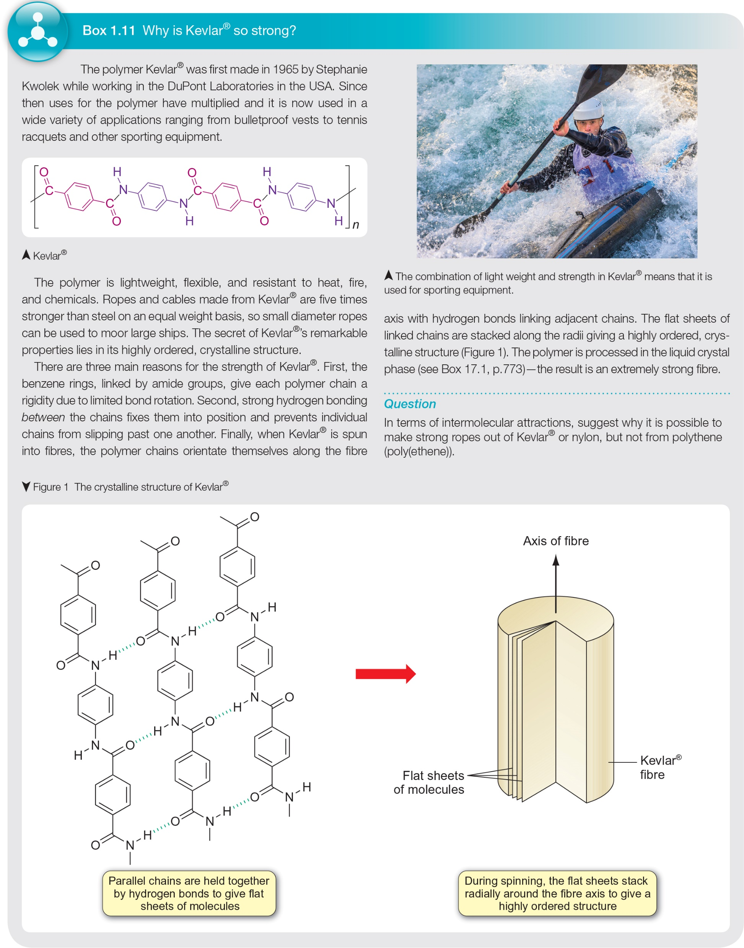
WHY IS KEVLAR SO STRONG?
DuPont, 1965
lightweight, flexible, resistant
5 times stronger than steel
highly ordered, crystalline structure
Benzene rings linked by amide group – rigidity (limited bond rotation)
Hydrogen bonding between the chains – prevents slipping
The chains orientate themselves along the fibre axis with H-bonding linking adjacent chains

Slide 19
MACROSCOPIC PROPERTIES
 | IONIC | METALLIC | MOLECULAR
Melting/boiling points | High | Usually high | Low
Hardness | Hard and brittle | Malleable and ductile | Soft
Electrical conductance | None in solid In liquid or aqueous solution | In solid and liquid | None
Solubility in polar solvent | Some | None | Very few
Solubility in non-polar solvent | None | None | Most

Slide 20
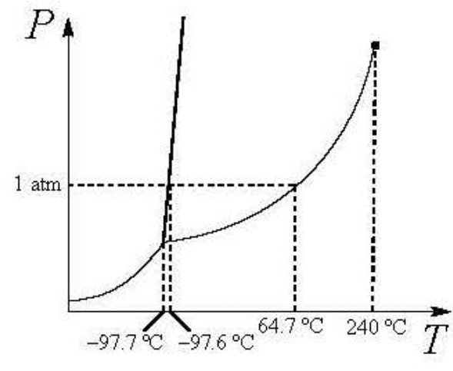
PRACTICE PROBLEMS
PRACTICE PROBLEM 1: A diamond film forms on a surface from gaseous carbon atoms in a vacuum. What is this phase change called (Enter the letter of your choice.)?
a. melting (fusion)
b. sublimation
c. condensation
d. crystallization (freezing)
e. evaporization
f. deposition
PRACTICE PROBLEM 2: The critical temperature of water is the:
a) temperature at which water vapor condenses
b) temperature at which solid, liquid and gaseous water can coexist
c) minimum temperature at which liquid water can exist
d) minimum temperature at which a good cup of tea can be made
e) maximum temperature at which liquid water can exist
PRACTICE PROBLEM 3:According to the phase diagram of methanol shown, which statement is correct?
a) Solid methanol sublimes at atmospheric pressure.
b) Water and methanol have the same relationship between freezing point and pressure as they both have hydrogen bonding
c) Solid, liquid, and gaseous methanol can only coexist at pressures above 1 atm.
d) At 1.25 atm pressure, the boiling point of methanol is greater than 64.7 ºC
e) At 200 ºC and 1 atm pressure, methanol is a supercritical fluid

