Slide 1
Data Center Technologies

Slide 2
Data Center
Data centres are designed to host critical computing resources in a centralized place. These resources can be utilized from a campus building of an enterprise network, from a branch office over the wide area network (WAN), and from the remote locations over the public Internet.​
Therefore, network plays an important role in the availability of data centre resources. ​
Network architecture addresses many functional areas of the data centre to ensure that data centre services are running around the clock

Slide 3
Data Center Network Design
Modular approach
  Network is divided into distinct building blocks based on features and behaviours
Advantages
  Blocks/modules added without redesigning entire network
  Hierarchical topology simplifies addressing
  Easy control of traffic flow & improved security(since blocks are independent)

Slide 4
Data Center Network Design cont.
Advanatges cont.
  Faster moves, adds and changes
  Scalable
  Simple to design, configure and troubleshoot

Slide 5
MultiLayer Network Design
Network is divided into three functional layer(can be either logical or physical)

Slide 6
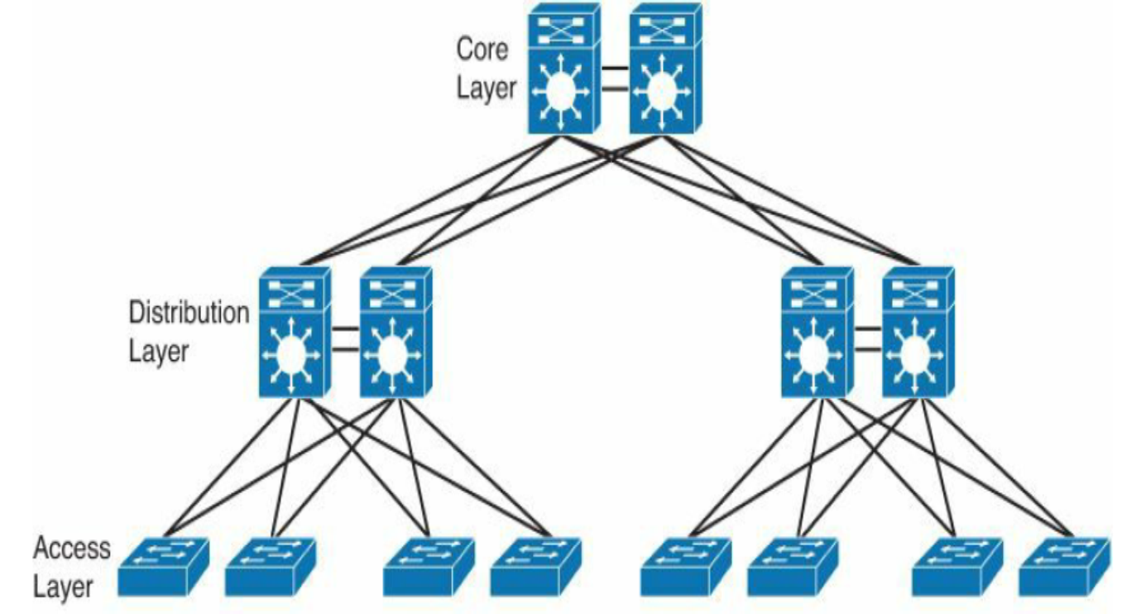
MultiLayer Network Design Cont
Hierarchical network model provides a modular framework
  Flexibility in design
  Ease of implementation
  Troubleshooting

Slide 7
Access Layer
Grants user access to network devices
Provides connectivity to servers
QoS marking
Implemented in Top of Rack/End of Topology
Layer 2 switching is used
First point of entry into network for edge devices

Slide 8
Access Layer
Switches in access layer are connected to two distribution layer switches for redundancy
Typically built in Layer 2 to allow better sharing of service devices across multiple servers
With Layer 2 access, the default gateway for servers can be configured at the aggregate layer

Slide 9
Aggregation Layer
Also called distribution layer
Segments work groups
Provides policy-based connectivity
Provides connectivity to network base services(load balancer, firewall)
Layer 2 & Layer 3 switching
Uplinks from access layer to data center core
Critical point for control & application services

Slide 10
Aggregation Layer
Lowers TCO & reduces complexity by reducing no. of components that are needed to configure & manage
If same VLAN is needed across multiple access layer devices, the aggregation layer needs spanning tree protocol(STP) for processing load
Notes:
Total Cost of Ownership

Slide 11
Core layer
Uses layer3 links
Its backbone
Provides high speed packet switching
Provides scalability
Must be highly available
Must support fast convergence

Slide 12
Core Layer(for large data center)
Following used to decide the need for core layer
  40 & 100 Gigabit Ethernet density(are there requirements for higher bandwidth connectivity)
  10 GB Ethernet density(without core will there be enough ports)
  Administrative domains & policies: separate cores help to isolate campus distribution and data center distribution layers for troubleshooting, administration & implementation of policies
  Anticipation of future development: impact that can result from implementing a separate core later might make it worthwhile to install it at the beginning

Slide 13
Collapse core design
Combining core &aggregation layer
For small/medium campus
Core layer provide direct connection to access layer switches, server farm & edge modules

Slide 14
Spine & Leaf Design
Most large scale modern data centers use spine & leaf
Leaf switch acts as access layer switch
Servers, edge devices connect to leaf
More spine increases the capacity of the network
Leaf increases port density

Slide 15
Port Channel
Switches connect to each other using multiple links
Multiple physical links are grouped to form logical bundle

Slide 16
Port Channel
Port channel interface can be configured with its own speed, bandwidth, delay, IP address, flow control
Also can shutdown port interface
Benefits
  Increased capacity
  High availability(operates if any one of the link is alive)
  Load balancing(distribute traffic across all operational links)
  Simplified network topology(aggregating multiple links to one logical link to avoid network loop & hence reduces STP calculation)

Slide 17
Link aggregation control protocol(LACP)
LACP provides a standard mechanism to ensure that peer switches exchange information and agree on the necessary details to bundle ports into a port channel.
LCAP must be enabled on both switches
Negotiate an automatic bundling of links by sending LACP packets to the peer
Both side of links should have compatible configuration(speed, flow-control etc.)to form a bundle

Slide 18
Port Channel Mode

Slide 19
Virtual Port Channel
A vPC enables the extension of a port channel across two physical switches.
These two switches work together to create a virtual domain

Slide 20
vPC
Data centers are switching from highly scalable Layer 3 switching to highly scalable Layer 2 switching(due to use of hypervisors)
STP is not efficient to manage large Layer 2 networks, so its needed to migrate towards vPC & Cisco FabricPath(as STP keeps only one link active at a time to prevent loop)
Limitations of classical port channel is that it operates between 2 devices only
In large network with redundant devices, the alternative path is often connected to a network with different topology that would cause a loop

Slide 21
vPC
vPC address this issue by allowing a pair of switches acting as a virtual endpoint, so it look like a single logical entity to port channel attached devices.
This environment combines the benefits of hardware redundancy & port channel.

Slide 22
vPC Benefits
Enables single device to use a port channel across two upstream switches
Eliminates STP blocked ports
Provides loop free topology
Uses all available uplink bandwidth
Fast convergence in case of failure
Ensure high availability

Slide 23
FabricPath
A large scale highly scalable and flexible Layer 2 fabric is needed in most data centers to support distributed & virtualized application workloads.
Limitations of STP
  Redundant links
  Builds tree like structure by blocking ports
  Elects root bridge, sets only one path to root (lacks multipathing)
  Inefficient path selection(shortest paths are missed)
  TimetoLive not available leading to repeated circulation
  Limited scalability

Slide 24
FabricPath
Combines benefits of Layer 3 routing with Layer 2 switching
Layer 3 Routing: scalability, multipathing, fast convergence, shortest path selection, but segmentation is a problem
FabricPath network is created by connecting switches into an arbitrary topology combining them in a fabric using a few simple commands

Slide 25
FabricPath
IS-to-IS protocol is used to provide fabric-wide intelligence & ties the element together.
No need for STP
Can be deployed in any topology, but a spine & leaf is often used in data center.

Slide 26
Benefits
Operational simplicity
  Easy to configure, operate, single protocol
Flexibility
  All servers connected to Fabric can be move around easily, lower operational cost
High performance
  Always chooses the shortest path, Equal-Cost multipath feature
High scalability & availability
Efficiency
  Does not store mac address, but learn mac address from frames they receive

Slide 27
Acknowledgement
All materials of this lecture are from CCNA Data Centre DCICT 640-916 official certification guide by N Shamsee, D Klebanov, H Fayed, A Afrose and O Karakok published by Cisco Press, 2015.

